Slide 1

A3.1 Material Classification and Properties
Design in theory

Slide 2
Contents
Physical, Chemical and Mechanical properties | Able to explain how and why materials are classified and discuss the advantages of classifying materials in terms of physical, chemical and mechanical properties.
Source or origin | Able to discuss frame, shell, solid and combination (for example, frame and shell) structures, and how they are used in the design of products. They need to understand that materials are classified into natural and human-made, including for example timbers, polymers, metals, glass, textiles, composites, smart materials and biomaterials.
Identifying the most suitable material | Able to evaluate the physical, chemical and mechanical properties to ensure the selection of the most appropriate material for a specific purpose.
Physical properties | Able to explain density, thermal expansion, thermal conductivity, melting point, electrical resistivity and electrical conductivity.
Chemical properties | Able to explain corrosion resistance, reactivity (food safe), hygroscopy and flammability
Mechanical properties | Able to explain tensile and compressive strength, stiffness, toughness, hardness, malleability, elasticity, plasticity and ductility.

Slide 3
Contents
Composites | Able to explain why combining materials can create composite materials more suitable for a specific purpose or context using an example.
Smart materials | Able to explain how materials can be selected to react to external stimuli, including piezoelectricity, shape memory, photochromicity, magneto-rheostatic, electro-rheostatic and thermoelectricity.
Biodegradable materials | Able to explain how biomaterials are a key part of a circular economy and can be used by designers to design out waste.

Slide 4
A 3.1.1 Materials are classified based on their physical, chemical and mechanical properties.
Materials are classified so that designers and manufacturers can predict how they will behave and choose the right material for a specific use. Different materials have different properties such as strength, conductivity, flexibility, durability, and resistance to heat or corrosion. Classification makes it easier to study, compare, and apply them efficiently.
Materials are commonly classified according to their
Physical,
Chemical, and
Mechanical properties. This helps in understanding how a material behaves under different conditions and where it can be used.
Physical properties tend to be the characteristics of materials that can be identified through testing that is considered to be non-destructive...

Slide 5
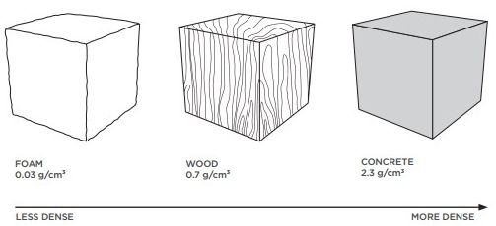
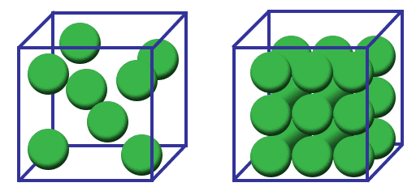
A 3.1.1 Materials are classified based on their physical, chemical and mechanical properties.
Physical Properties
Volume - is the quantity of three-dimensional space enclosed by some closed boundary, for example, the space that a substance solid, liquid, gas, or shape occupies or contains
Physical properties
These properties tend to be the characteristic of materials that can be identified through testing that is considered to be non-destructive, although some deformation is required to test hardness. This exception is often why hardness is often categorised as a mechanical property.
Density - is the mass per unit volume of a material. It’s importance is in portability in terms of a product’s weight and size. Design contexts include, pre-packaged food (instant noodles) is sold by weight and volume, packaging foams.
Mass - relates to the amount of matter that is contained with a specific material. It is is often confused with weight understandably as we use Kg to measure it. Mass is a constant whereas weight may vary depending upon where it is being measured.
Weight - relies on mass and gravitational forces to provide measurable value. Weight is technically measure as a force, which is the Newton, ie a mass of 1 Kg is equivalent to 9.8 Newtons [on earth].
Electrical resistivity - This is a measure of a material’s ability to conduct electricity. A material with a low resistivity will conduct electricity well.

Slide 6
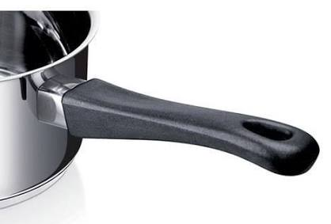

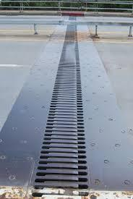
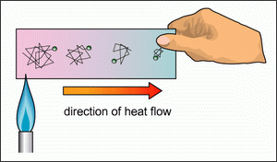
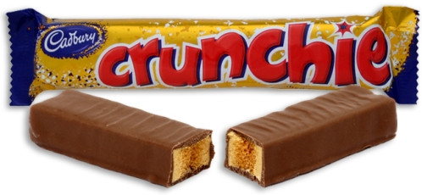
A 3.1.1 Materials are classified based on their physical, chemical and mechanical properties.
Physical Properties
Thermal expansion- A measure of the degree of increase in dimensions when an object is heated. This can be measured by an increase in length, area or volume.
Thermal conductivity- A measure of how fast heat is conducted through a slab of material with a given temperature difference across the slab.
Thermal conductivity is important for objects that will be heated or must conduct or insulate against heat gain or loss. e.g. polystyrene foam in a fridge insulation, vacuum flasks, car radiator, element in an electric kettle.
Heat expansion strips. Enable elevated roads to contract and expand
Heat transfer occurs through conduction- hot to cold
Hardness- is defined as the resistance a material offers to penetration or scratching. Ceramic floor tiles are extremely hard and resistant to scratching or cutting devices, e.g. drill bit, cutting tools, screwdrivers, files, abrasive papers & cutting knives. Hardness should be considered with the mechanical property of brittleness and toughness.
Thermal conductivity is important for objects that will be heated or must conduct or insulate against heat. The particles will travel through conduction from hot to cold.
Crunchie bar- hard but brittle, lacks toughness. [mechanical]
Hot particles vibrate more rapidly

Slide 7
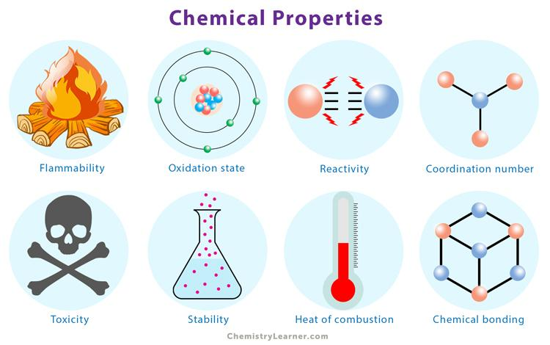
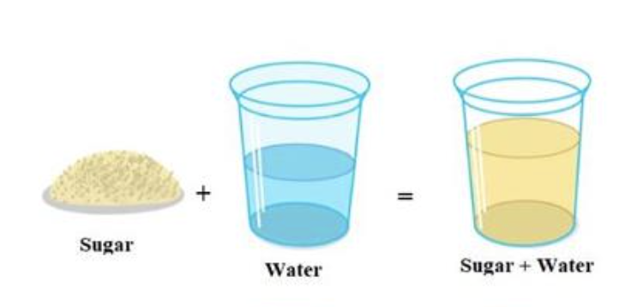

A 3.1.1 Materials are classified based on their physical, chemical and mechanical properties.
Chemical Properties
Corrosion Resistance
Corrosion resistance is a material's ability to withstand chemical or electrochemical degradation caused by environmental exposure to moisture, oxygen, or acids. It typically relies on inherent chemical stability or the spontaneous formation of a passive, protective oxide layer that halts further oxidation. Materials with high corrosion resistance such as stainless steel, titanium, and specialized polymers—are essential for longevity in marine, chemical, and outdoor environments.
Stainless steel has good corrosion resistance, so it is used for kitchen sinks and outdoor products.
Solubility
Solubility is a physical property describing the maximum amount of a solute that can dissolve in a specific solvent at a given temperature and pressure. It is governed by intermolecular forces, chemical polarity, and temperature, reaching thermodynamic equilibrium when the solution becomes saturated.
Salt is soluble in water, while sand is not.

Slide 8

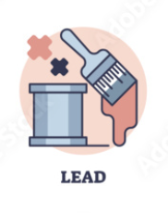
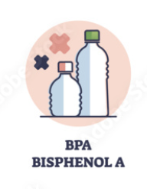

A 3.1.1 Materials are classified based on their physical, chemical and mechanical properties.
Chemical Properties
Toxicity
Toxicity is a chemical property describing the degree to which a substance can cause harm or adverse effects to a living organism or biological system. It depends on key variables such as the dosage, exposure route (inhalation, ingestion, or skin contact), and whether the contact is acute or chronic. Assessing toxicity is critical in materials engineering, chemical safety, and environmental design to ensure safe handling and prevent health hazards.
Some paints, adhesives, and plastics can release harmful chemicals, so safer alternatives may be selected.
Flammability
Flammability is a material's capacity to easily ignite and sustain combustion when exposed to a heat source, flame, or spark. It is governed by properties such as flash point, vapor pressure, and chemical composition, which dictate how rapidly the substance catches fire and burns..
Paper and some plastics are highly flammable, while metals such as steel are much less flammable.

Slide 9

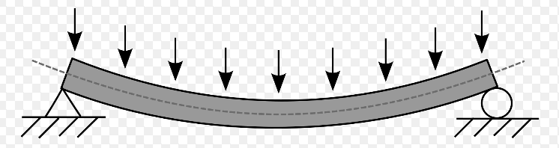
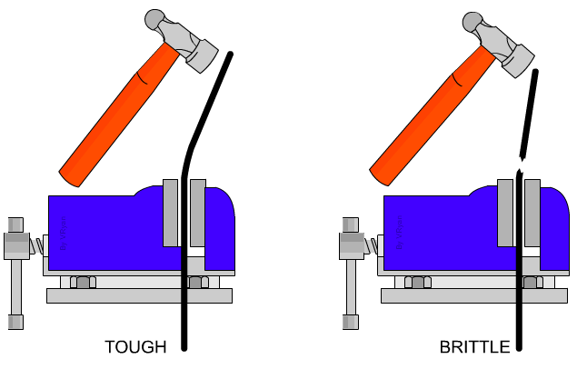
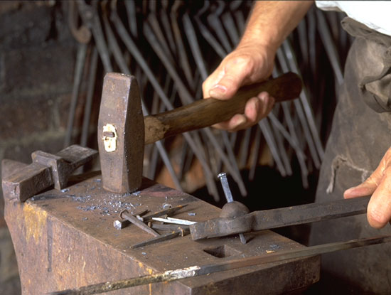
A 3.1.1 Materials are classified based on their physical, chemical and mechanical properties.
Mechanical Properties
Design contexts where mechanical properties are/or aesthetic characteristics are important.
Stiffness- is the resistance of an elastic body to deflection by an applied force. This property is an important consideration for an airplane wing or a downhill skateboard, where maintaining shape is crucial to performance.
Stiffness- is the resistance of an elastic body to deflection by an applied force.
Stiffness- resistance to deflection
Aircraft wings- stiffness a key property
Toughness - is the ability of a material to absorb energy and plastically deform without fracturing. One definition of material toughness is the amount of energy per unit volume that a material can absorb before rupturing. It is also defined as a material's resistance to fracture when stressed.
Toughness - is the ability of a material to absorb energy and plastically deform without fracturing.
Toughness - is the ability of a material to absorb energy and not fracture under impact
Anvils & hammers - are tough tools reduces brittleness & increases toughness.

Slide 10

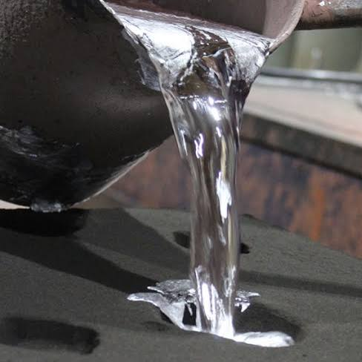
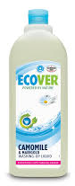
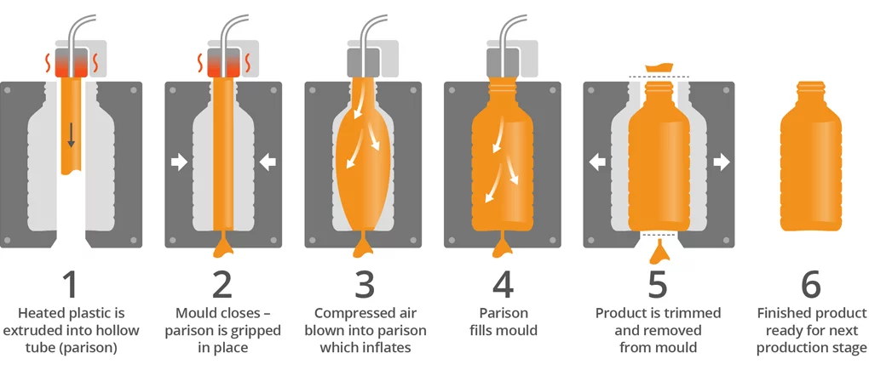
A 3.1.1 Materials are classified based on their physical, chemical and mechanical properties.
Mechanical Properties
Plasticity - The ability of a material to be changed in shape permanently by external blows or pressure, without cracking or breaking (e.g. plasticine). Some materials are more ‘plastic’ when heated, e.g plastic. This is important in plastic moulded products and casting of metals.
Aluminium casting- requires plasticity to flow
Blow moulding- requires plasticity to shape and form
Stress- is defined as the force per unit area of a material and is normally determined by applying a tensile force to a sample of material.
Strain- is defined as extension per unit length. After a tensile force is applied to a sample material, it is expected that there will be some extension of elongation in the sample.

Slide 11


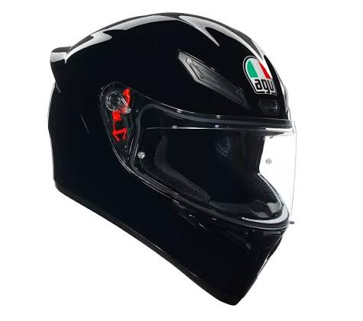
A 3.1.1 Materials are classified based on their physical, chemical and mechanical properties.
Mechanical Properties
Hardness
Hardness is a material's ability to resist localized surface deformation, such as scratching, abrasion, or penetration under applied loads. It indicates how well a substance withstands surface wear and tear,
A tempered glass screen protectors has good scratch hardness properties
Toughness
Toughness is a material's ability to absorb energy and plastically deform before fracturing, measuring its overall resistance to sudden impacts and crack propagation. It requires a balance of high strength and good ductility,
A helmet needs to be tough so it can absorb impact during a fall.
Mobile - tempered glass
Ceramic tiles- resistance to scratching

Slide 12
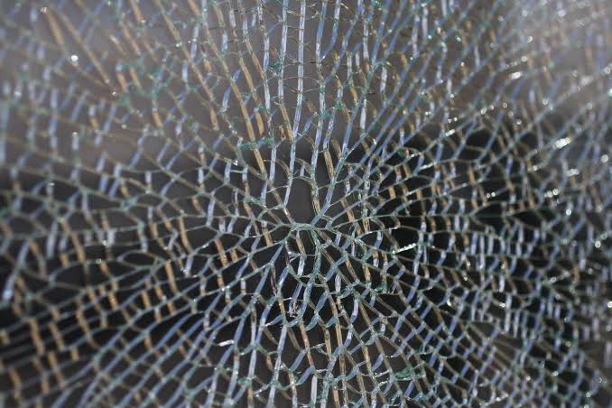
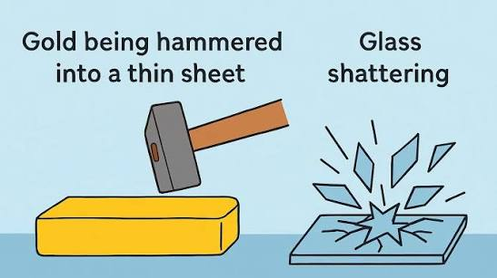
A 3.1.1 Materials are classified based on their physical, chemical and mechanical properties.
Mechanical Properties
Brittleness
A material fractures under applied stress with negligible permanent deformation.Unlike ductile materials, brittle substances absorb very little energy before failing, making them susceptible to sudden breakage under tensile or impact loads despite often having high hardness or compressive strength.
Glass is brittle and can shatter when dropped.
Malleability
Malleability is a mechanical property describing a material's ability to undergo permanent plastic deformation under compressive stress without cracking or shattering. It allows substances—most notably metals like gold, aluminum, and copper—to be easily hammered, pressed, or rolled into thin sheets.

Slide 13
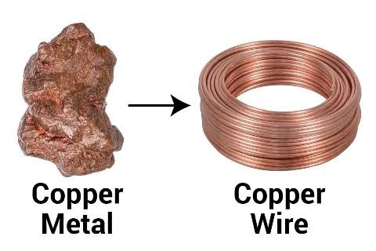
A 3.1.1 Materials are classified based on their physical, chemical and mechanical properties.
Mechanical Properties
Ductility
Ductility is a mechanical property describing a material's ability to undergo significant plastic deformation under tensile stress before fracturing. It allows substances—such as copper, aluminum, and mild steel—to be pulled, drawn, or extruded into long, thin wires without snapping.

Slide 14
A 3.1.2 Materials are classified according to their source or origin.
Classifying materials by their source or origin categorizes substances based on where and how they are obtained, primarily dividing them into natural and synthetic groups.
Natural
Natural materials are harvested directly from nature, originating either from geological reserves (such as stone, clay, and metallic ores) or biological organisms (such as wood, wool, and cotton).
Eg.: Timbers, Wood, Cotton, Metal, Minerals, Glass, Biomaterials
Synthetic
Synthetic materials, in contrast, are artificially manufactured through chemical synthesis often utilizing petroleum or industrial precursors to produce substances with tailored properties like plastics, nylon, and synthetic rubber.
Eg.: Polymers, Composites, Smart materials, Engineered textiles
This classification framework helps engineers, designers, and manufacturers evaluate material availability, environmental impact, sustainability, and production costs when selecting substances for specific applications.

Slide 15
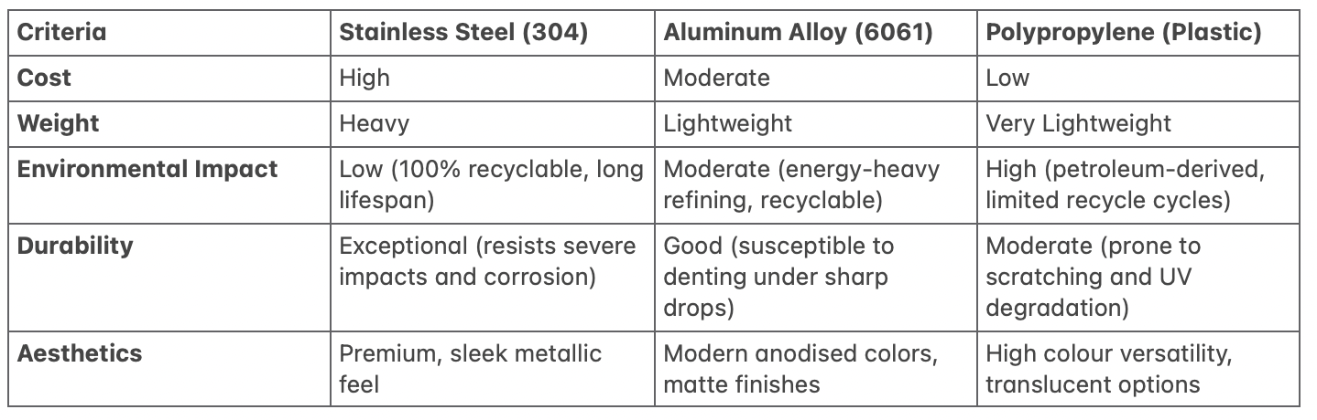
A 3.1.3 Identifying the most suitable material for a product is a complex and challenging task, involving the consideration of physical, chemical and mechanical properties and aesthetic characteristics.
Choosing the right material for a product is rarely simple because no single material possesses every ideal trait. Designers must constantly manage trade-offs, where boosting one desirable property often compromises another.
Performance vs. Weight: Car frame out of thick steel increases structural safety, but adds heavy weight that drastically reduces fuel efficiency.
Strength vs. Cost: Titanium is strong and lightweight, but it is far too expensive for mass-market consumer products
Durability vs. Ease of Manufacturing: Ceramics resist extreme heat and scratching, but they are brittle and difficult to shape into complex parts
Aesthetics considerations
Environmental & ethical considerations
Cost considerations
Before picking a material, designers study data sheets, test real samples, and compare competing choices to make sure the product works properly, looks appealing, stays within budget, and limits environmental impact.
Physical testing
Tensile testing
Hardness Testing
Impact Testing
Thermal Testing
Wear & Fatigue Testing:
Comparison charts
Designers compare materials side-by-side in structured tables and charts to evaluate performance.
Research and Technical Data Sheets
Designers review material data sheets and manufacturer specifications to gather performance data
Comparison chart

Slide 16


A 3.1.3 Identifying the most suitable material for a product is a complex and challenging task, involving the consideration of physical, chemical and mechanical properties and aesthetic characteristics.
Material Selection
Ashby Diagram Booklet guides designers to eliminate materials

Slide 17


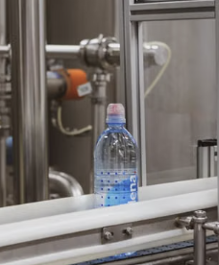
A 3.1.4 Physical properties include aspects of a material that can be measured and observed without it changing in any way.
Physical properties are characteristics of a material that can be observed or measured without changing the material’s chemical composition or identity. Examples include colour, density, texture, melting point, electrical conductivity, electrical resistivity and thermal conductivity.
Designers consider these properties when they choose material for a specific user or environment. They specifically focus on Function, Safety and Manufacturing.
Melting point:
Designers consider a material’s melting point for three important reasons:
Function: The material must not melt or deform during normal use. Aluminium is suitable for cookware because its melting point is much higher than typical cooking temperatures.
Safety: A high enough melting point reduces the risk of a product failing or becoming hazardous when exposed to heat. Electrical components use materials that can withstand the heat generated during operation.
Manufacturing: Melting point helps determine the manufacturing process and temperature required to shape the material. Plastics with relatively low melting points can be heated and moulded into different shapes.

Slide 18

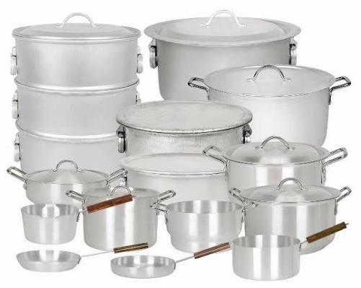
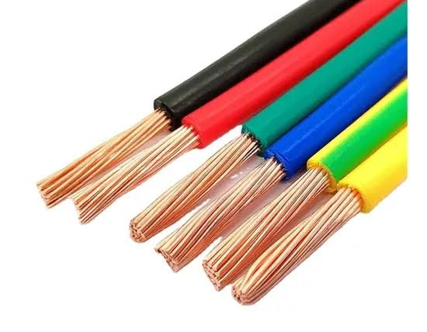
A 3.1.4 Physical properties include aspects of a material that can be measured and observed without it changing in any way.
Electrical resistivity:
Electrical resistivity is a material’s resistance to the flow of electric current. A material with low resistivity allows electricity to flow easily, while a material with high resistivity resists current flow.
Ceramics is used in electrical insulators and components.
Density:
Designers will consider Aluminium for cooking utensils as it has a low density and high thermal conductivity, making it suitable for such products.
Electrical conductivity:
Designers will consider Copper for electrical cables as it has high electrical conductivity and is easily drawn into wires, making it suitable for the product.

Slide 19
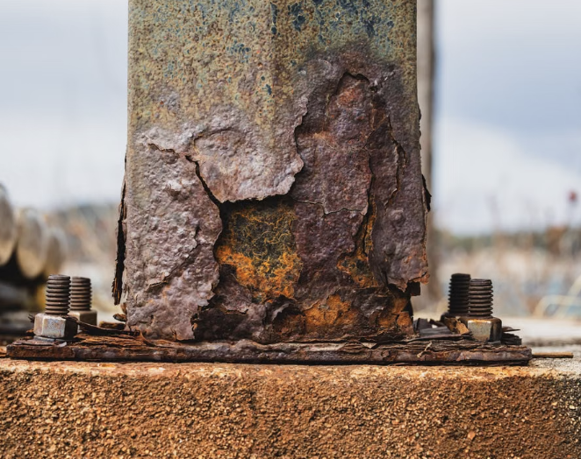


A 3.1.5 Chemical properties include aspects of a material that lead to it chemically reacting with another.
Chemical properties describe how a material reacts chemically with other substances or its environment, causing a change in its chemical composition. These include corrosion resistance, flammability, reactivity and oxidation.
Example: Iron reacts with oxygen and moisture to form rust, so designers may choose stainless steel for products that need better corrosion resistance.
Designers consider chemical properties to ensure a material is safe, durable and suitable for its intended environment. They help designers predict how a material may react to water, oxygen, chemicals, heat or other substances.
Example: Stainless steel is chosen for kitchen sinks because it has high corrosion resistance, helping the product remain durable when exposed to water and cleaning chemicals.

Slide 20

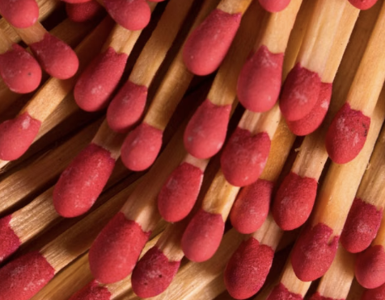



A 3.1.5 Chemical properties include aspects of a material that lead to it chemically reacting with another.
Reactivity describes how easily a material chemically reacts with other substances. Designers consider this for food-contact products because a reactive material may react with acidic or salty foods and potentially contaminate the food.
Glass has very low reactivity with most foods, drinks, and household chemicals.
This means it generally does not react with or alter the taste, colour, or composition of food.
Example: Glass jars and bottles are used to store acidic foods such as pickles, sauces, and fruit juices.
Flammability is the ability of a material to ignite and burn when exposed to a source of heat or flame. It is considered a chemical property because burning involves a chemical reaction that changes the material into new substances.
Example: Wood is flammable, so designers must consider its use carefully in products such as furniture and buildings to reduce fire risks.

Slide 21
A 3.1.6 Mechanical properties include aspects of a material affected by the application of a force.
Stiffness
Toughness
Plasticity
Hardness
Malleability
Ductility
Brittleness
Compressive strength
All these topics are covered in previous slides

Slide 22
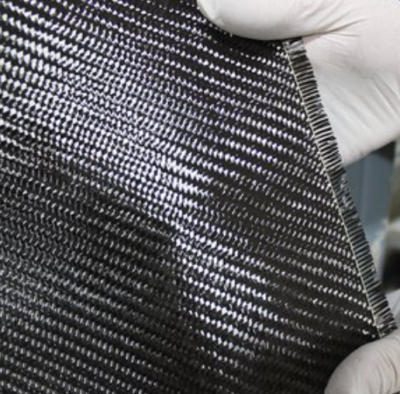

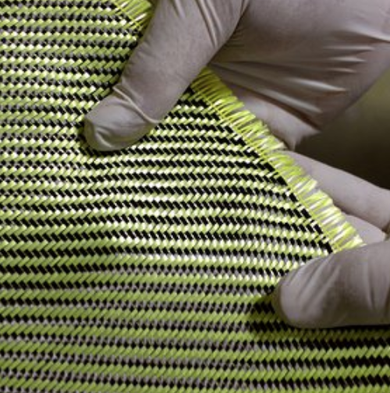
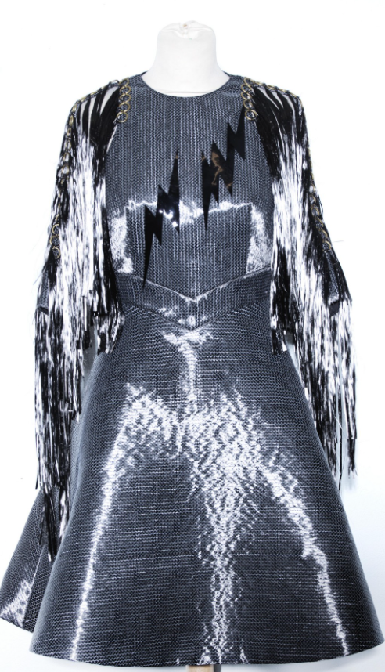

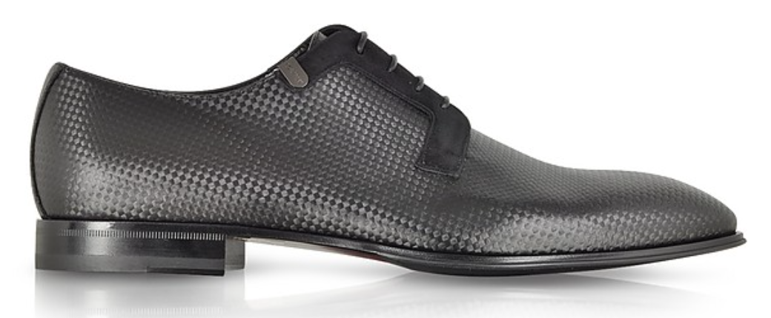
A 3.1.7 Composites consist of two or more materials combined to enhance their properties.
Composites are a combination of two or more materials that are bonded together to improve their mechanical or physical properties. Composites can be a ‘catchall’ term that covers many different materials and processes of making them. In these slides we will break the different composites into 3 categories - Form, Process, and Composition.
Textiles: Fibres.
Fibres can be spun into filaments, string or rope. It can also be used as a component for composite material or matted into sheets to make such products as fabrics, paper or felt. Synthetic fibres can be produced very inexpensively and in large quantities in comparison to natural fibres.
Sheets: Glass
Glass is made from silicone dioxide, sodium oxide and calcium oxide, and is generally made into sheets.
When glass is laminated then it becomes a glass composite because there is a layer of Polyvinyl Butyral PVB between two sheets of glass. Laminate glass is often used as safety glass, in car windscreens for example. It reduces the fragment size of the glass when broken. It is also commonplace in public spaces and glass doors. Laminating glass substantially increases the strength of ‘normal’ glass. When laminated in multiple layers it can stop bullets.
Carbon Fibre fabric
The strength of Carbon Fibre fabric
Kevlar fabric
Kevlar and Carbon Fibre (CF) are two good examples of fibres that are woven in specific ways to produce very strong textiles. The main difference between these two materials is that Kevlar contains nitrogen, and Carbon Fibre does not, but contains carbon. On their own these fabrics do not possess strength beyond that of any woven fabric, but once they are combined with a resin, their strength can be astonishing.
Carbon Fibre is so versatile it can be made into almost anything,
How bulletproof vests work
Laminate glass: bulletproof

Slide 23
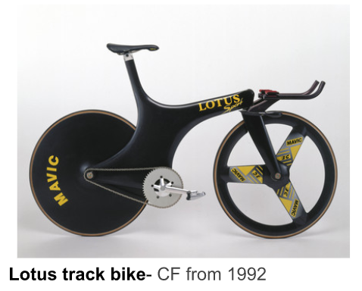
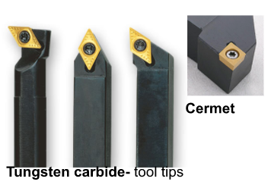
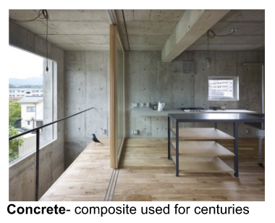
A 3.1.7 Composites consist of two or more materials combined to enhance their properties.
Particles: Metals & Concrete.
Particle reinforcement in composites is a less effective means of strengthening than fibre reinforcement.
Particle reinforced composites achieve gains in stiffness primarily, but can also achieve increases in strength, toughness and wearability in terms of concrete composites.
Particulate reinforced composites find applications where strength, toughness, and hardness may need to be increased.
Matrix: Carbon Fibre.
There is a reason that a material like carbon fibre can be strong and lightweight at the same time. It is related to the atoms that make up these materials, and the way that these atoms bond together.
As with all composites, there are two categories of constituent materials - matrix and reinforcement. The matrix for carbon fibre is epoxy resin, that surrounds and supports the reinforcement materials - the woven CF fabric.
How Koenigsegg uses carbon fibre.
Hard tungsten carbide particles are located in the softer matrix - a matrix provides a medium for binding and holding reinforcements together as a solid.
Carbon fibre: extremely strong and light
Epoxy or polyester resin can be used to hold the carbon fibre sheets into their final form. At Koenigsegg the sheets of carbon fibre are impregnated with epoxy resin. The epoxy resin is cured during the moulding process with heat and pressure in a device called an autoclave. This is an efficient and very accurate process which enables manufacturers to create products at very high tolerances.
Concrete is a composite material composed of aggregate, sand and small stones - bonded with a fluid cement that hardens over time. Concrete has been around since 1300 BC.
An alternative, more bespoke method is using the hand layup process. A mould is still required, but this time the CF weave sheets are placed in the mould, then resin is hand applied to the sheets, then more weave is laid on top.

Slide 24
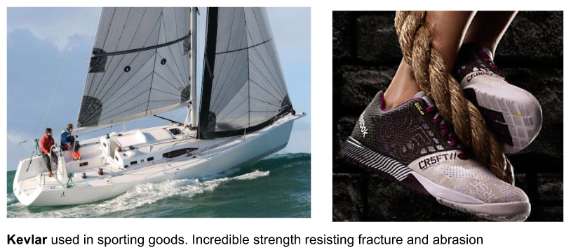
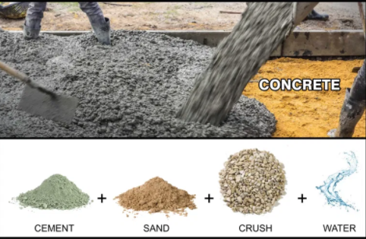

A 3.1.7 Composites consist of two or more materials combined to enhance their properties.
Concrete: the word comes from the Latin word ‘concretus’ meaning ‘compact’. Often additives and reinforcements, such as steel bars known as ‘rebar’ are included into the mixture to achieve different properties of the finished material. When these ingredients are mixed together, they form a fluid mass that is easily moulding into shape. Over time the cement forms a hard matrix which binds the rest of the ingredients together into a stone-like material of many uses.
Kevlar: Kevlar®️ is a high strength material that was first commercially used in the 1970’s as a replacement for steel in racing tires. Typically it is spun into ropes or woven into fabric sheets that can be used such, or an ingredient in a composite material manufacture.
The quest for lighter, stronger, durable and safe sporting goods has made Kevlar®️ a popular choice for both equipment manufacturers and consumers. The same properties and performance attributes that have proven so effective in industrial and life-protection applications also appeals to athletes, outdoor enthusiasts, and anyone looking for better performance in their sporting products.
Its natural toughness helps allow fabrics and threads to stand up to repeated abuse. Kevlar®️ helps minimise vibration transfer, and can sustain deformation without breaking. It’s very high strength to weight is also an important property.
The physical properties of density and strength are determined, in part, by the proportions or ratio of the 4 key ingredients - cement, sand, aggregate and water. The sand helps the cement and water from a stronger bond, but you can make cement without it.
How cement is made.
Concrete has been used for 100’s of years.

Slide 25
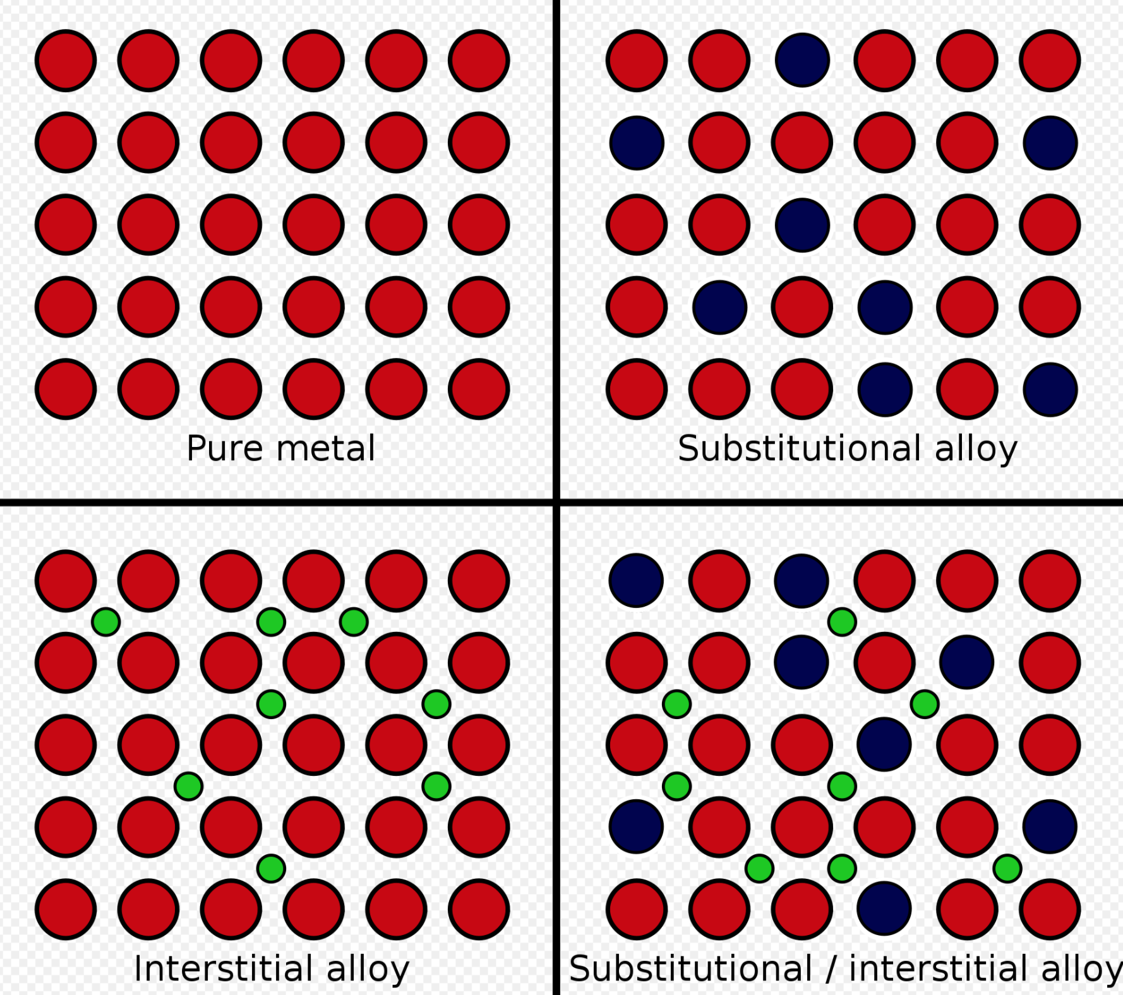
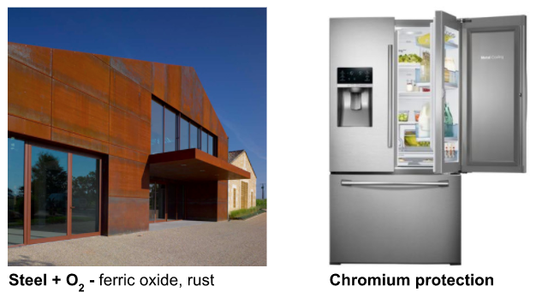
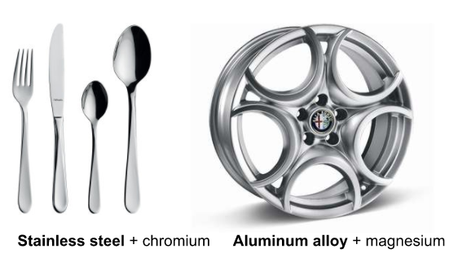
A 3.1.7 Composites consist of two or more materials combined to enhance their properties.
An alloy is a mixture of at least two elements, one of which is a metal. Alloys often have properties that are different to the metals they contain. This makes them more useful than the pure metals alone, and designers can exploit these differences in many ways. Alloys for example are often harder than the metal they contain.
Alloys contain atoms of different sizes, which distorts the regular arrangements of atoms. This makes it more difficult for the layers to slide over each other, so alloys are harder than pure metals. The arrangement of the atoms and where they sit in the structure of the the alloy will also have an effect on the properties of the alloy. It is these different properties that designers and manufacturers can use to improve products and designs - how do they improve them?
The tensile strength of the metal is increased by alloying, but the malleability and ductility are reduced. (Malleability is the ability to hammer, shape or roll metal. Ductility , the measure of a metals ability to undergo plastic deformation before fracturing). These differences in properties from the original pure metal is due to the presence of ‘foreign’ atoms which interfere with the atoms in the crystals during plastic deformation.
Pure iron is of little use as an engineering material because it is too soft and ductile. By adding carbon to iron however, we can produce a range of alloys with quite different properties. We call these carbon steels, but in reality they are alloys. Steels produced with a carbon content between 0.1% and 0.3% are classified as mild steels. It is also harder and tougher than iron and has a higher tensile strength.
Stainless steel differs from steel by the amount of chromium present. Unprotected carbon steel rust readily when exposed to air and or moisture. The chromium protects against this, and would be used on products that would be exposed to these conditions. Alloy wheels are a mixture of aluminium and magnesium. This alloy is used for its strength, and lightness.

Slide 26
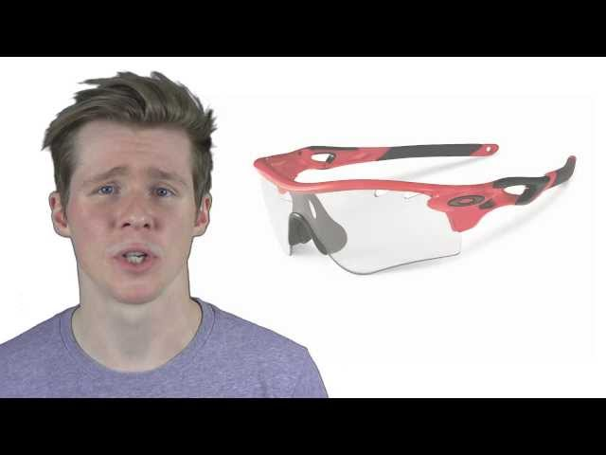

A 3.1.8 Smart materials are materials that have one or more properties that can be significantly changed in response to changes in their environment.
Design contexts where properties of smart materials are exploited
Photo-chromicity- refers to a material that can described as having a reversible change of colour when exposed to light. One of the most popular applications is for colour-changing sunglass lenses, which can darken as the sun brightens. A chemical either on the surface of the lens or embedded within the glass reacts to ultraviolet light, which causes it to change form and therefore its light absorption spectra.
Oakley Transitions- use photochromic lenses
Thermoelectricity- is generated by a device that converts heat and the temperature difference between two materials directly into electrical energy. It is the difference between the temperature that generates electricity. This electricity can be used to measure, monitor and control temperature.
Nest was co-founded by former Apple engineers Tony Fadell and Matt Rogers in 2010 and now produces a range of household monitoring devices. The temperature monitors uses thermocouples to drive the electrical signal to provide the data. Nest products form part of the interface to create smart systems that are remotely driven through smartphone apps.
Nest - temperature monitor and control
MR+ ER- responsive fluids

Slide 27



A 3.1.8 Smart materials are materials that have one or more properties that can be significantly changed in response to changes in their environment.
Magneto-rheostatic,electro-rheostatic materials are fluids, which can experience a dramatic change in their viscosity. These fluids can change from a thick fluid (similar to motor oil) to nearly a solid substance within the span of a millisecond when exposed to a magnetic or electric field; the effect can be completely reversed just as quickly when the field is removed.
Magneto-rheostatic, electro- rheostatic materials are fluids, which can experience a dramatic change in their viscosity.
MR+ ER- responsive fluids
Piezo, is a term that is derived from the Greek meaning for piezo, squeeze or pressure.
Piezoelectricity, is a term that is derived from the greek meaning for piezo, squeeze or pressure where electricity is generated when piezoelectric material is deformed, The pressure acting upon the material it gives off a small electrical discharge. Piezoelectric materials can be used in reverse to generate a tone of a sound, when an electricity is used as an input- this cause the piezoelectric materials to vibrate, acting as a very small speaker.
Piezo- circuit Piezo as an actuator- generates electricity

Slide 28

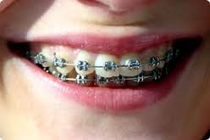
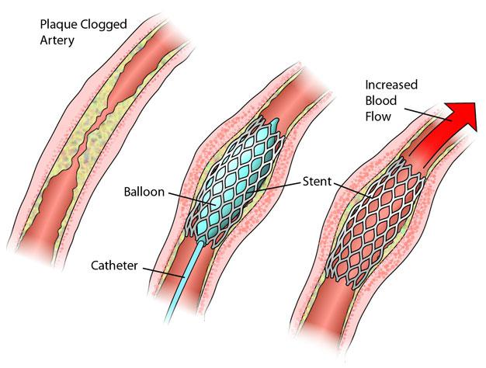
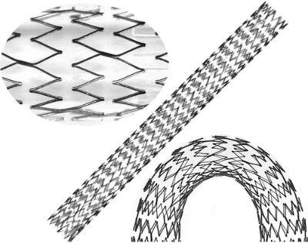

A 3.1.8 Smart materials are materials that have one or more properties that can be significantly changed in response to changes in their environment.
Shape memory- are metals that exhibit pseudo-elasticity and shape memory effect due to rearrangement of the molecules in the material. Pseudo-elasticity occurs without a change in temperature. The load on the SMA causes molecular rearrangement, which reverses when the load is decreased and the material springs back to its original shape. The shape memory effect allows severe deformation of a material, which can then be returned to its original shape by heating it.
SMA- temperature changes the shape of a metal flower
Nitinol- dental applications.
Nitinol stents- used in the treatment of CHD
Nitinol stents are used to repair damaged blood vessels. They are inserted to prevent the collapse and bursting in the case of coronary heart disease. They enter cold and expand to body temperature.

Slide 29

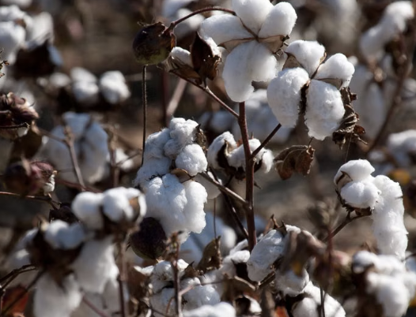
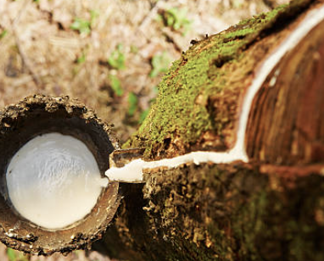
A 3.1.9 Biodegradable materials break down in the environment after disposal or at the end of their useful life.
Biodegradable materials can be broken down naturally by microorganisms such as bacteria and fungi after disposal or at the end of their useful life. Designers consider biodegradability to reduce waste and environmental impact.
Example: Paper and untreated wood are biodegradable materials that can naturally decompose over time.
Cotton is biodegradable, making it a suitable material for products where reducing end-of-life environmental impact is important.
Natural rubber can biodegrade under suitable environmental conditions.
Paper
Cotten
Natural rubber

Slide 30
