Slide 1

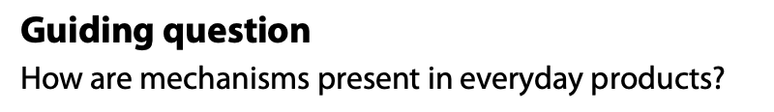
INTRODUCTION TO
MECHANICAL SYSTEMS
Design in theory

Slide 2
Contents
Four types of motion | Identify the four basic types of mechanical motion: linear; rotary; oscillating; and reciprocating.
Input into an output | Describe inputs, processes and outputs in the context of mechanical systems.
Mechanical advantage | Outline a mechanical advantage and suggest how simple mechanical systems may improve performance in terms of function and efficiency.
Speed, direction or power of a motion | Identify gear-driven, belt-driven, cam, lever and linkage systems.
Simple or complex mechanical systems | Explain the basic principles of mechanical motion and discuss how gears, pulleys, cams, levers and linkages can be combined to create complex mechanical systems.

Slide 3
Contents
Gears | Identify the different types of gear systems (spur, bevel, rack and pinion, worm, ratchet and pawl, idler and compound) and their components, and outline how they are used providing examples.
Pulleys | Identify components of pulley systems, and outline how they are used providing examples.
Cam | Identify different shaped cams (pear, circular, triangular, eccentric, oval and snail) and outline how they are used providing examples.
Levers | Identify the three types of levers (1st class, 2nd class and 3rd class) and the position of the Load (L), Effort (E) and the Fulcrum, and outline how they are used providing examples.
Linkages | Identify parallel, reverse and bell crank linkages, and outline how they are used providing examples.

Slide 4

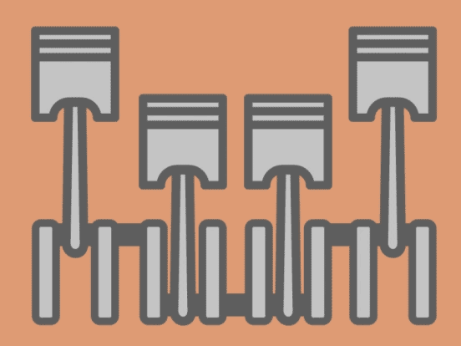
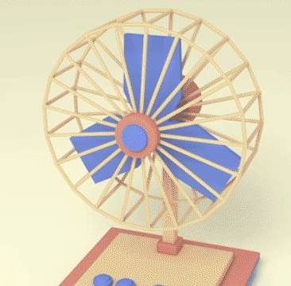

A 3.3.1 There are four types of motion involved in mechanical systems.
Motion is the foundation of mechanical systems, machines, and automation, defining how components move and interact to perform useful work. There are four types of motion.
1. Linear Motion: Movement in a straight line and in one direction. Eg.: A train moving along a straight track or a drawer being pulled out.
2. Reciprocating Motion: Movement in a straight line, but moving backwards and forwards (or up and down) in a repeating cycle. Eg.: The needle on a sewing machine or the piston in an internal combustion engine.
3. Rotary Motion: Movement following a circular path around a fixed center point (an axle or shaft). Eg.: A bicycle wheel, a drill bit, or a ceiling fan.
4. Oscillating Motion: Movement along a curved path (arc) that moves back and forth about a central pivot point. Eg.: A playground swing, a pendulum in a clock, or a windshield wiper.
Linear
Reciprocating
Rotary
Oscillating

Slide 5
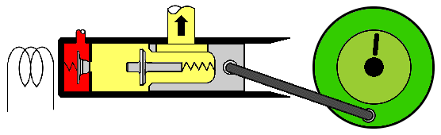
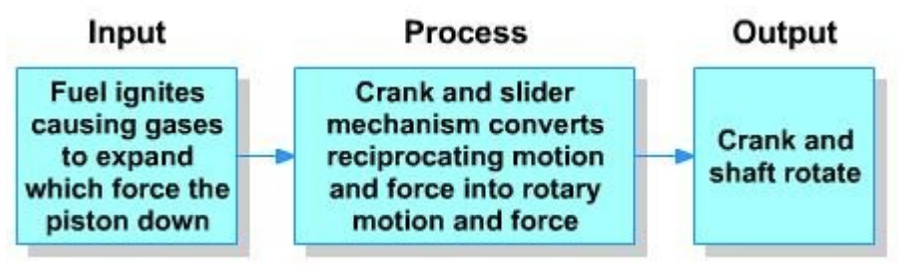
A 3.3.2 Mechanical systems convert an input into an output.
A mechanical system is a group of components that interact to convert an input force and motion into a desired output force and motion. This process typically changes the magnitude of the force, the direction of movement, or the type of motion entirely.
Input is the source of energy or movement that enters the system. It is the "trigger" required to start the mechanical process.
Process is the "middle man." This is where the actual mechanism lives. It consists of components that change the input's speed, force, or type of motion. usually performs one of three functions:
Changing Motion Type:
e.g., turning a rotating motor into a reciprocating needle (using a cam).
Changing Direction:
e.g., using a bell crank to turn a horizontal pull into a vertical lift.
Mechanical Advantage:
e.g., using a gear train to reduce speed but increase Torque
source : https://commons.wikimedia.org/
Output is the final result or the "work" performed by the system. It is the specific movement or force that the product was designed to achieve.

Slide 6
A 3.3.3 Mechanical systems can provide a mechanical advantage to the user.

Slide 7


A 3.3.3 Mechanical systems can provide a mechanical advantage to the user.
MECHANICAL ADVANTAGE (MA)
CALCULATING EFFICIENCY
Mechanical Advantage allows a small effort to move a large load.
Velocity Ratio (VR) is the ratio of distances moved:

Slide 8
A 3.3.4 Mechanical systems are used to increase or decrease the speed, direction or power of a motion.

Slide 9
A 3.3.5 The four types of motion can be combined to create simple or complex mechanical systems.

Slide 10
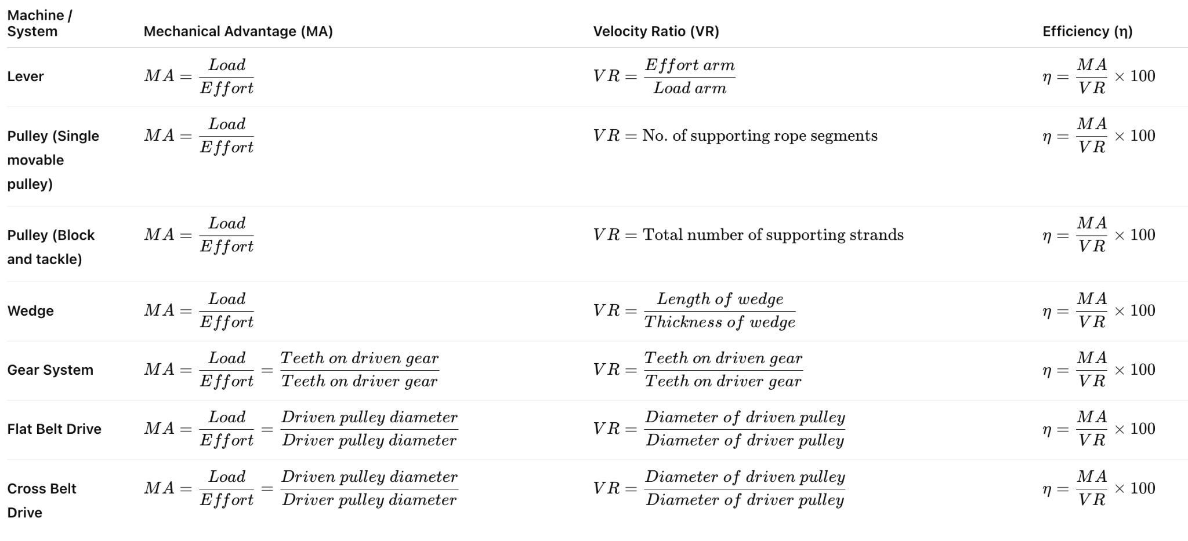
Formulae for Simple Machines & Power Transmission Systems

Slide 11
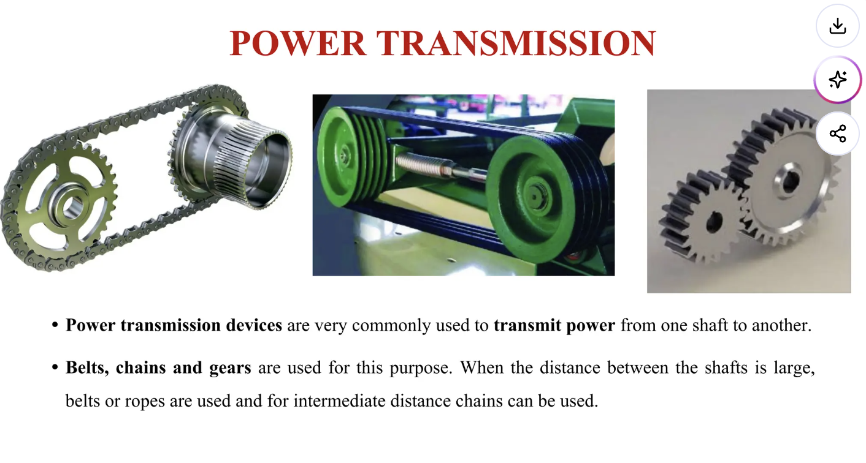
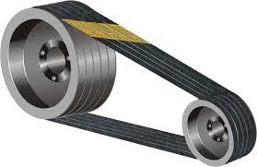
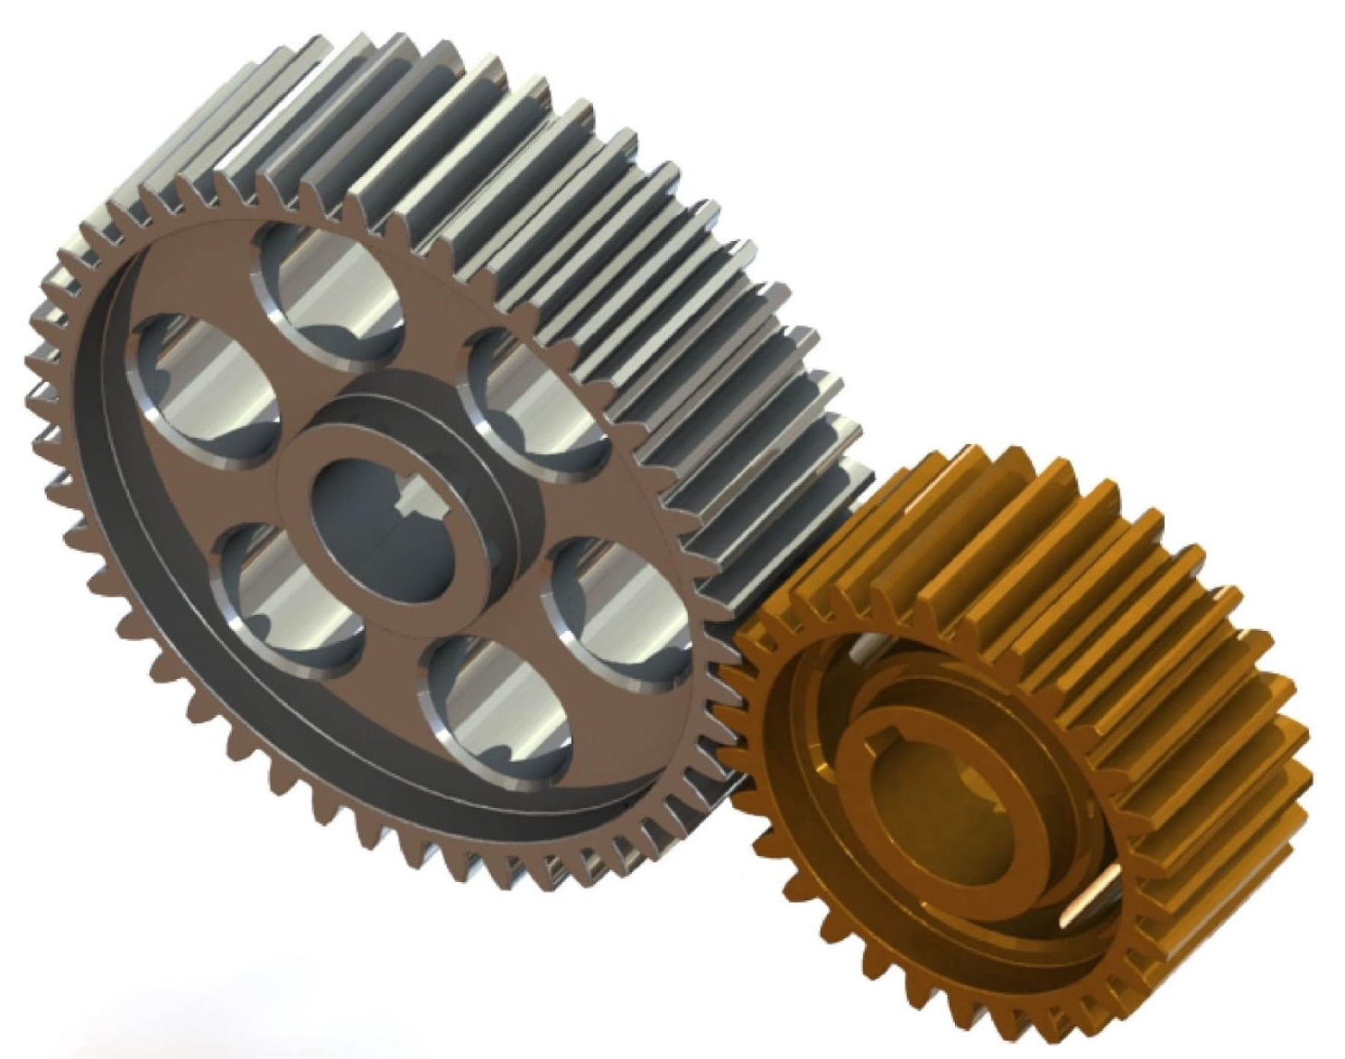

Slide 12
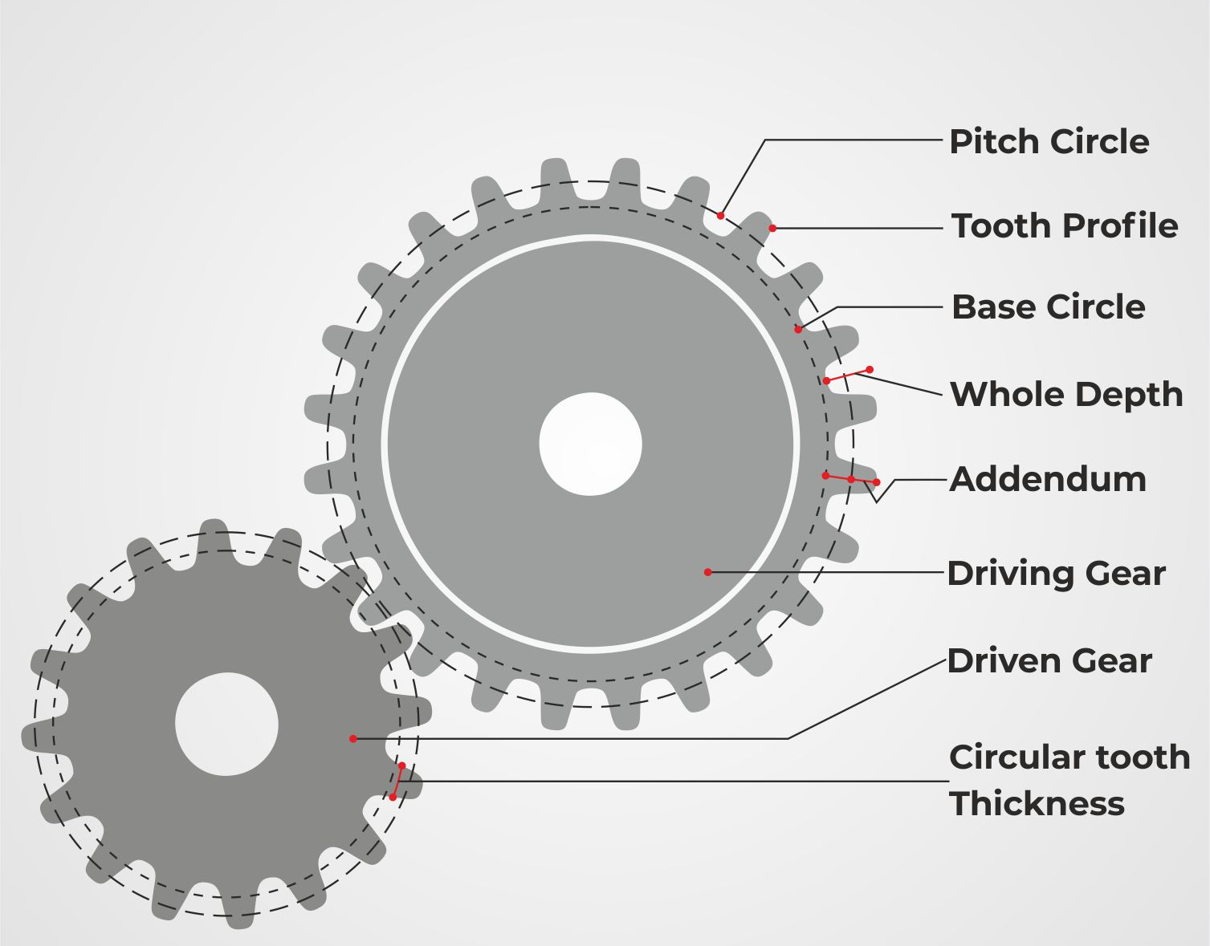
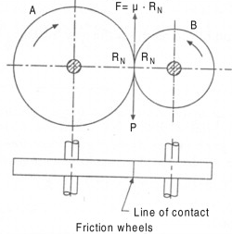
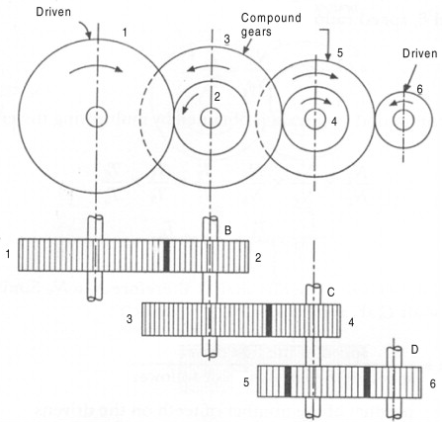
A 3.3.6 Gears transmit rotary motion from one gear shaft to another, and have a number of teeth.

Slide 13
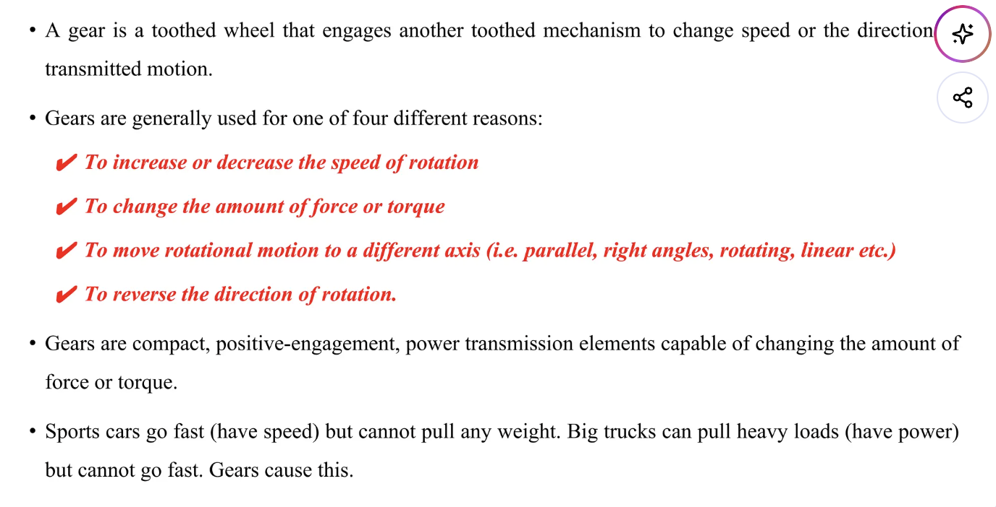
A 3.3.6 Gears transmit rotary motion from one gear shaft to another, and have a number of teeth.

Slide 14
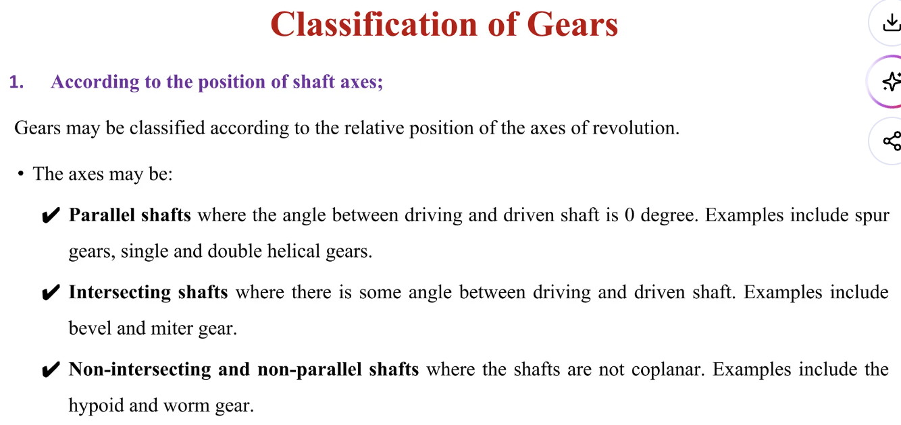
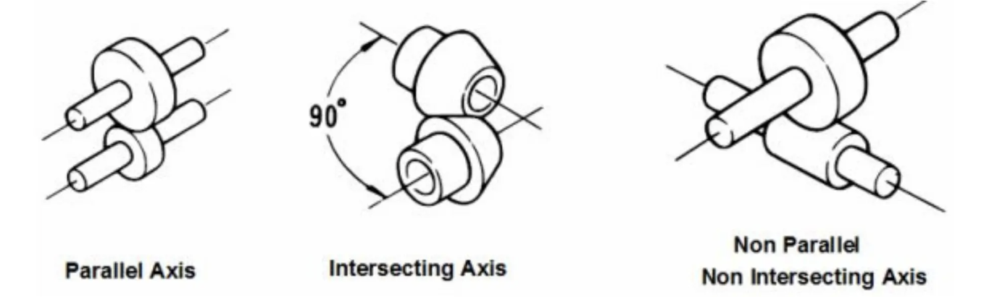
A 3.3.6 Gears transmit rotary motion from one gear shaft to another, and have a number of teeth.

Slide 15
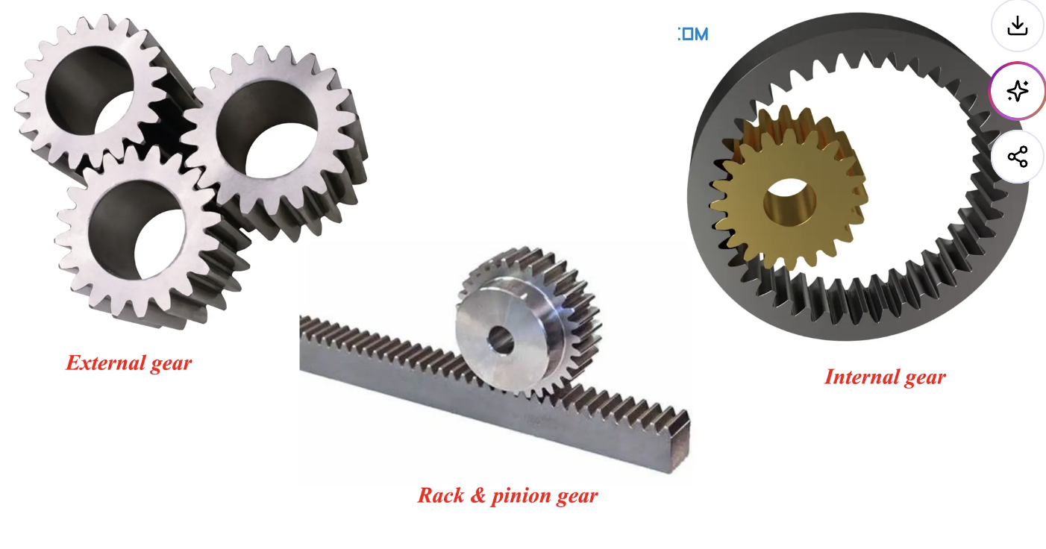
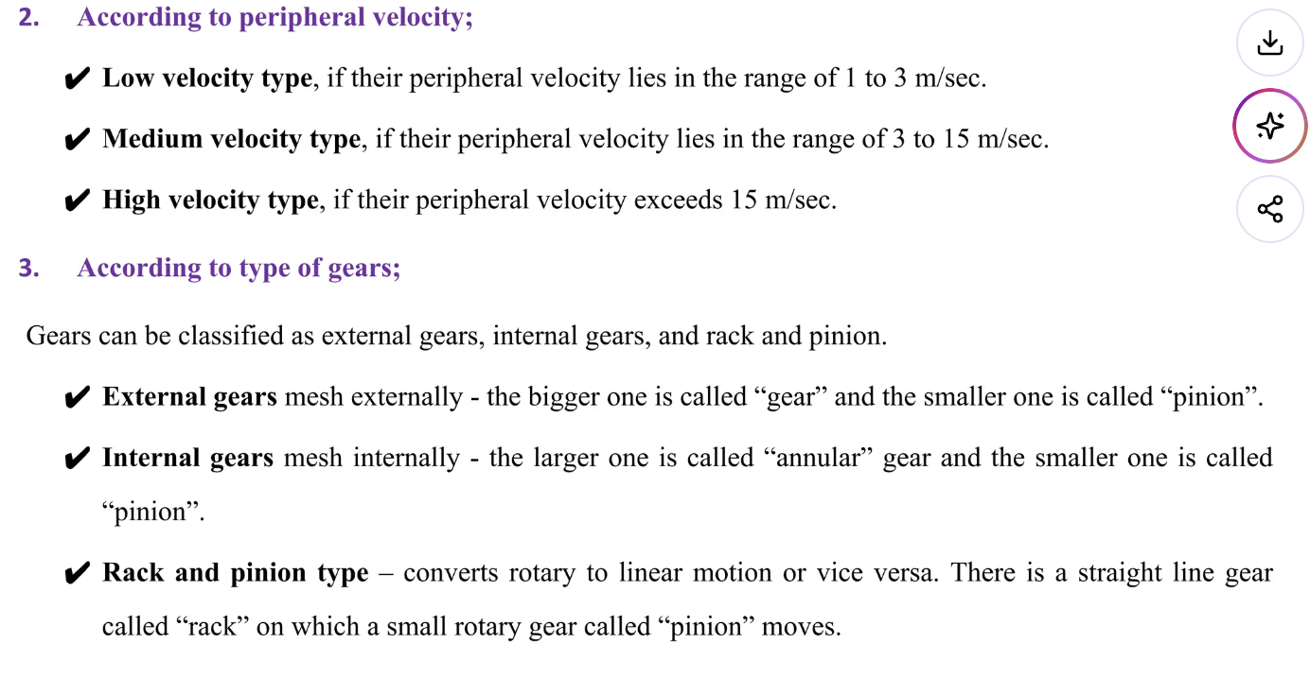
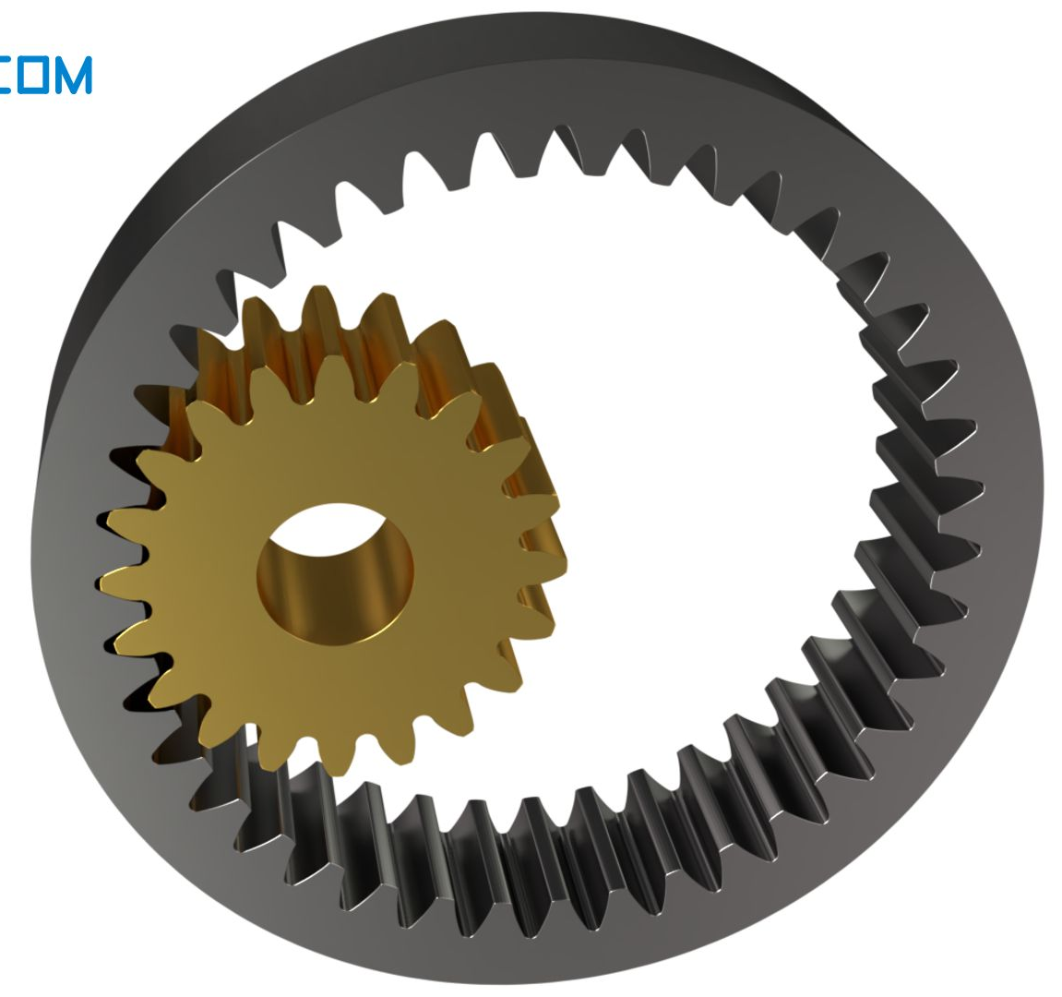
A 3.3.6 Gears transmit rotary motion from one gear shaft to another, and have a number of teeth.

Slide 16
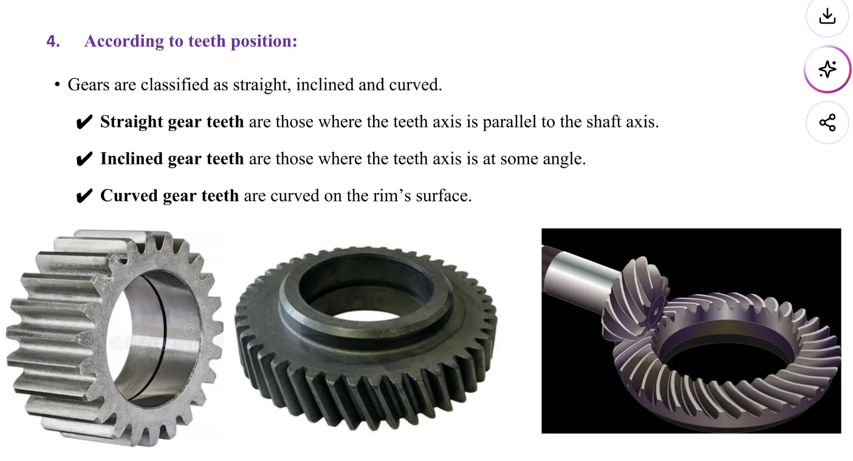
A 3.3.6 Gears transmit rotary motion from one gear shaft to another, and have a number of teeth.

Slide 17
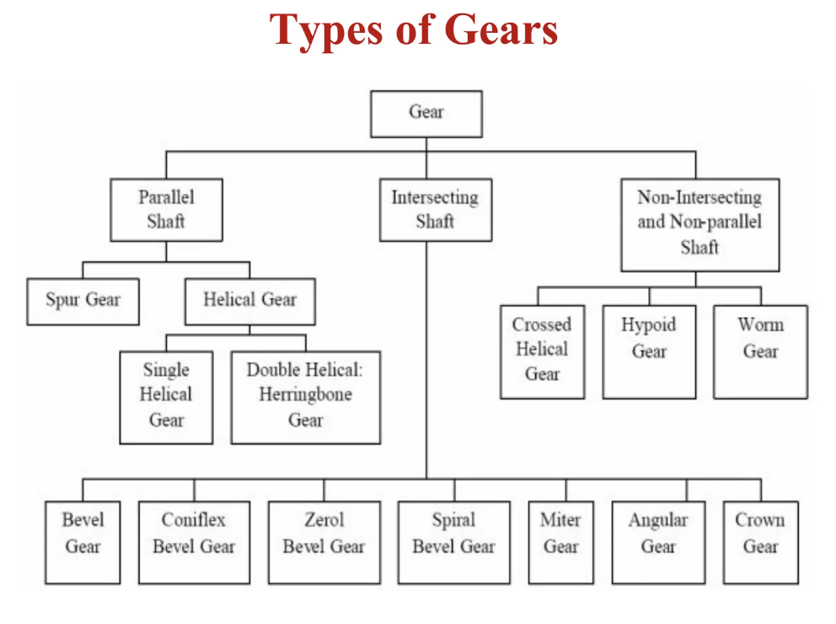
A 3.3.6 Gears transmit rotary motion from one gear shaft to another, and have a number of teeth.

Slide 18
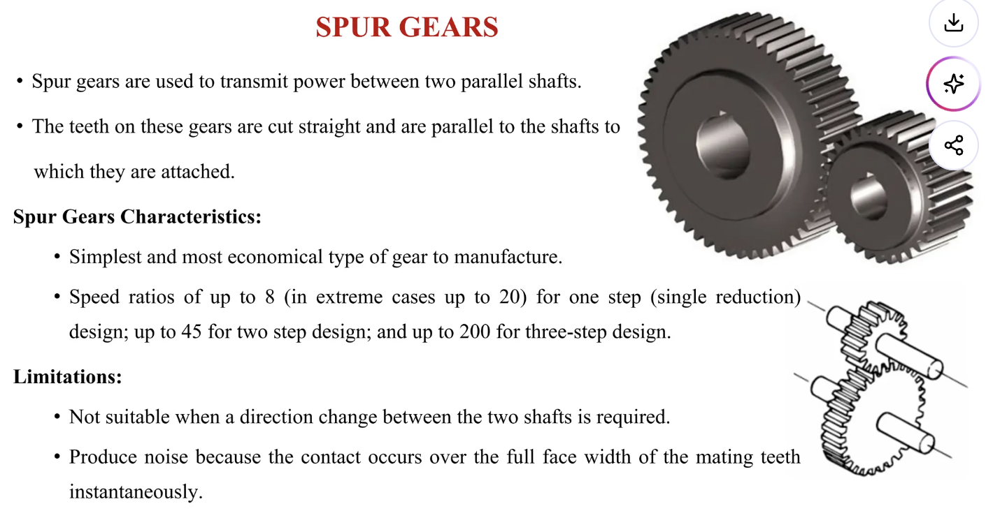
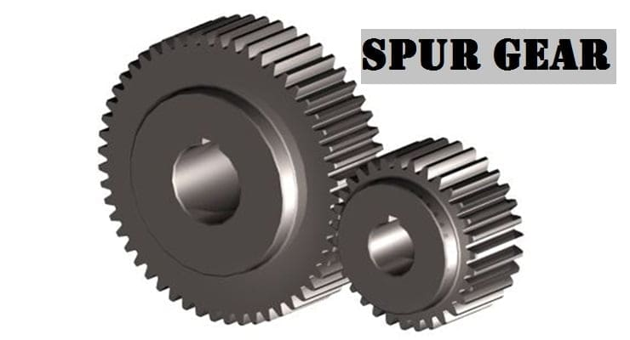
A 3.3.6 Gears transmit rotary motion from one gear shaft to another, and have a number of teeth.

Slide 19
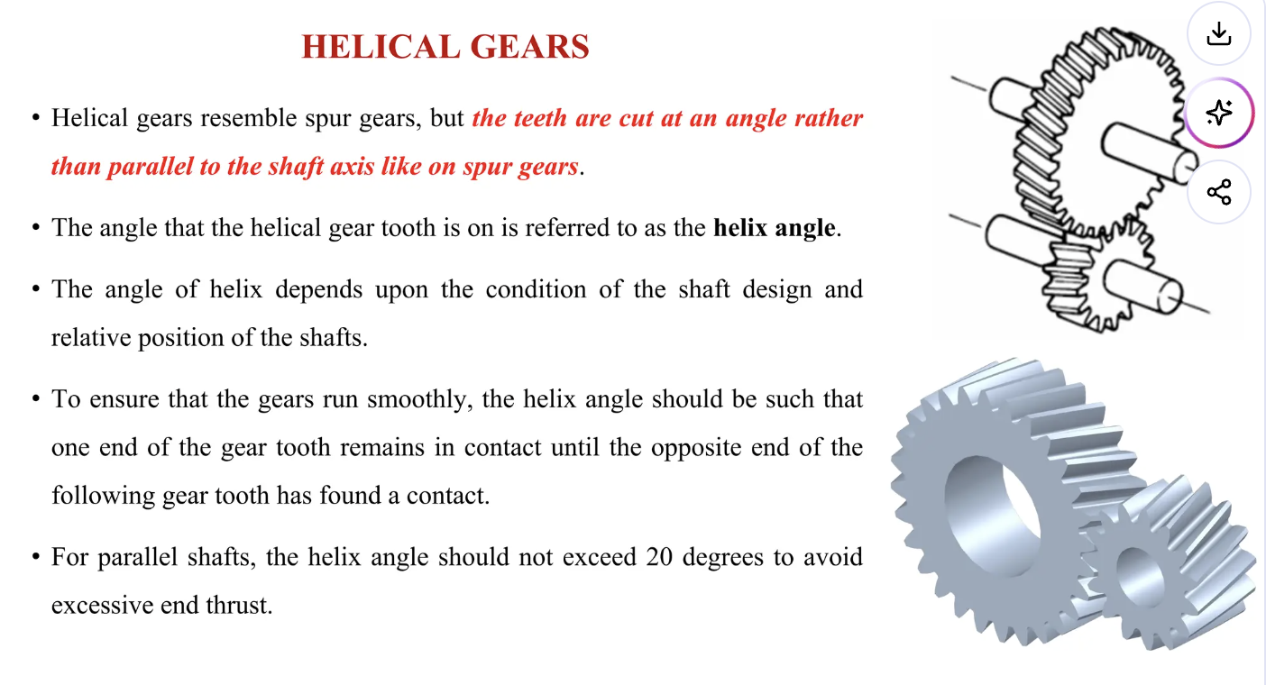
A 3.3.6 Gears transmit rotary motion from one gear shaft to another, and have a number of teeth.

Slide 20
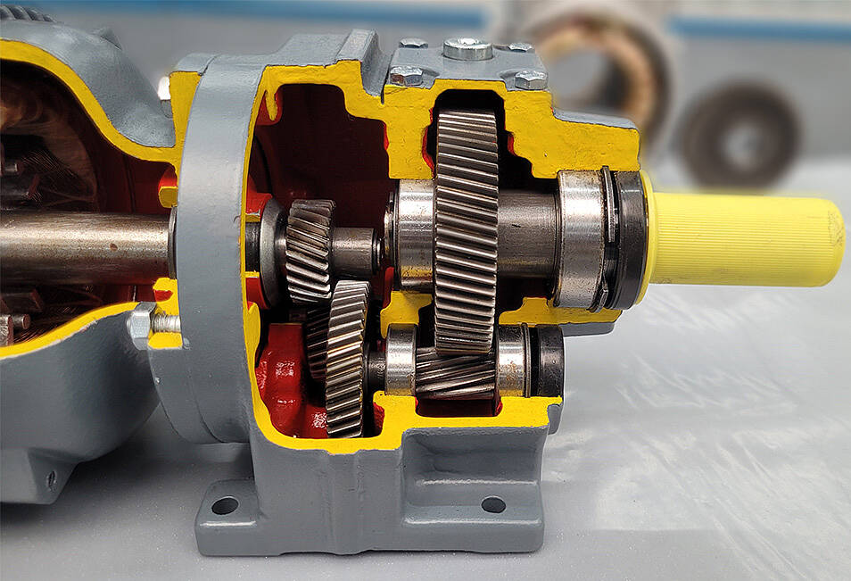
A 3.3.6 Gears transmit rotary motion from one gear shaft to another, and have a number of teeth.

Slide 21
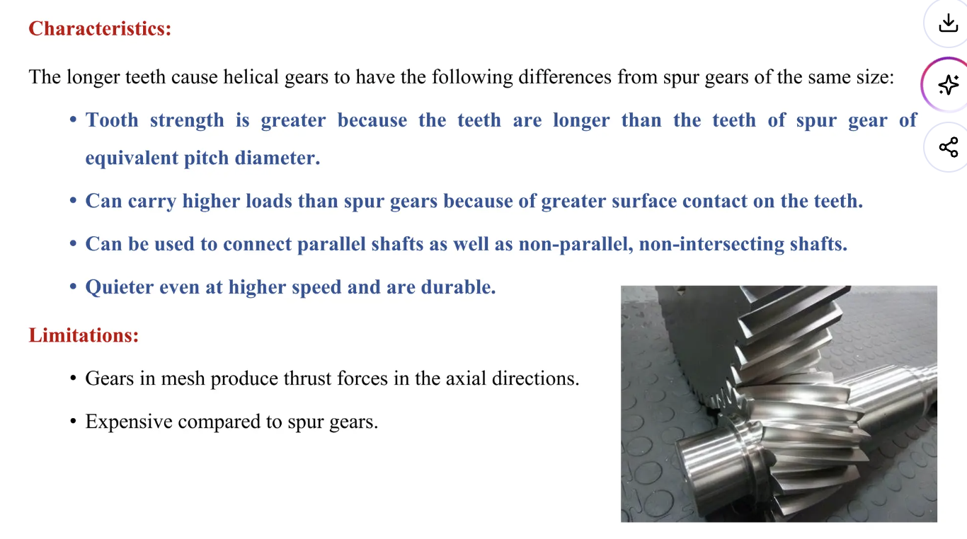
A 3.3.6 Gears transmit rotary motion from one gear shaft to another, and have a number of teeth.

Slide 22
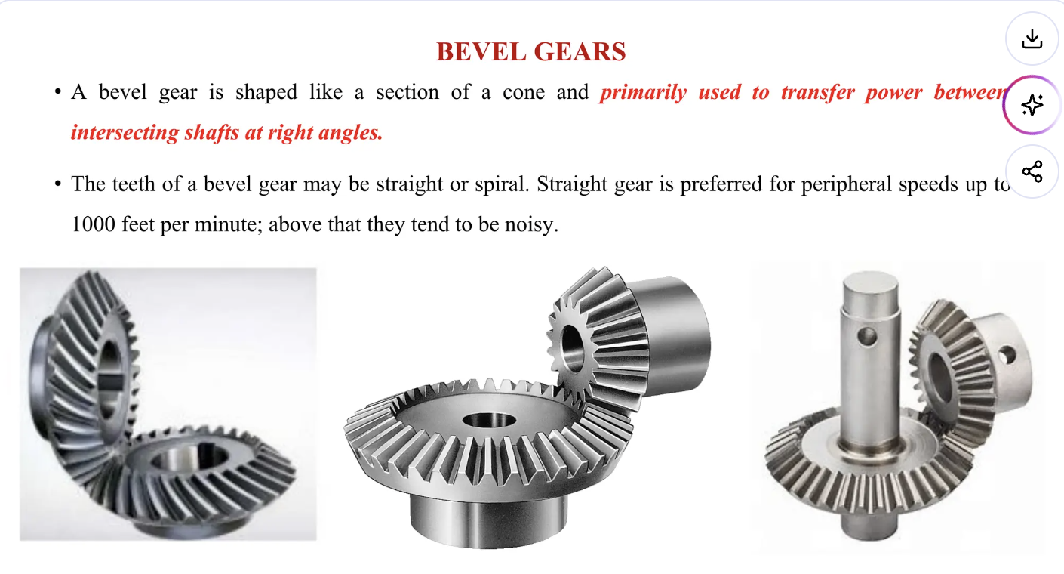
A 3.3.6 Gears transmit rotary motion from one gear shaft to another, and have a number of teeth.

Slide 23
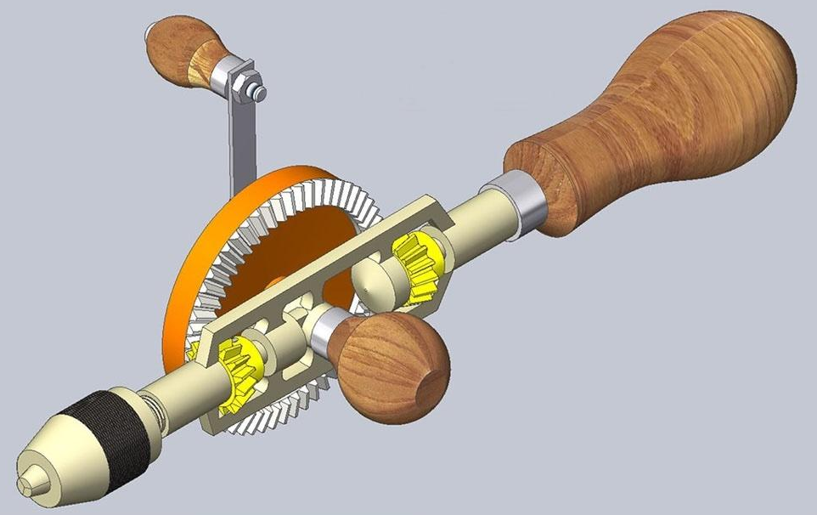
A 3.3.6 Gears transmit rotary motion from one gear shaft to another, and have a number of teeth.

Slide 24
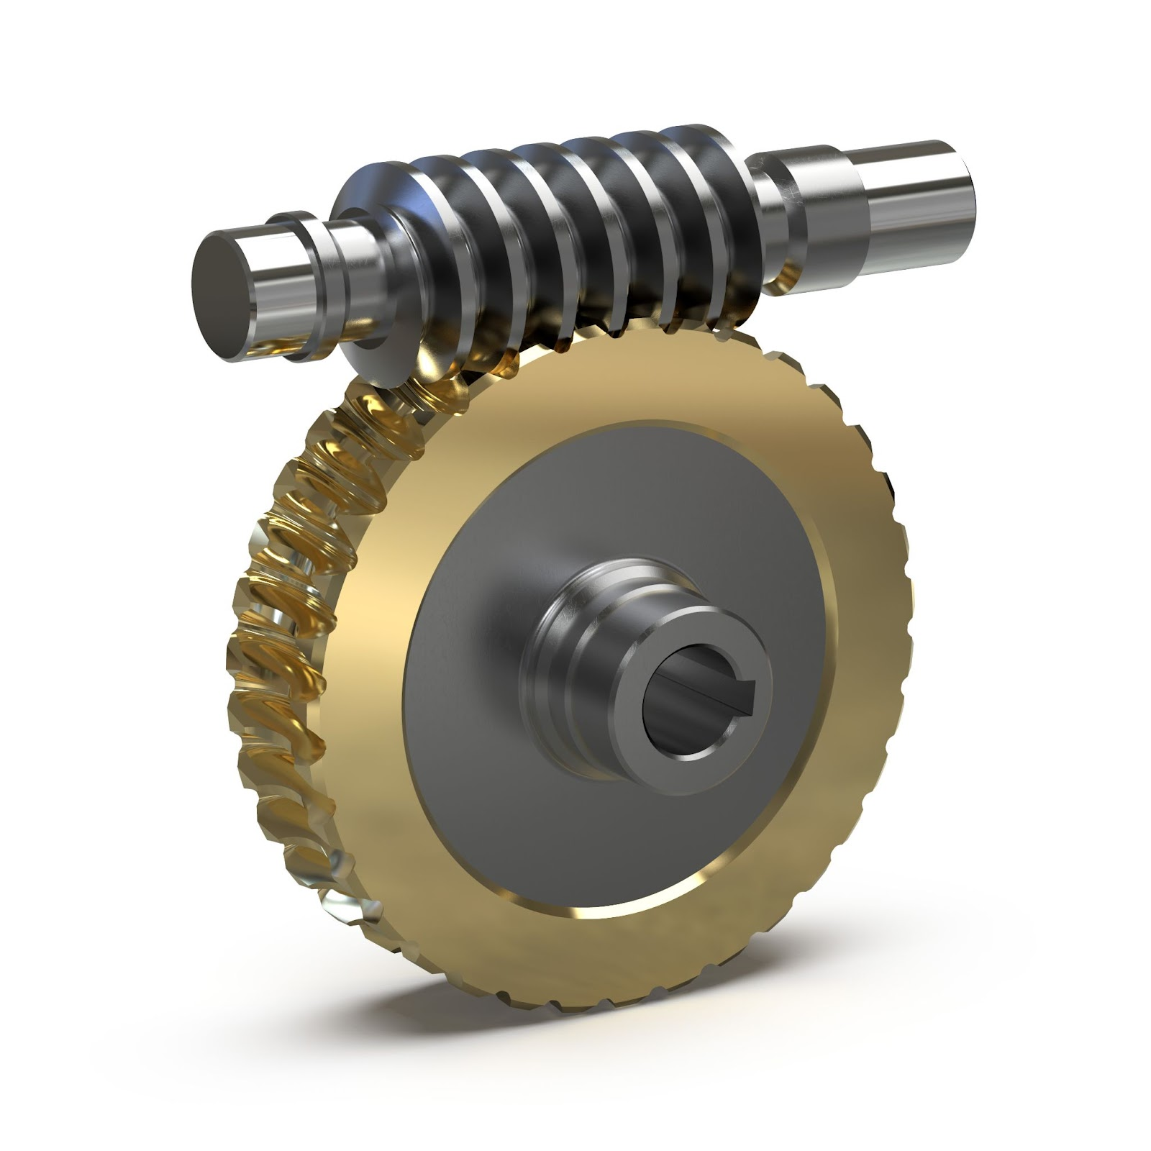
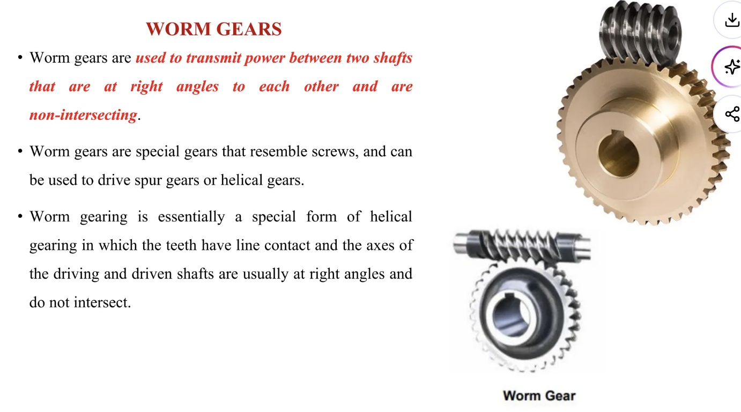
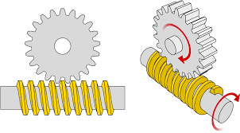
A 3.3.6 Gears transmit rotary motion from one gear shaft to another, and have a number of teeth.

Slide 25
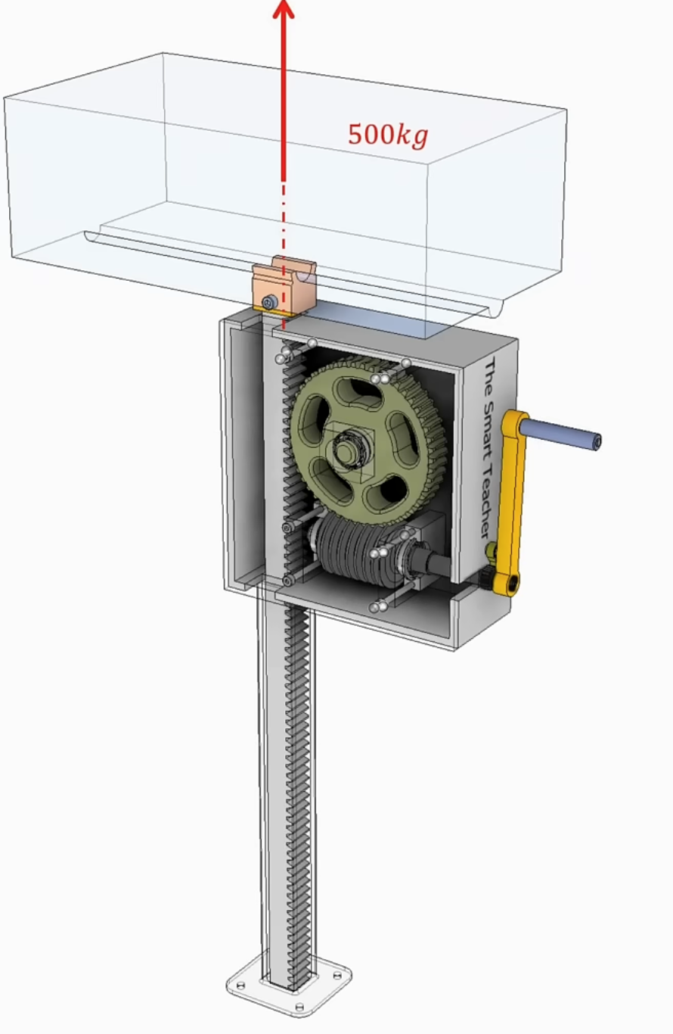
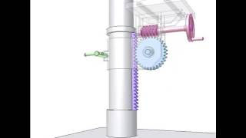
A 3.3.6 Gears transmit rotary motion from one gear shaft to another, and have a number of teeth.

Slide 26
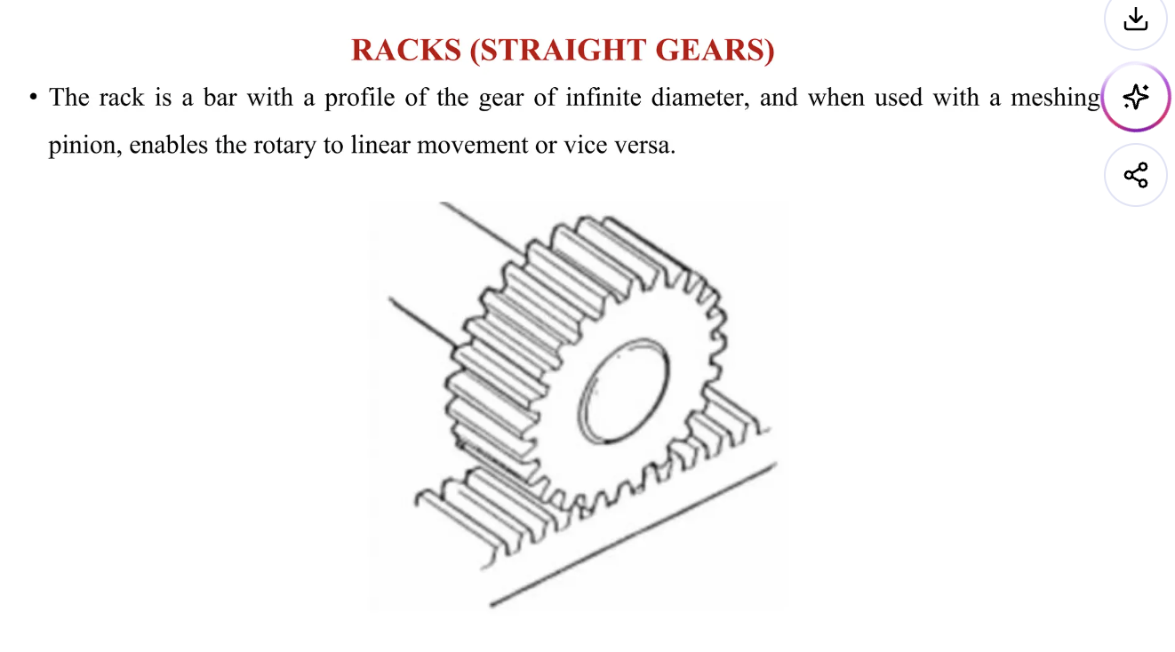
A 3.3.6 Gears transmit rotary motion from one gear shaft to another, and have a number of teeth.

Slide 27
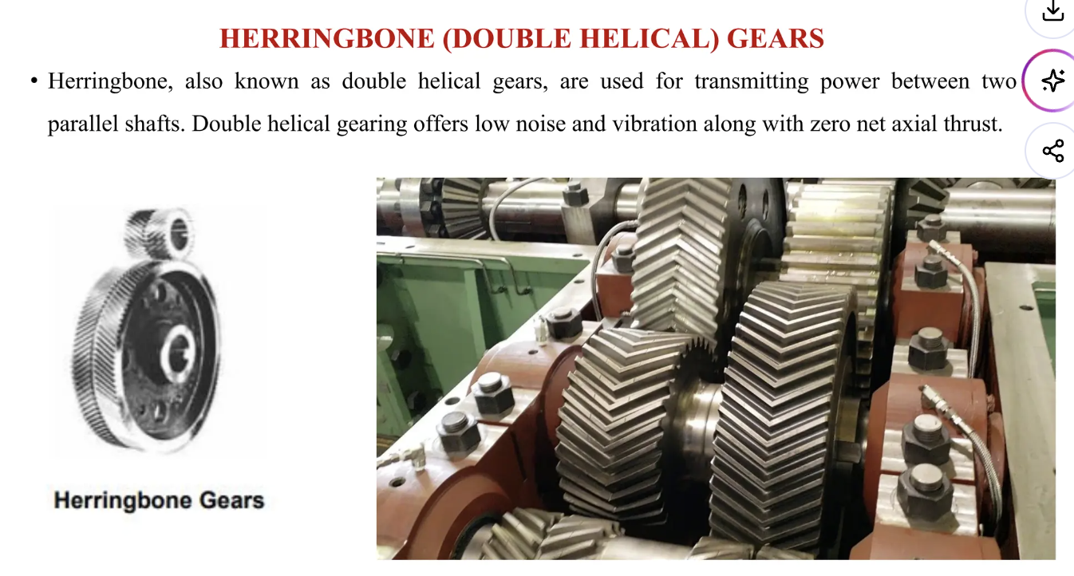
A 3.3.6 Gears transmit rotary motion from one gear shaft to another, and have a number of teeth.

Slide 28
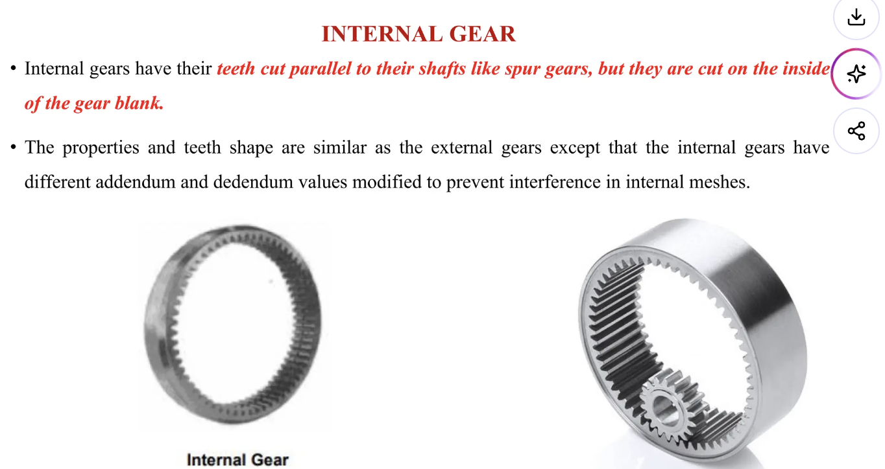
A 3.3.6 Gears transmit rotary motion from one gear shaft to another, and have a number of teeth.

Slide 29
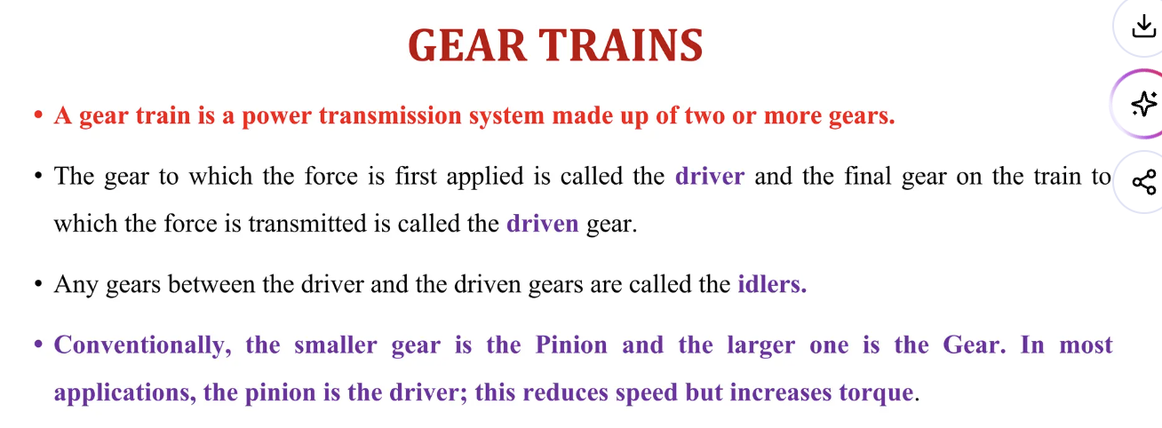
A 3.3.6 Gears transmit rotary motion from one gear shaft to another, and have a number of teeth.

Slide 31
A 3.3.7 Belt-driven systems are driven by pulleys.

Slide 32
A 3.3.8 The shape of a cam dictates the type of motion

Slide 33
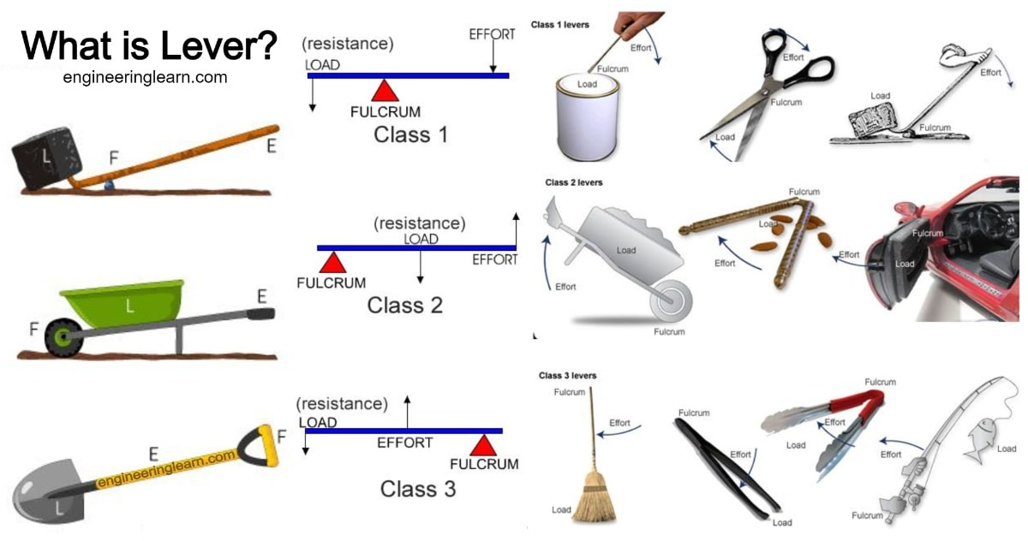
A 3.3.9 Levers comprise a beam acting on a fulcrum (pivot) and are classed based on the relative position of the fulcrum to an applied load and effort.

Slide 34
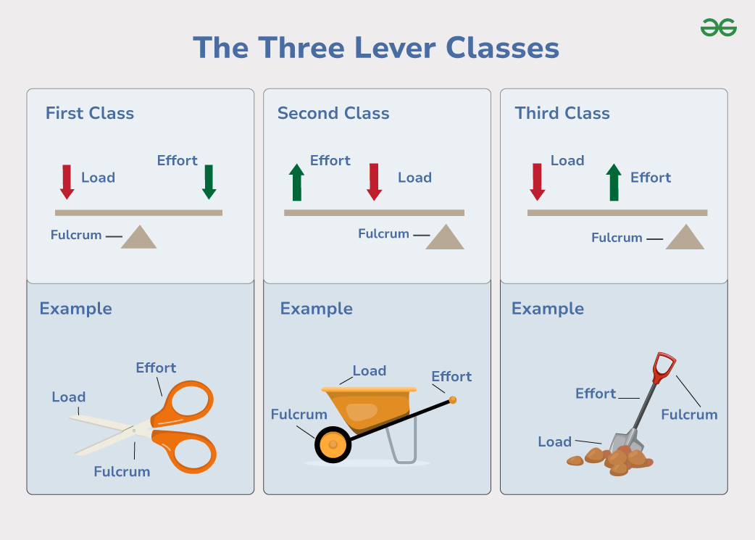
A 3.3.9 Levers comprise a beam acting on a fulcrum (pivot) and are classed based on the relative position of the fulcrum to an applied load and effort.

Slide 35
A 3.3.10 Linkages are used to change the direction of a movement, alter the magnitude of a force or make parts of a system move in a particular way.

Slide 36

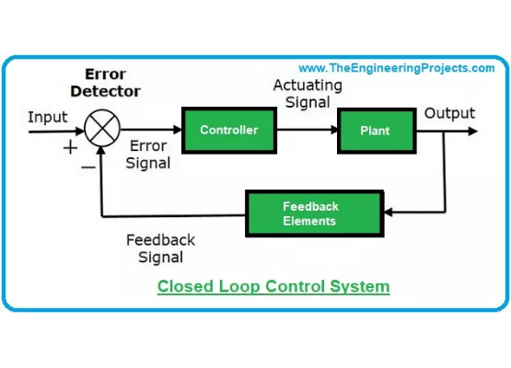
A 3.2.4 Static and dynamic forces can be identified according to how they act on a structure.
DEFINING A SYSTEM
A mechanical system is an assembly of moving parts that work together to perform a specific task. In Design Technology, we analyze these using the "Black Box" systems approach.
•
Input: The force or energy put into the system.
•
Process: The mechanism that changes the input motion or force.
•
Output: The final motion or force delivered by the system.

Slide 37

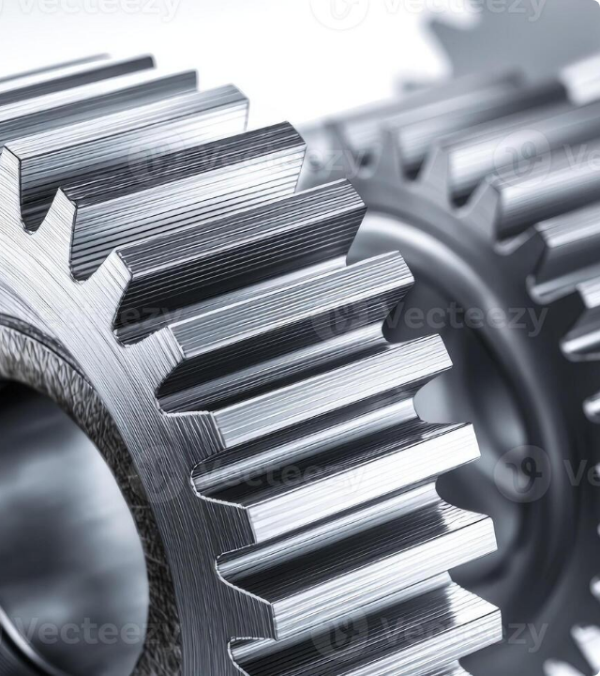

GEARS & GEAR RATIOS
Gears transmit rotary motion and can change speed, torque, and direction. The relationship between the input and output gears is the Gear Ratio.
If the driver gear is smaller than the driven gear, torque increases but speed decreases (gearing down).

Slide 38

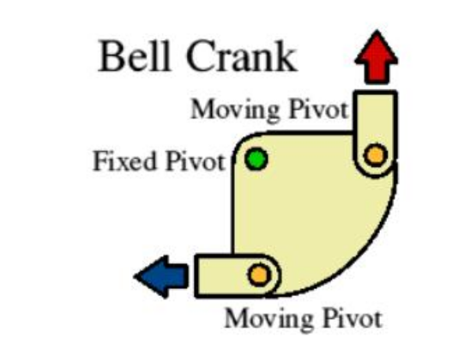
LINKAGES
THE BELL CRANK
Linkages are used to transfer motion and force, often changing their direction.
•
The Bell Crank changes the direction of motion by 90 degrees.
•
Input force is applied to one arm, causing the pivot to rotate and the output arm to move perpendicularly.
•
Widely used in bicycle brake mechanisms and control linkages in aircraft.

Slide 39
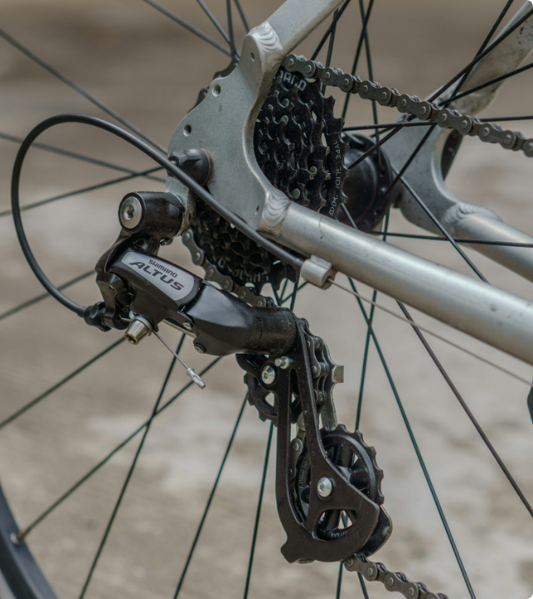
EXAMPLE: THE BICYCLE
The bicycle is a complex mechanical system primarily using chain and sprocket transmission.
•
Input: Rotary motion at the pedals (Driver).
•
Process: The chain transmits force to the rear cassette. Derailleurs change gear ratios dynamically.
•
Output: Rotary motion at the rear wheel (Driven).
•
Analysis: Lower gears (large rear sprocket) provide high torque for climbing, while high gears provide speed on flats.

Slide 40
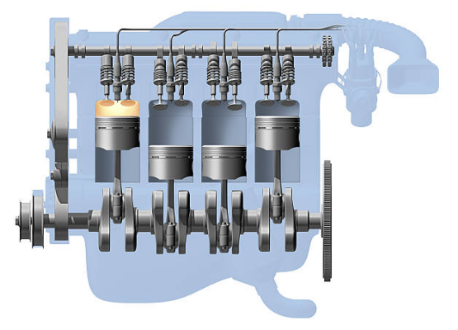
EXAMPLE: INTERNAL COMBUSTION
RECIPROCATING TO ROTARY
The internal combustion engine is a prime example of motion conversion necessary for transportation.
•
Pistons: Move up and down (Reciprocating Motion) due to combustion.
•
Connecting Rods: Connect the pistons to the crankshaft.
•
Crankshaft: Converts the linear/reciprocating force into Rotary Motion to drive the wheels.
•
This system requires precise timing and lubrication to function effectively.

Slide 41
WHAT ARE MECHANISMS?
Made up of linkages and members
Used to convert one type of motion to the other
Not 100% efficient
There are a number of terms and concepts used to determine the effectiveness of each building block.
These include load, effort, fulcrum, mechanical advantage, velocity ratio and efficiency.

Slide 42
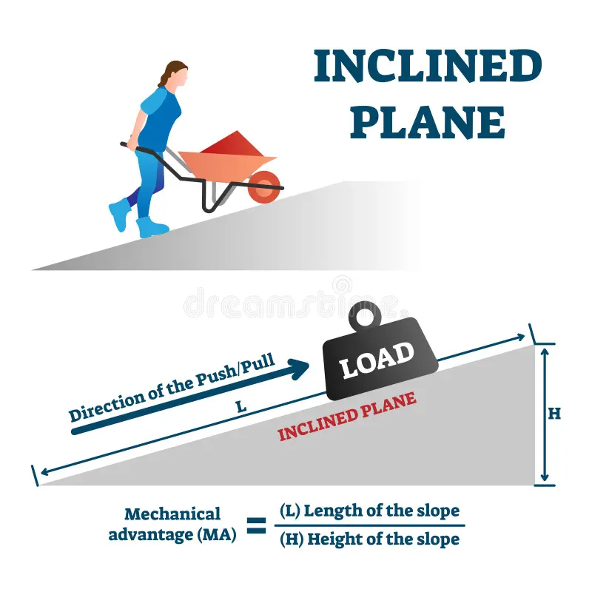
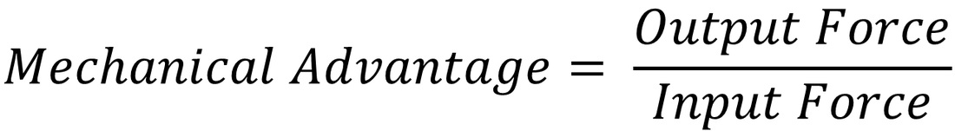
Work Output = Output force x Vertical Height
Work Input = Input force x Inclined Length

Slide 43
