Slide 1

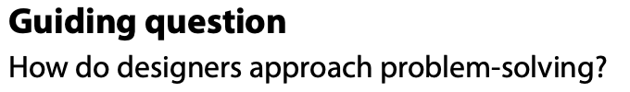
The Design Process
Design in practice

Slide 2
Contents
Design thinking and its five sections | Outline each stage of the design process (empathize; defining the project; ideation and modelling; designing a solution; presenting a solution).
Research | Distinguish between primary and secondary sources, qualitative and quantitative data and how they are used to identify design opportunities, develop an understanding of users and generate ideas for solutions to problems.
Primary research | Primary research methods to gather first-hand data (user observations, interviews, surveys, questionnaires, focus groups, material testing and product analysis) and analyse the data to establish user requirements and design specifications, develop a persona and suggest further developments of a solution.
Secondary research | Analyse secondary data sources (internet-based research, government data and statistics research, university research and literature search) to establish user requirements and design specifications, develop a persona and suggest further developments for a solution.
Empathize; Persona | Able to identify issues, problems and challenges using user-centred research methods and techniques, and to identify user needs for specific user groups to understand their experience, motivations and interactions with products and environments.

Slide 3
Contents
User observation; Storyboard | Able to map a user’s journey using a storyboard and identify pain points within that journey that provide design opportunities.
Product analysis | Able to analyse a range of products that either provides a solution to a problem or can inspire a solution to a problem.
Problem statement | Able to explain the nature of a problem by writing a problem statement that clearly defines their design intentions.
Design specifications | Able to construct design specifications based on primary and secondary research that communicate the essential and desirable success criteria of the redesigned product.
Ideation and modelling | Able to apply ideation techniques to develop a range of diverse and appropriate ideas that address a problem statement and respond to design specifications.
Iterative analysis | Able to compare their ideas with the design specifications and user needs as they refine their solutions.

Slide 4
Contents
Developing a solution | Able to demonstrate iterative development of a design using the model, test, refine cycle.
Models, prototypes and mock-ups | Able to create feasible models of an intended solution at appropriate levels of fidelity that generate performance data when tested with end-users.
Technical drawing | Able to create detailed drawings of components and assembled products that communicate dimensions, scale and assembly details.
Presenting a solution | Able to create virtual representations of a solution, highlighting key usability features, and explain how it meets the design specifications and achieves the design intentions as a proposed solution or as an improvement to an existing product.

Slide 5
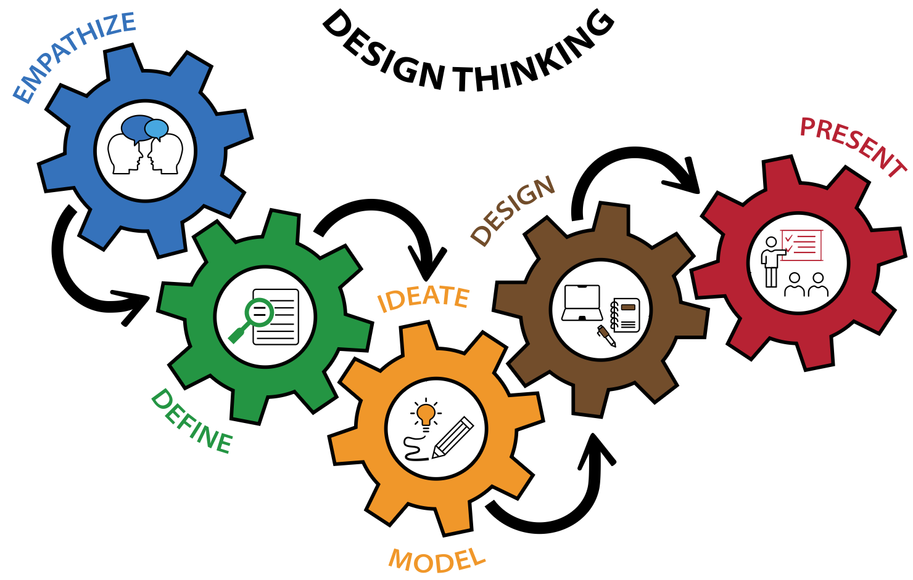
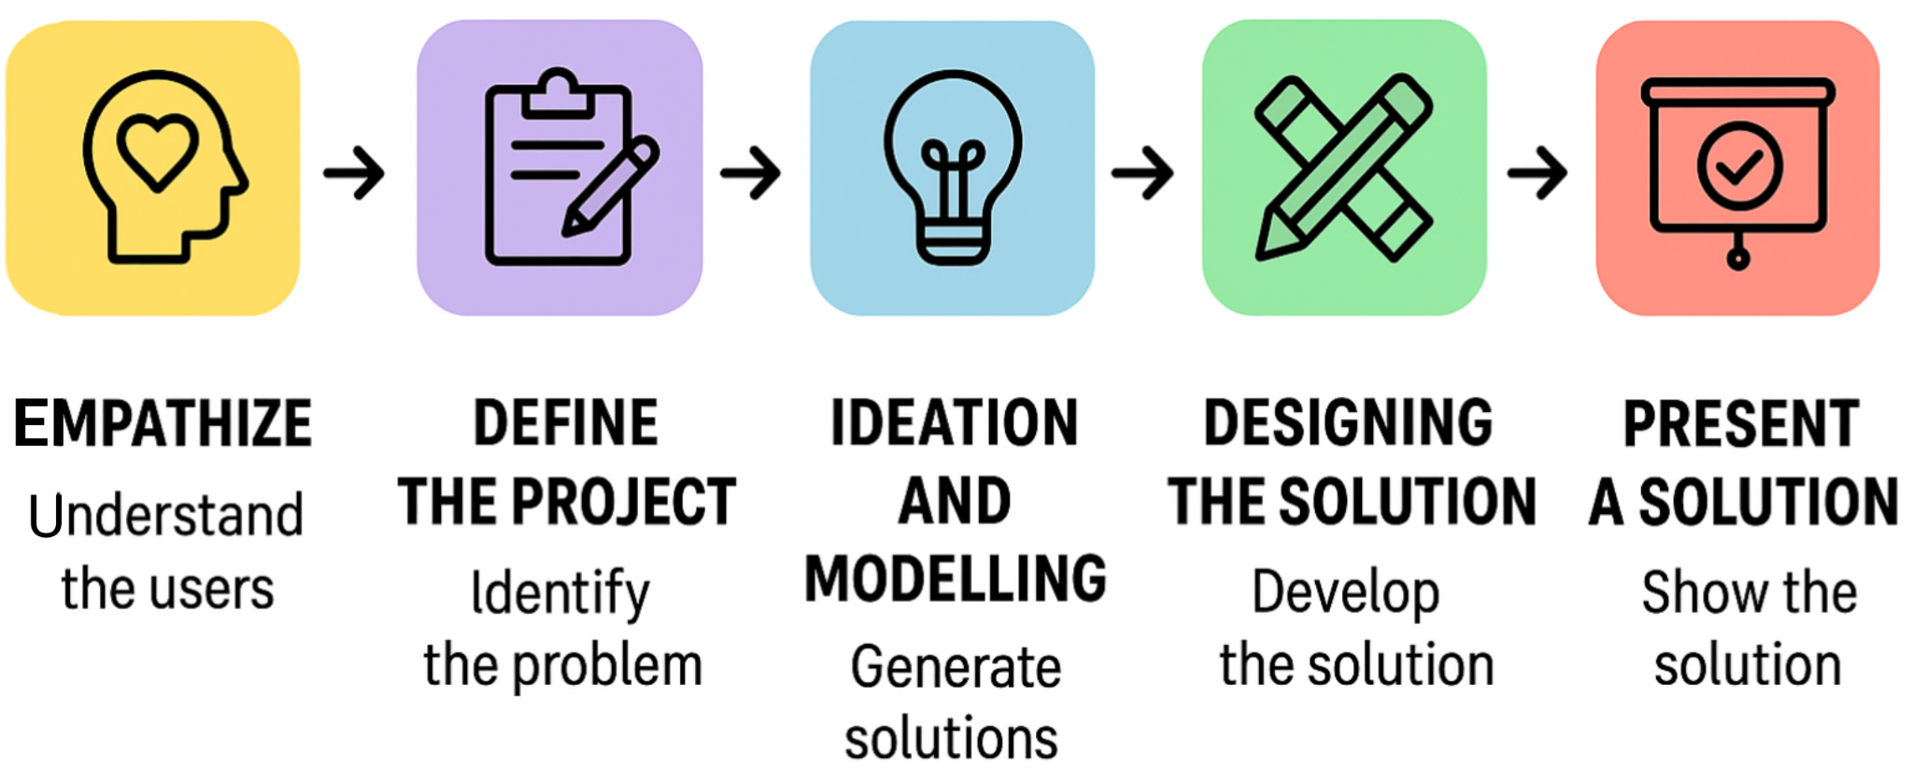
B 2.1.1 The design process represents a design thinking model and is comprised of five sections.
Design Thinking is a human-centred, flexible and iterative approach to problem solving. It emphasises understanding the needs and perspectives of intended users, generating creative ideas, making prototypes, testing, evaluating and refining solutions (see figure 1, which shows the design thinking process). This method encourages to revisit and repeat stages as needed, fostering flexibility and responsiveness to new insights or changes in project requirements. The iterative nature of the process enables continual refinement and improvement of the intended solution.
The Five Sections (Stages) of Design Thinking
Figure 1: The Design thinking process
1. Empathize
2. Define the project
3. Ideation and Modelling
4. Designing the solution
5. Present a solution

Slide 6
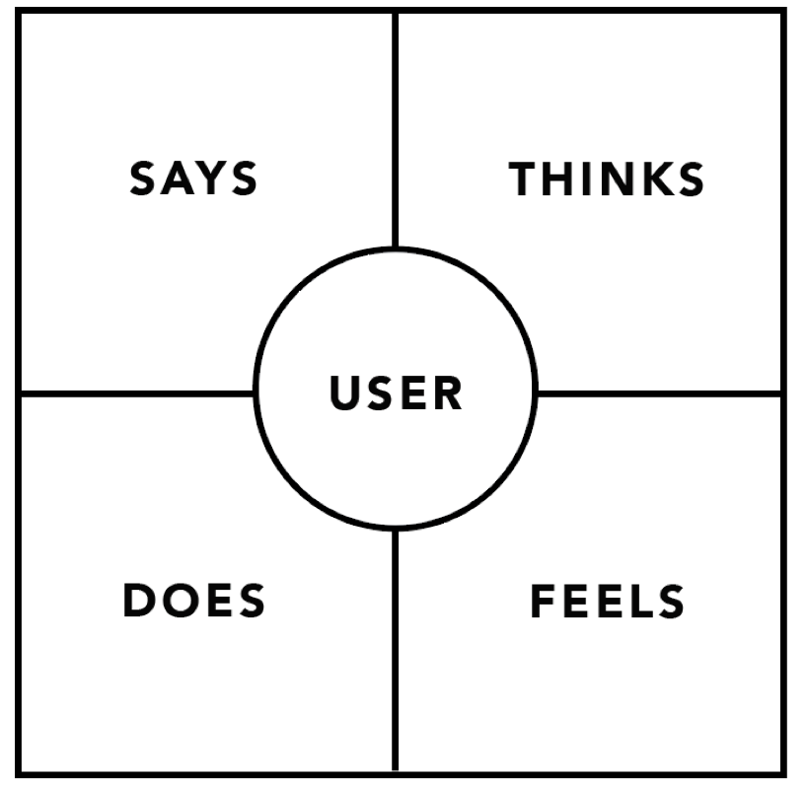
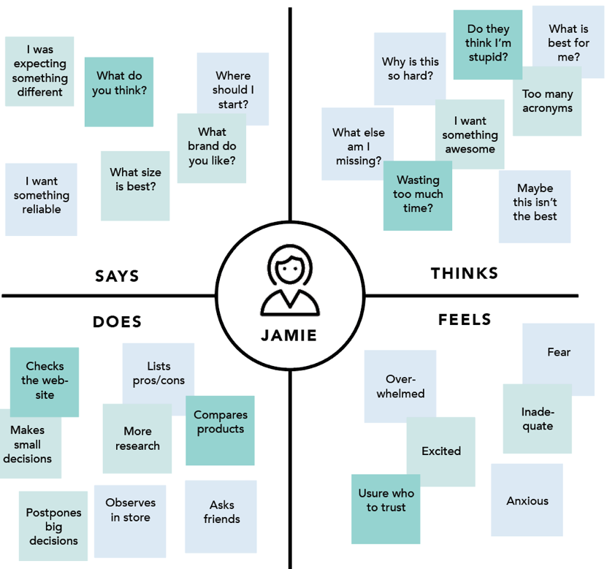
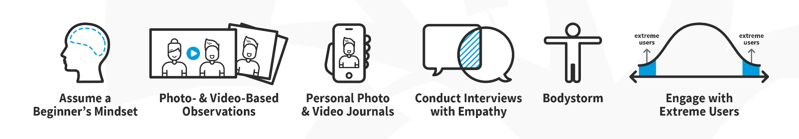
B 2.1.1 The design process represents a design thinking model and is comprised of five sections.
1. Empathize
Empathize is the first stage of the design thinking process, where designers seek to deeply understand the needs, emotions, and experiences of the end users. Instead of assuming what people want, designers actively observe, interview, and engage with users to gain real insights into their challenges and perspectives. For example, if a team is designing a new school bag, they might spend time talking to students, watching how they pack and carry their bags, and asking questions about pain points such as heavy loads or disorganized compartments. Similarly, when developing an app for elderly users, designers might observe how older adults interact with smartphones, noting difficulties like small icons or complex navigation. By empathizing, designers uncover hidden needs—such as comfort, accessibility, or emotional connection—that lead to more human-centred and meaningful solutions.
Empathy Map
To empathize means to understand users' needs, thoughts, and feelings by interviewing, observing, engaging with them, and setting aside personal assumptions to gain deep insight into their world.
Capture insights (what people say, feel, do) to inform later stages.

Slide 7
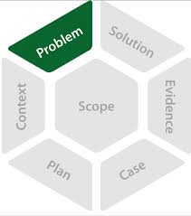
B 2.1.1 The design process represents a design thinking model and is comprised of five sections.
2. Define the project
In the Define stage, insights from the empathize phase are synthesized into a clear problem statement or design challenge. Instead of framing the issue broadly, the designer articulates it in a focused way that guides ideation. For example, after studying students’ struggles with heavy school bags, the defined problem might be: “How might we design a lightweight, organized, and durable bag that reduces strain on students’ backs?” A strong definition gives direction and criteria for success.
• synthesize quantitative and qualitative research data findings
• present the context of the problem
• define the user needs and impact.
This stage of the design process focuses on problem-solving and innovation. Based on research and analysis generated in the empathize phase, students synthesize user-centred solutions.

Slide 8
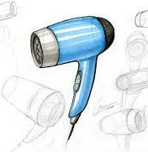
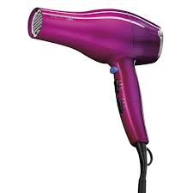
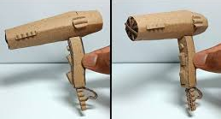
B 2.1.1 The design process represents a design thinking model and is comprised of five sections.
3. Ideation and Modelling
Ideation focuses on generating a wide range of creative solutions to the defined problem. Designers use brainstorming, sketching, and mind-mapping to think beyond obvious answers and explore diverse possibilities. For example, in rethinking a cafeteria tray, ideas could range from collapsible trays to smart trays that track nutrition. The aim is to push past initial assumptions, explore both practical and wild ideas, and then filter the most promising ones for further development.
Graphic model
Designers use appropriate informal or formal sketches or drawings and digital or physical fidelity modelling to communicate their ideas visually. The process of sketching or drawing design ideas involves an informal or formal approach that must address the key opportunities identified through the exploration of the persona and the task analysis.
CAD model
Physical model
Generate a diverse set of feasible ideas (ideation) that ultimately arrive at a design solution (modelling). After establishing the design opportunity, primary persona, problem statement and design specifications, students engage in ideation and modelling to explore a range of potential solutions.

Slide 9
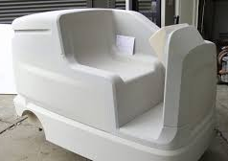
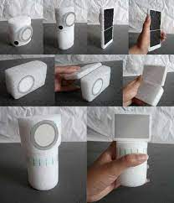
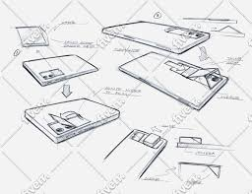
B 2.1.1 The design process represents a design thinking model and is comprised of five sections.
4. Design the solution
In the design of a solution, designers respond to the problem statement to create, test and refine a high fidelity concept prototype or working model of their final proposal. This should capture the essential features of the proposed redesigned solution. Designers focus on functionality, aesthetics, and usability while testing and iterating based on the feedback.
This stage checks whether the solution truly solves the problem, is easy to use, and meets user needs. For example, if developing a fitness app, the prototype could be tested with athletes to see if navigation is intuitive and features are helpful. Insights from testing often lead to refinements or even revisiting earlier stages, making it an iterative process that strengthens the final design.
Designers employ a range of modelling and testing strategies to develop and refine their idea, ensuring the product meets the design specification requirements and intended users’ needs. high-fidelity models which can be tested against multiple aspects of the design specifications, offering a more comprehensive evaluation of the selected idea with end-user feedback to aid the development stages towards a solution.
Formal design drawings are produced to represent the design solution. These should include
assembled, exploded and orthographic details, including components, intended to communicate the
drawings accurately to a third-party manufacturer.

Slide 10
B 2.1.1 The design process represents a design thinking model and is comprised of five sections.
5. Present a solution
Presenting an annotated solution and its key features is the final stage of the design process. The solution reached should be the best version of the redesigned product with appropriate enhancements.
Designers present the intended solution to a third-party manufacturer using appropriate visual communication methods, which can be created by hand or by computer-aided design (CAD). The presentation showcases the product’s features and may include perspective, exploded, assembly, orthographic, net development, cutaway views and finite element analysis (FEA), etc. It can include a range of presentation styles featuring concise annotations to highlight different key features of the redesigned product and provide multiple perspectives of the solution.
Highlight the annotated key features of the redesigned product. These could include, for example, aesthetics, form, functionality, dimensions, components, materials, manufacturing processes, user experience and other relevant aspects.

Slide 11
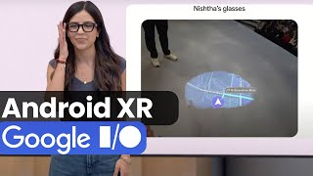

Why do some products fail even though they look good
What do you think went wrong with this design?
What could the designer have done differently before making the product?

Slide 12
A school locker redesign
A water bottle for elderly people
An app to reduce food waste in a cafeteria
A chair for long video calls
Come up with 3 questions they would ask users (qualitative research)
Think of 2 types of data they could collect (quantitative research)
Identify how they might find this data (primary or secondary sources)

Slide 13
Feature | Quantitative Data | Qualitative Data
Format | Numbers | Words
Type of question | “How many?”, “How much?” | “Why?”, “What do you think?”
Collection methods | Surveys, sensors, tools | Interviews, observation
Use in design | Measure/test performance | Understand user experience

Slide 14
B 2.1.2 Research is an ongoing activity throughout the design process, critical to identifying design opportunities, understanding user needs and generating feasible real-world solutions to problems.
Research provides the foundation for creating solutions that are relevant, effective, and user-centred. It helps designers move beyond assumptions by uncovering real user needs, preferences, and problems through evidence-based insights. Research also highlights constraints such as cost, materials, and environmental factors, ensuring designs are practical and feasible. By studying existing products, market trends, and emerging technologies, designers can avoid repeating past mistakes and identify opportunities for innovation. Ultimately, by using the research data, designers can make informed decisions that enhance usability, functionality and overall user satisfaction.
Research Methodologies in Design
1. Primary Research
Collecting new, first-hand information directly from users, clients, or environments. To gather original data that reflects real user needs, behaviours, and experiences.
Primary research methods:
Interviews
Surveys & questionnaires
Focus groups
Observations / field studies
User testing / experiments
Example: Interviewing students to understand their difficulties with heavy school bags.
2. Secondary Research
Gathering existing information that has already been collected, analysed, or published by others. To build background knowledge, explore existing solutions, and identify gaps or opportunities.
Secondary Sources:
Books, academic journals, reports
Market research databases
Case studies
Online articles, videos, blogs
Patents and product reviews
Example: Studying market reports on ergonomic furniture before designing a new office chair.

Slide 15
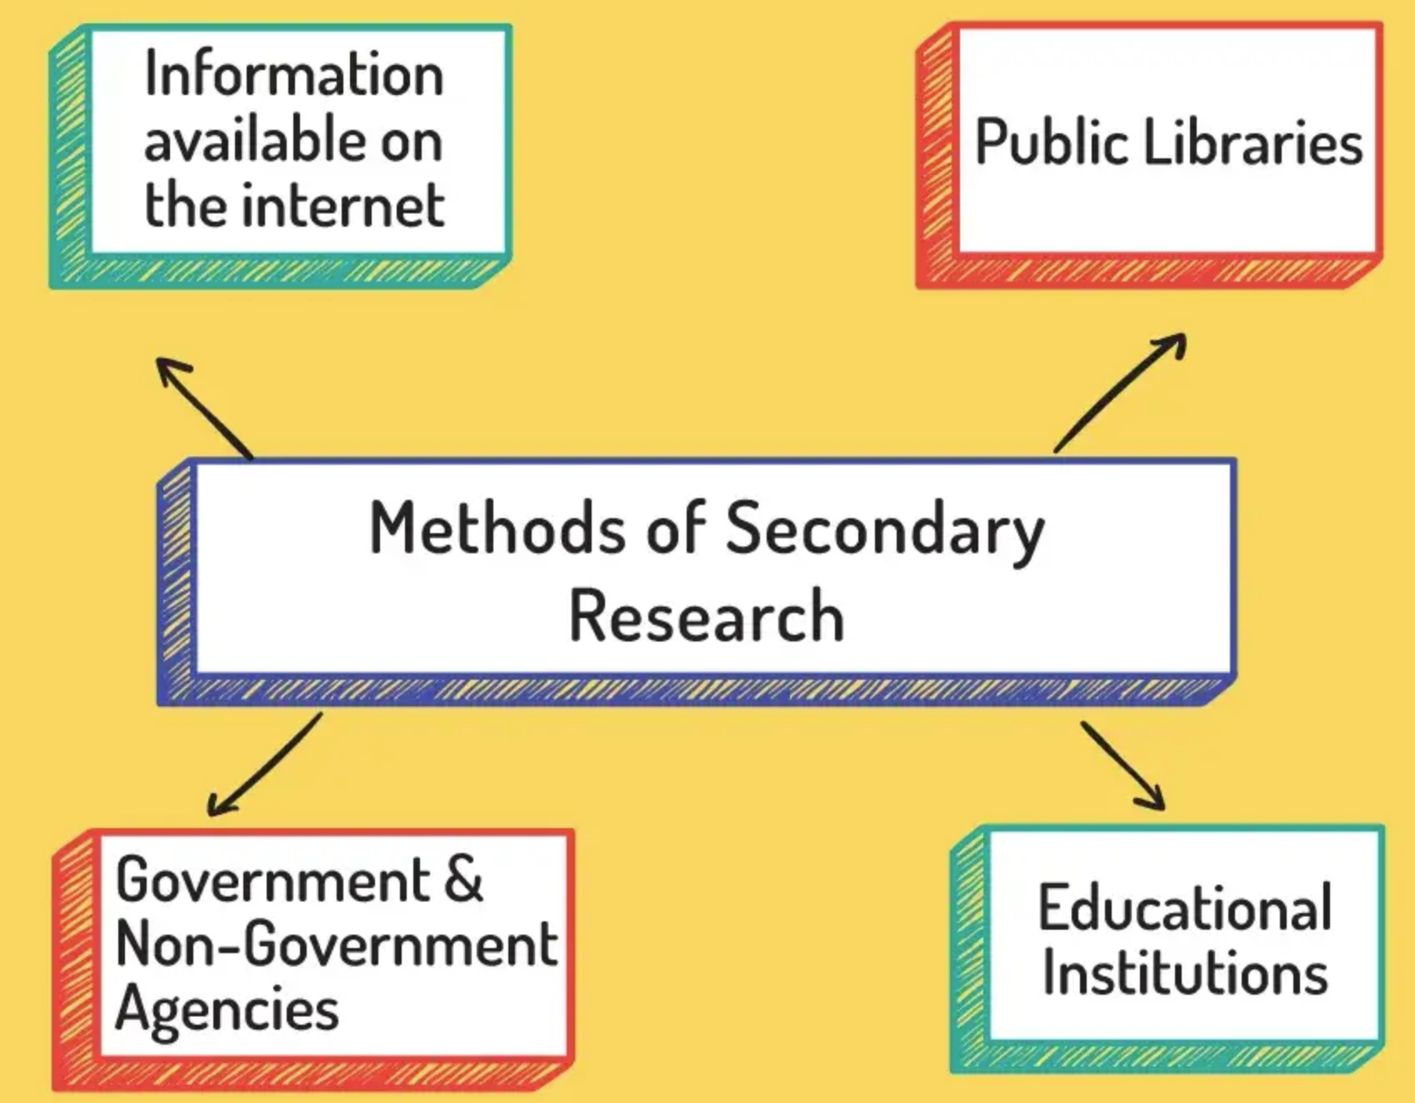

Slide 16
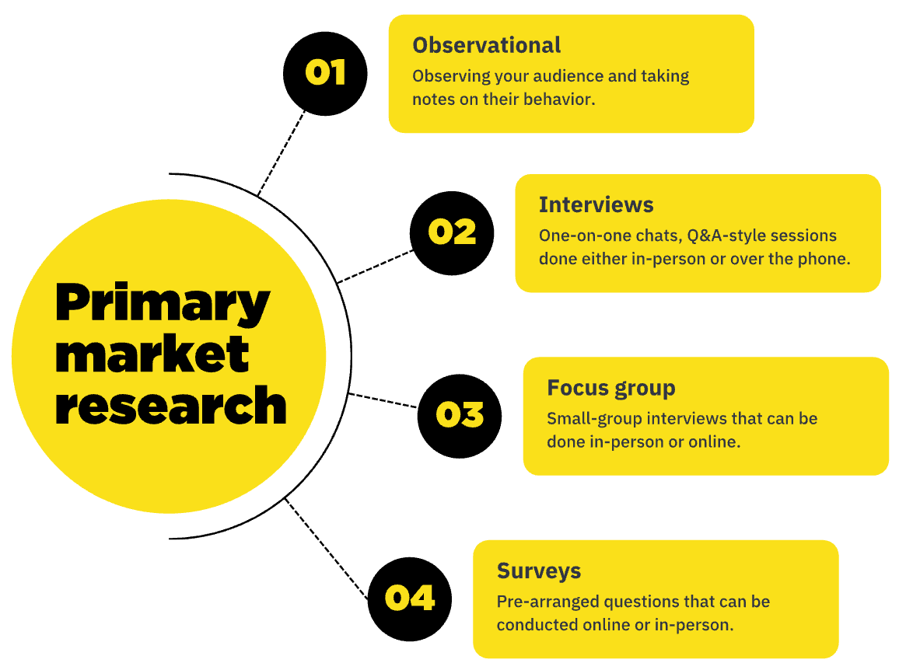
B 2.1.3 Primary research involves the collection of first-hand data relevant to the design context.
Collecting first hand data directly relevant to the design context.
Methods of Primary Research:
User Observations – Watching users interact with products or environments to identify pain points and usability issues.
User trials- Test a design with real users performing specific tasks to identify design issues and validate solutions
Interviews – Direct conversations with users to gain qualitative insights into their needs, challenges, and expectations.
Surveys & Questionnaires – Structured methods for collecting quantitative and qualitative data from a larger audience.
Focus Groups – Group discussions that explore user opinions, preferences, and feedback on design concepts.
Materials Testing – Evaluating the performance, durability, and suitability of materials for a product.
Product Analysis – Examining existing products to assess strengths, weaknesses, and opportunities for improvement.
Primary research is the collection and analysis of original information and data from the focus groups, target audiences, individual people or organisations perceived as the actual intended market for the product, system or service.
Primary research:
User trails.
User research.
Field trials.
Product analysis.
Observation.

Slide 17

B 2.1.4 Secondary research involves the collection of data provided by a third party and is used to support or validate primary research.
Secondary Data Research is the process of gathering and analyzing information that has already been collected, published, or recorded by others. Instead of collecting new data directly from users (like in primary research), secondary research relies on existing sources.
Examples of secondary data sources:
Books, academic journals, and articles
Government reports and statistics
Online databases and websites
Company reports, annual reviews, and market research studies
Newspapers, magazines, and media publications
Secondary research helps students understand background information, market trends, existing solutions, user demographics, and competitor analysis before developing new ideas.

Slide 18
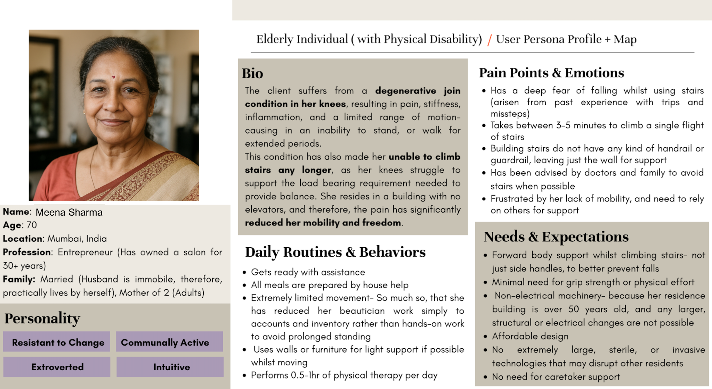
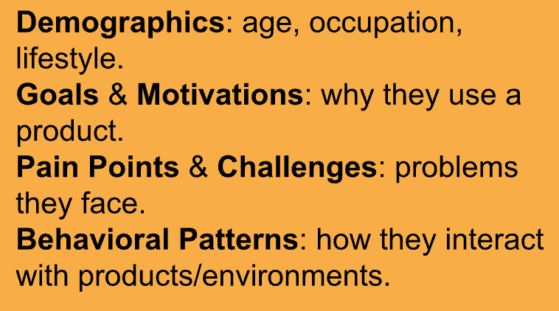
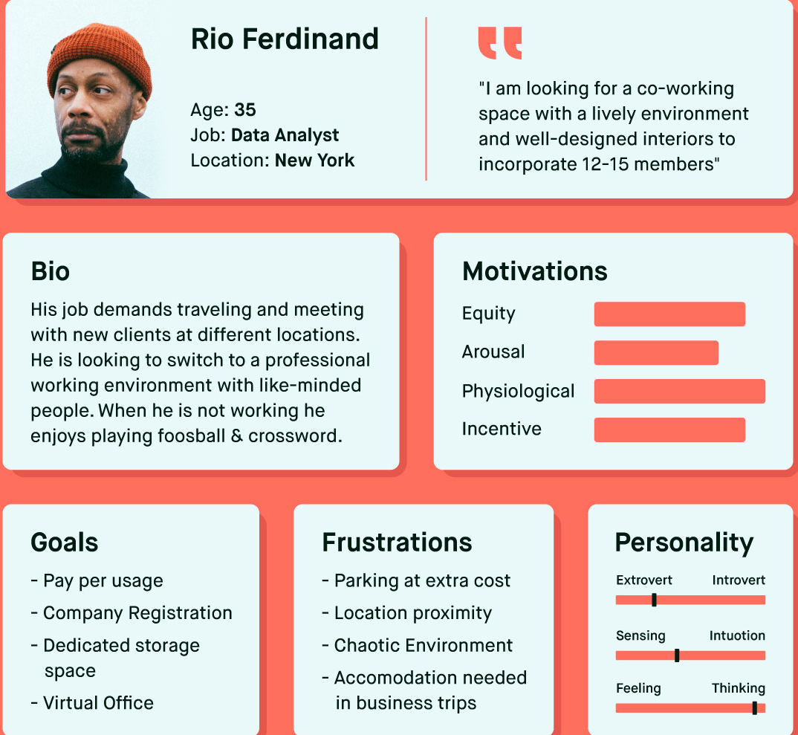
B 2.1.5 When empathizing with the user, designers develop a persona used to represent a group of end-users they are solving a problem for.
A persona is a fictional, yet research-backed, representation of a target user.
It's not a real person, but rather a composite character created to help designers understand and empathize with the needs, behaviors, and motivations of their users.

Slide 19
Primary and Secondary Persona
B 2.1.5 When empathizing with the user, designers develop a persona used to represent a group of end-users they are solving a problem for
A primary persona is the main, core user for whom a product is designed, embodying the most critical needs and goals.
A secondary persona represents a significant but less central user whose needs are also met by the product but may not be the primary focus of design and development efforts.
Example: To design a hospital bed
Primary Persona : Patient
Secondary Persona : Nurse, Doctor.

Slide 20

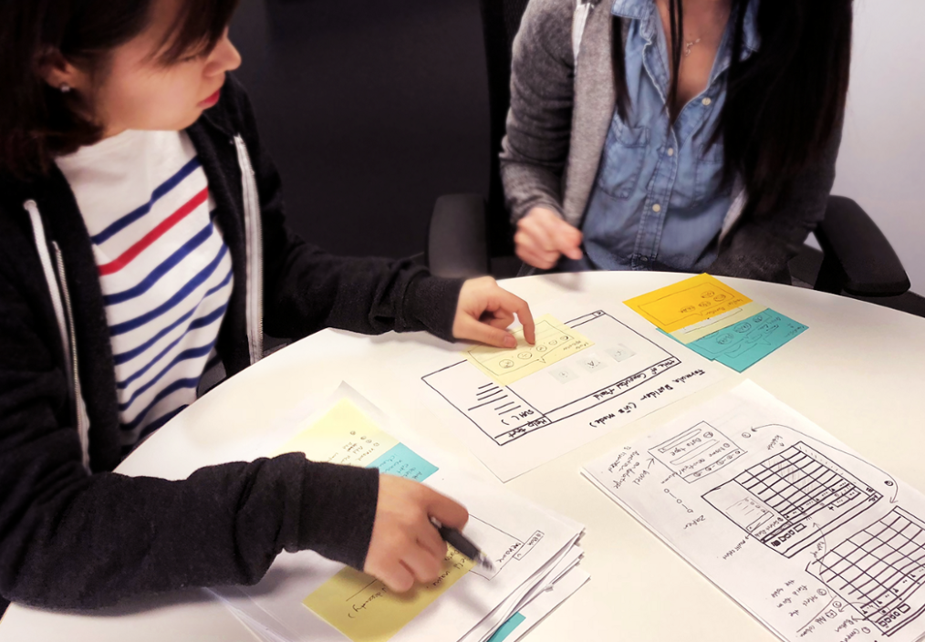
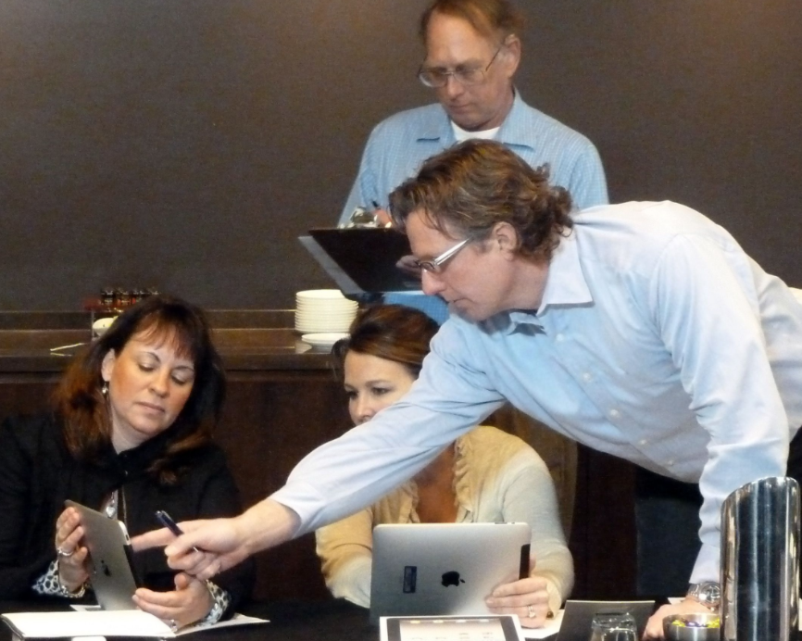
B 2.1.6 Designers engage in user observation, mapping the user’s journey as they carry out a task. They use a storyboard to identify the steps in the design process and design opportunities.
A User trial is the observation of people using a product and the collection of comments from who have used the product. In user observations a person's behaviour is often emphasised rather than concentrating on the collection of their comments. You can observe a person using a product and not ask for comments, this would still be a user trial.
Users can be given products to test over a period of time. This is often done as part of commissioning new products or redesigning an old product. Manufacturers obtain feedback from users to see if the design or existing product meets the needs of that target market. The manufacturers can then identify and rectify any problems with the product before full blown production goes ahead and the product enters the market.
User trials usually create quantitative data collected by questionnaire or interview if you require more qualitative data. User trials are classed as primary sources of data collection. User trials and observations are useful and appropriate for gaining information on ease of use (ergonomics), performance, price, and aesthetics. The usability of the products can be tested, to find out how its used and abused in a real world context. Users can identify strengths and weaknesses in a product. Usually requires a real product.

Slide 21
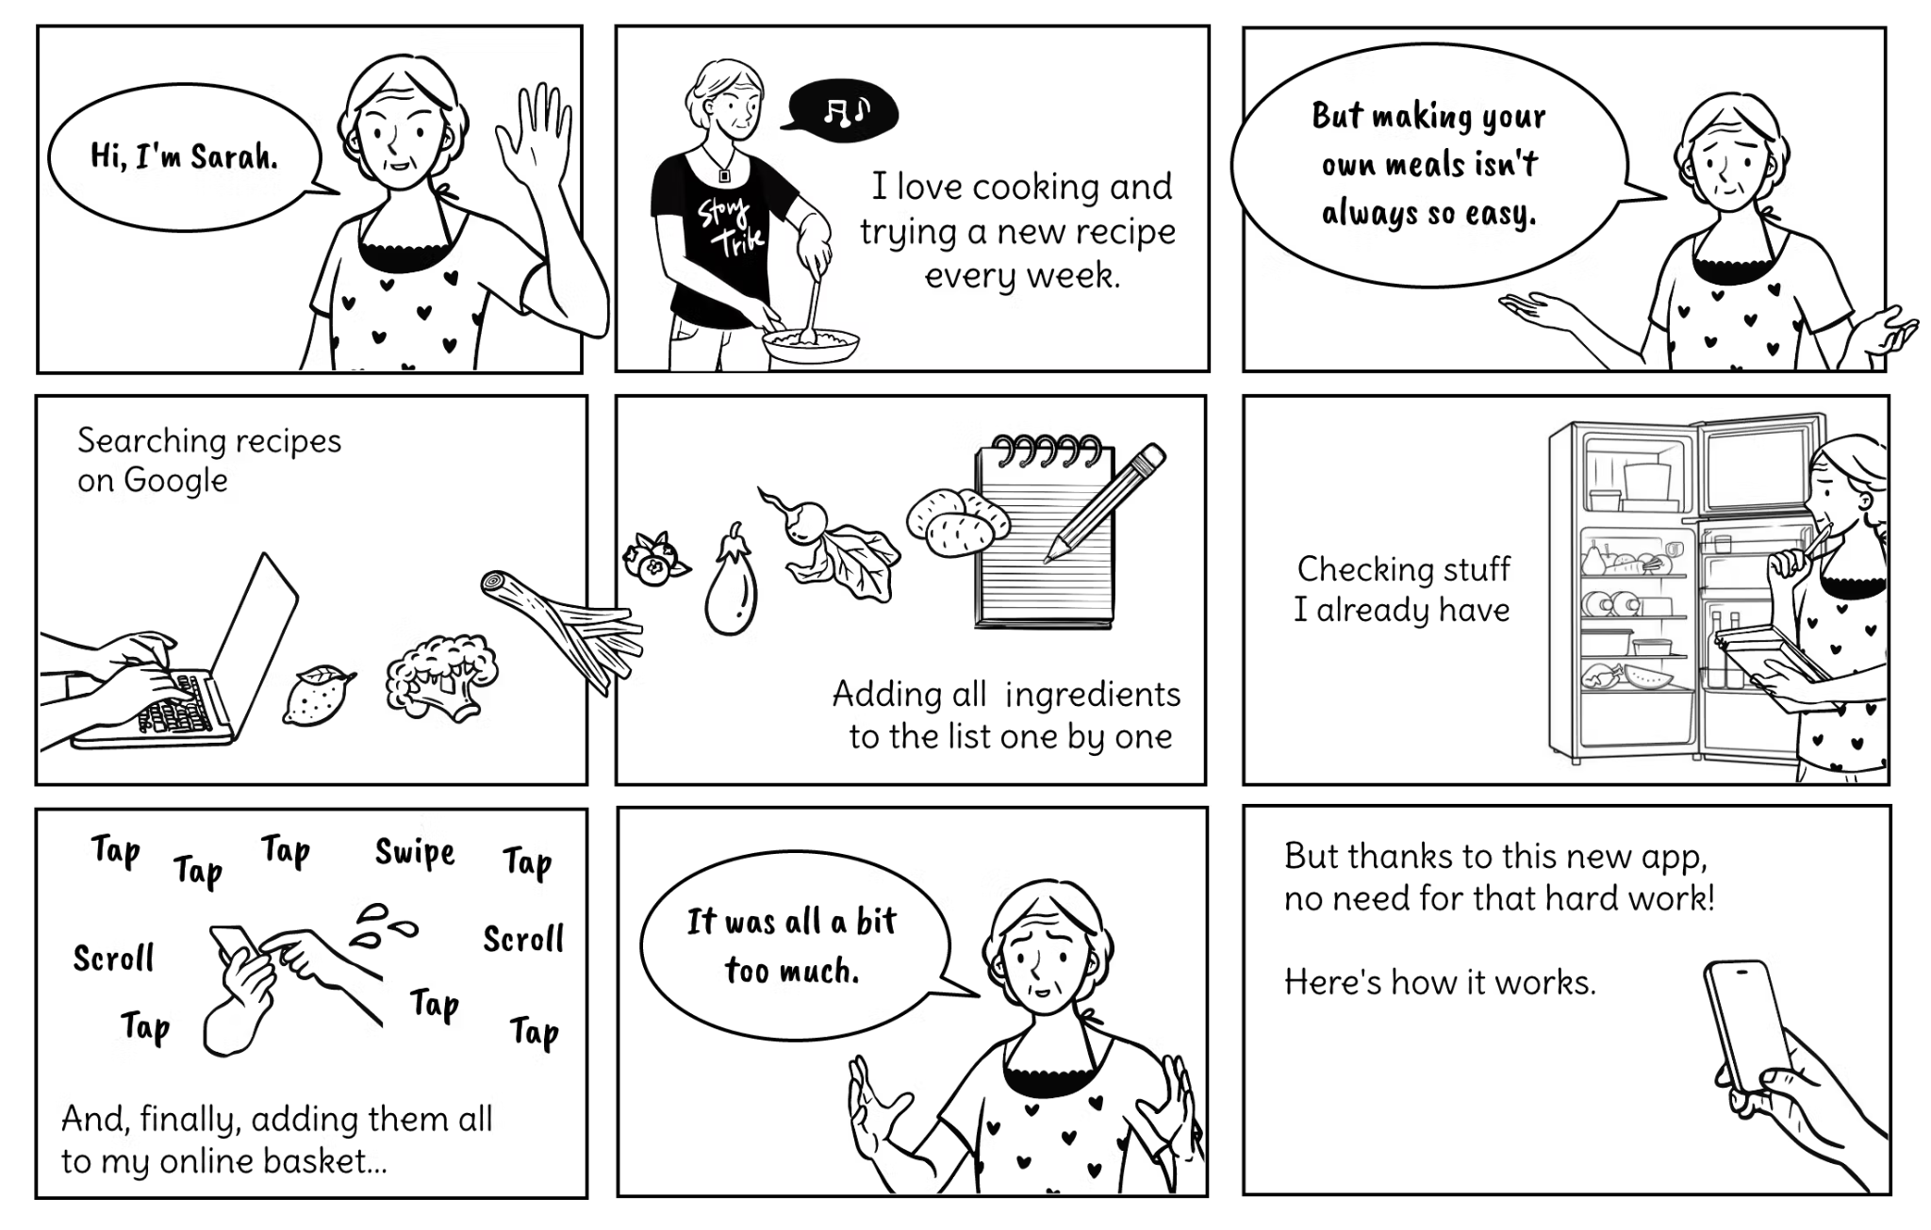
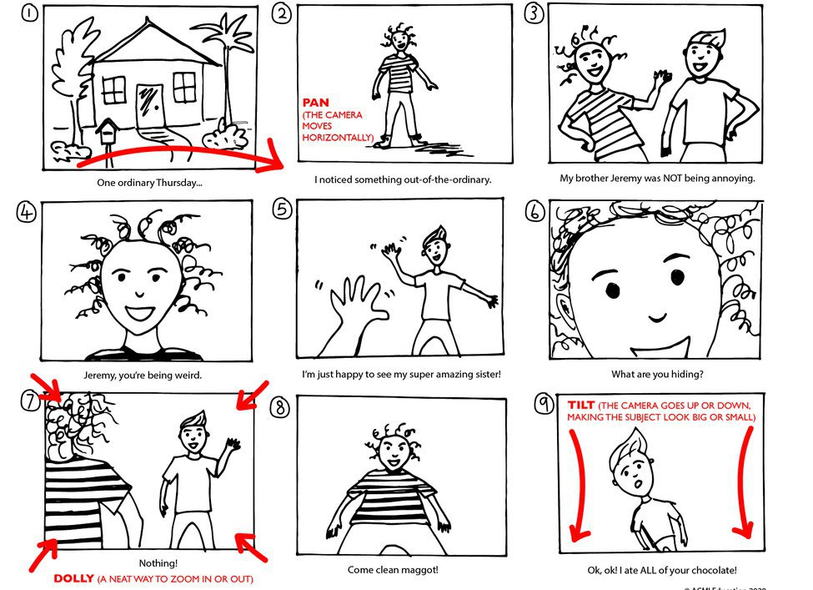
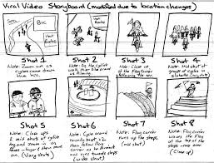
B 2.1.6 Designers engage in user observation, mapping the user’s journey as they carry out a task. They use a storyboard to identify the steps in the design process and design opportunities.
A storyboard explains the problem by showing the user’s experience and justifies the need for a design solution by highlighting the difficulties and consequences.
It shows the user’s journey, struggles, and needs in a sequence of sketches or frames.
A storyboard visually represents the user's experience step by step, helping designers understand how users interact with a product or service. It typically includes scenes that depict each stage of a task, illustrating the actions users take and the decisions they make along the way. By mapping out these interactions, designers can identify moments where users face challenges or obstacles. These challenges could include confusion, frustration, or inefficiencies in the process. Additionally, the storyboard helps highlight potential areas for design improvements, ensuring that solutions align with real user needs.

Slide 22
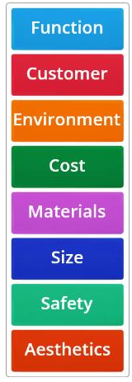
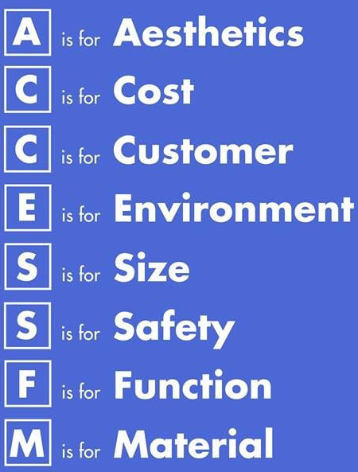

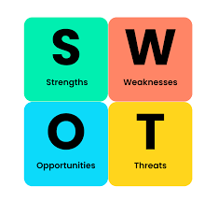
B 2.1.7 Product analysis is a tool used by designers to gain insight into the function, performance and features of an existing product.
Product analysis is used by designers to evaluate existing products in terms of function, performance and features. It helps identify strengths and weaknesses, understand user needs, and gain insights into market trends. This information supports informed decision-making and inspires innovation for improved or new product development. Designers examine factors such as usability, materials manufacturing processes, ergonomics, aesthetics and sustainability.
Product analysis is a research and evaluation tool that guides designers to create products that are functional, user-friendly, performs, and has features which are required by the user.

Slide 23
B 2.1.8 The first step in solving a problem is to define it.

Slide 24
B 2.1.9 Defining clear design specifications leads to clear parameters for the development of a solution.

Slide 25
B 2.1.10 The ideation and modelling stage involves developing distinct ways to solve a particular problem that demonstrate different approaches to develop a solution.

Slide 26
B 2.1.11 Iterative analyses and evaluation of design ideas lead to improved design ideas.

Slide 27
B 2.1.12 When developing a solution, designers use an iterative model, test, refine cycle until all major design specifications and user requirements are satisfied.

Slide 28
B 2.1.13 Models, prototypes and mock-ups of solutions are created to test their effectiveness and to
gather feedback for further refinement and development.

Slide 29
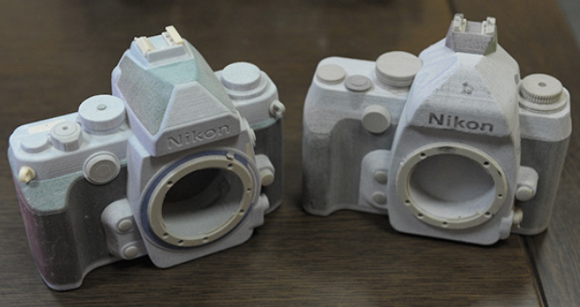

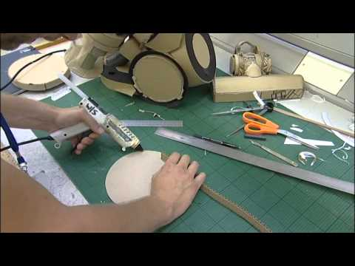
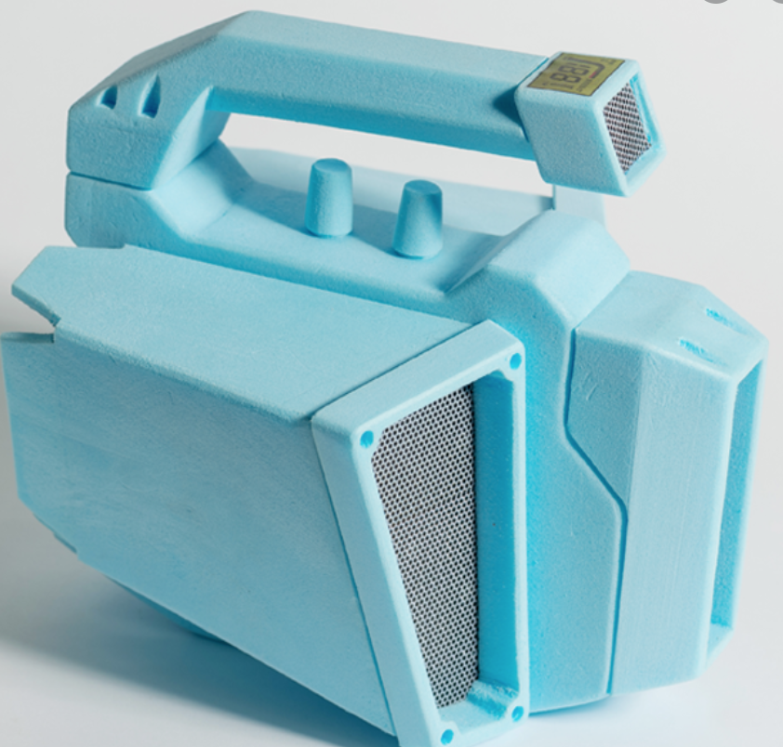
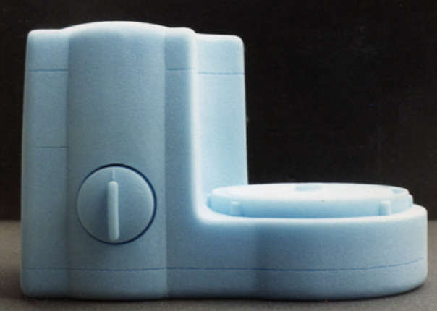
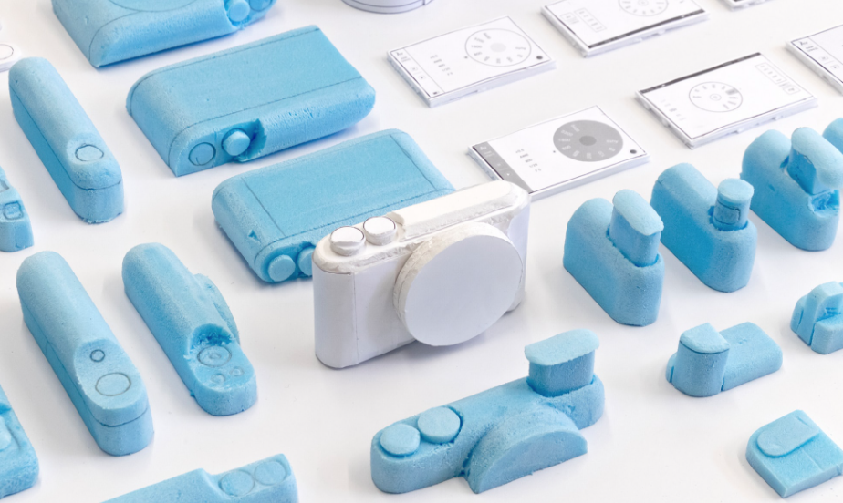
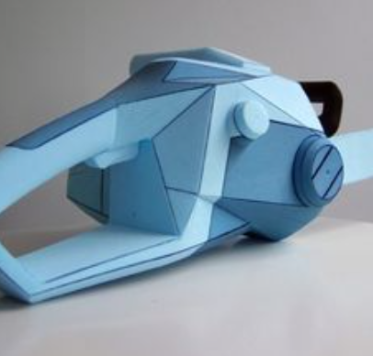
B 2.1.13 Models, prototypes and mock-ups of solutions are created to test their effectiveness and to
gather feedback for further refinement and development.
Physical models allow for visualisation of an idea by examining a model and getting feedback from actually handling it. A physical model can be used obtain important data such as test and simulation measurements. Modeling of a physical object allows the user to better understand the problem and presents a means for manipulating the object in order analyse it full and get constructive feedback. Physical models can also be quickly and easily altered and modified to react to feedback.
3D physical models.
Some great advice on designing.
3D prototyping - Dyson.
Blue styrofoam is a common material for physical modelling.

Slide 30
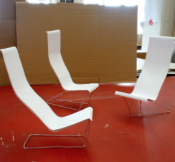
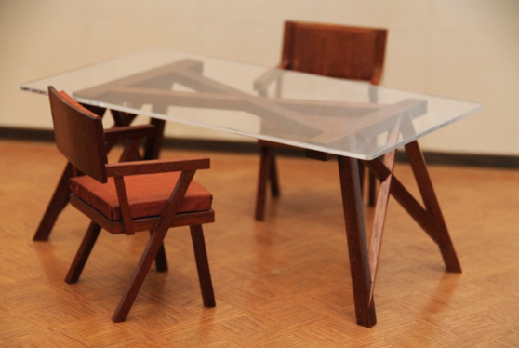
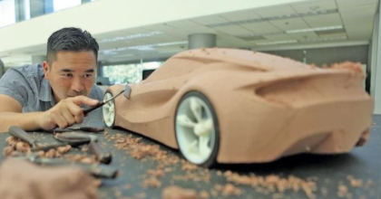
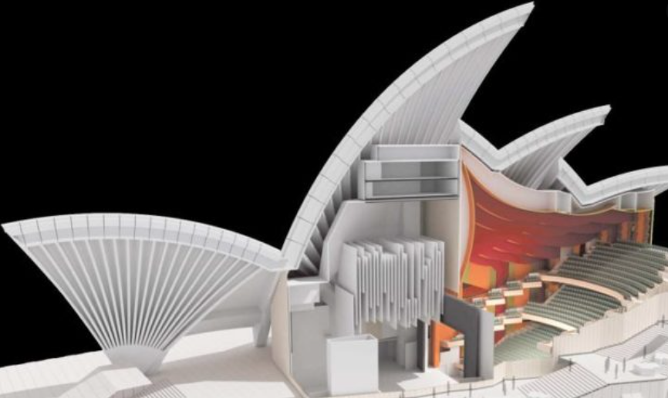
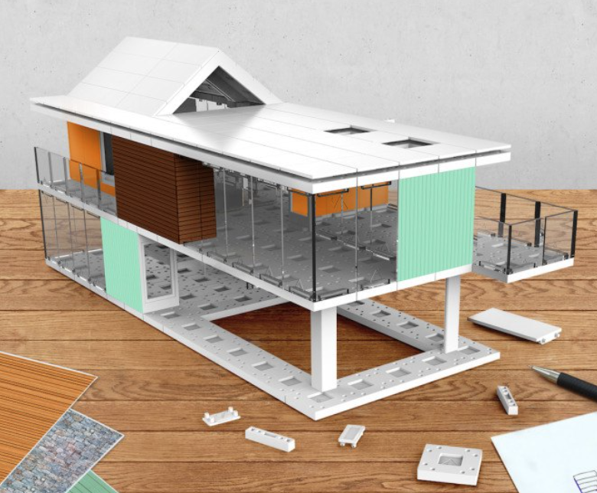
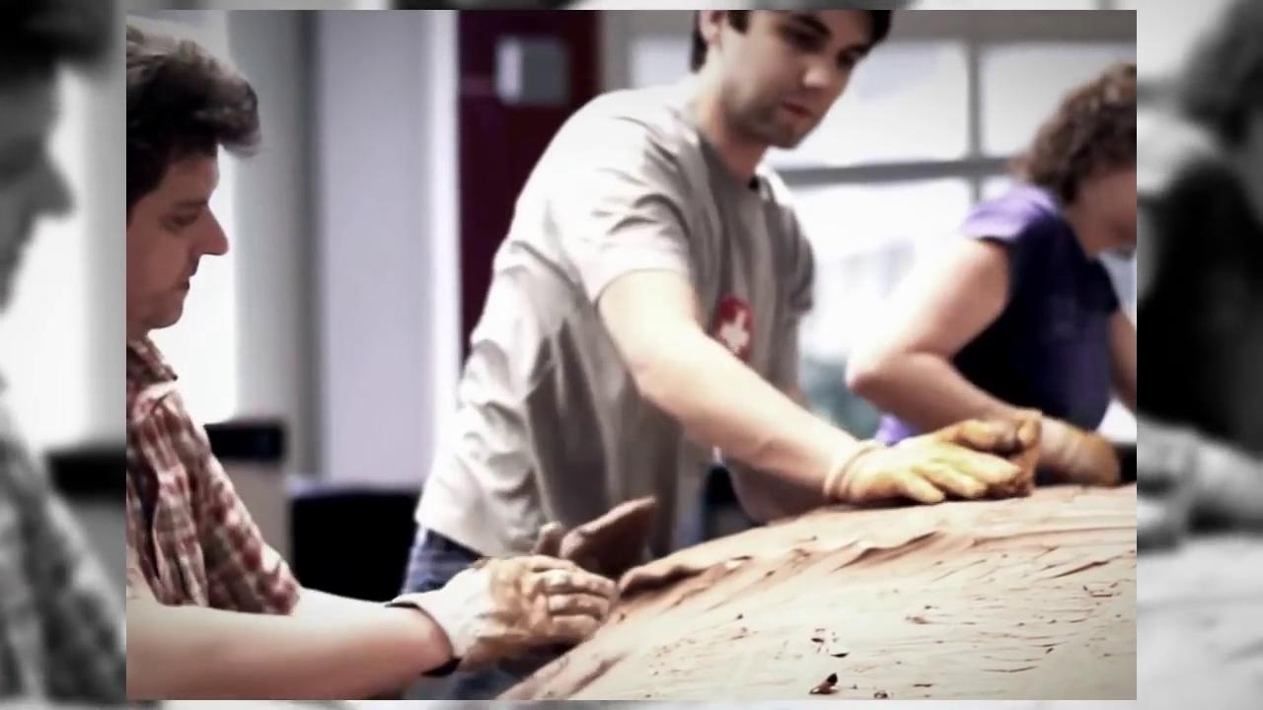
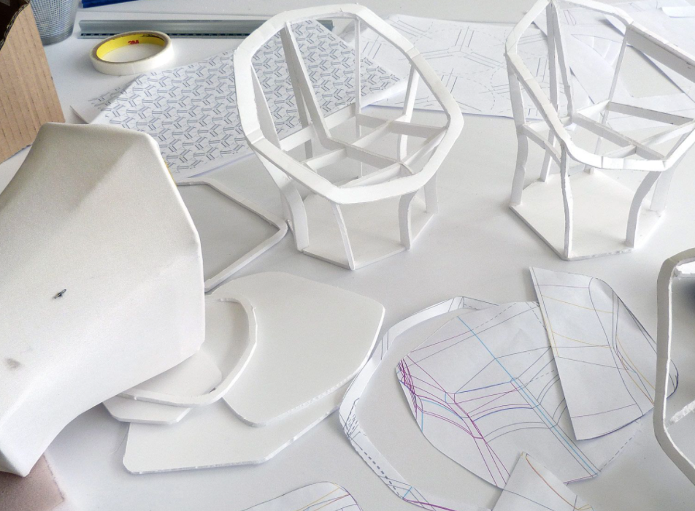
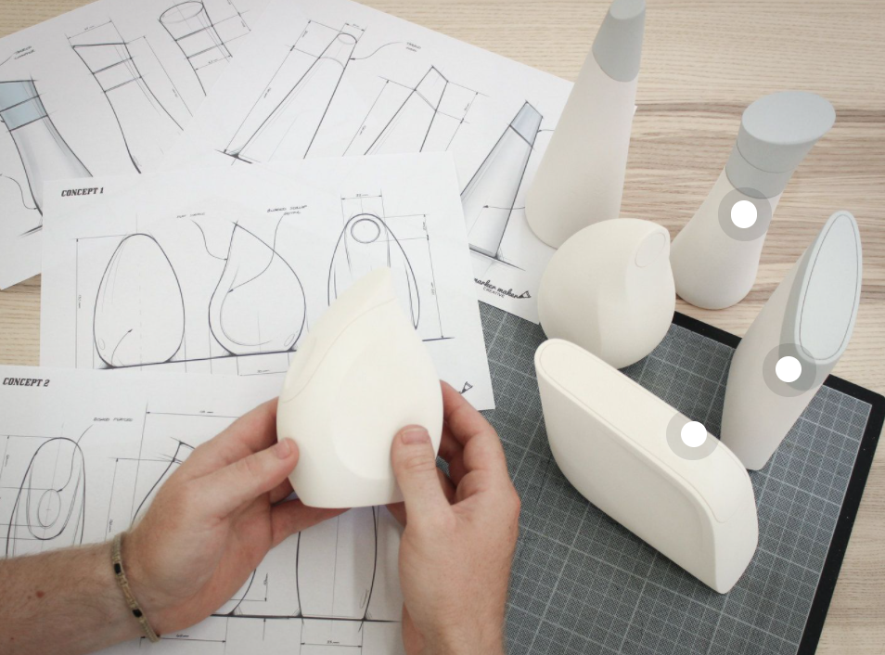
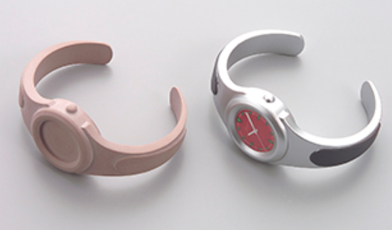
B 2.1.13 Models, prototypes and mock-ups of solutions are created to test their effectiveness and to
gather feedback for further refinement and development.
A scale model is a smaller or larger physical copy of an object. Scale models allow the design ideas to be visualised, and direct feedback to given. A good example of the use of scale models can be seen in architecture. A full size building is modelled by greatly reducing the scale. This enables designers, and clients to visualise the structure of the building, but also the exterior and interior aesthetics and lines. Unforeseen factors can be highlighted, and modifications can easily be made before going to full scale production.
Small scale furniture models.
Small scale clay models.
Small scale models are generally used to express and idea or look at the overall aesthetics and proportions of the product. They are used for a number of products and purposes, but tend to be low fidelity and do not going to great detail about construction methods or use the exact materials of the final product. Small scale modelling can be a fast method to develop design ideas, or they can be something far more sophisticated and expensive like an architectural model that is used to communicate design thinking, specific ideas or aesthetic issues.
Architectural models.
The car industry utilises a large number of different types of modeling, small scale, large scale, physical and digital. This video shows how BMW goes through their design and development process. How many different types can you see?

Slide 31
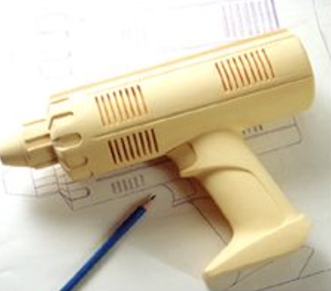
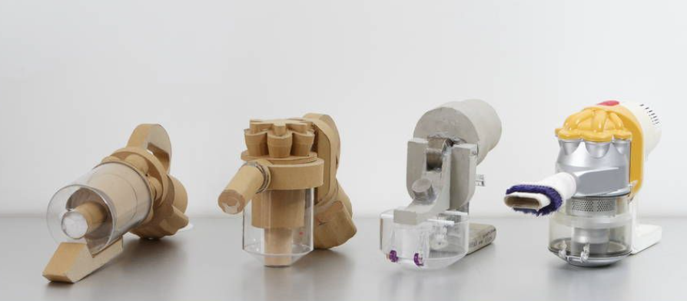
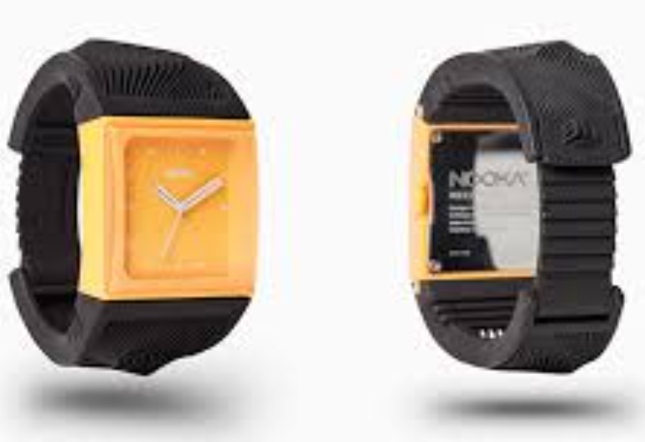
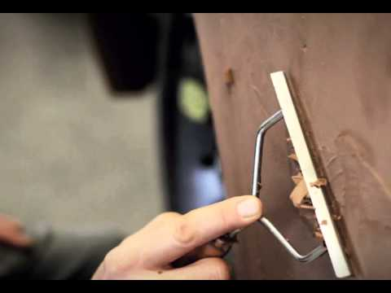
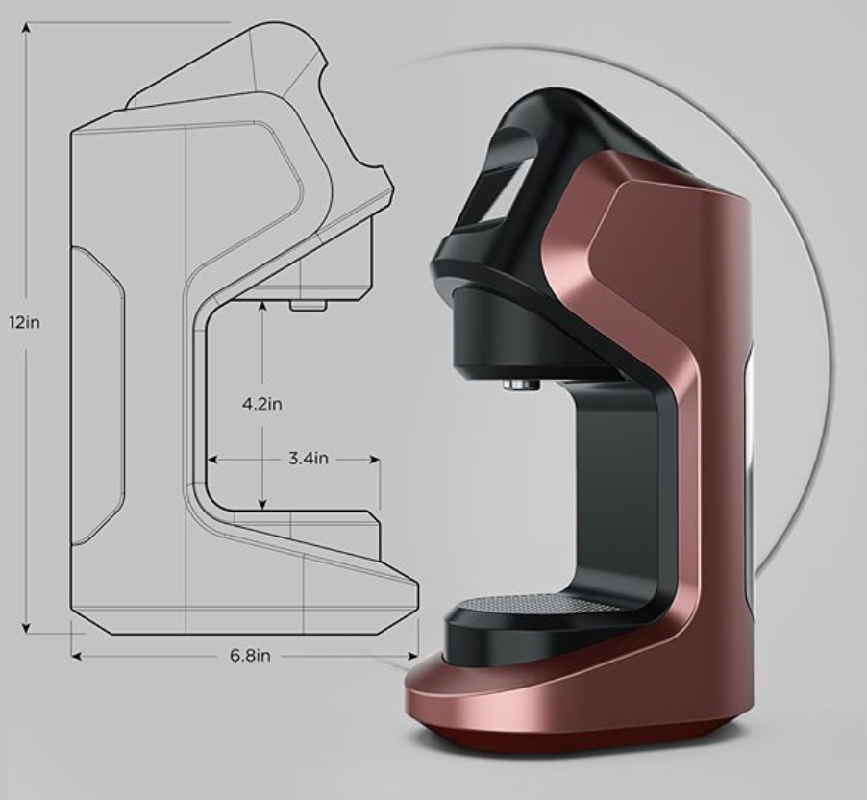
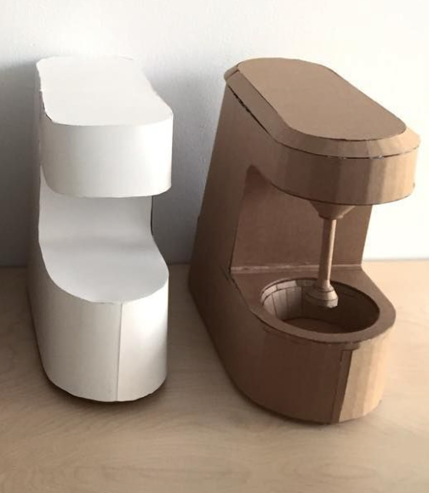
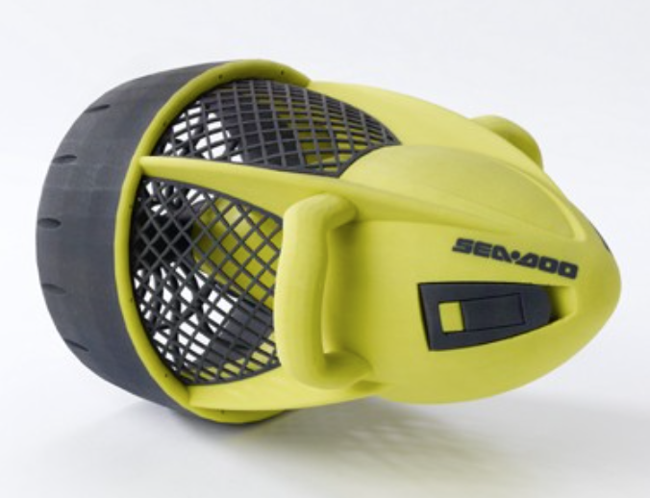
B 2.1.13 Models, prototypes and mock-ups of solutions are created to test their effectiveness and to
gather feedback for further refinement and development.
Aesthetic models are developed to look and feel like a true representation of the final product. They are used for many purposes including ergonomic and visual appeal. Aesthetic models do not function, they are not prototypes. Aesthetic models look like the final product, but do not work as the final product would. Aesthetic models can be relatively simple, consisting of chunks of foam, finished and painted to look like the real thing. They can also be more sophisticated, simulating weight, balance and material properties - obviously these types of aesthetic models would be more expensive and time consuming to produce.
Usually, aesthetic models are ‘for show’ and are not designed to be handled excessively. They give non-designers a good representation of the feel and look of a product. Aesthetic models can be expensive to produce, as they need to have a good surface finish and be life size. They allow the designer, user and manufacturer to visualise the design and provide feedback. They are non-working models and only really show how an object will look.
The car industry extensively uses aesthetic models.

Slide 32
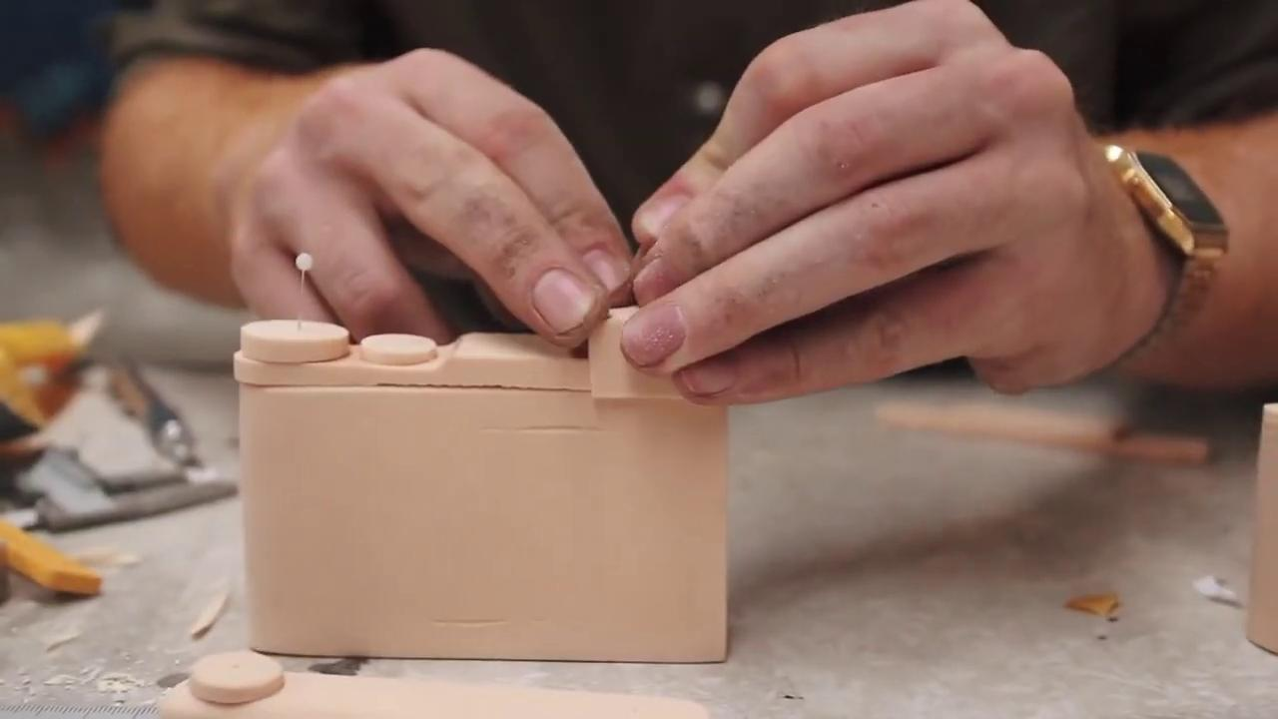



B 2.1.13 Models, prototypes and mock-ups of solutions are created to test their effectiveness and to
gather feedback for further refinement and development.
Mock-ups are commonly used by product designers, architects and engineers. The intention is often to produce a full size replica, using inexpensive materials in order to verify a design.
Mock-ups are often used to determine the proportions of the piece, or to fit it into a specific space or room. The ability to see how the design relates to the rest of the space or other components is an important factor in determining critical sizes and design elements.
When designing a functional product, such as a household device, mock-ups can be used to test whether they suit typical human shapes and sizes. Designs that fail to take these into consideration may not be practical to use. Mock-ups can also be used to test colour, finish, and design details which cannot be visualised from the initial drawings and sketches. Mock-ups used for this purpose can be reduced or enlarged in scale.
The cost of making mock-ups is often more than repaid by the savings made by avoiding going into production with a design which needs improvements.
Foam modelling is a cheap and quick way to make mock ups.
Full size mock up.
A mock-up can be scale or full size model, used for teaching, demonstration, design evaluation, promotion, and other purposes.
Dyson mock ups - used as part of their design process.
Dress making mock up.

Slide 33







B 2.1.13 Models, prototypes and mock-ups of solutions are created to test their effectiveness and to
gather feedback for further refinement and development.
Mock-ups are used to test ideas, and they are usually used in the early stages of prototyping a design. They are scale or full-size representations of a product to gain feedback from users. A mock-up can be considered a prototype if it includes some functionality.
Mock-ups are part of the prototyping process, this video shows how a functional mock up is made.
2D models:
exploring the configuration of the mechanisms.
Example: Once the design team decide which direction to take with respect to the rocker, crank mechanism, they use 3D modelling (functional mock-ups) to analyse the mechanical motion and layout of the components.
They then test them with users of various sizes, age, strength to analyse and refine the mechanism to suit all target users groups.
After the final mechanised mock-up is approved, several 3D foam designs are created, and their weight calculated. The design team would then present these design concepts to the client, before agreeing on a final design idea.
3D models:
Functional mock-up.
3D models:
Finalised mock-up used for presentation to the client.

Slide 34




B 2.1.13 Models, prototypes and mock-ups of solutions are created to test their effectiveness and to
gather feedback for further refinement and development.
A prototype is the further advancement in the design process than a mock-up. A prototype is a simple model built to test, evaluate and validate a design concept. Prototyping is used to provide specifications for a real, working product rather than a theoretical one. It is built to be tested and used in order to provide feedback to the design team from a variety of stakeholders in the product.
Dyson prototypes - using card and foam.
Prototypes are developed to function for two main reasons:
For the design development team - to learn from creating the prototype and discuss any issues that arise.
For the user - from whom the design development team learn from user interaction and feedback.
A prototype can be developed using a variety of fidelities (coming up on the next slide), depending who the prototype is to be used for.
James Dyson made 5127 prototypes of his vacuum cleaner before it was ready for launch.
Prototype - from the Greek Protos meaning First or Before.

Slide 35




B 2.1.13 Models, prototypes and mock-ups of solutions are created to test their effectiveness and to
gather feedback for further refinement and development.
In the field of modelling and simulation, fidelity refers to the degree to which a model or simulation reproduces the state and behaviours of a real world object, feature or condition. Basically, fidelity is the measure of realism that a model, mock-up, prototype or simulation has. These can be classified into three groups:
Range of Fidelity | LOW | MEDIUM | HIGH
Type of model | Conceptual representation that relates to the design idea. Basic forms, cheap easily manipulated materials used. | More detailed model, specific details are highlighted. May have an element of functionality. Some interaction with the user. | Mock-up of the design idea. As close as possible to the final product. Can be used to present to a client.
Low Fidelity.
Medium Fidelity.
High Fidelity.
Dyson prototype: Range of fidelity.
Fidelity is a measure of realism of a model or simulation.

Slide 36
B 2.1.14 The physical details of a new product need to be communicated for it to be manufactured.
Detailed technical drawings are vital for manufacturing because they provide precise dimensions, tolerances, materials, and assembly details that ensure accuracy and consistency during production. They serve as a universal language between designers, engineers, and manufacturers, reducing misunderstandings and mistakes. By clearly outlining every aspect of the product, these drawings guide production processes, support quality control, and help verify that the final product meets the required specifications. They also improve efficiency by minimizing errors, reducing material waste, and saving time, while serving as official documentation for future maintenance, modifications, or replacement. Most importantly, detailed technical drawings help maintain safety by preventing incorrect manufacturing or faulty assembly that could compromise product reliability.
Without detailed technical drawings, manufacturers would have to rely on assumptions, which can lead to costly errors and unsafe products.

Slide 37






B 2.1.14 The physical details of a new product need to be communicated for it to be manufactured.
Orthographic Drawings – 2D views (front, top, side) of an object showing exact dimensions and proportions for manufacturing.
Isometric Drawings – 3D representations drawn at an angle to give a clearer sense of the object’s form and structure.
Exploded View Drawings – Show how different parts fit together in an assembly, useful for instructions and product manuals.
Sectional Drawings – Cutaway views that reveal internal features or hidden components not visible from the outside.
Detail Drawings – Focus on a specific part or component, showing enlarged dimensions, tolerances, and finishes.
Assembly Drawings – Show how multiple parts are put together, often including a bill of materials.
CAD Models and Renderings – Digital 2D/3D drawings created using software for precise modeling, simulation, and visualization.

Slide 38

B 2.1.15 When presenting a solution, it is important to communicate clearly the need for the solution, and the key features that demonstrate how it solves a given problem.
Key Aspects of Presenting a Solution:
Identifying the Need – Clearly define the problem and explain why a solution is necessary.
Demonstrating Key Features – Highlight the usability, functionality, and unique elements that make the design effective.
Using Virtual Representations – Utilize 3D models, renderings, animations, or digital prototypes to visually communicate the product’s form and operation.
Explaining How It Meets Specifications – Show how the design adheres to technical, ergonomic, aesthetic, and sustainability requirements.
Justifying Design Improvements – If refining an existing product, compare it to the previous version and explain how it enhances performance, usability, or efficiency.
Combining a visual prototype or CAD drawing, a rationale for design decisions, and a clear explanation of how the solution meets the design specification.

Slide 39


