Slide 1

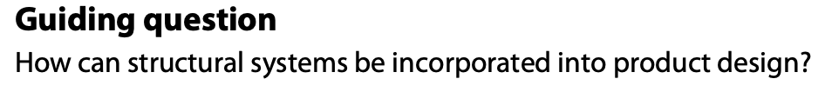
B3.2 Structural systems Application and Selection (HL)
Design in practice
HL Topic

Slide 2
Contents
Structures of everyday products | Analyse and model the forces acting on and within the structure of existing products and be able to suggest how existing structures can be strengthened
Young’s Modulus | Able to calculate Young’s Modulus
Structures fail | Identify why a structure has failed, including interpreting data from finite element analysis (FEA).
Force diagram | Able to interpret simple force diagrams for a given structure
Safety factors (SFs) to prevent failure | Able to calculate SFs

Slide 3
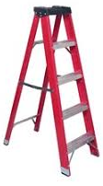
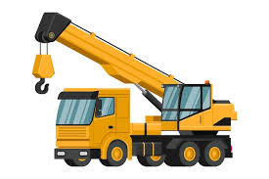
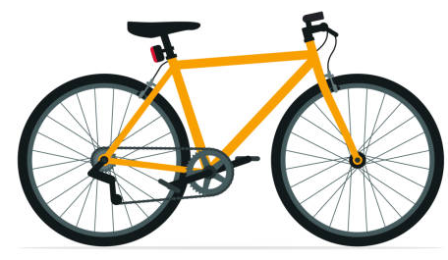
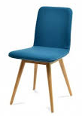
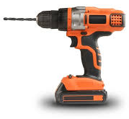
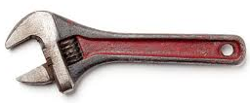
B 3.2.1 Structures are present in the design of everyday products.
Structures are essential elements in the design of everyday products because they determine how well a product supports loads, withstands forces, and performs its intended function. A structure is a system of connected parts that transfers forces safely, and it is found in almost every product—from furniture and bicycles to packaging, tools, and electronics.
Everyday products must resist different types of forces such as tension, compression, bending, shear, and torsion. For example, a chair supports compressive forces, while a bicycle frame resists bending and torsion. Even small items like clips or cutlery are shaped to handle structural stresses effectively.
Designers apply various strengthening techniques to improve the performance of structures. These include triangulation in frames, corrugation in cardboard packaging, lamination in plywood and boards, and the use of composite materials such as carbon fibre for lightweight strength. The choice of material—metal, plastic, wood, or composite—also influences the product’s structural efficiency, safety, and environmental impact.
Good structural design ensures that products are safe, durable, lightweight, and cost-effective. Understanding structures allows designers to create solutions that meet user needs while optimising materials and performance, making structural knowledge fundamental for IBDP DT students.

Slide 4
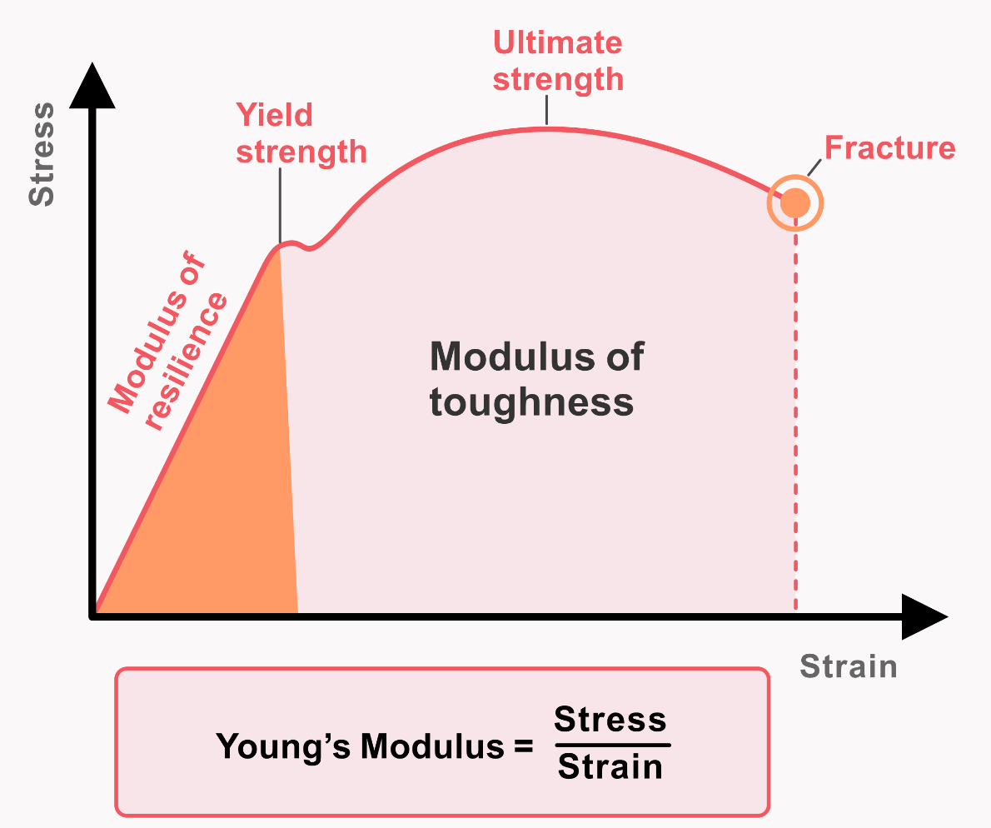
B 3.2.2 Young’s Modulus is the measure of stiffness of a material.
Young’s Modulus is a measure of how stiff a material is.
Think of it as a number that tells you how much a material stretches when you pull it.
If a material has a high Young’s Modulus, it is very stiff and does not stretch easily.
Example: steel, glass → very hard to stretch.
If a material has a low Young’s Modulus, it is flexible and stretches more easily.
Example: rubber → stretches a lot.
How much force you apply
Young’s Modulus =
How much the material stretches
(per unit length)
Or even simpler:
Force needed to stretch something
Stiffness =
How much it stretches

Slide 5
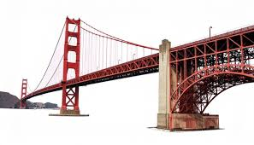

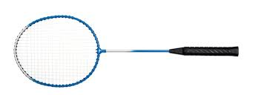
B 3.2.2 Young’s Modulus is the measure of stiffness of a material.
Why it matters?
Designers and engineers use Young’s Modulus to decide which materials can support heavy loads, which materials bend or flex safely, how strong and durable a product will be, whether a material is suitable for beams, frames, springs, etc.
Example:
Bridges need materials with high Young’s Modulus so they don’t bend too much.
Sports equipment like fishing rods or tennis racquets may need materials that flex, so a lower Young’s Modulus can be useful.

Slide 6
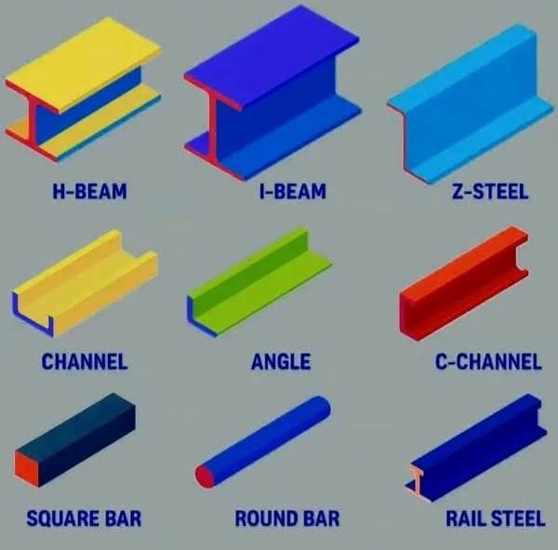
B 3.2.3 Structures fail due to overloading, material choice, size and shape.

Slide 7
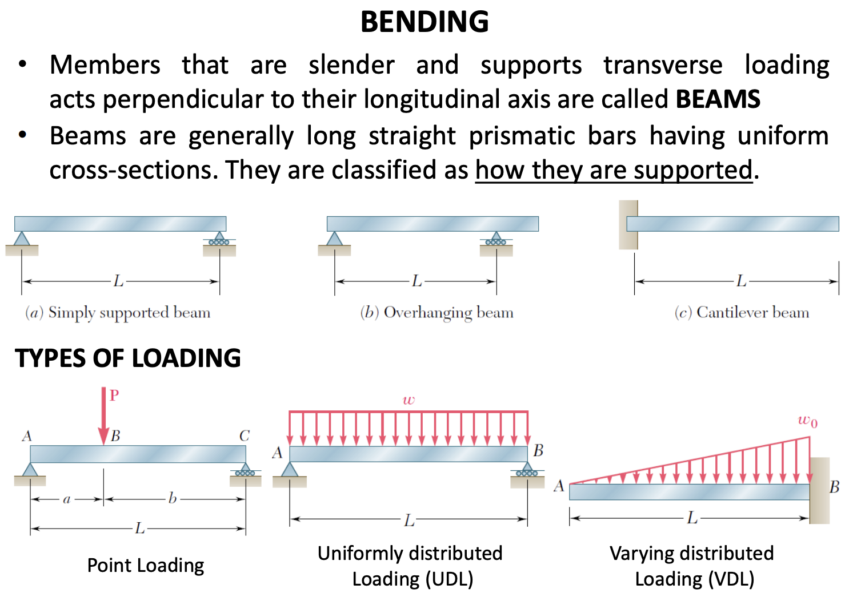
B 3.2.4 Forces acting on a structure or within a beam can be represented diagrammatically.

Slide 8
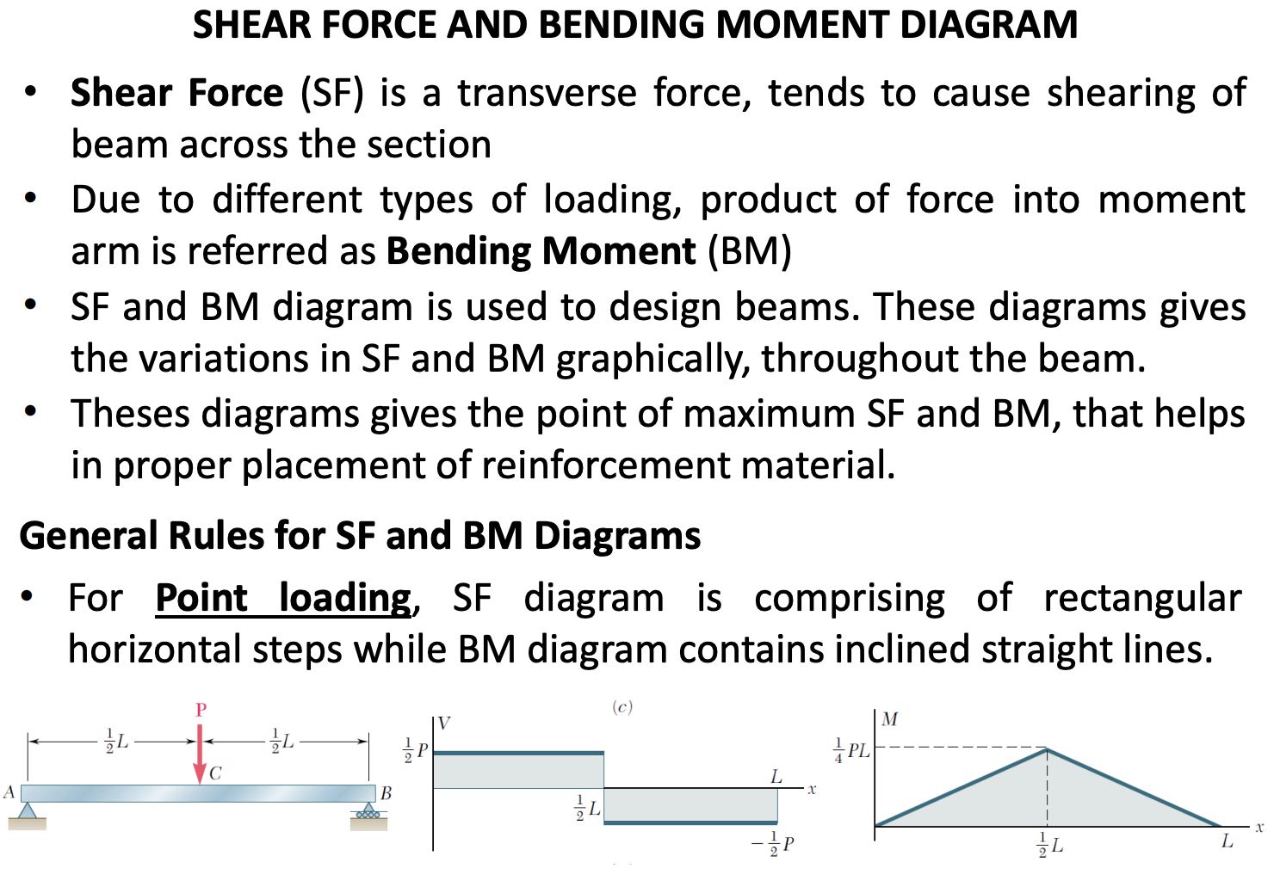

Slide 9
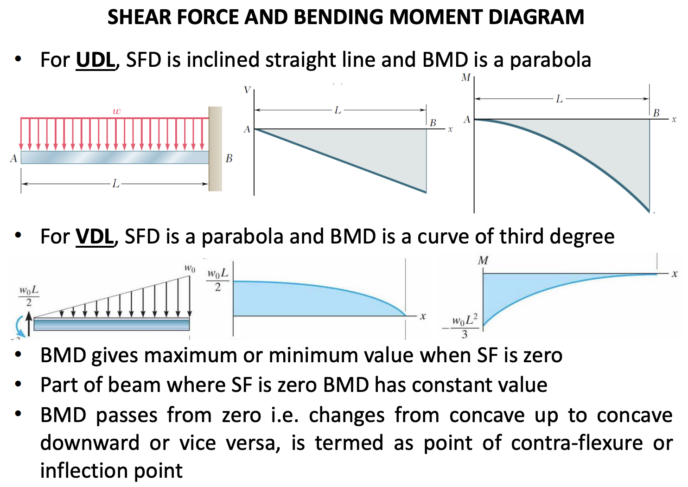

Slide 10
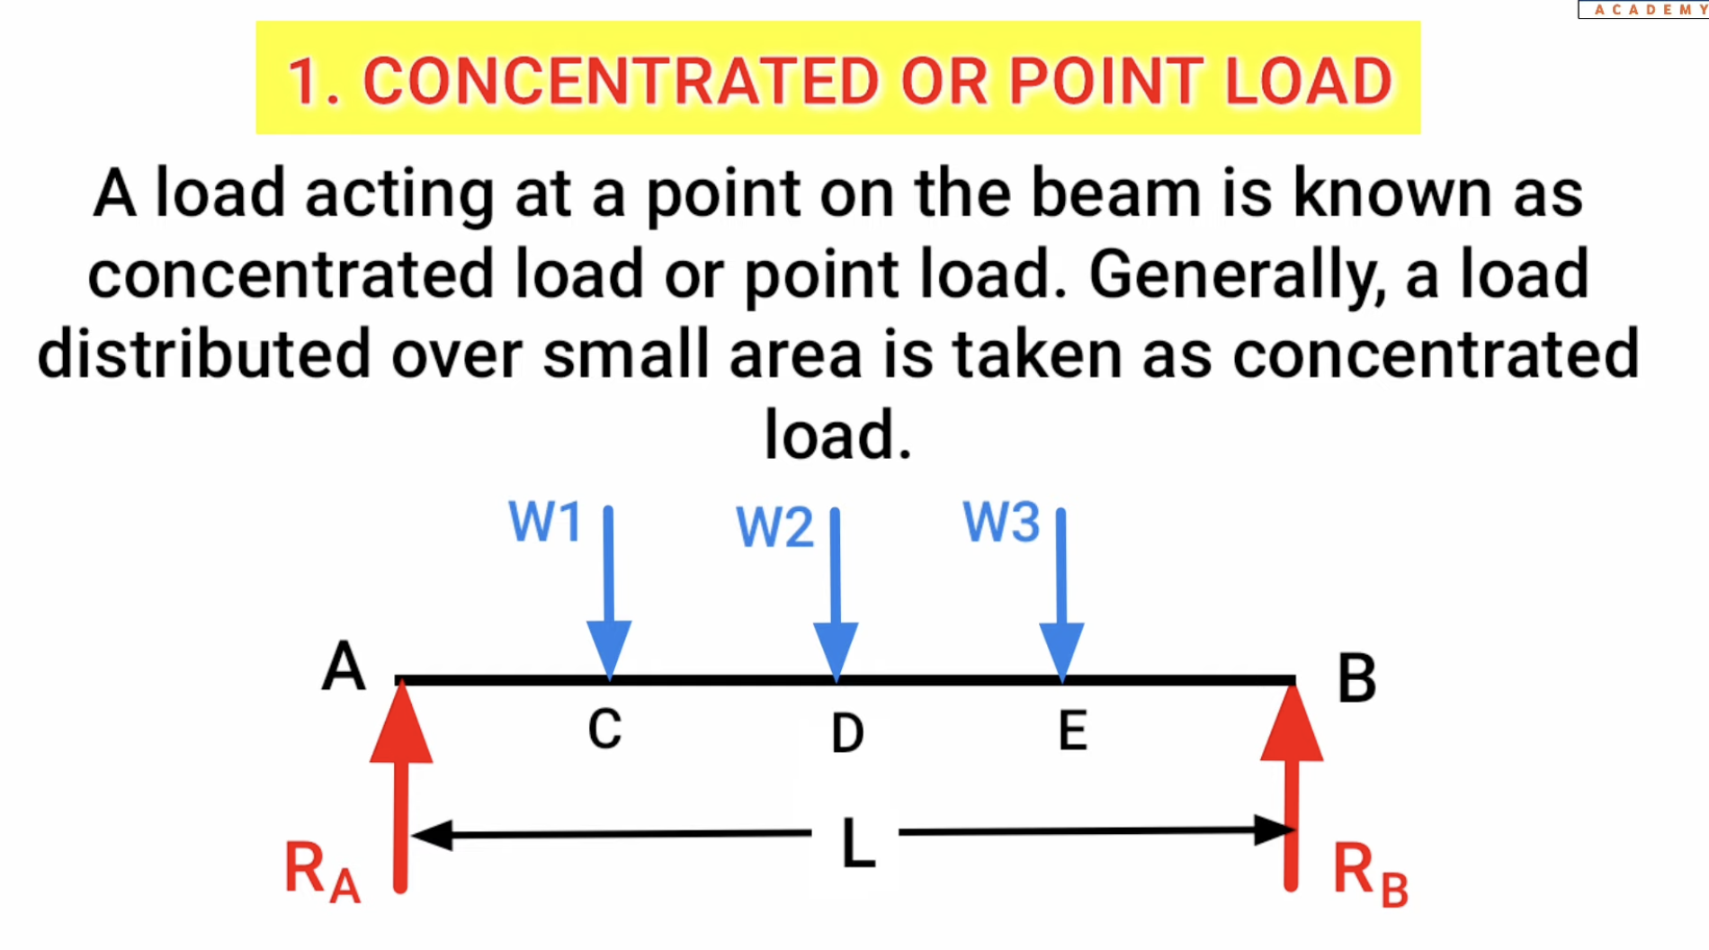

Slide 11
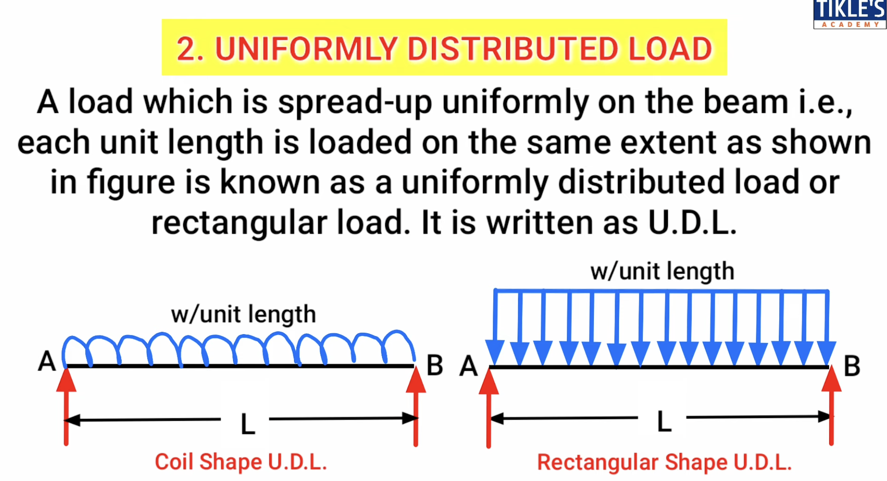

Slide 12
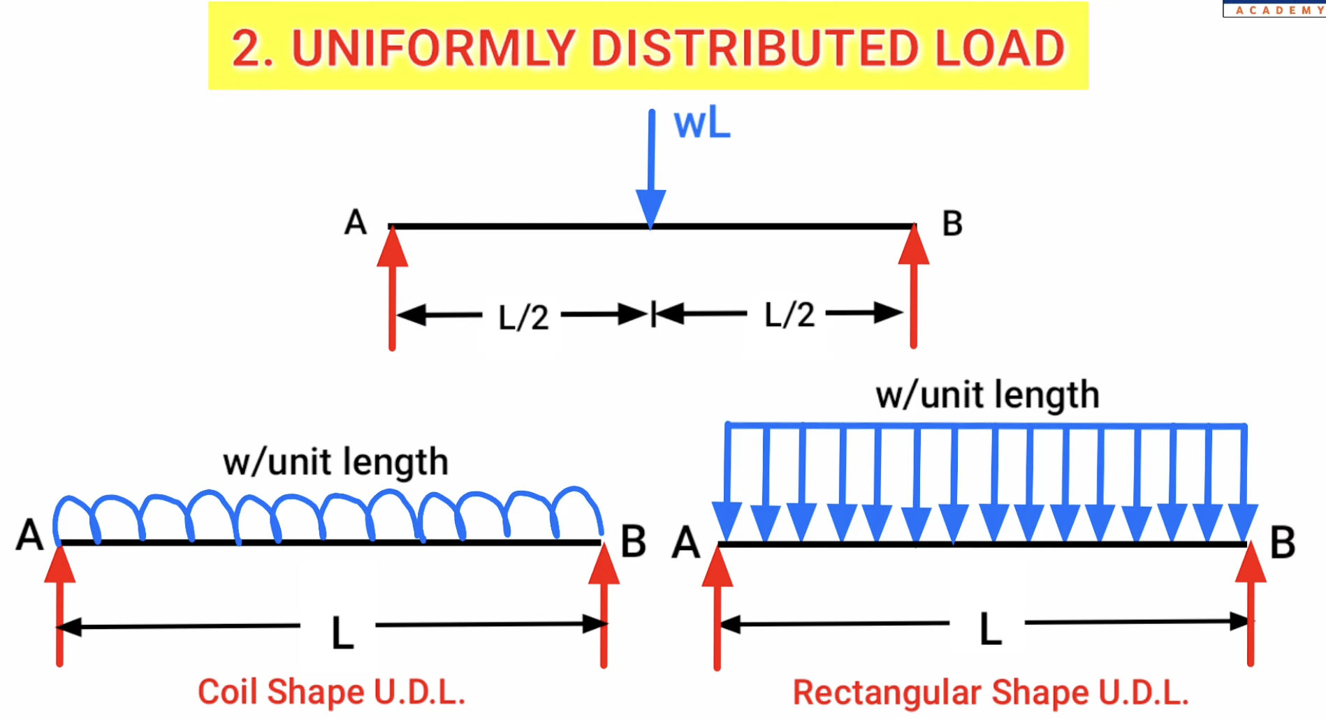

Slide 13
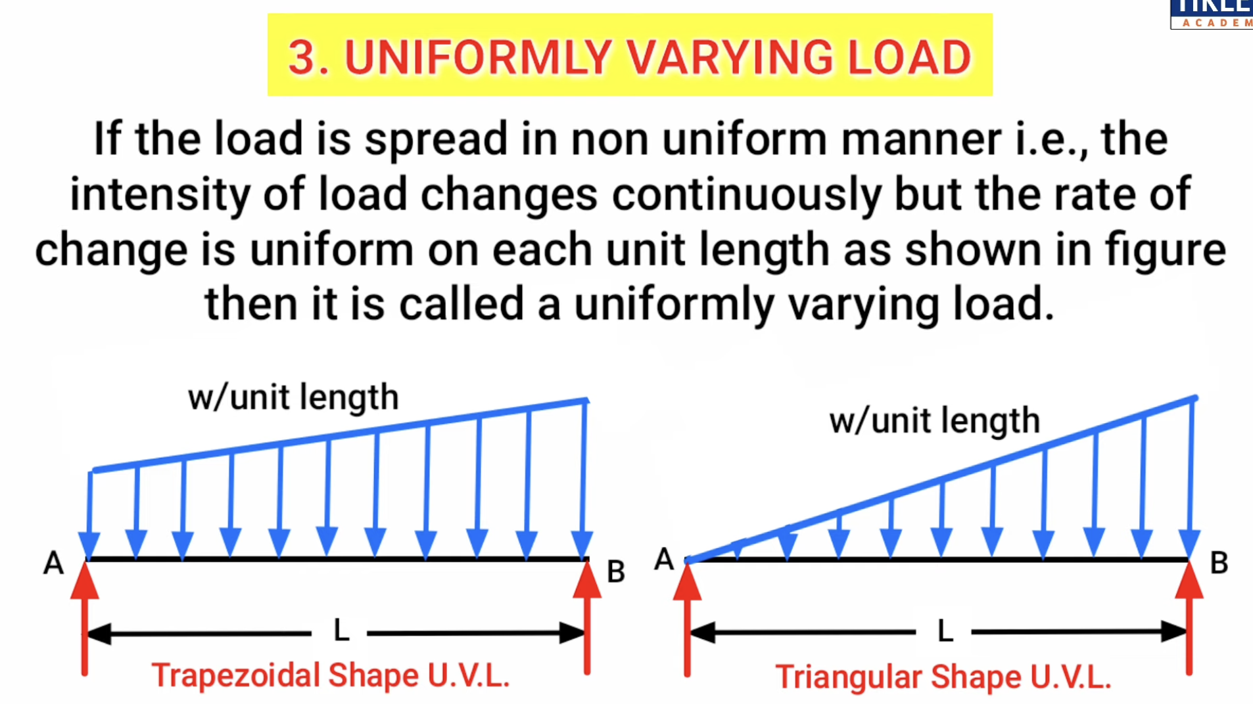

Slide 14
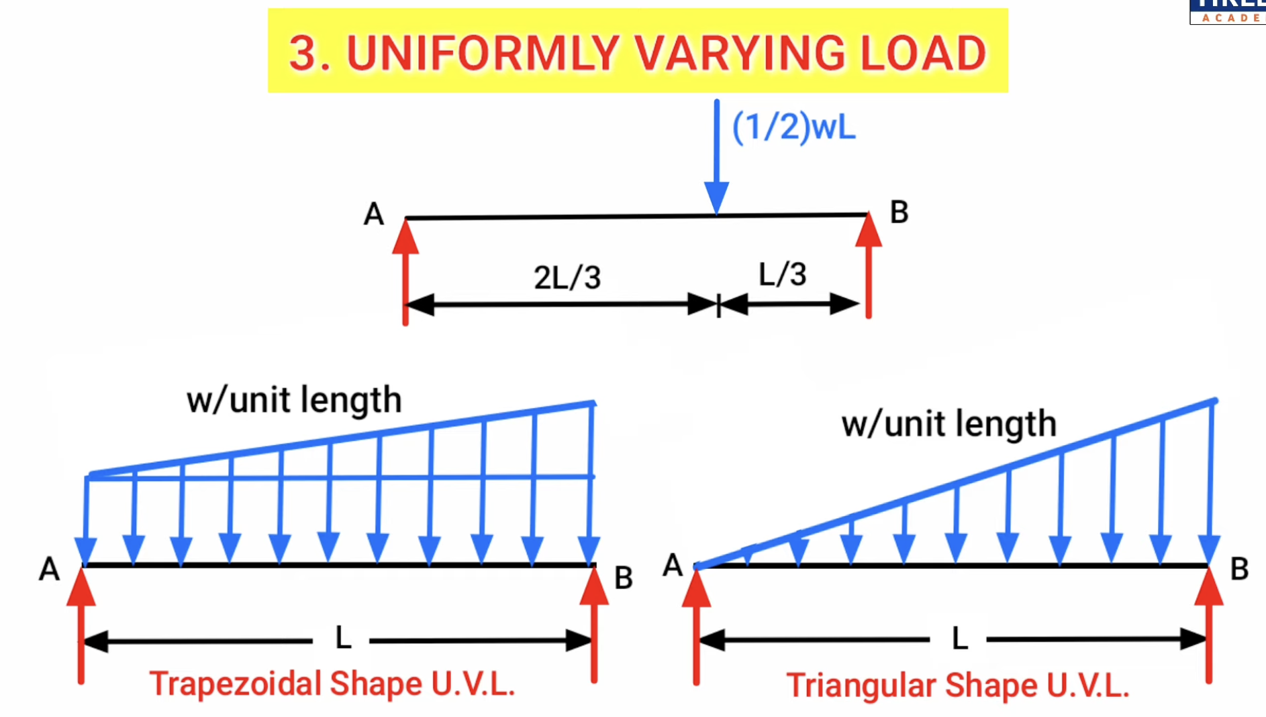

Slide 15
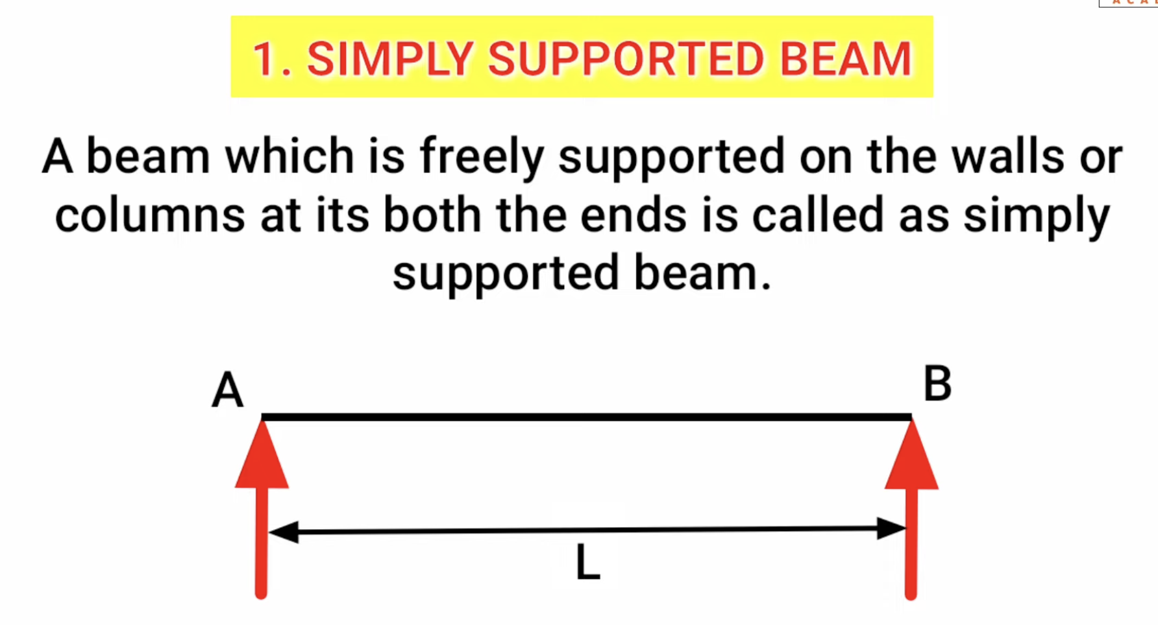

Slide 16
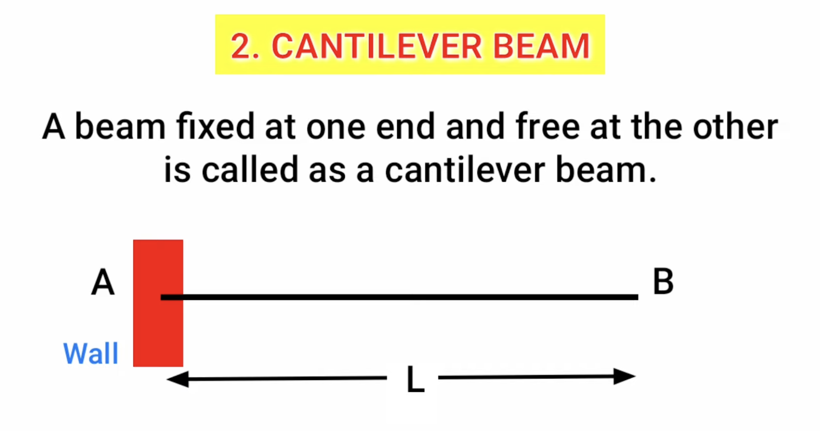

Slide 17
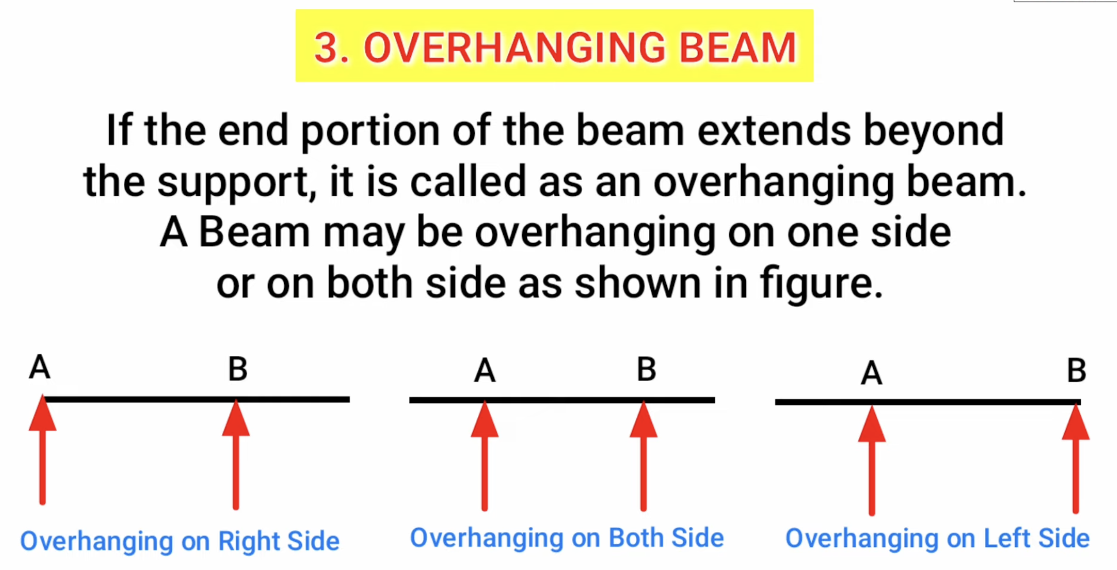

Slide 18
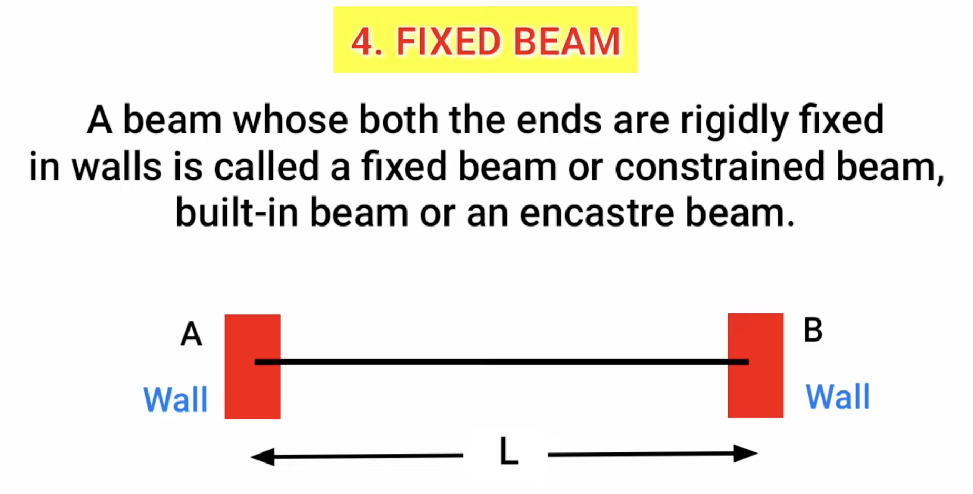

Slide 19
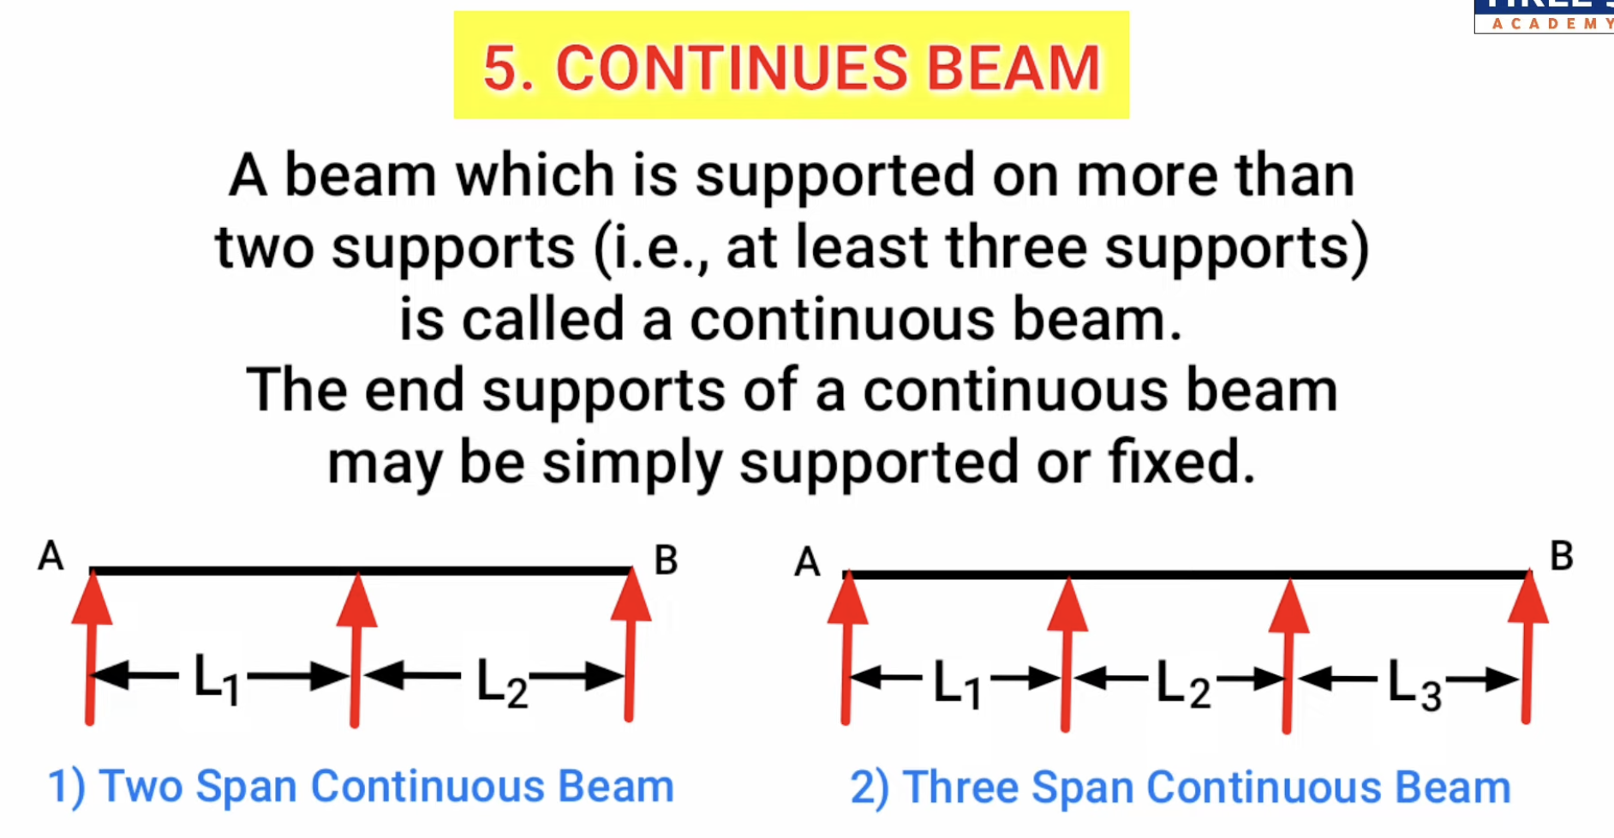

Slide 20
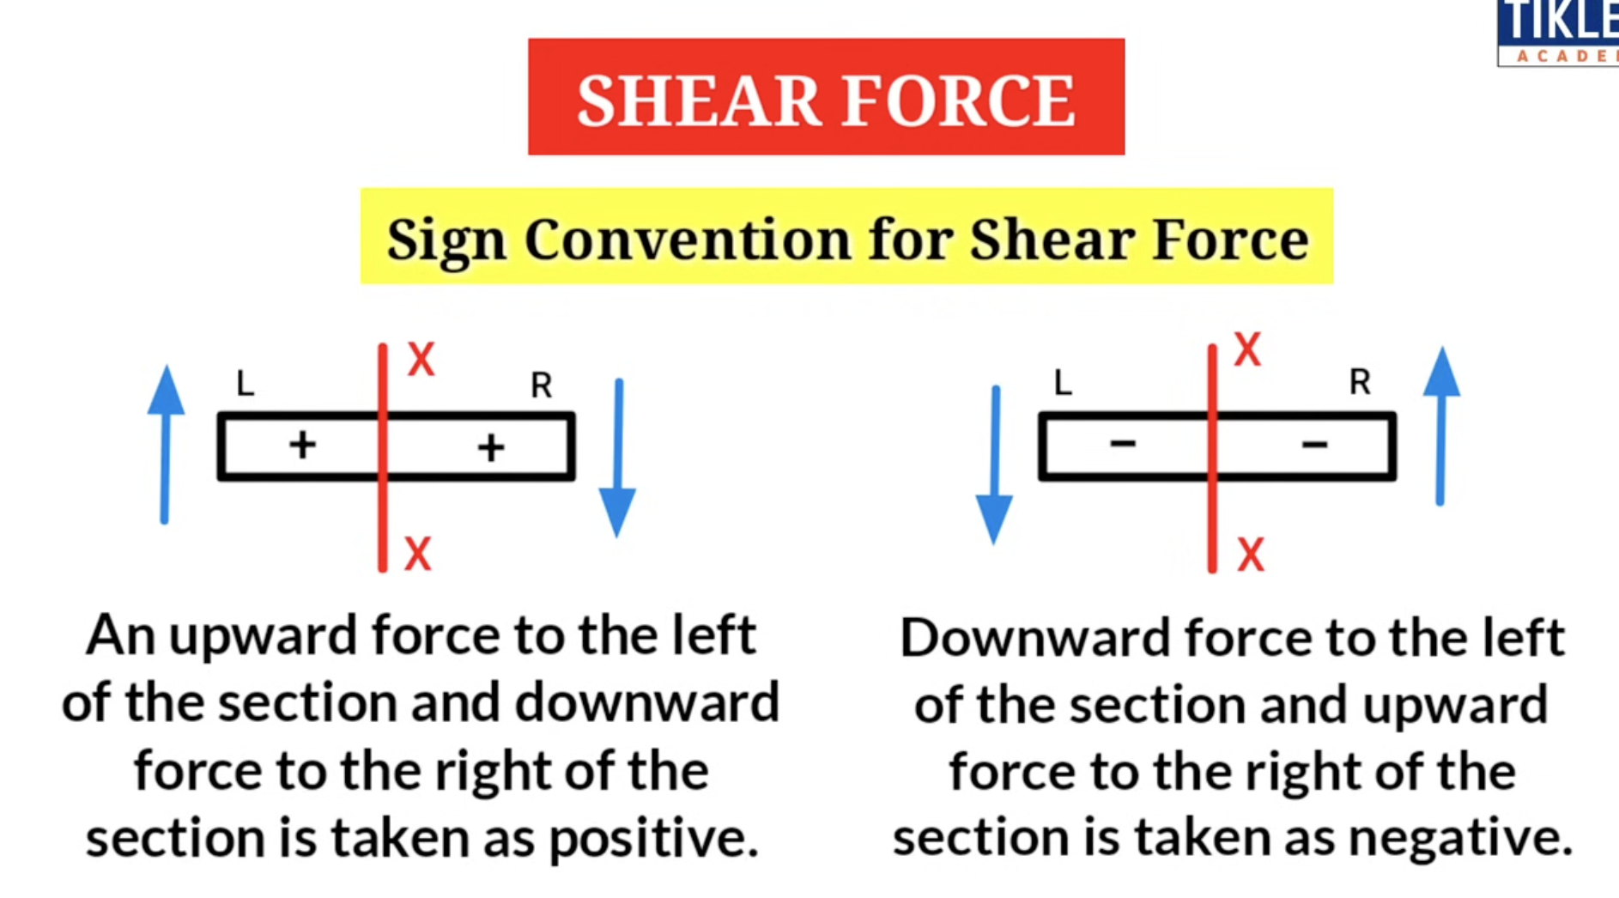

Slide 21
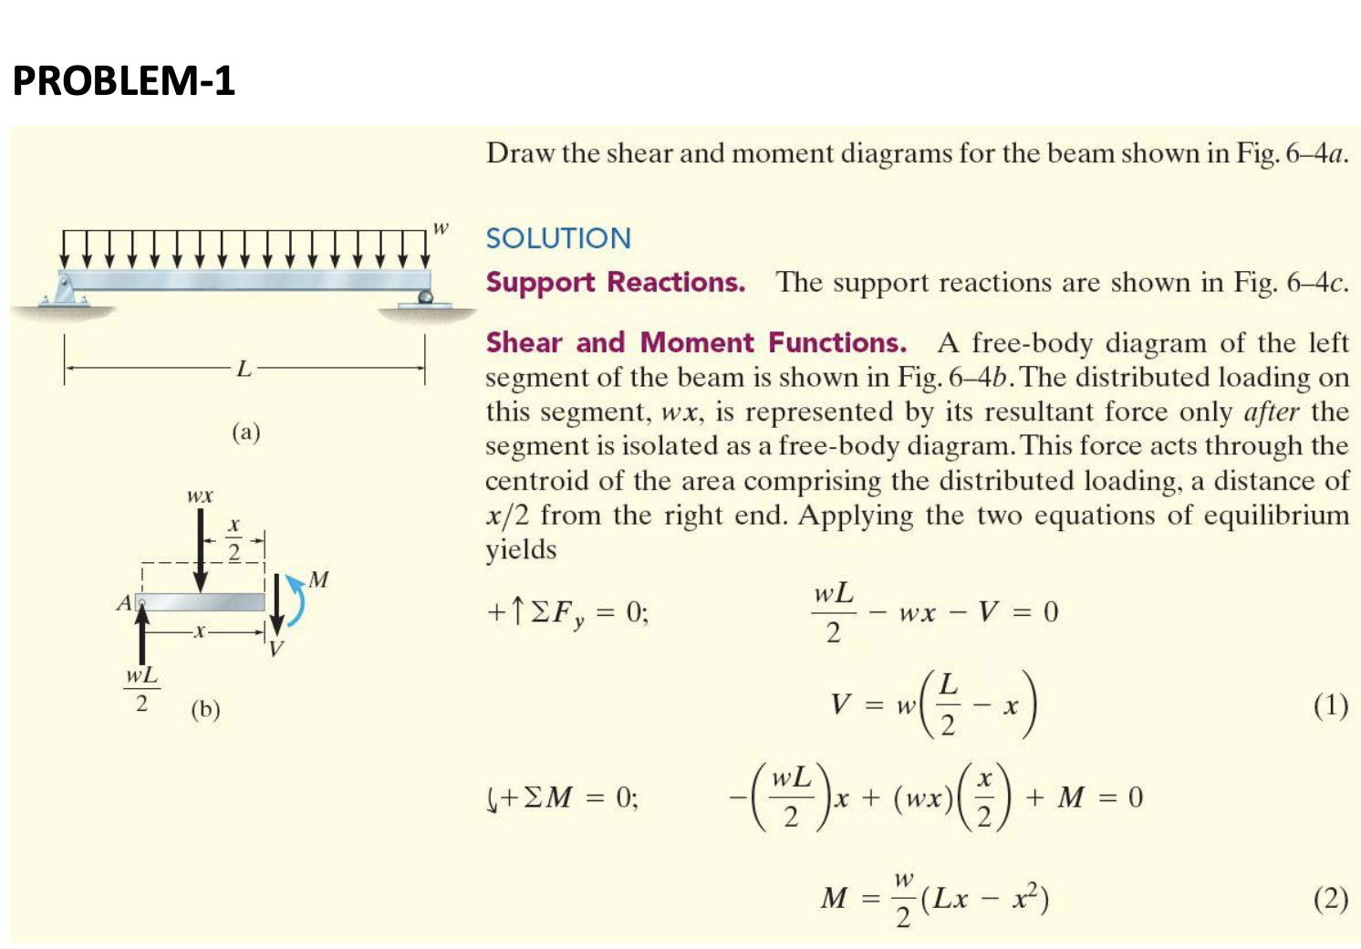

Slide 22
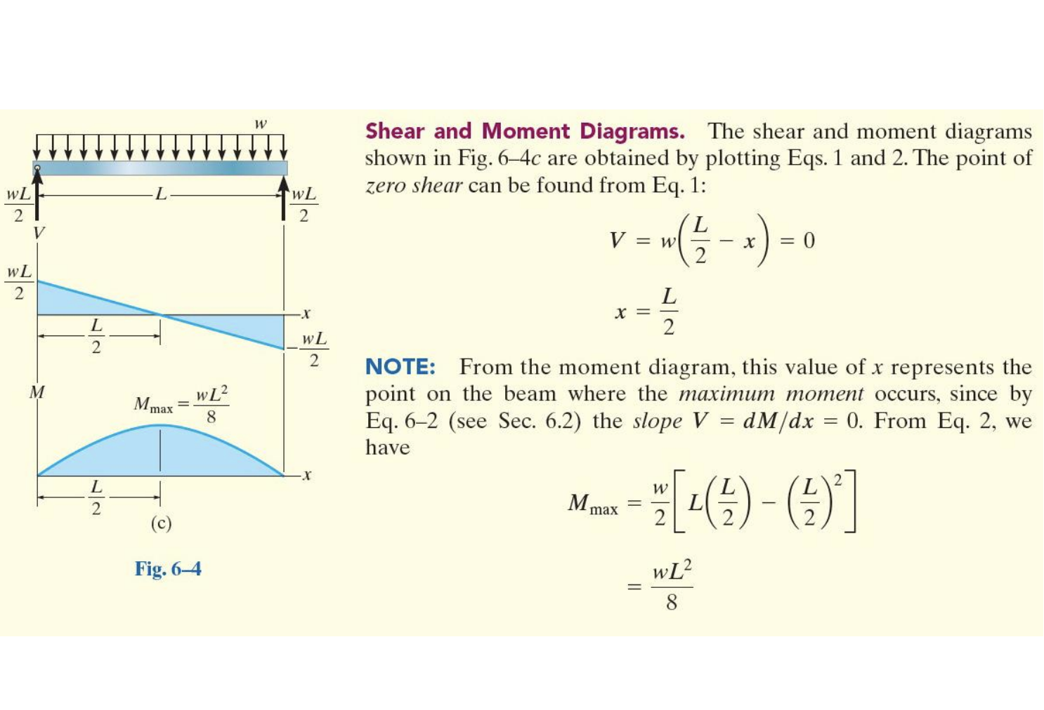

Slide 23
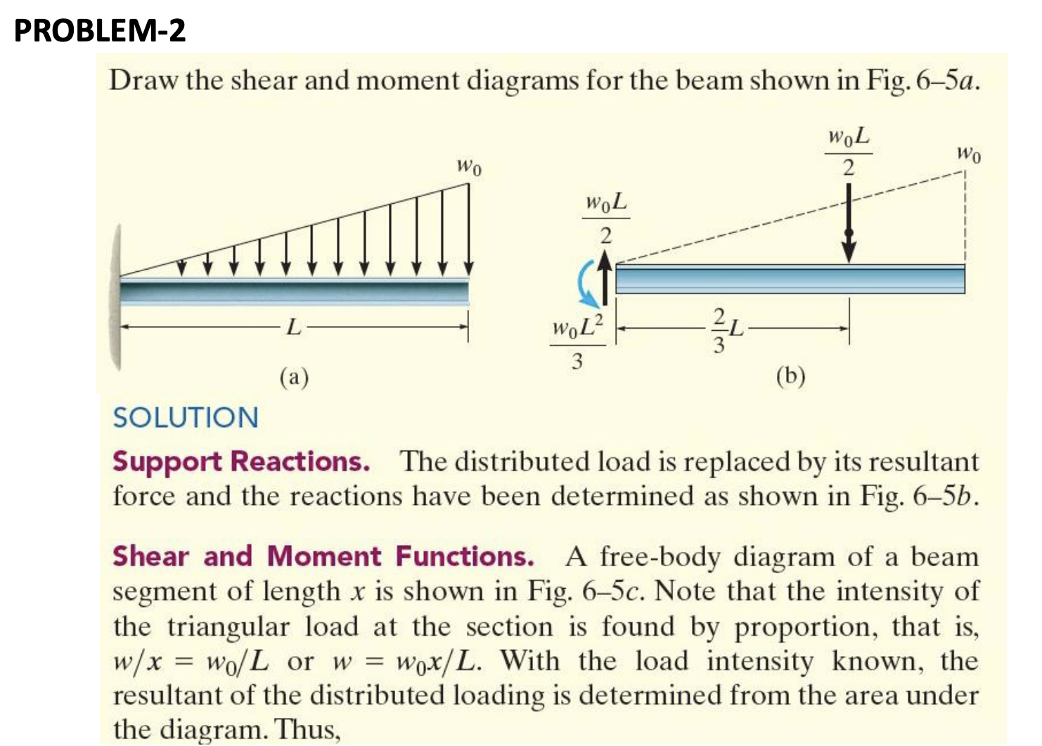

Slide 24
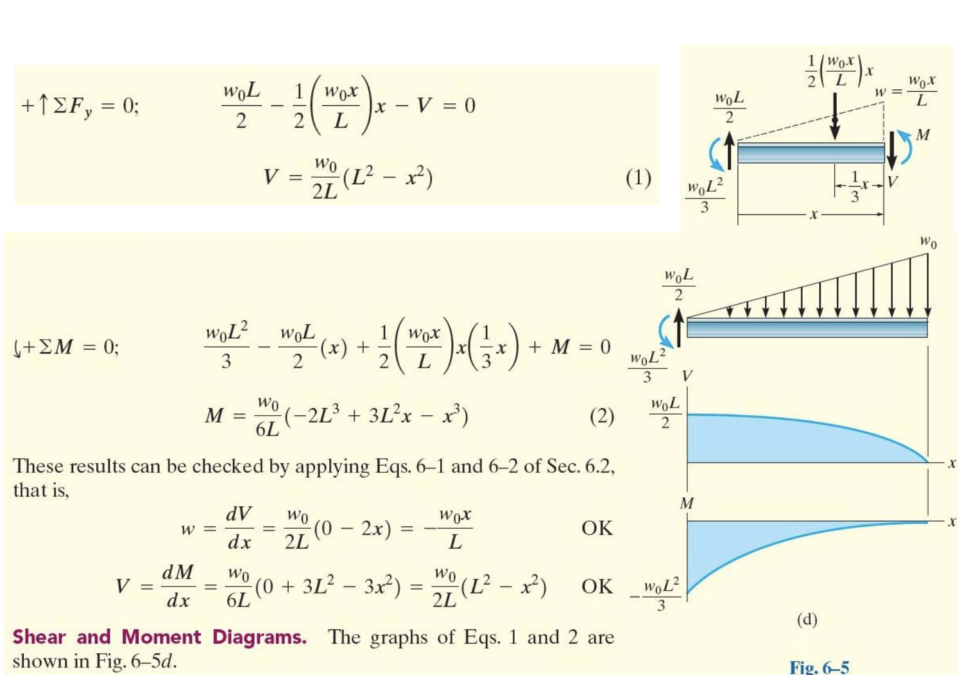

Slide 25
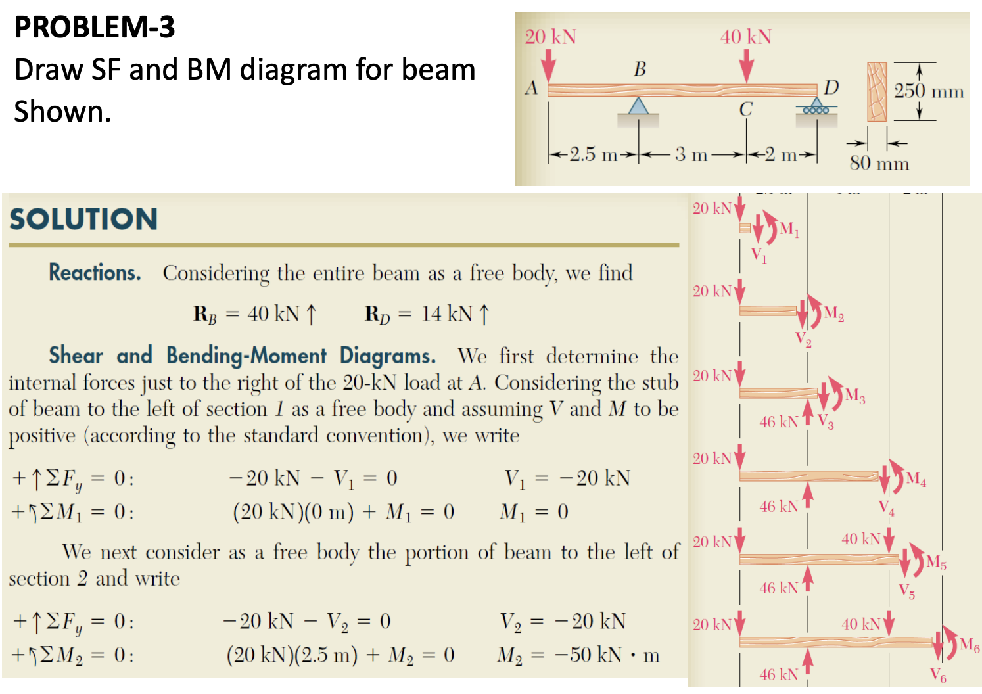

Slide 26
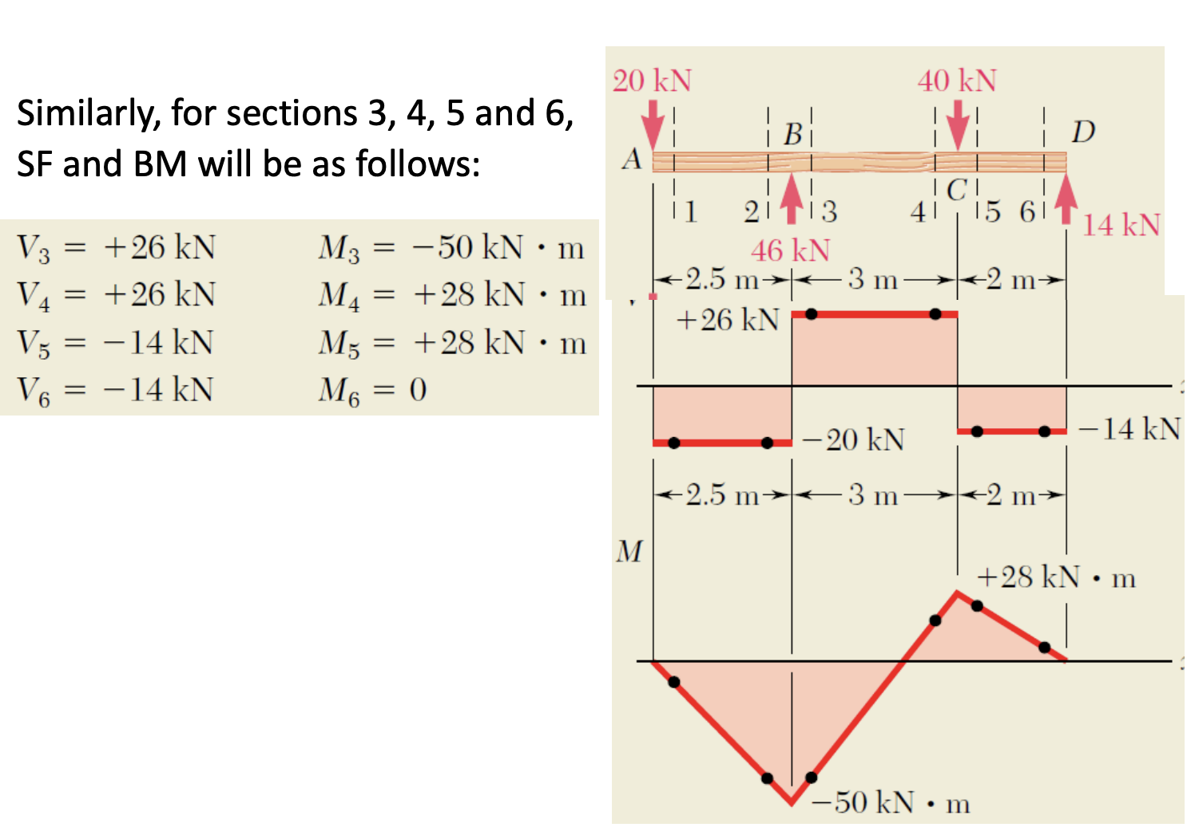

Slide 27
B 3.2.1 Safety factors (SFs) are a way to design in contingency to prevent failure from overloading a structure.

Slide 28
PARTS TO BE COMPLETED
Product Selection
Force Identification
Free-Body Diagram
Material Property Check
Stress–Strain Interpretation
Young’s Modulus Calculation
Failure Analysis
FEA Interpretation
Safety Factor Calculation
Strengthening Proposals

Slide 29
