Slide 1


Mechanical Systems Application and Selection
Design in practice

Slide 2
Contents
Mechanical advantage | able to calculate mechanical advantage in gear, pulley, belt and lever systems.
Velocity ratios | able to calculate velocity ratios for gear-, pulley- and belt-driven systems.
Efficiency | able to calculate efficiency for gear- and belt-driven systems.
Gear- and belt-driven systems | able to calculate gear ratios and belt-driven system ratios considering the use of drive and driven gears, calculate the speed of rotation of a gear system at several points, including initial input and final output speed, and construct systems that use gears to increase or decrease speed and motion.
Cams and followers | able to analyse how cam systems translate rotary motion into reciprocating motion, construct mechanical systems that use cams, and interpret diagrams that represent the use of cams in a system.
Levers | able to analyse the Load (L), Effort (E) and Fulcrum, calculate Load (L) and Effort (E), construct mechanical systems that use levers, and interpret diagrams that represent the use of levers in a system.

Slide 3
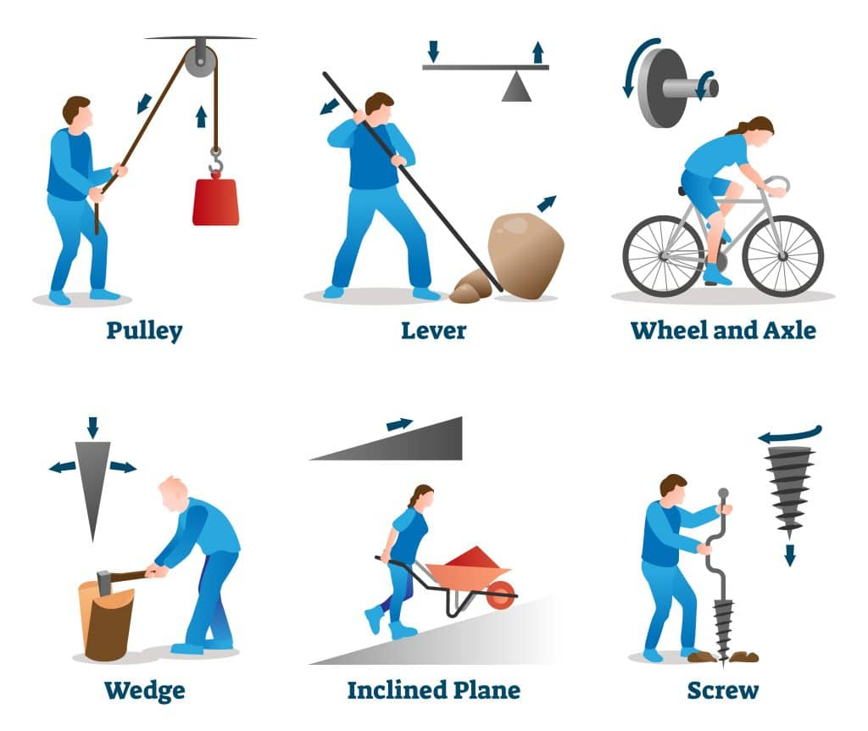
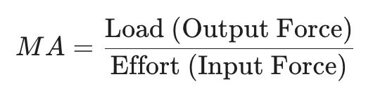
B 3.3.1 Mechanical advantage of a system can be calculated.
Mechanical Advantage is a measure of the force amplification achieved by using a tool or machine system. In other words, is a measure of how much a machine or mechanism multiplies the input force to make the task easier to perform.
Mechanical advantage of a system can be calculated to understand how effectively a machine multiplies force. It is defined as the ratio of the output force produced by the machine to the input force applied. In simple terms, it shows how much easier a machine makes work. For example, in devices like levers, pulleys, and inclined planes, mechanical advantage helps determine how much effort is reduced.
The formula used is Mechanical Advantage (MA) = Load / Effort.
A higher mechanical advantage means less effort is needed to move a load. However, this may also result in a greater distance over which the effort must be applied.
Mechanical advantage can be ideal or actual, depending on whether friction and energy losses are considered.
Mechanical Advantage is calculated depending on the type of system begin used. Lets look at one by one

Slide 4
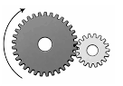
B 3.3.1 Mechanical advantage of a system can be calculated.
Mechanical Advantage in Gear Systems
Number of teeth on driven gear
MA = ————————————————
Number of teeth on driver gear
Mechanical advantage (MA) in gears is calculated based on the ratio of the sizes or teeth of the gears involved. In a simple gear system, MA depends on how many teeth the driving gear (input) and the driven gear (output) have.
The formula is:
Mechanical Advantage (MA) = Number of teeth on driven gear / Number of teeth on driving gear
For example, if a small gear with 10 teeth drives a larger gear with 40 teeth, the MA is 40/10 = 4. This means the output force (torque) is four times greater than the input, making it easier to move heavy loads
Alternatively, it can also be calculated using the diameters of the gears:
MA = Diameter of driven gear / Diameter of driving gear
40
MA = ——— = 4
10

Slide 5
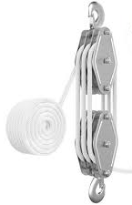
B 3.3.1 Mechanical advantage of a system can be calculated.
Mechanical Advantage in Pulley System
For pulley systems, you usually don’t need forces, just count the number ropes:
MA = Number of rope segments supporting the load
Example:
If number of ropes are 4, the MA = 4
If number of ropes are 6, the MA = 6
Only count ropes directly supporting the load. Ignore the rope you pull (free end)
MA = 3

Slide 6
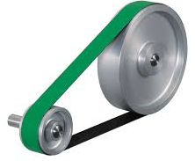
B 3.3.1 Mechanical advantage of a system can be calculated.
Mechanical Advantage in Belt Drives
Diameter of driven pulley
Ddriven
MA = ——————————————
= ————
Diameter of driver pulley
Ddriver
Driver pulley is connected to motor/input
Driven pulley is connected to output/load
Example
If the diameter of the driver pulley is 8 cm and the diameter of the driven pulley is 24 cm
Force increases, output force is 3 times input
Speed decreases, output speed is 1/3
24
MA = ——— = 3
8
24
MA = ——— = 3
8
Mechanical advantage in belt drives = ratio of driven pulley size to driver pulley size.

Slide 7
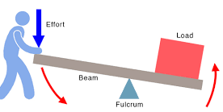
B 3.3.1 Mechanical advantage of a system can be calculated.
Mechanical Advantage in Levers
It is the ratio of the effort arm to the load arm.
Effort arm is the distance from fulcrum to effort
Load arm is the distance from fulcrum to load
Example
If the effort arm is 60 cms and the load arm is 20 cms.
You get 3 times more force than you apply. The more distance of the effort arm, the less the effort or force required.
60
MA = ——— = 3
60
20
MA = ——— = 3
20

Slide 8
B 3.3.1 Mechanical advantage of a system can be calculated.
Why designers calculate MA ?
Designers calculate mechanical advantage (MA) because it directly affects how well a product works and performs for the user. A higher MA means less force is needed, it makes products easier and safer to use. Example scissors, bottle openers, wheelbarrows, If MA is too low user will get tired quickly.
Designers ensure users can actually apply the required force. Example tools for children or elderly people.
Designer use this to control force/speed. Like in Crane requires force, less speed, but the fan requires speed and less force.
Helps in building efficient systems Helps optimize how energy is transferred, reduces energy waste in systems.
Ensures safety, and to select material based on their properties.
Designers consider mechanical advantage to balance force, speed, efficiency, and user comfort, ensuring products are safe, functional, and suited to human capabilities.

Slide 9
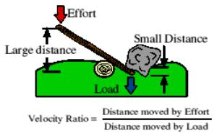
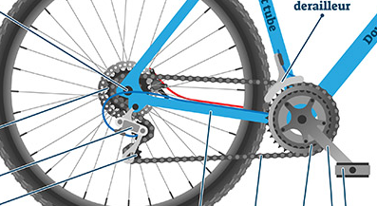
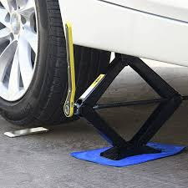
B 3.3.2 Velocity ratios for gear, pulley and belt-driven systems can be calculated.
Velocity Ratio (VR)
It tells you how much faster or slower the effort moves compared to the load. It compares movement (distance or speed), not force. For example, in a high gear on a bicycle, one revolution of the pedal crank causes several revolutions of the bicycle wheel. Conversely, a car jack requires a lot of movement of the handle to lift the car just a short distance.
This property is known as the Velocity Ratio (VR), and is calculated by dividing the distance moved by the effort by the distance moved by the load.
If effort moves a long distance and load moves a short distance → high VR
Distance moved by the effort
VR = ——————————————
source:dtonline.org
Distance moved by the load
You move the handle 10 ft
Load rises 2 ft
10
VR = ——— = 5
2

Slide 10
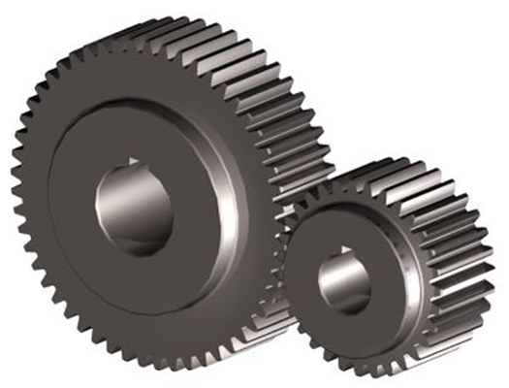
B 3.3.2 Velocity ratios for gear, pulley and belt-driven systems can be calculated.
However, depending on the mechanical system VR is calculated using number of teeth for gear system and diameter of pulleys and belt system.
Velocity Ratio (VR) in Gear system
For gears, the velocity ratio (often called the Gear Ratio) is determined by the number of teeth on the input (driver) gear versus the output (driven) gear.
The formula is:
If the Driven gear has 40 teeth and the Driver has 10, the VR is 4. This means the driver must spin 4 times to make the driven gear spin once.
Number of teeth in the driven gear
VR = ——————————————
Driven gear = 40 teeth
Driver gear = 10 teeth
Number of teeth in the driver gear
40
VR = ——— = 4
10

Slide 11
B 3.3.2 Velocity ratios for gear, pulley and belt-driven systems can be calculated.
Velocity Ratio (VR) in Pulley and Belt systems
Belt drives work similarly to gears, but instead of teeth, we use the diameter of the pulleys. Since the belt speed is constant for both pulleys, the larger pulley will rotate more slowly.
The formula is:
If the Driven pulley has a diameter of 200 cms and the Driver pulley has a diameter of 100, the VR is 2. This means the driven pulley spins half as fast as the driver pulley.
Diameter of the the driven pulley
Driven pulley diameter = 200
Driver pulley diameter = 100
VR = ——————————————
Diameter of the the driver pulley
200
VR = ——— = 2
100

Slide 12
B 3.3.2 Velocity ratios for gear, pulley and belt-driven systems can be calculated.
It’s a common mistake to confuse Velocity Ratio with Mechanical Advantage (MA).
While VR is purely about distance and geometry,
MA =Load / Effort, accounts for real-world factors like friction.

Slide 13
B 3.3.3 Efficiency can be calculated.
Efficiency
Efficiency is a measure of how much of the energy put into a machine is actually converted into useful work. No machine is 100% efficient because some energy is always "lost" usually transformed into hea, friction or slippage . At its most basic, efficiency is the ratio of Output to Input. It is almost always expressed as a percentage.
Useful work output
Efficiency = ——————————— X 100%
Total energy input
Example : If you put 100 J of energy into a pulley system and only 80 J is used to lift a load:
The remaining 20% is lost, usually due to friction in pulleys or air resistance.
80
Efficiency = ———— X 80%
100
Why Efficiency matters for designers ?
To minimise waste of energy and reduce running cost.
To select material and components that reduce friction and wear.
To design systems that last longer and perform better under load.
To ensure the system meets safety and environmental standards.

Slide 14
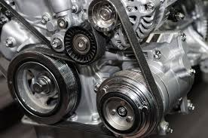
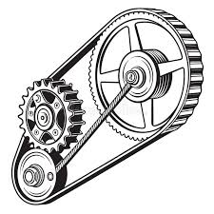
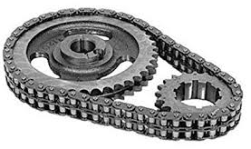
B 3.3.4 Gear- and belt-driven systems are used to change the direction, speed, power and efficiency of a rotary motion.
Gear and belt-driven systems are commonly used by designers to transfer rotational motion and modify its direction, speed, power, or efficiency to meet specific requirements. By linking a driver (input) to one or more driven (output) components, designers can control how fast parts rotate, the amount of torque transmitted, and the direction of movement.

Slide 15
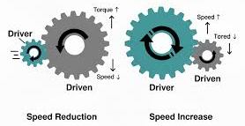
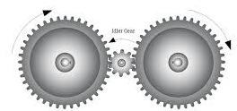
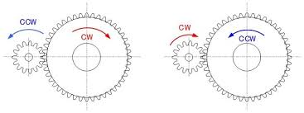

B 3.3.4 Gear- and belt-driven systems are used to change the direction, speed, power and efficiency of a rotary motion.
Speed and Torque (Power):
By changing the ratio between the driver and driven components, designers trade speed for torque. A small gear driving a large gear increases torque (power) but decreases output speed. This is vital in applications like a winch or a car’s first gear.
Direction:
Gear systems can reverse rotation (two meshed gears turn in opposite directions) or change the axis of motion using bevel or worm gears. Belt systems can maintain the same direction or, if "crossed," reverse it.
Efficiency:
This is the "cost" of the transformation. Belt systems are often quieter but can suffer from slippage, reducing efficiency. Gears are more "positive" (no slip) but lose energy through friction and heat.

Slide 16
B 3.3.4 Gear- and belt-driven systems are used to change the direction, speed, power and efficiency of a rotary motion.
Gear Ratio and Output Speed
A small gear with 25 teeth drives a larger gear with 75 teeth at an RPM (Revolutions Per Minute) of 600.
Calculate the Gear Ratio(GR):
Calculate the Output Speed:
Teeth on Driven gear
75
3
GR = ——————————— = ——— =
Teeth on Driver gear
25
Driver teeth
25
Output speed = Input speed X ——————— = 600 X –––– =
200 rpm
Driven teeth
75

Slide 17
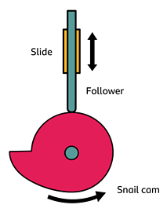
B 3.3.5 Cams and followers are used to change rotary motion to reciprocating motion.
A cam and follower system is a specialized mechanism used to transform continuous rotary motion (circular) into reciprocating motion (linear back-and-forth).
How it Works
The system consists of two main parts:
The Cam: A profile-shaped disc (like a pear, circle, or heart) attached to a rotating shaft.
The Follower: A rod that rests on the edge of the cam. As the cam rotates, its varying profile forces the follower to move up and down or side-to-side.

Slide 18
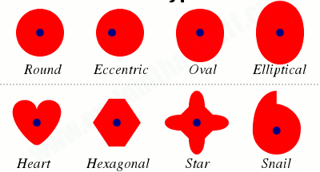
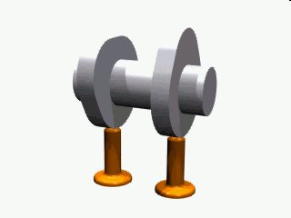
B 3.3.5 Cams and followers are used to change rotary motion to reciprocating motion.
The "Profile" defines the Motion
The beauty of this system lies in the cam profile. By changing the shape of the cam, designers can precisely control the timing, distance, and dwell (pauses) of the movement:
Pear-shaped cams create a long dwell period where the follower stays still before a sudden rise.
Snail cams provide a gradual rise followed by a sudden drop.
Eccentric (circular) cams produce a smooth, rhythmic "sine wave" motion.

Slide 19
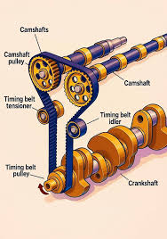

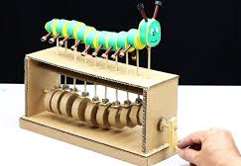
B 3.3.5 Cams and followers are used to change rotary motion to reciprocating motion.
Applications
This transformation is essential in internal combustion engines, where cams open and close fuel valves at exact intervals. You’ll also find them in sewing machines to move the needle or in automated toy "automata" to create lifelike movements. For a designer, it is the go-to solution when a machine needs to "pulse" or "step" rather than just spin.

Slide 20
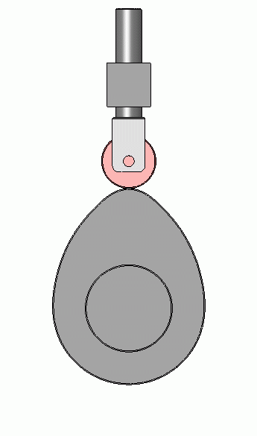
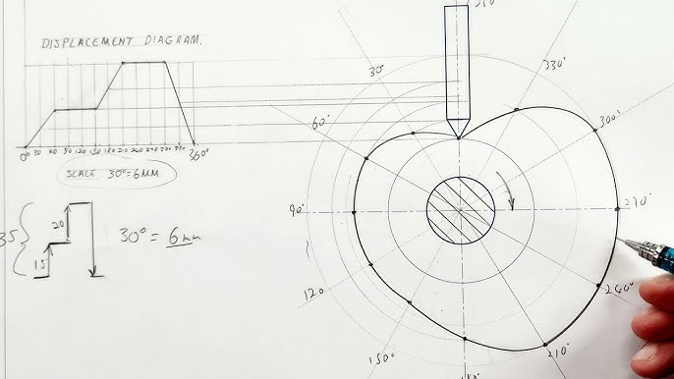
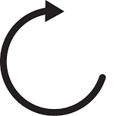
B 3.3.5 Cams and followers are used to change rotary motion to reciprocating motion.
Height
(Y axis)
Verticla
Rotation angle
(X axis) -Horizontal
Displacement Diagram
A displacement diagram is a graphical representation of the follower's movement as the cam completes one full rotation (360°).Think of it as a "map" of the follower's journey. It plots the height (lift) of the follower against the angle of rotation of the cam. This is the most critical part of the design process because designers design the diagram before they draw the actual cam.

Slide 21
B 3.3.5 Cams and followers are used to change rotary motion to reciprocating motion.
Displacement Diagram
A graph to show how follower moves(height) when cam rotates(angle).
X axis = angle of rotation (in degree)
Y axis = movement (displacement) of the follower (up and down)
When the follower rise (move up)
When it stays (dwell)
When it falls (move down)
Cam Angle (in degree) | Displacement (mm)
0 | 0
60 | 30
120 | 30
180 | 40
240 | 40
300 | 20
360 | 0
40
*
*
30
*
*
Follower displacement
*
20
10
*
*
60
120
180
240
300
360
Angle of rotation (in degree)

Slide 22

B 3.3.6 Levers reduce the effort needed to exert a force and move a load.
A lever is a simple machine consisting of a rigid bar pivoted at a fixed point called a fulcrum. The core principle of a lever is Mechanical Advantage (MA), the ability to move a large load using a significantly smaller effort.
Levers reduce the effort needed by exploiting the relationship between force and distance. By increasing the distance between the effort and the fulcrum (the effort arm), the amount of force required to move the load decreases.

Slide 23
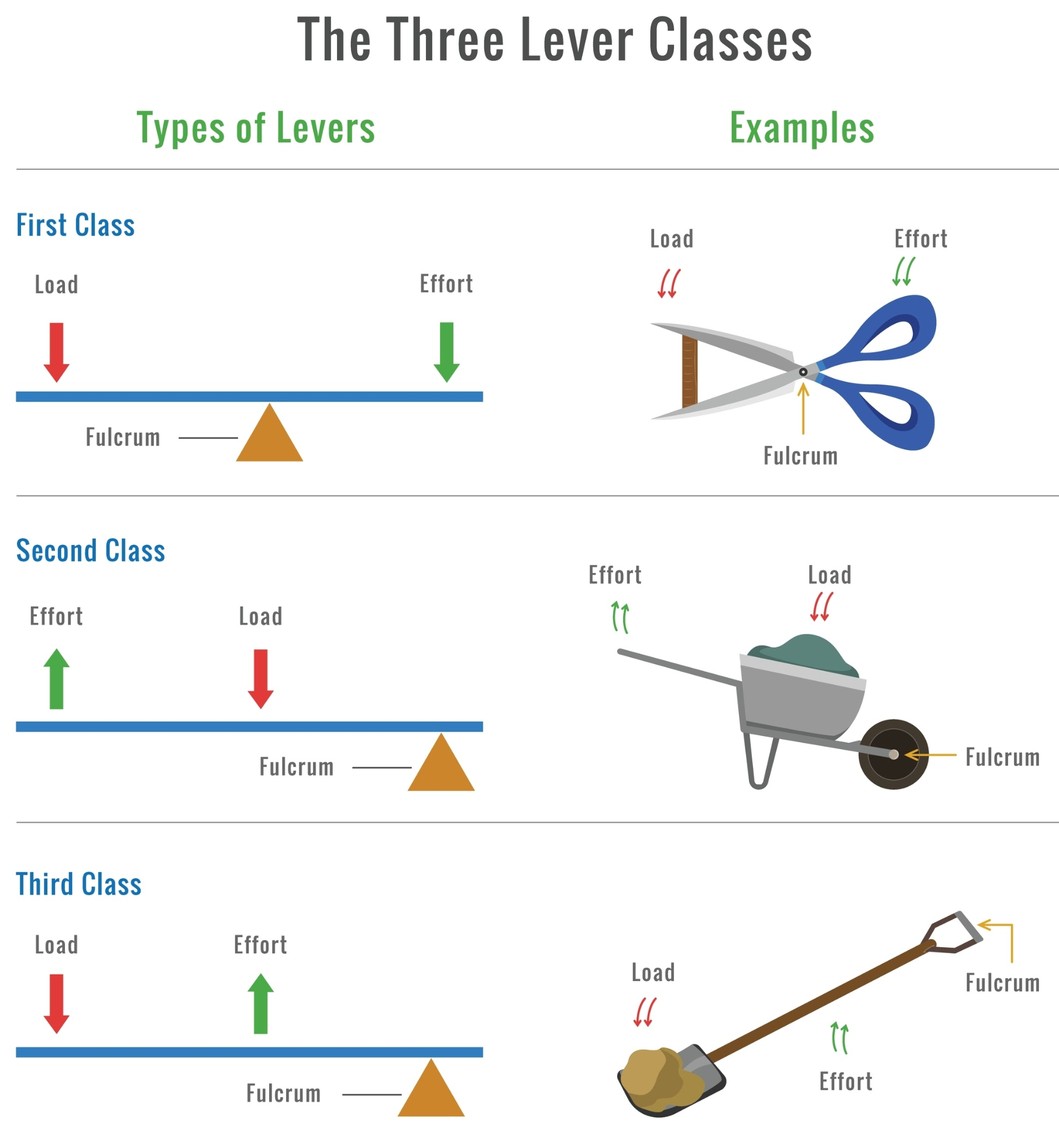
B 3.3.6 Levers reduce the effort needed to exert a force and move a load.
Designers select lever classes based on the desired outcome:
1st Class:
The fulcrum is in the middle. Used to magnify force or reverse direction. (e.g., Pliers)
2nd Class:
The load is in the middle. These always reduce effort because the effort arm is always longer than the load arm. (e.g., Wheelbarrow)
3rd Class:
The effort is in the middle. These actually require more effort but provide greater control and speed for the load. (e.g., Tweezers)

Slide 24
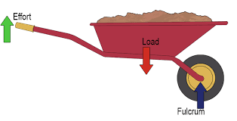
B 3.3.6 Levers reduce the effort needed to exert a force and move a load.
Calculate Load and Mechanical Advantage
Length of Effort Arm
MA = ——————————————
Lenght of Load Arm
30 kgs
If the distance of distance of fulcrum to handle is 900mm and the distance of load to fulcrum is 300mm. The load in the wheelbarrow is 30 kgs.
Calculate the MA of the wheelbarrow.
How much lighter does the load feels to the user?
300mm
900mm

Slide 25
B 3.3.6 Levers reduce the effort needed to exert a force and move a load.
Calculate Load and Mechanical Advantage
For a wheelbarrow (a second-class lever), the Mechanical Advantage (MA) is:
Length of Effort Arm
MA = ———————————
Lenght of Load Arm
30 kgs
Calculate the MA of the wheelbarrow.
Effort arm = 900 mm
Load arm = 300 mm
Mechanical Advantage = 3
How much lighter does the load feels to the user?
Actual load = 30 kg
Since MA = 3, the effort required is:
The load feels like 10 kg to the user, it feels 20 kg lighter than the actual load
900
MA = ————— = 3
300
300mm
900mm
30
Effort = ——— = 10 kgs
3

Slide 26
