Slide 1

Design in context
Responsibility of the designer

Slide 2
Contents
Clients, their community and the environment | Outline how design decisions have resulted in products that have had significant positive or negative impacts on a community or on the environment’s sustainability.
Safety | Discuss how standards can help designers ensure the well-being, health and safety of users when using their products.
Obsolete | Discuss how obsolescence (including planned, social, style, functional, technological) affects the triple bottom line (TBL) and identify products that have been impacted.

Slide 3
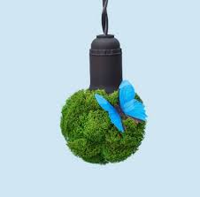
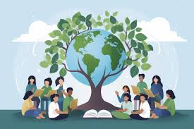
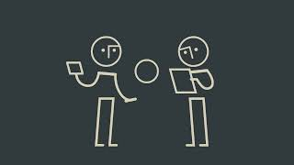
C 1.1.1 A designer has a responsibility to the needs of clients, their community and the environment when designing and creating products.
Design choices are highly crucial in determining how products affect communities and the environment. Well-considered designs can bring positive benefits, such as affordable housing that enhances living standards or sustainable packaging that minimizes waste and preserves resources. In contrast, careless design decisions like using non-recyclable materials, creating energy-intensive products, or reducing product lifespan can damage ecosystems and place heavy burdens on society.
Responsible design is essential, as it improves functionality and accessibility while also supporting sustainability and community well-being in the long term.

Slide 4
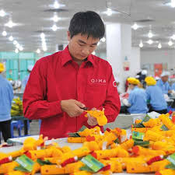
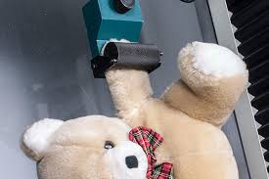
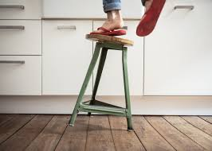
C 1.1.2 It is a designer’s responsibility to ensure their products are safe to use.
Designers have an important responsibility to make sure that their products are safe to use. Unsafe design can cause accidents, health problems, and even result in legal issues or a loss of trust from customers. For example, when designing toys for children, designers must avoid small detachable parts that could be choking hazards and use non-toxic materials to keep children safe. In consumer electronics, safety features such as proper insulation and heat management are necessary to prevent electric shocks or fires. Similarly, in furniture design, products must be stable and durable so they do not collapse during regular use. By following safety standards, carrying out thorough testing, and meeting legal regulations, designers ensure their products protect users while also being dependable and trustworthy.

Slide 5


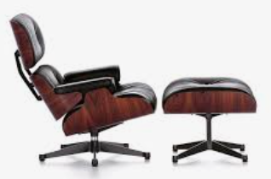
C 1.1.3 Products can become obsolete due to a number of factors and this can be planned.
Obsolescence
Some products are considered to be design classics based on the quality of execution, enduring qualities and restraint - what does this actually mean?
All classic designs have qualities that enables them to fulfill its function as an actual product, whether it is making toast or shading your eyes from the sun. Some products however obtain a classic status that transcends their basic function and they become iconic objects, for what they look like, or what they stand for in society. For example, The Spitfire fighter plane has transcended past its original function as a weapon of war for the British people and has reached iconic status in their culture to represent freedom and liberty.
What classics designs from your culture have reached iconic status?
How a classic design defies obsolescence and transcends its original function.
These two video outline what obsolescence is, and how industry has used this as a means of generating more sales. Whether this is right or wrong is up to you to decide, but how does this connect to classic designs? A classic design might be so entrenched into our culture and life that it may no longer be needed as a functional object, or may have actually
become technically obsolete. However, because of its iconic status and its valued place in our society and culture it is still highly valuable. It may still sell in small numbers although it may not be commercially viable to produce in large numbers, it may still have a “niche” marketplace. If it has been taken out of production, the resale value of the existing and remaining items can increase enormously as the amount of available items reduces over time. Such items become collectable and have investment value. This can also lead to an increase in the products “iconic” status. Classic cars are a good example of this. Some classic designs may not intrinsically be worth much money but are valuable and desirable objects to certain owners or collectors, such as children’s toys etc.
Obsolete. No longer produced or used; out of date.

Slide 6
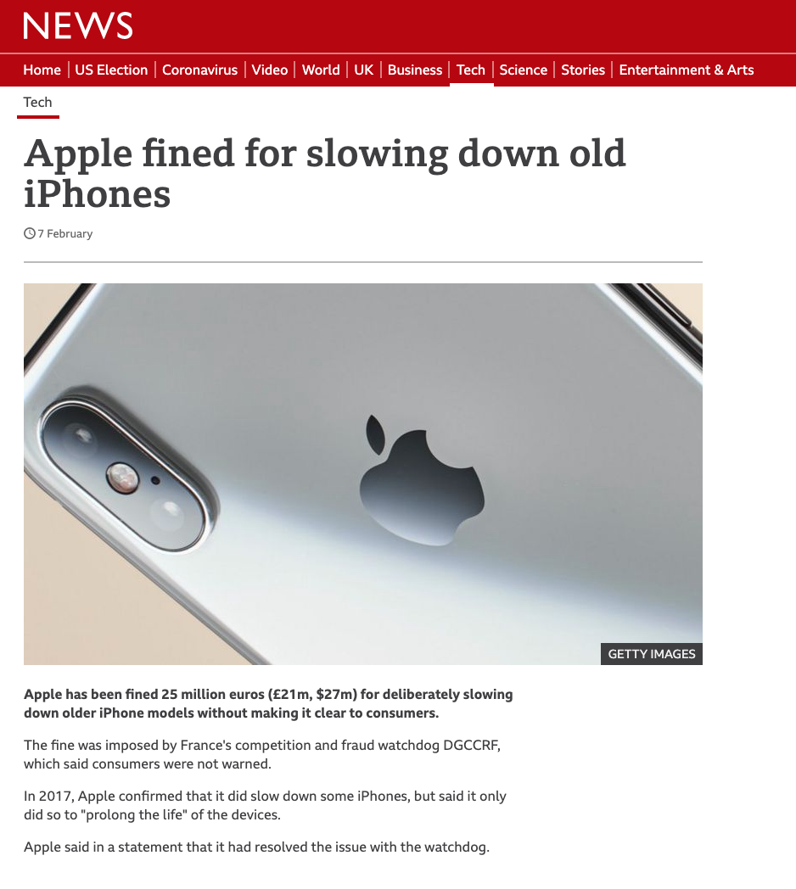
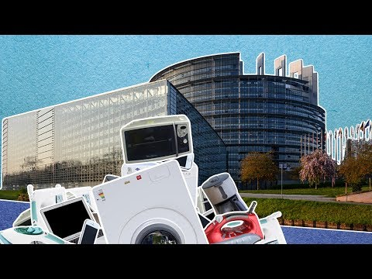
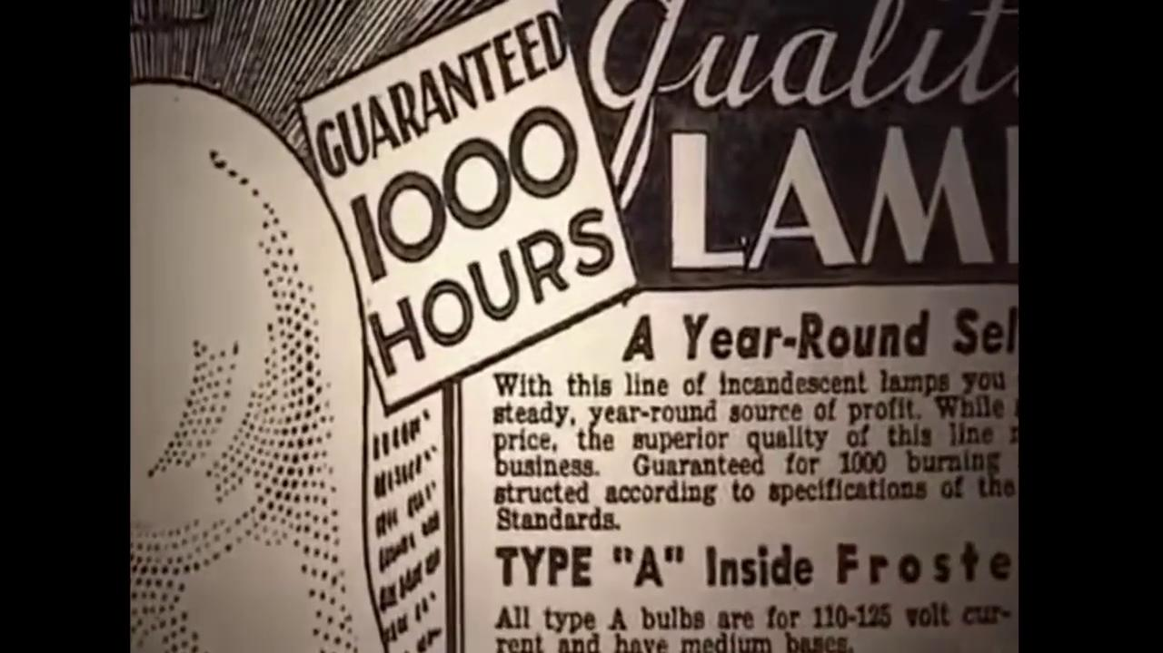
C 1.1.3 Products can become obsolete due to a number of factors and this can be planned.
Planned obsolescence
Planned obsolescence can sometimes be called premature obsolescence. This is where the technology of the product is in advance of the products current life cycle. Premature obsolescence is where a company deliberately slows down their older models so customers will seek to upgrade to the latest version. This has become more prevalent with electronic products, as it is easy to schedule a software upgrade to initiate the process.
Apple is possibly the most recent and famous company caught doing this. In 2017 it was forced to admit that is was deliberately slowing down its older models. It was eventually fined €25 million in Europe for doing so.
Planned obsolescence is when a product is deliberately designed to have a specific product cycle. It is usually designed to shorten the life span of the product.
The product is deliberately designed to last long enough to develop a customers lasting need. It is also designed to convince the customer that the product is a quality item, even though it will eventually need replacing. In this way, when the product fails the customer will want to buy another up-to-date model. You can argue whether this is morally right or wrong, but many many companies have been using this practice for years.
Obsolescence can also determined by fashion, material, technology or improvements in manufacturing techniques. These however would not be seen as planned obsolescence, but through natural progression, and be part of product innovation and invention.

Slide 7
C 1.1.3 Products can become obsolete due to a number of factors and this can be planned.
Planned obsolescence
Planned obsolescence can sometimes be called premature obsolescence. This is where the technology of the product is in advance of the products current life cycle. Premature obsolescence is where a company deliberately slows down their older models so customers will seek to upgrade to the latest version. This has become more prevalent with electronic products, as it is easy to schedule a software upgrade to initiate the process.
Apple is possibly the most recent and famous company caught doing this. In 2017 it was forced to admit that is was deliberately slowing down its older models. It was eventually fined €25 million in Europe for doing so.
Planned obsolescence is when a product is deliberately designed to have a specific product cycle. It is usually designed to shorten the life span of the product.
The product is deliberately designed to last long enough to develop a customers lasting need. It is also designed to convince the customer that the product is a quality item, even though it will eventually need replacing. In this way, when the product fails the customer will want to buy another up-to-date model. You can argue whether this is morally right or wrong, but many many companies have been using this practice for years.
Obsolescence can also determined by fashion, material, technology or improvements in manufacturing techniques. These however would not be seen as planned obsolescence, but through natural progression, and be part of product innovation and invention.

Slide 8
C 1.1.3 Products can become obsolete due to a number of factors and this can be planned.
Types of obsolescence
Type | Definition | Impact on Users/Markets | Example
Planned | Product is deliberately designed with a limited lifespan. | Consumers must replace products sooner; creates waste but boosts company sales. | Printers that stop after a fixed number of prints.
Technological | New technology makes older products outdated or incompatible. | Forces upgrades; encourages innovation but leaves old products behind. | Smartphones losing software support.
Aesthetic (Style/Design) | Products become unfashionable due to changing styles or trends. | Fuels consumerism; waste from still-functional products. | Fast fashion or yearly car model redesigns.
Functional | Product no longer performs as well compared to new alternatives. | Pushes innovation in efficiency and usability; old products become redundant. | CRT TVs replaced by LED flat screens.
Perceived | Consumers believe their product is outdated because of marketing or social pressure. | Encourages unnecessary replacement; strongly linked to branding and lifestyle. | Upgrading to the newest iPhone even if the old one works.

Slide 9
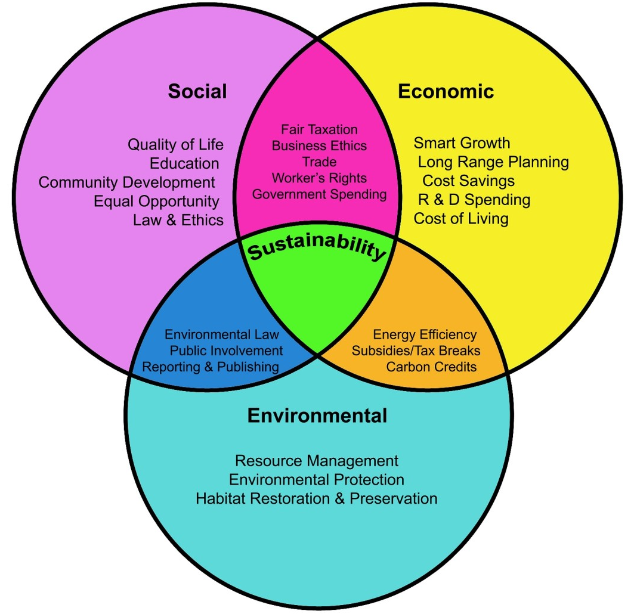
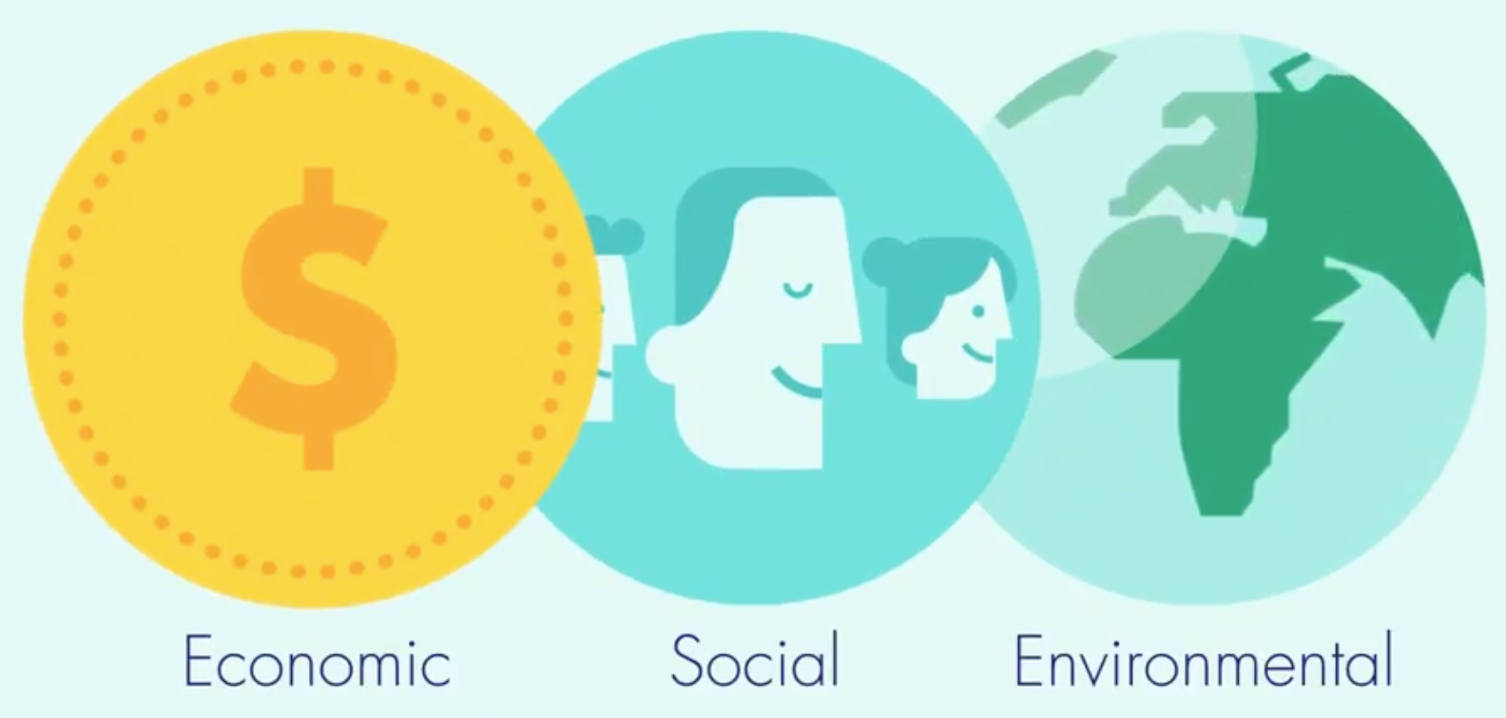
C 1.1.3 Products can become obsolete due to a number of factors and this can be planned.
Triple Bottom Line (TBL)
The concept of the triple bottom line means that business success is no longer defined by monetary gain but also by the impact an organisation’s activities have on society as a whole - Environmental, Economic and Social.
hubpages.com
Triple Bottom Line
Using resources more productively and redesigning production, it is technically possible to deliver the same or equivalent goods and resources with lower environmental impact while maintaining social and equity benefits.

Slide 10
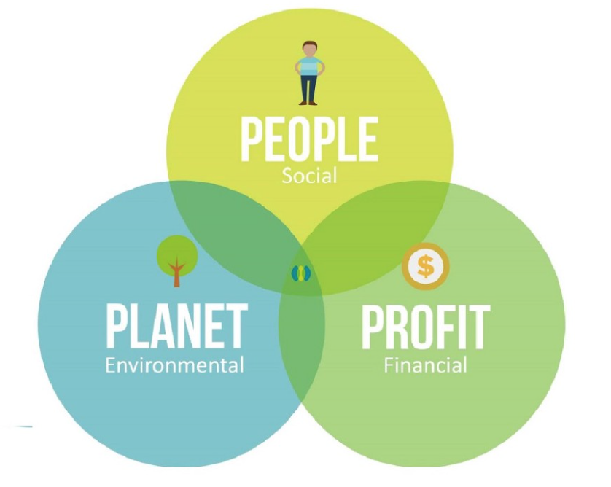
C 1.1.3 Products can become obsolete due to a number of factors and this can be planned.
Triple Bottom Line (TBL)- Environment (Planet)
Development in the environmental sense is a recent concern relating to the need manage scarce natural resources in a prudent manner - because human welfare ultimately depends on the environment they live in, and the ecology that depends on that environment. Ignoring safe ecological limits could undermine the long term prospects for development.
Environmental sustainability focuses on the overall viability and normal functioning of natural systems. Understanding what is happening within your local, regional, and global environment will help improve sustainable development. Variables that should be taken into consideration would include: air and water quality, energy consumption, natural resources, solid and toxic waste, land use/land coverage etc. This is by no way an extensive list, but provides a small insight to what is required. To help organisations identify potential environmental impacts a project or governmental policy could have on a specific area, it is best to analyse all this data over an extended period of time. Some variables they might look for in a specific area would include:
In the land, air or water | Human activities
Sulfur dioxide concentration. Nitrogen oxide concentration. Pollutants. Excessive nutrients. | Electrical consumption. Fossil fuel consumption. Solid and hazardous waste management. Changes in land use / land cover.
How environmental sustainability can successfully be done.
What happens when its not.

Slide 11
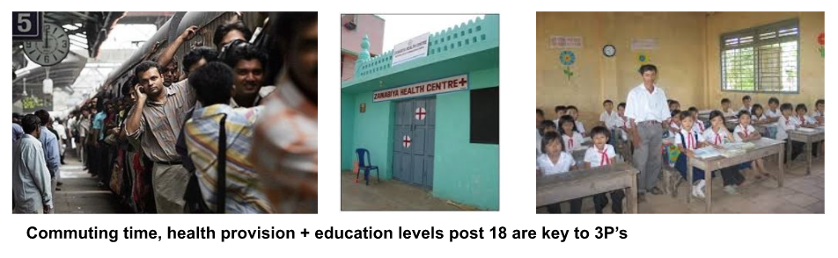
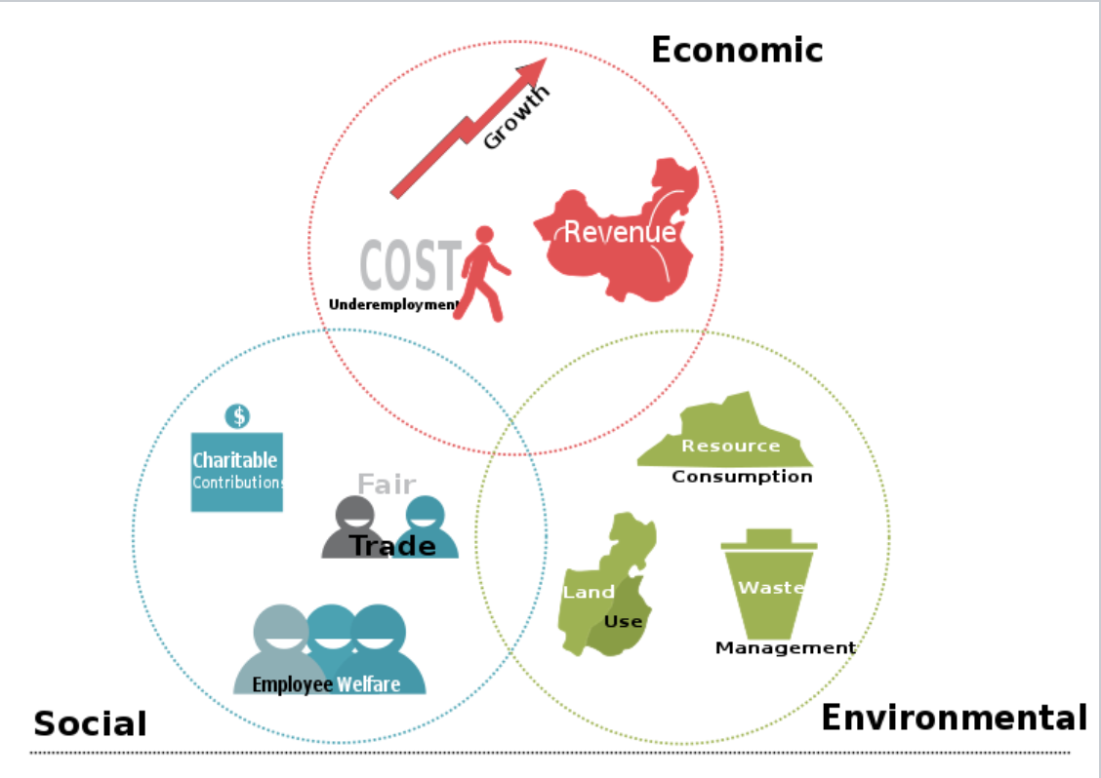
C 1.1.3 Products can become obsolete due to a number of factors and this can be planned.
Triple Bottom Line (TBL)- Social (People)
The people, social equity, or human capital bottom line pertains to fair and beneficial business practices toward labour and the community and region in which a corporation conducts its business. A TBL company conceives a reciprocal social structure in which the well-being of corporate, labour and other stakeholder interests are interdependent.
An enterprise dedicated to the triple bottom line seeks to provide benefit to many constituencies and not to exploit or endanger any group of them. A TBL business would not use child labour and monitor all contracted companies for child labour exploitation, would pay fair salaries to its workers, would maintain a safe work environment and tolerable working hours, and would not otherwise exploit a community or its labour force.
A TBL business also typically seeks to "give back" by contributing to the strength and growth of its community with such things as health care and education.
Markers for measuring TBL Social:
Unemployment rate.
Female labour force participation rate.
Median household income.
Relative poverty.
% of population with higher education.
Average commute time.
Violent crime rate per capita..
Life expectancy rate.

Slide 12
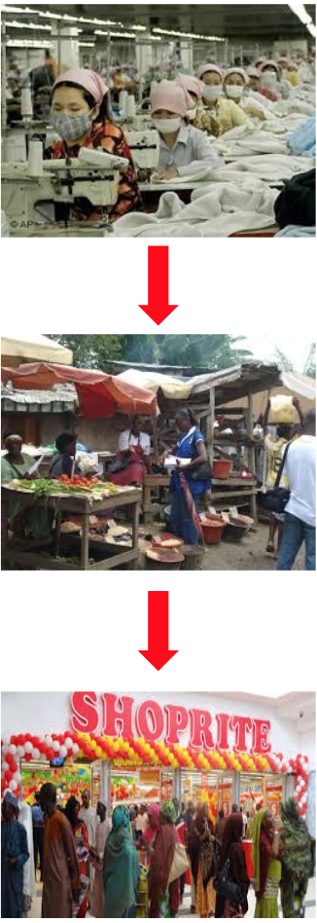
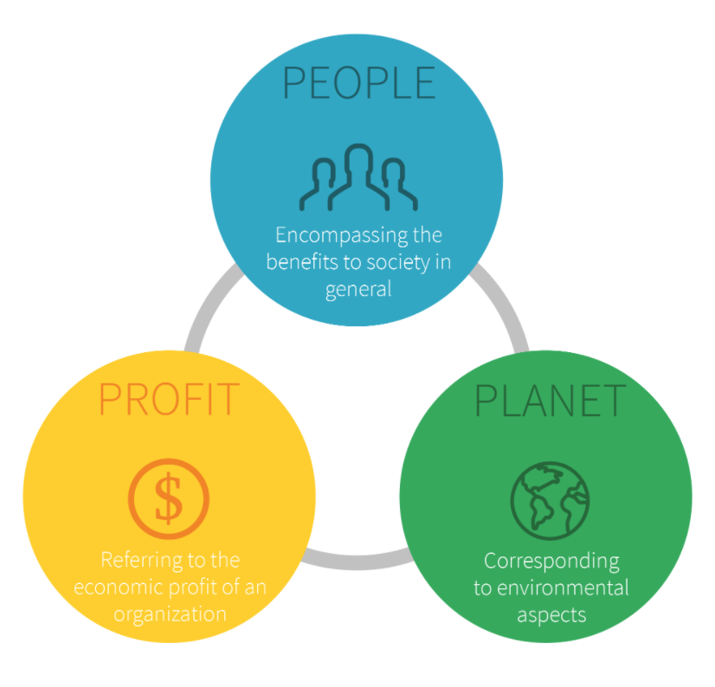
C 1.1.3 Products can become obsolete due to a number of factors and this can be planned.
Triple Bottom Line (TBL)- Economic (Profit)
The profit or economic bottom line deals with the economic value created by the organization after deducting the cost of all inputs, including the cost of the capital tied up. It therefore differs from traditional accounting definitions of profit. In a sustainability framework, the "profit" aspect needs to be seen as the real economic benefit enjoyed by the host society. It is the real economic impact the organization has on its economic environment, and not just the economic benefit to the company or organisation. This section is often confused to be limited to the internal profit made by a company or organization
Economic progress is often evaluated in terms of wealth - measured in a society's ability to pay for goods and services consumed. Thus, many governments economic policies typically seek to enhance income, and induce more efficient production and consumption of goods and services. The stability of prices and employment are among other important objectives.
Growth, development, productivity, trickle down.
“Trickle down economics” or “trickle down theory” is the economic political argument that the increases in wealth of the rich are good for the poor because some of the additional wealth will eventually trickle down to the middle class and poor.
Markers for measuring TBL Economic:
Personal income levels.
Cost of unemployment.
Job growth.
Employment distribution by sector.
Percentage of firms in each sector.
Input of each sector to GDP.

Slide 13
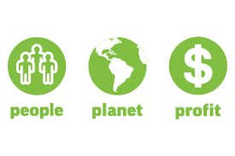
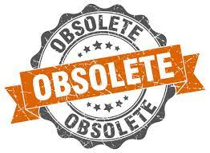
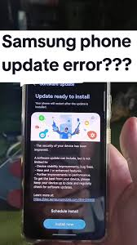
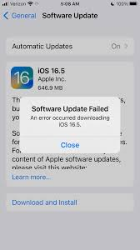
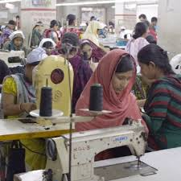
C 1.1.3 Products can become obsolete due to a number of factors and this can be planned.
Effects of obsolescence on TBL - Social (People)
Impact on People
Negative:
Consumers are forced to spend more money replacing products sooner than necessary, which can create financial strain.
Frustration and distrust build when products are deliberately designed with short lifespans.
Example: Smartphones that stop receiving software updates after a few years leave users with insecure devices, even if the hardware still works.
Positive (sometimes):
Rapid replacement cycles create demand for new jobs in design, marketing, and sales.
Example: The fashion industry’s "fast fashion" creates many employment opportunities, though often in poor working conditions.
People: Pay more, feel frustrated, but sometimes benefit from job creation.

Slide 14
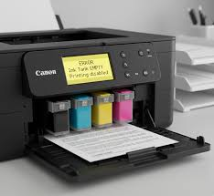
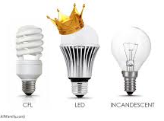
C 1.1.3 Products can become obsolete due to a number of factors and this can be planned.
Effects of obsolescence on TBL - Environment (Planet)
Impact on Planet
Negative:
More electronic waste (e-waste) and landfill pollution due to short-lived products.
Increased resource extraction for raw materials (e.g., rare earth metals in electronics).
Example: Printers designed with chips that prevent them from working after a set number of prints generate unnecessary waste.
Positive (rare):
If old products are replaced by newer, more energy-efficient models, total environmental impact could reduce.
Example: Replacing incandescent bulbs with LED lighting decreases long-term energy use.
Planet: Suffers from resource depletion and waste, though energy efficiency gains can help.

Slide 15
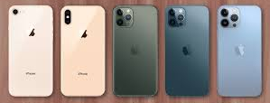
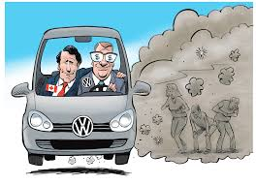
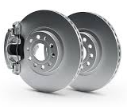
C 1.1.3 Products can become obsolete due to a number of factors and this can be planned.
Effects of obsolescence on TBL - Economic (Profit)
Impact on Profit
Positive:
Obsolescence drives repeat purchases, boosting company profits.
Example: Apple releases new iPhone models every year, encouraging customers to upgrade. Creates opportunities for secondary markets (repair services, refurbished goods).
Negative:
Brand reputation can suffer if consumers feel manipulated.
Increasing regulation (like Right to Repair laws in the EU and US) may penalize companies that practice aggressive planned obsolescence.
Example: Volkswagen faced backlash when older parts became unavailable quickly, reducing customer trust.
Profit: Companies gain short-term profit, but risk long-term reputation and regulatory challenges.

Slide 16
