Slide 1

Design in context
Inclusive Design

Slide 2
Contents
Inclusive Design | Discuss how inclusive design requires designing universally accessible products for all users, including those with physical, sensory and cognitive impairments.
Limitations | Discuss how the average person correlates to the 50th percentile adult and child, and how it is not always appropriate to design for the average person.
Design for extremes | Discuss the advantages of designing for extremes when designing products for a general population, and identify where a design for extremes strategy has been used.

Slide 3
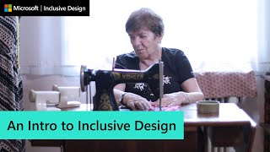

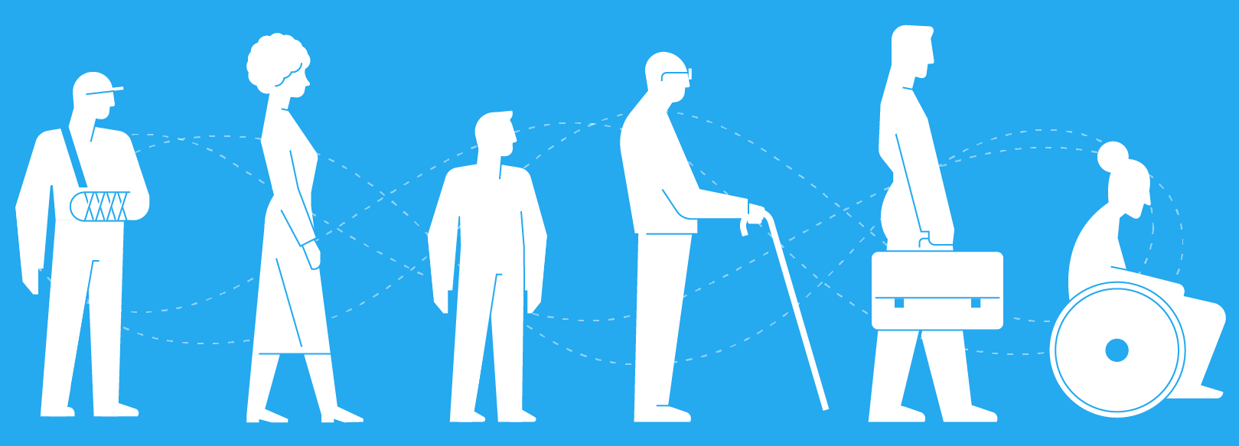
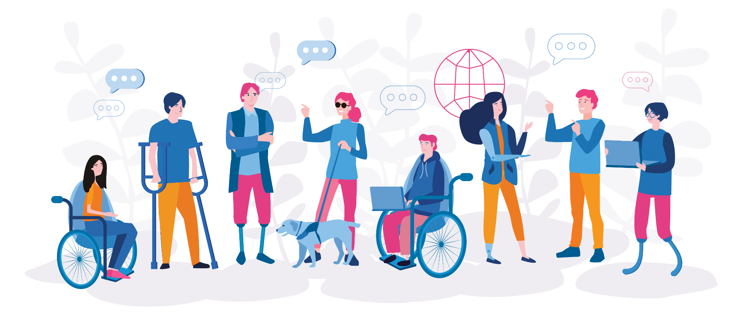
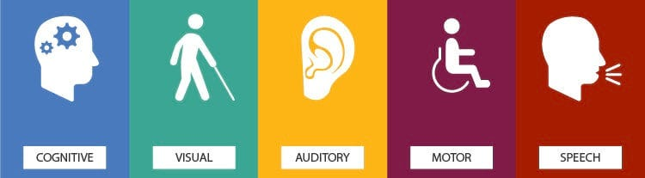
C 1.2.1 Inclusive design ensures products that address the needs of the widest possible audience, regardless of their age or ability, and focuses on designing universally acceptable products for all users.
Inclusive design is a methodology for creating products, services, and environments that are usable and accessible to the widest possible range of people, regardless of age, ability, gender, race, or other aspects of their diverse human experience.
It overlaps with accessibility, universal design, but is more flexible and emphasizes designing with difference (i.e. involving marginalized users in design) rather than just meeting standards.

Slide 4

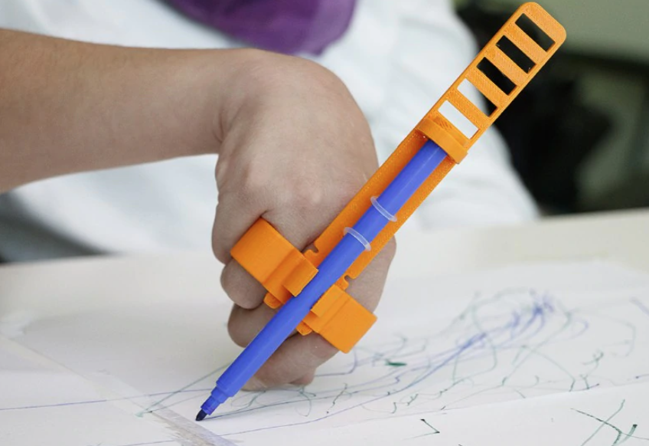
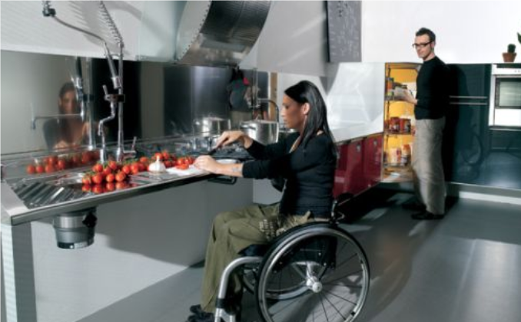
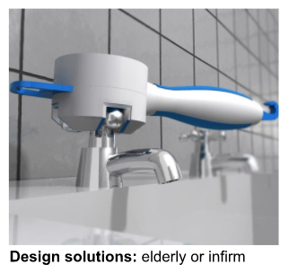
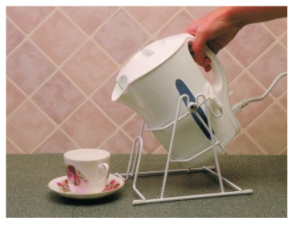
C 1.2.1 Inclusive design ensures products that address the needs of the widest possible audience, regardless of their age or ability, and focuses on designing universally acceptable products for all users.
Classification of users
iDEO have worked on a project designing homes for wounded soldiers. For this to be successful they had to fully understand the user’s in order to design a house
User populations can be classified into groups depending on age, gender, and physical condition. This can allow the design to gather detailed feedback to generate insights for designs that target specific groups and address their particular needs.
that met their specific needs. To do this, they had to identify and fully understand the criteria by which they should group their users.
Physical conditions might include:
Arthritis.
Partial paralysis.
Parkinson’s disease.
Repetitive strain inquiries.
Blindness.
Loss of hearing - full or partial.
Reduced sense of touch.
Children.
Elderly or infirm.
A group of users that suffer with arthritis in their wrists would have different concerns with the design of a range of products, and would give different feedback than a population of users with no artritis.
Designers can also classify users into groups by considering criteria such as interests, habits, nuances, emotional response to specific stimuli. The criteria about which a product will be designed, will be defined by the classification of the user group.

Slide 5
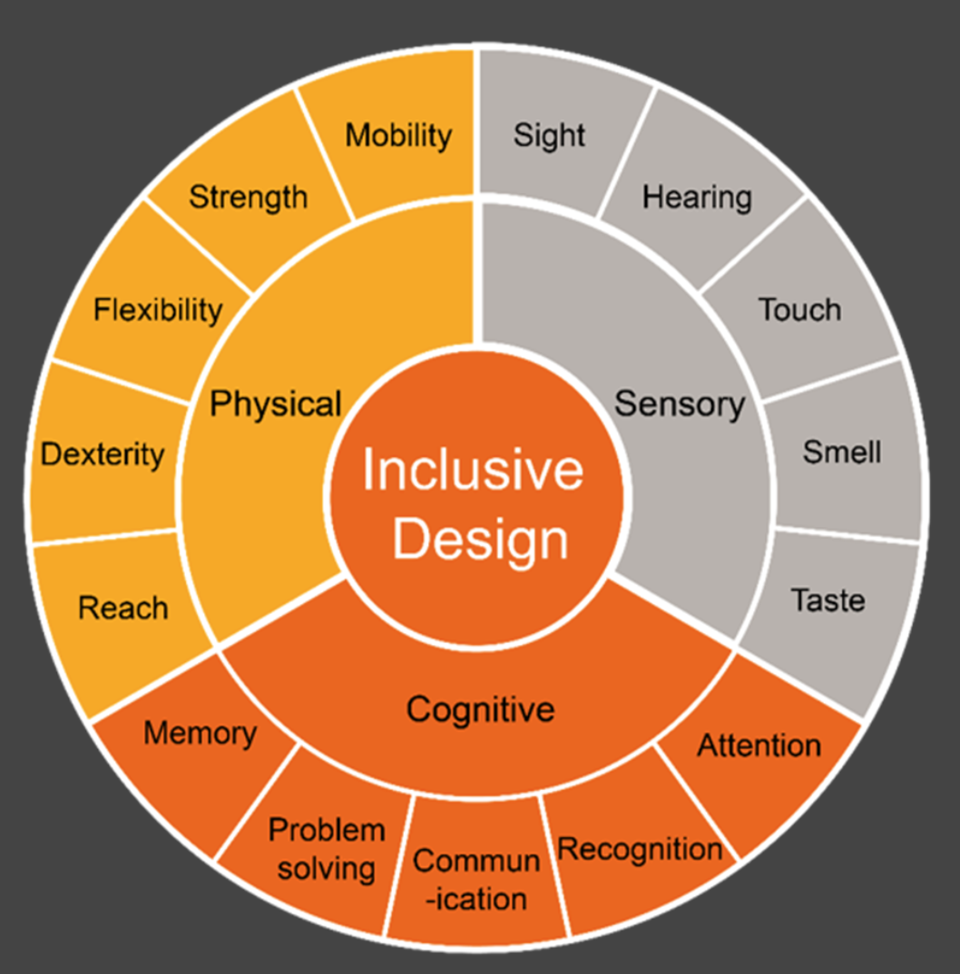
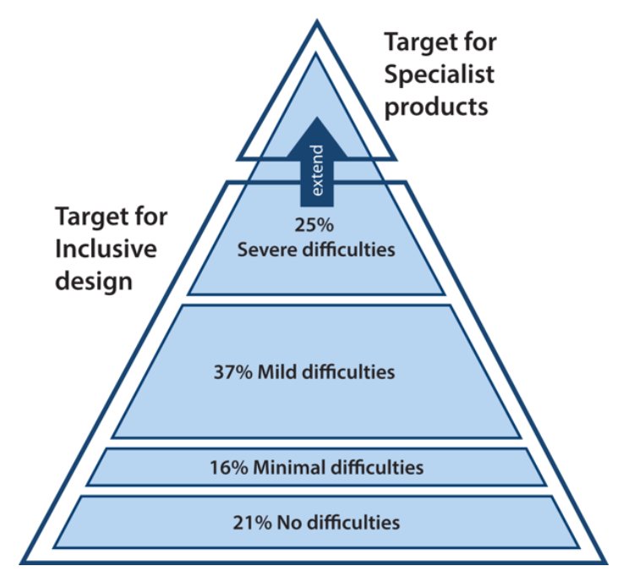
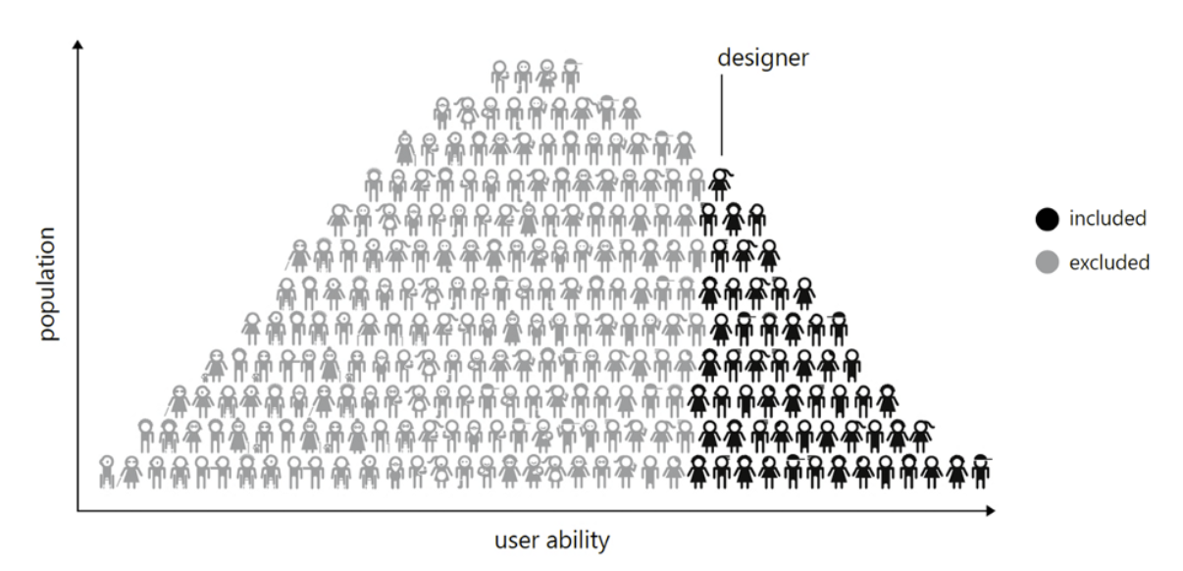
C 1.2.1 Inclusive design ensures products that address the needs of the widest possible audience, regardless of their age or ability, and focuses on designing universally acceptable products for all users.
Inclusive design is important to the designers of tomorrow - and those that educate them. Future consumer markets will be more diverse than ever in terms of age and physical ability. In the past, design education looked at ‘special needs design’ exclusively for special needs groups. Attitudes are changing, now the focus is on better mainstream solutions for everyone, supported by new design research techniques to make the development process more user-centred. Being inclusive for all ensures there is sufficient markets for the products and increases the feasibility of innovation into new products that are accessible to widest target audience as possible.
The pyramid model of diversity can be used to show how inclusive design aims to extend the target market to include those that are less able, while accepting that specialist solutions may be required to satisfy the needs of at the very top of the pyramid.
Why is inclusive design important?
Demographic change is a major challenge for designers. For example, there are already over 130 million people over 50 in the EU alone. In 2020 that means one in every two adults will be over that age. The rapid aging populations, and growing numbers of people with disability are having a profound effect on new product and service design. The need for more socially inclusive design is raising in importance in the business community. Designs that include the needs of marginalised groups of people is regarded not only as socially desirable, but also as a commercial opportunity. If you design products for people with no difficulties, you are then excluding 79% of the population. It makes no commercial sense to do so.

Slide 6
C 1.2.2 Inclusive design is not always possible.
Challenge / Limitation | Explanation | Examples / Impacts
Trade-offs & Conflicting Needs | Different user groups often have opposite needs, so satisfying one may reduce usability for another. | A touchscreen interface with very small buttons may be great for someone with high dexterity, but terrible for someone with a motor impairment.
Resource / Cost Constraints | Designing for many edge cases requires extra time, budget, specialized user research, prototyping, testing, and often custom features. Many projects do not have that margin. | A startup may not afford to build different accessible modes, so they optimize for “typical” users and add minimal accessibility.
Technological Limitations | Hardware or software constraints prevent accommodating certain needs. Some assistive technologies may not integrate well. | In older smartphones, you may not be able to retrofit high-contrast text modes or advanced voice control. Or in digital products: some browsers or OS versions don’t support required APIs for accessibility.
Lack of Knowledge / Awareness | Designers may not know about certain disabilities, cultural issues, or edge cases. Inclusive user research is often neglected. | Many websites are still designed with default assumptions (able-bodied, sighted, young) — e.g. poor color contrast, no alt text, no screen reader support. (Nielsen Norman Group)
Difficulty in Predicting All Variability | You can’t imagine or test every kind of human variation (sensory, cognitive, physical, cultural). Some disabilities or conditions are rare or emergent. | For example, designing for all forms of neurodiversity (autism, ADHD, dyslexia, …) is complex; what helps one group might confuse another.

Slide 7
C 1.2.2 Inclusive design is not always possible.
Challenge / Limitation | Explanation | Examples / Impacts
Standards / Regulations / Legacy Systems | You have to work with legacy systems or regulatory constraints, which limit what you can change. Backwards compatibility matters. | A public building may have structural constraints; older infrastructure might not permit large ramps or wide doors. Or software systems must support older hardware, making it harder to modernize accessibility.
Perceived vs Real Demand & ROI | Organizations may underestimate how many users need inclusive features, or not see enough financial return to prioritize them. | A company might argue “only 1% of users have this disability,” so inclusive features are “extra cost.”
Design Complexity & Performance Penalties | More features, adaptability, modes can make the system more complex, heavier, slower, and harder to maintain. | A UI that adapts dynamically to many input modes (voice, gesture, keyboard, touch) may be slower, more bug-prone, and more expensive to maintain.
Conflict with Aesthetics / Branding | Some inclusive features might conflict with a brand’s desired visual aesthetic or minimalism, so they get deprioritized. | Low-contrast text or high-contrast modes might “clash” with a brand’s color scheme; adding extra buttons or controls might disturb the clean design.
Cultural / Contextual Differences | What is inclusive in one culture or context may be exclusionary in another. Local needs, norms, and values differ. | In some places, certain colors or symbols have different cultural meanings; in rural vs urban settings, modes of access differ (e.g. internet speed, device type).

Slide 8
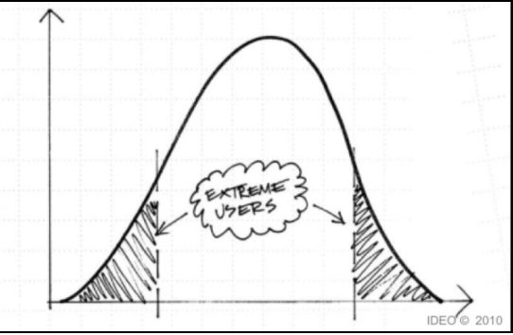
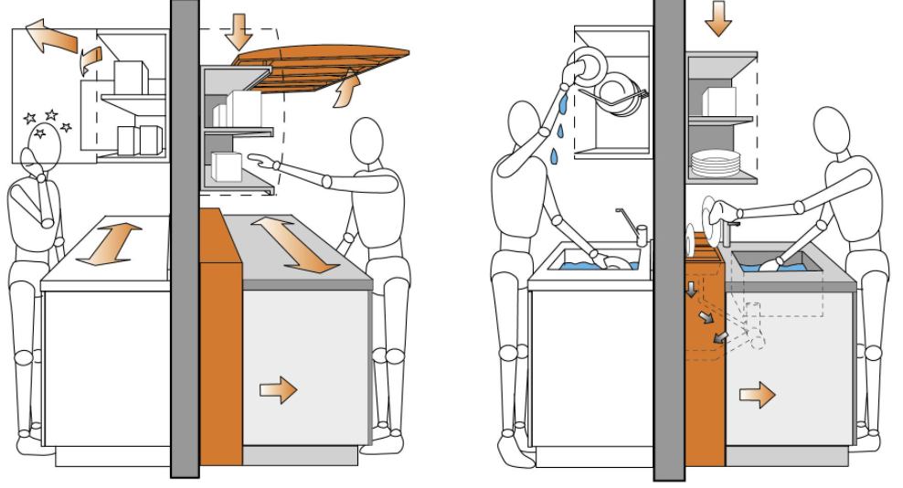
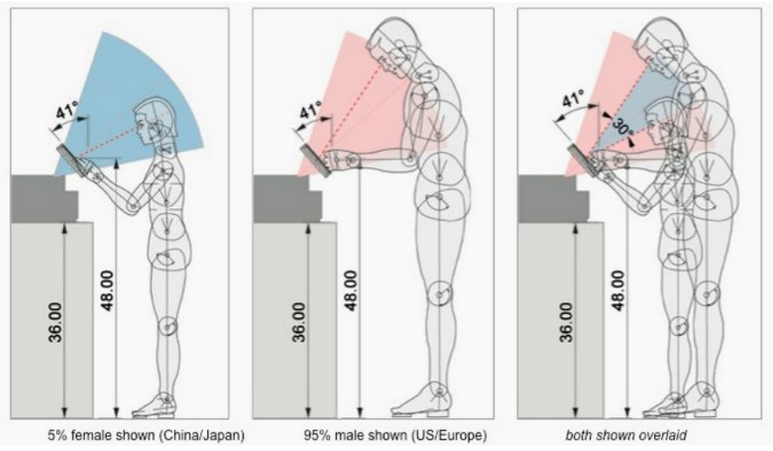
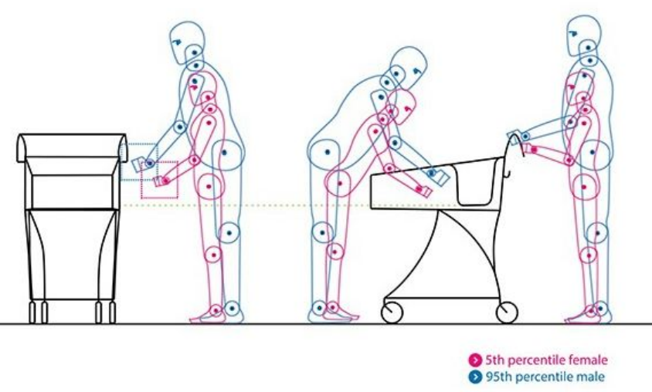
C 1.2.3 Designers often use a “design for extremes” strategy to develop solutions suitable for use by those with physical, sensory and cognitive impairments, which are also appropriate for the general population.
One common way of defining the range of user population is the so-called ‘method of extremes’. Using this method, sample ‘users’ are selected to represent the extremes of the user population, plus one or two intermediate values. For example, in a study to establish a recommended height of a kitchen worktop three groups of users were selected.
The shortest would be the 2.5th percentile range - 1500 mm tall ± 25mm.
The mean range or the 50th percentile - 1625 mm tall ± 25mm.
The tallest would be the 97.5th percentile - 1740 mm tall ± 25mm.
Why were these ranges chosen - who do you think the target market would be?
Another example of method of extremes:
If you were designing a doorway using the height, shoulder and hip width of the average person, then half the people using the doorway would be taller, and half would be wider. Since the tallest people aren’t necessarily the widest, you need to consider the extremes for each dimension. In this case you would need to design with the dimensions of the widest, and the tallest people in your user population group, to ensure the vast majority of users can walk through it normally.
What other things can you think of that are designed using the method of extremes?
Deciding which percentile range to design for will depend on the what you are designing, and who you are designing for.

Slide 9
C 1.2.3 Designers often use a “design for extremes” strategy to develop solutions suitable for use by those with physical, sensory and cognitive impairments, which are also appropriate for the general population.
Usually you will find if you pick the right percentile range, 95% of people will be able to use your design. Sometimes you can’t accommodate all of your users, because there are conflicting solutions in your design. In this case, you will have to make a judgement call about what is the most important feature, and which ones the user will have ‘live’ with. However, you must never compromise safety, and if there is a real risk of injury, you may have to use more extreme percentiles - the 1st or 99th percentile to make sure everyone is protected and not just 90% of people.
What are you designing for? | Examples: | Measurements to consider: | Users you should accommodate:
Easy reach. | Vehicle dashboards. Shelving. | Arm length, shoulder width. | Smallest user - 5%
Adequate clearance to avoid contact or trapping. | Inspection covers. Cinema seats. | Shoulder or hip width. Thigh length. | Largest user - 95%
A good match between user and product. | Seats. Helmets, pushchairs. | Floor-knee height, head circumference, weight. | Maximum range - 5 to 95%
Comfortable and safe posture. | Lawnmowers. Monitor positions, workspace height. | Elbow height, seated eye height. | Maximum range - 5 to 95%
Easy operation. | Door handles. Light switches, screw top bottles. | Grip strength, hand width, height. | Smallest or weakest - 5%
Restricted reach or limited operational space. | Machine guards. Safety railings, emergency stops. | Finger width, arm length. | Smallest user - 5% Largest user - 95%

Slide 10
