Slide 1

Design in context
C1.3 Beyond Usability
HL Topic

Slide 2
Contents
The four-pleasure framework | Outline how the four-pleasure framework can be used to create designs that intentionally trigger socio-, physio-, psycho- and ideo-pleasure responses.
The ACT model | Suggest how the ACT model can be used as a framework for creating products that intentionally trigger positive emotional responses, considering desirability, usability and usefulness.

Slide 3
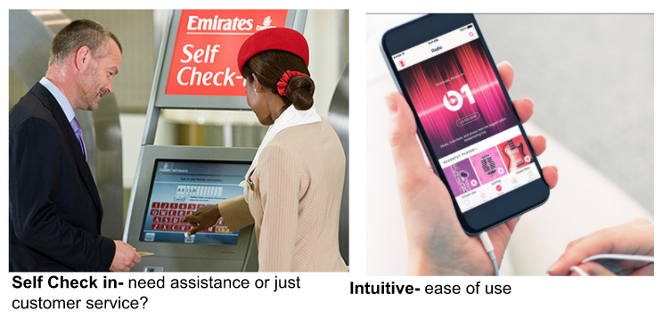
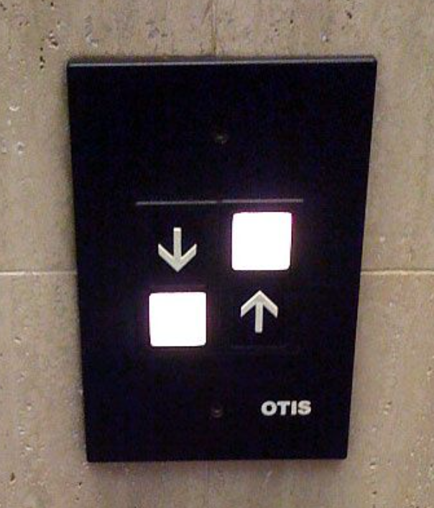
C 1.3.1 The four-pleasure framework can act as a critical component to determine how users interpret and interact with a product.
Usability
Usability is the extent to which a product can be used by specific users to achieve specific goals effectively (completely and accurately) and efficiently (fast with minimal effort) while functioning in a predictable and consistent manner. If so, the product can be considered intuitive, pleasant, satisfying to use and tolerant of user errors - that is, it prevents and enables users to recover from errors.
“Good design makes a product understandable” - Dieter Rams

Slide 4
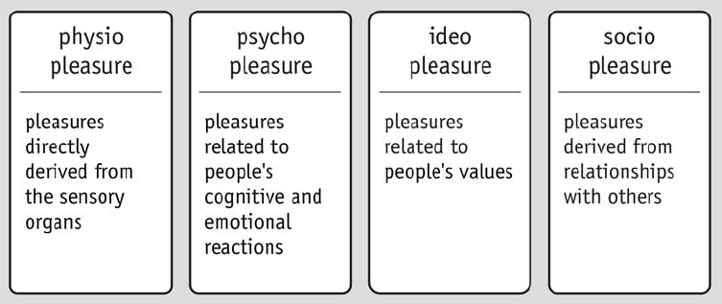
C 1.3.1 The four-pleasure framework can act as a critical component to determine how users interpret and interact with a product.
Quick View

Slide 5
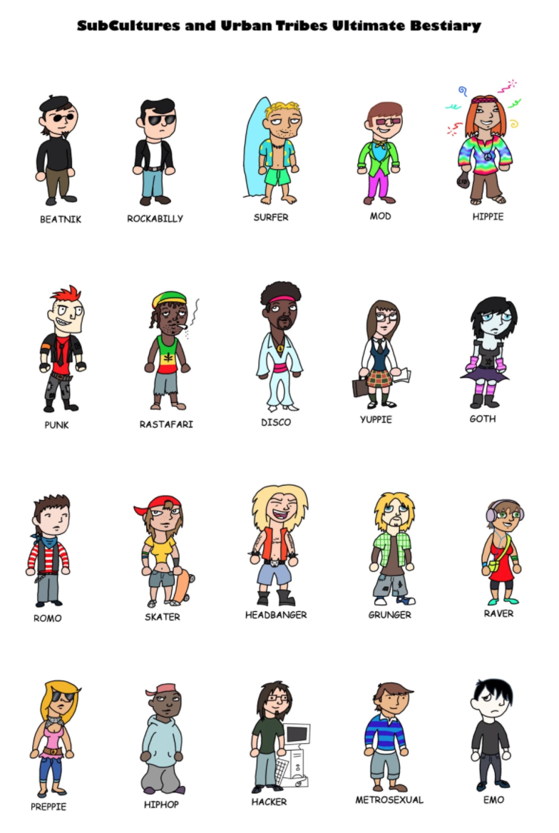
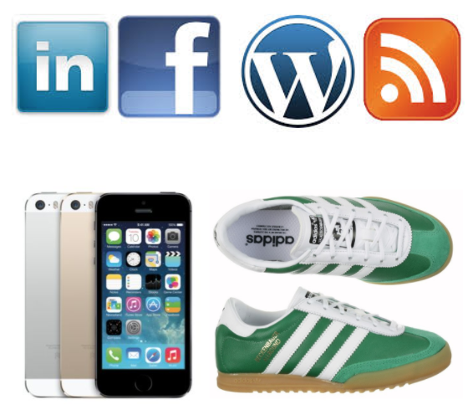

Pleasure comes from a feeling of belonging to a social group, social enablers, and other ways that one can identify oneself with social groups
C 1.3.1 The four-pleasure framework can act as a critical component to determine how users interpret and interact with a product.
Socio-pleasure
Socio-pleasure can be derived from social interaction and connections with a product, service or system. People ‘like’ being part of a group, and being connected with each other. Products, systems and services can facilitate social interactions in a variety of ways - Email, internet, phones for example facilitate communication between people.
Pleasure from relationships with others, for example, friends, loved ones, colleagues or like-minded people or with society as a whole is generally seen by humans as a positive in their lives, and most people will crave this type of pleasure. Products may promote social interaction by being conversation starters, for example, jewelry, artwork or furniture. Clothing can communicate social identity and indicate that a person belongs to a particular social group.

Slide 6
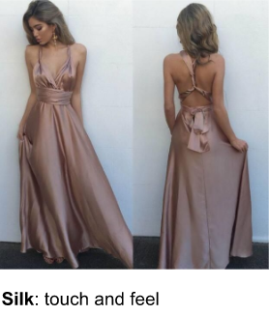
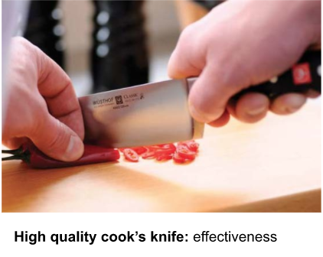
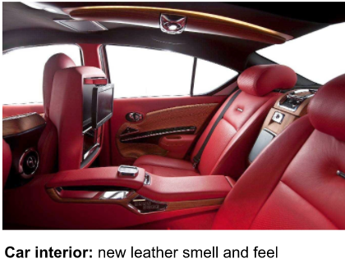


C 1.3.1 The four-pleasure framework can act as a critical component to determine how users interpret and interact with a product.
Physio-pleasure
Physio-pleasure is a sensual pleasure that is derived from touching, smelling, and tasting something. It is also conveyed by an object's effectiveness enabling an action to be performed correctly.
Physio-pleasure is that satisfactory feeling you get when using a product, for example:
Touch - the feel of a silk garment on your skin. The smooth controls on a touchscreen or tablet.
Taste - the luxurious taste of chocolate melting in your mouth. The warm satisfaction of a hot drink on a cold day.
Smell - fresh baked bread. Cut grass, or the smell of leather in a new car.

Slide 7

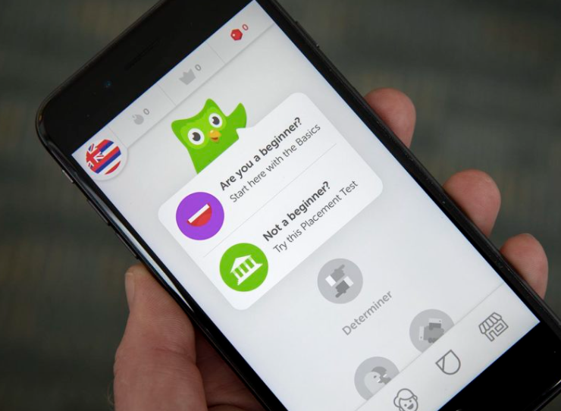

C 1.3.1 The four-pleasure framework can act as a critical component to determine how users interpret and interact with a product.
Psycho-pleasure
Psycho-pleasures are derived from cognition, discovery, knowledge and other things that satisfy your intellect. The cognitive demands of using a product or service and the emotional reactions you get from completing these tasks can be considered psycho-pleasure.
For example; the first time you pick up a new phone or tablet and start playing with it, you quickly get an idea how it works. Even if you don’t get it straight away, it is learnable, memorable and pretty constant - you soon get to ‘know the ropes’ and understand operate it effectively - this leads to a sense of satisfaction and achievement, largely because ‘it works’.
Games and puzzles are enjoyable because they present a challenge that we need to overcome. Whether finishing a Rubik’s cube or achieving checkmate in a game of chess, there is cognitive-emotional pleasure derived from such activities.
Rubik’s cube: Cognitive challenge.
DuoLingo: Discovering new knowledge - language learning
New technology: Discovering how it works.

Slide 8

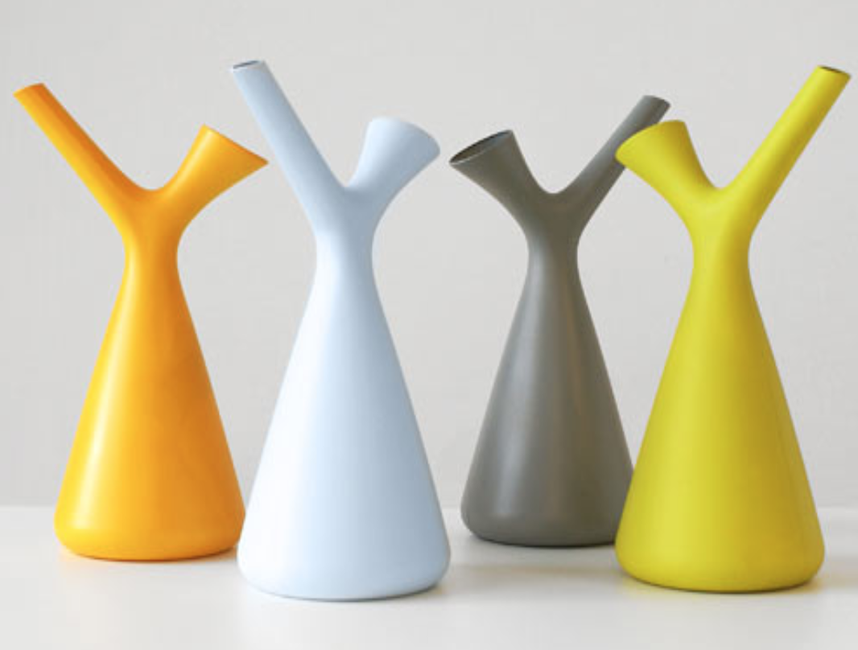
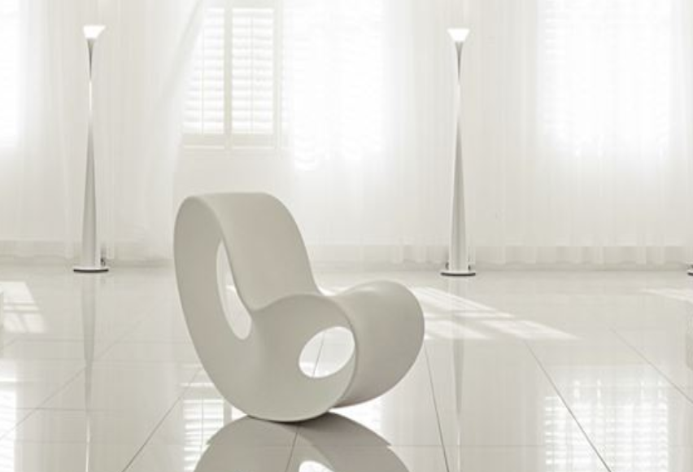

C 1.3.1 The four-pleasure framework can act as a critical component to determine how users interpret and interact with a product.
Ideo-pleasure
Ideo-pleasures are pleasures that are linked to our ideas - aesthetically and culturally, and pleasures that satisfy people's tastes, values and aspirations. Ideo-pleasures can be derived from products that are aesthetically pleasing by appealing to the customers personal values.
Values can be philosophical, religious, or relate to some particular issue, such as the environment or political movement. These values can be embodied in products, or be a symbol of a particular movement or socio-group. For example, a product made from biodegradable materials might be seen as embodying the value of environment responsibility. Ideo-pleasures can also be derived from the emotional feeling of appreciating beautifully designed, crafted and manufactured products.
Aesthetic sensibilities are often closely linked to our ideological or cultural identity, and determine to a great extent the pleasure they bring. For example, many people love the idea or indeed do get great pleasure from driving VW camper vans. This is where the ‘idea’ of it is greater than the reality. They are often impractical, unreliable and relatively expensive in comparison other vehicles that offer far greater utility - this is often the case with classic cars.

Slide 9

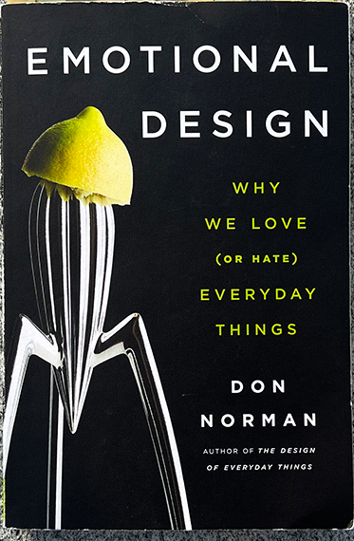

C 1.3.1 The four-pleasure framework can act as a critical component to determine how users interpret and interact with a product.
The four-pleasure framework relates to other design principles such as Donald Norman’s three levels of design appeal: visceral, behaviour and reflective outlined in 2003 in ‘Emotional Design’. Norman believed that designs that engage the emotions improved the user experience.
He suggested such design s should invoke three emotional responses :
Visceral (immediate sensory reaction),
Behavioural (functional usability),
Reflective (meaning and personal value)
A well designed product should provide pleasure at each level or interaction with -
Physical sensations like touch and aesthetics relating visceral;
Ease of use and functionality to behavioural; and
Personal connection or societal impact to the reflective level.
Don Norman
Video: Emotional Design

Slide 10
C 1.3.1 The four-pleasure framework can act as a critical component to determine how users interpret and interact with a product.
Physio-pleasure (Visceral):
As as it focuses on the immediate sensory experience of a product, like its texture, smell or visual appeal.
Psycho-pleasure (Behavioral):
As it relates to the pleasure derived from successfully completing a task or interacting with a product intuitively.
Socio-pleasure (Reflective):
As importance to the social meaning and personal value of a user associates with a product, like status or belonging within a group.
Ideo-pleasure (Reflective):
As it I'm encompasses the deeper meaning and personal values associated with a product, like sustainability or ethical considerations.

Slide 11
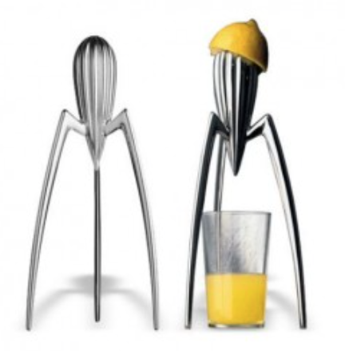
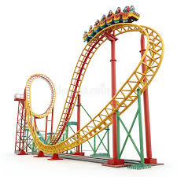
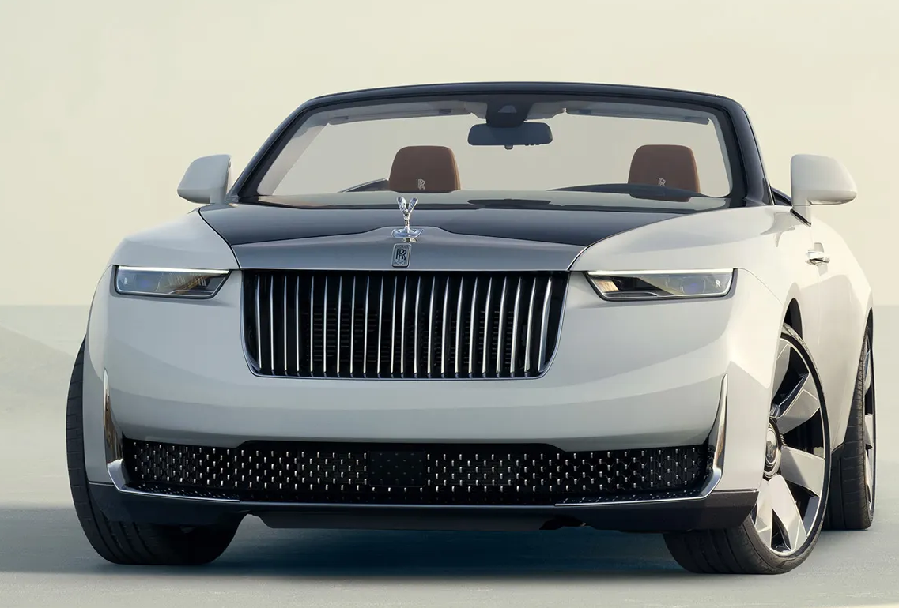
C 1.3.1 The four-pleasure framework can act as a critical component to determine how users interpret and interact with a product.
Examples:
Products can bring about a number of emotions at one time.
The Alessi juicer, its unusual design can a visceral reaction, and people want to own it to show they have specific tastes (reflective). However, most people would agree that it is not very good at doing its job as a juicer, conflicting and creating a negative behavioural reaction.
Amusement parks have a good relation between reflection and visceral reactions. The ride may look scary and dangerous, but the reflective levels tells you that ‘it’s safe, nothing is going to happen’; its calming you down, where as the visceral is operating at full force. Before getting on the ride the visceral level wins, but after you safely finish it, the reflective level wins.
A luxury car, visceral level(Physio-pleasure) the smooth leather interior, sleek design and engine sound. Behavioral level (Psycho-pleasure), the ease of driving and handling, advance features to enhance driving. Reflective level (Socio and Ideo pleasure), the prestige associated with owning a high-end brand, reflecting user’s success ans status.
Notes:
The 4 pleasure framework relates to other design principles such as Donald Norman’s three levels of design appeal: visceral, behaviour and reflective outlined in 2003 in ‘Emotional Design’. Norman beieved that designs that engage the emotions improved the user experience. He suggested such design s should invoke three emotional reponses :
Visceral ( immediate sensory reaction),
Behavioural (functional usability),
Reflective (meaning and personal value)

Slide 12
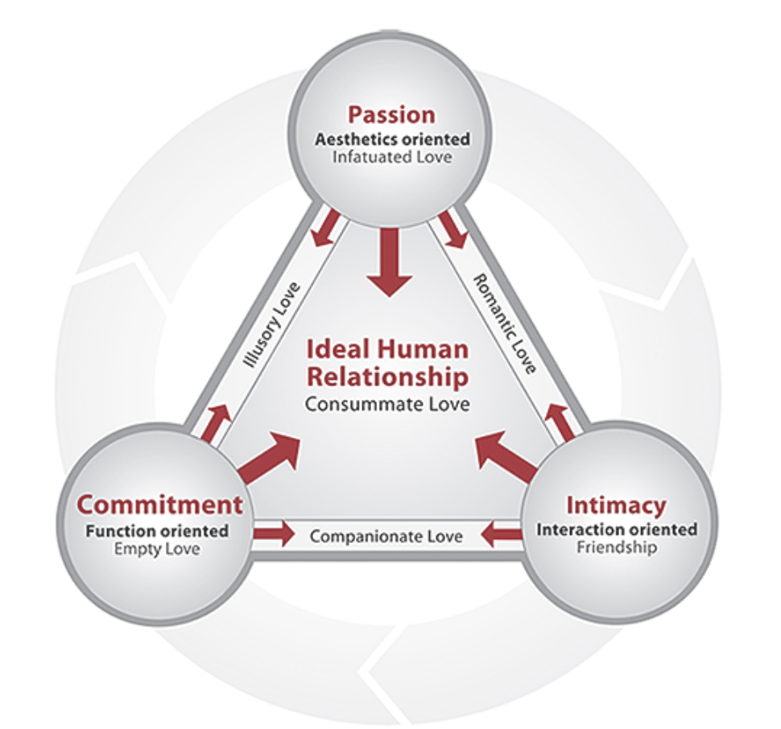
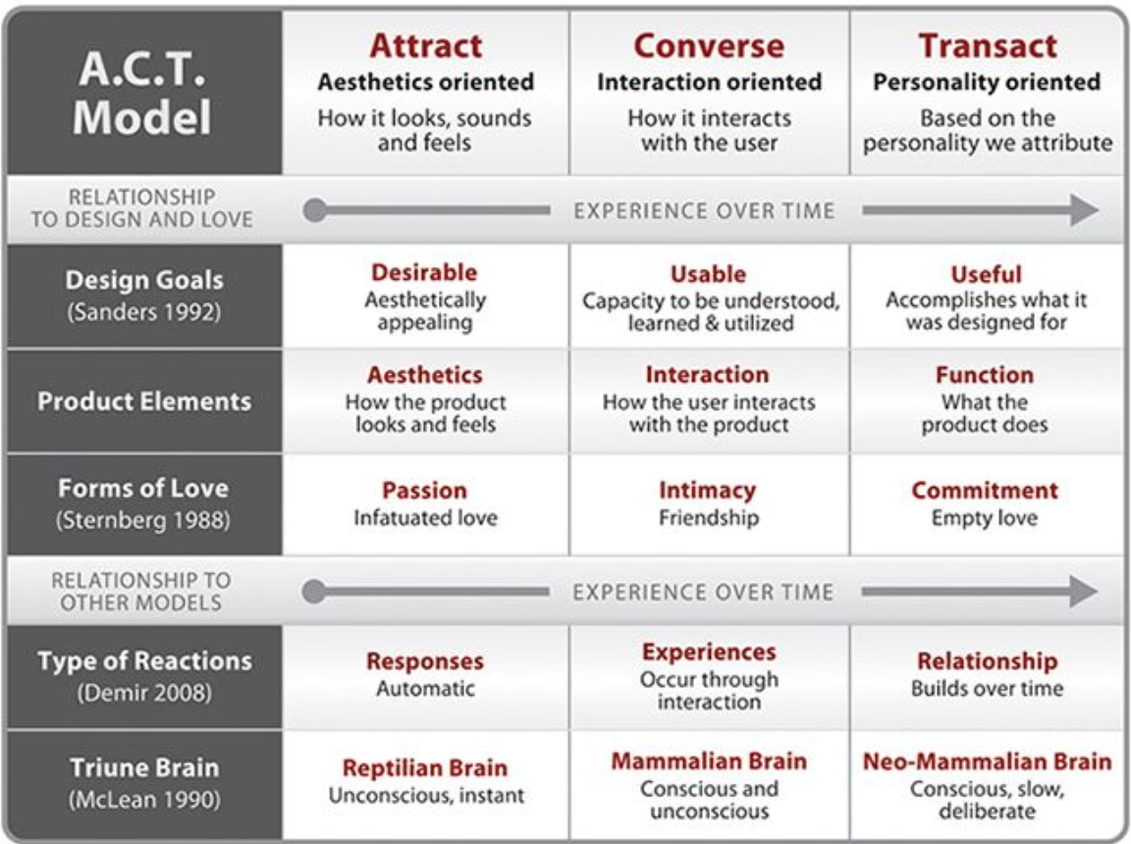
C 1.3.2 The attract/converse/transact (ACT) model is a framework used by designers to improve the relationship between a user and a product.
Attract, converse, transact model (ACT)
The ACT model is the result of the work of Trevor Van Gorp and Edie Adam in their book ‘Design of Emotions’.
The ACT model is a framework for creating design that improve the relations of the users with a product, and intentionally trigger emotional responses.
The Attract part of the model is aesthetics orientated.
The Converse part of the model is interaction orientated.
The Transact part of the model is function oriented.
When all three elements of the model are addressed, products become desirable, useable, and useful.
For products to become successful they must be desirable to attract the user’s attention. The user’s then approach and converse (interact) with it. At this point it becomes important that your product is usable. After your product has consistently performed to your user’s expected standards, the user will find it useful and will be willing to commit to transact (work with) the product.

Slide 13
