Slide 1

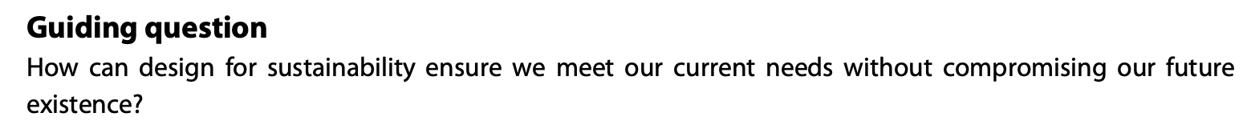
Design in context
Design for Sustainability

Slide 2
Contents
Choices and decisions | Discuss strategies to achieve sustainability and the importance of decision- making when addressing issues related to sustainable design, including waste, pollution and energy consumption.
The five principles of sustainable design | Analyse sustainable products to demonstrate how they meet Datchefski’s principles.
The triple bottom line (TBL) | Explain the TBL and the relationship between the three Ps (people, profit, planet), which includes conflict and compromise.
Balance between the three Ps of the TBL | Explain how the TBL can help designers to prioritize the needs of clients, communities and the environment to discover design opportunities.

Slide 3
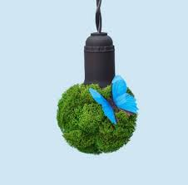
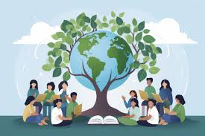
C 2.1.1 Design for sustainability involves the choices and decisions made for developing designs (products) and design methodologies.
Design choices are highly crucial in determining how products affect communities and the environment. Well-considered designs can bring positive benefits, such as affordable housing that enhances living standards or sustainable packaging that minimizes waste and preserves resources. In contrast, careless design decisions like using non-recyclable materials, creating energy-intensive products, or reducing product lifespan can damage ecosystems and place heavy burdens on society.
Responsible design is essential, as it improves functionality and accessibility while also supporting sustainability and community well-being in the long term.

Slide 4
C 2.1.1 Design for sustainability involves the choices and decisions made for developing designs (products) and design methodologies.
Sustainable design focuses on reducing environmental impact through careful strategies and informed decision-making. Designers can minimize waste by using fewer materials, selecting recycled or renewable resources, and designing products for reuse, repair, or recycling. Efficient design and longer product life spans help reduce the amount of waste sent to landfills. Pollution can be addressed by choosing low-impact manufacturing processes, reducing harmful chemicals, and improving product durability to lower emissions from production and transport.
Reducing energy consumption is another key strategy. This includes designing energy-efficient products, optimizing manufacturing methods, and using renewable energy sources where possible. Decisions made during the design stage are especially important because they strongly influence a product’s overall environmental footprint. Effective decision-making allows designers to balance sustainability with cost, function, and user needs. By making responsible and well-informed choices, designers can create practical, long-lasting solutions that benefit the environment, society, and future generations.

Slide 5
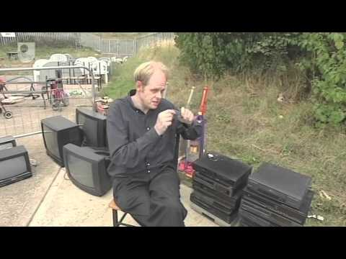
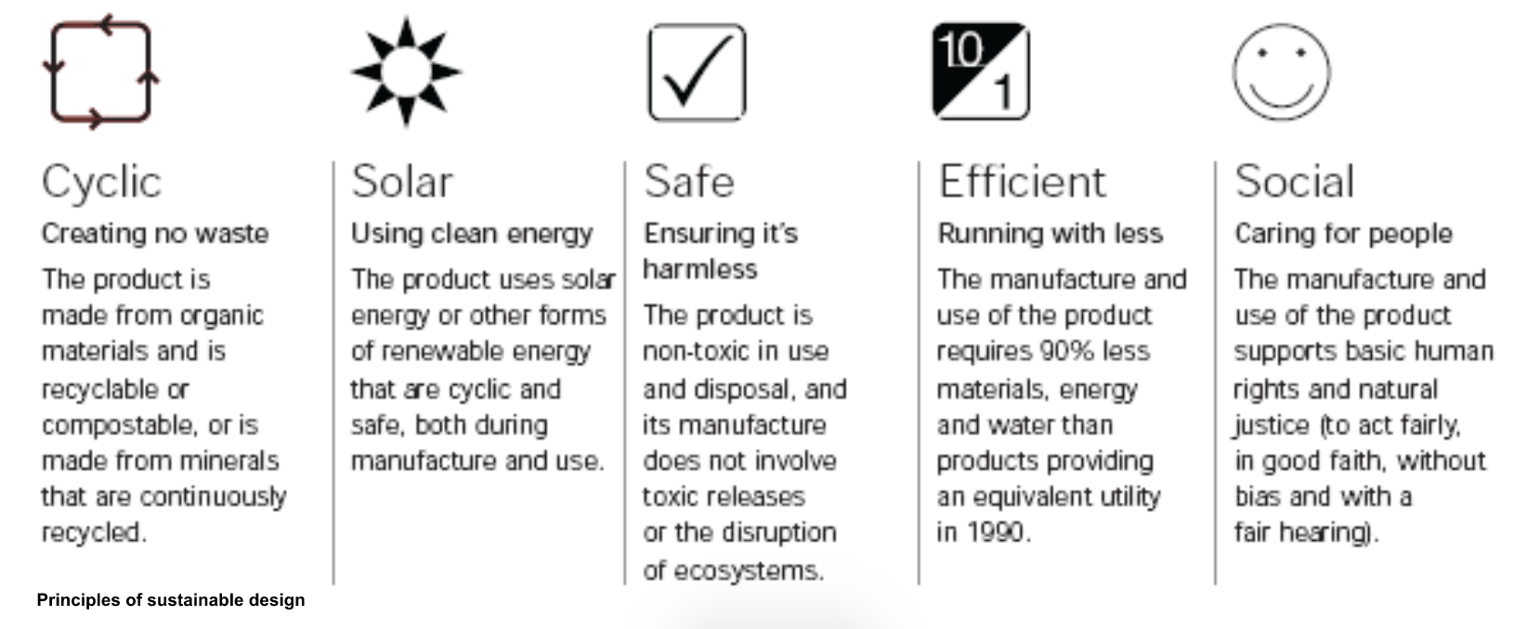
C 2.1.2 The five principles of sustainable design are that a product must be cyclic (create no waste), solar (use clean energy), safe (cause no harm), efficient (use the least amount of energy and materials as possible) and social (support basic human rights) (Datchefski, 1999).
Edwin Datschefski redefines the “beauty” of design by calculating the total impact of product and services in five distinct categories. Datschefski developed these principles in response to the “greenwashing” - the promotion of products that have minor environmental or green credentials as “sustainable”.
The five principles Datschefski came up with are; Cyclic, Solar, Safe, Efficient, and Social. They are a holistic approach to sustainable design, but Datschefski understands that only selected principles will be possible/applicable to some products.

Slide 6
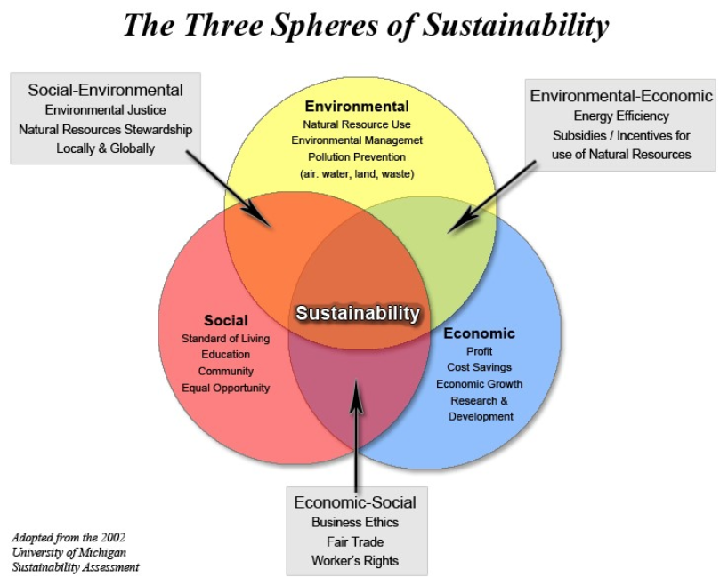
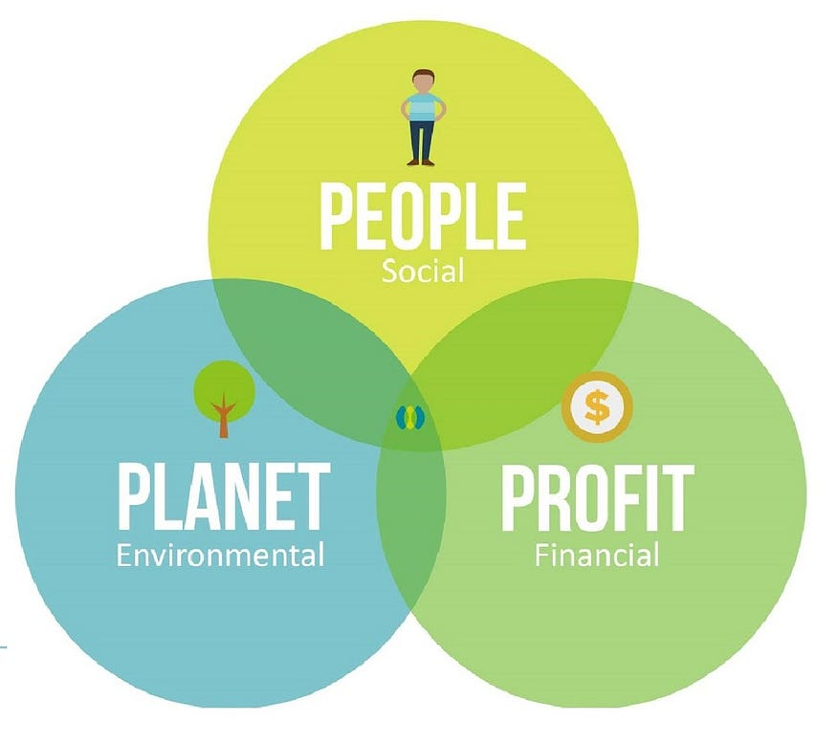
C 2.1.3 The triple bottom line (TBL) measures levels of success of a product in relation to social (people), economic (profit) and environmental (planet), which are key responsibilities of a designer.
The concept of the triple bottom line means that business success is no longer defined by monetary gain but also by the impact an organisation’s activities have on society as a whole - Environmental, Economic and Social.
Using resources more productively and redesigning production, it is technically possible to deliver the same or equivalent goods and resources with lower environmental impact while maintaining social and equity benefits.
This topic is covered in detail in C1.1 Responsibility of the Designer
Source: https://medium.com/

Slide 7
C 2.1.4 Designers make decisions by considering the balance between the three Ps of the TBL.
The Triple Bottom Line (TBL) helps designers balance people, planet, and profit when developing products and solutions. By considering social, environmental, and economic impacts together, designers can better prioritize the needs of clients, communities, and the environment. TBL encourages designers to create solutions that are not only profitable for clients but also socially responsible and environmentally sustainable. This approach helps identify design opportunities such as improving user well-being, reducing environmental impact, and lowering long-term costs. By using TBL, designers make informed decisions that lead to ethical, innovative, and sustainable designs that benefit all stakeholders.
Designers balance the three Ps of the Triple Bottom Line—people, planet, and profit—when making decisions. They consider social impact, environmental responsibility, and economic viability together to ensure designs meet user needs, reduce environmental harm, and remain financially sustainable.
Examples:
Eco-friendly packaging design:
Using biodegradable or recycled materials to reduce waste (Planet), making packaging safe and easy to use (People), and lowering material and transport costs (Profit)
Public seating for urban spaces:
Creating durable, comfortable seating for communities (People), using recycled or weather-resistant materials (Planet), and minimizing maintenance costs for local authorities (Profit)
Solar-powered outdoor lighting:
Improving safety in public areas (People), using renewable energy (Planet), and reducing long-term energy and maintenance expenses (Profit)

Slide 8
