Slide 1

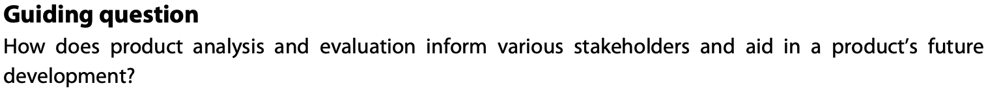
Design in context
Product Analysis and Evaluation

Slide 2
Contents
Product analysis and evaluation | Discuss the purpose of a product analysis exercise and why it is important for product design development.
Range of stakeholders | Identify the various stakeholders, such as users, manufacturers and engineers, that will help in any future development of a product.
SWOT analysis | Analyse a product using a SWOT analysis based on function, performance, usability, features and materials.I
Testing and reverse engineering data | Identify areas of the product that require improvement and to determine how well the product meets the needs of the user.
Compare products | Compare competing and similar products to identify opportunities for further product improvements.
Constructive discontent | Identify areas where a product is not meeting the needs of its users.
Product analysis | Discuss the purpose of a product analysis task and why it is important for product design development.

Slide 3
C 3.1.1 Product analysis and evaluation is a process that involves examining a product performance to determine its strengths and weaknesses, and identify opportunities for improvement.
Product analysis is the systematic examination of an existing product to understand its function, structure, materials, usability, and user experience.
Purpose is to gather insights that can inform and inspire new design ideas or improvements.
Involves studying:
Aesthetics : How it looks (form, color, style).
Function : What it does and how well it performs its purpose.
Ergonomics & usability : How easy and comfortable it is to use.
Materials & manufacturing : What it’s made of and how it’s made.
Cost & sustainability : Economic and environmental impact.
Target market : Who it’s designed for and how it meets their needs.
An example would be to analyse a Dyson hair dryer, looking at airflow technology, material choices, noise reduction, energy efficiency, and user comfort.
Evaluation is the critical assessment of a product (either an existing one or your own prototype) to determine how effectively it meets the design brief and user requirements.
The purpose is to identify successes, limitations, and opportunities for improvement.
Methods:
Testing prototypes
User feedback / interviews
Surveys or observation
Comparing against specification points
Life cycle analysis (LCA)

Slide 4
C 3.1.2 As part of the product analysis process, a product should be tested and information gathered from a range of stakeholders.
As part of the product analysis process, a product should be tested and evaluated to determine how effectively it performs and meets user needs. Testing provides objective data on aspects such as function, durability, ergonomics, and safety, helping designers identify strengths and weaknesses.
Equally important is gathering feedback from a range of stakeholders—including users, clients, manufacturers, and retailers—each offering unique insights. Users comment on comfort and usability, manufacturers assess production feasibility, and retailers evaluate market appeal.
Information can be collected through surveys, interviews, observations, and usability tests, combining both qualitative and quantitative data. This ensures that the design is user-centred and evidence-based, reducing the likelihood of design errors or inefficiencies.
Overall, integrating testing and stakeholder input makes the product analysis more reliable, supports informed design decisions, and leads to better-performing, sustainable, and market-relevant products.

Slide 5
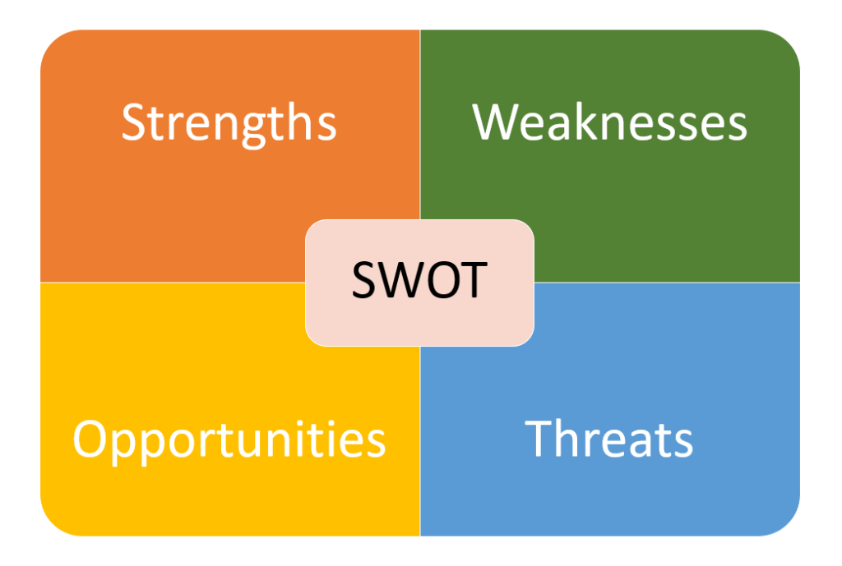
C 3.1.3 A SWOT analysis is a standard product analysis tool that is used to identify a product’s strengths, weaknesses, opportunities and threats.
A SWOT analysis in product design is a strategic planning tool that evaluates a product's Strengths, Weaknesses, Opportunities, and Threats. Strengths and weaknesses are internal, controllable factors like a product's unique features or missing skillsets, while opportunities and threats are external, uncontrollable factors like market trends or competitor actions. By analyzing these four areas, designers and teams can make more informed decisions about product development and strategy
How Designers Use SWOT?
During ideation → to evaluate early product concepts.
During development → to prioritize improvements or redesigns.
Before launch → to identify risks and marketing angles.
Smart Water Bottle
Strengths
- Tracks hydration using sensors and app integration.
- Sustainable materials appeal to eco-conscious users.
- Sleek, modern design attracts tech-savvy customers.
Weaknesses
- Expensive compared to regular bottles.
- Requires charging, which may inconvenience users.
- Limited compatibility with some smartphone models.
Opportunities
- Growing interest in health and wellness products.
- Potential for partnerships with fitness apps.
- Expansion into corporate wellness programs.
Threats
- Competing brands offering cheaper smart bottles.
- Rapid tech obsolescence and software issues.
- Privacy concerns about data collection.
A SWOT analysis helps designers evaluate a product’s Strengths, Weaknesses, Opportunities, and Threats to guide decision-making during the design process. It ensures the design aligns with user needs, market demands, and business goals.

Slide 6
C 3.1.4 Function, performance and usability can be established using data generated through testing and reverse engineering.
Reverse engineering is the process of analysing an existing product’s constituent components in order to understand how it was put together and how it works. It is used in cases where an engineered product or technology is not functioning as it should, so must be ‘deconstructed’ and engineered to understand where the errors and flaws may lie.

Slide 7
C 3.1.5 Weaknesses identified in a product or range of products can lead to opportunities for product improvement.
UCD is a design process paying particular attention to the needs of potential users of a product, through involvement of users through all stages of the design process. It considers how likely users are to interact with the product, and test design concepts, prototypes and products with users. Sometimes called “empathic design”, the user centred design approach puts the design team in direct contact with the people they are designing for. They do this to empathise with potential users, so to gain a better understanding of the user’s thoughts, needs, values and beliefs. The design team often includes anthropologists, ethnographers, and psychologists to advise the creative designers.

Slide 8
C 3.1.6 Constructive discontent can be used to identify areas where the product is not meeting the needs of its users and to determine how it can be improved to meet those needs.
UCD is a design process paying particular attention to the needs of potential users of a product, through involvement of users through all stages of the design process. It considers how likely users are to interact with the product, and test design concepts, prototypes and products with users. Sometimes called “empathic design”, the user centred design approach puts the design team in direct contact with the people they are designing for. They do this to empathise with potential users, so to gain a better understanding of the user’s thoughts, needs, values and beliefs. The design team often includes anthropologists, ethnographers, and psychologists to advise the creative designers.
User Centred Design fundamental principles:
A design is based on an explicit understanding of users, tasks and environments.
Users are involved throughout the design and development process.
The design is driven and refined by user-centred evaluation.
The process is iterative - lots of ideas.
The design addresses the whole user experience.
The design team includes multidisciplinary skills and perspectives.

Slide 9
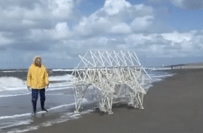
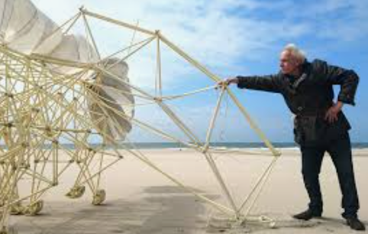
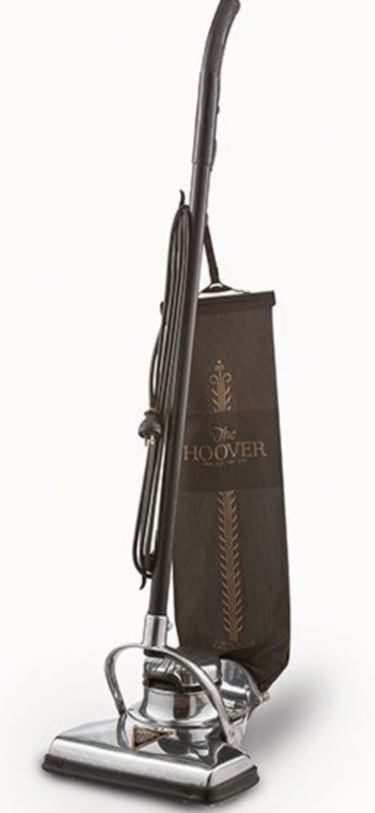

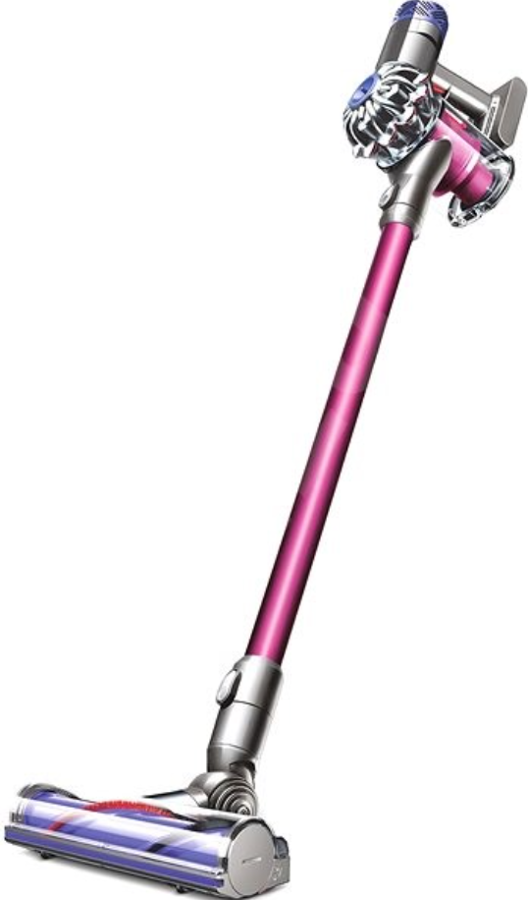

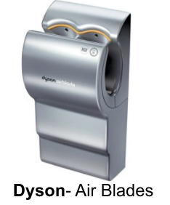
C 3.1.6 Constructive discontent can be used to identify areas where the product is not meeting the needs of its users and to determine how it can be improved to meet those needs.
Drivers for invention include personal motivation to express creativity, or for personal interest, scientific or technical curiosity, constructive discontent, the desire to help others, or simply they want to make money. These will all be explored in the following slides.
Expressing creativity or personal interest:
While there are many fine examples of this type of driver for invention, none are possibly as dramatic as The Kinesthetic Strandbeest sculptures designed and created by Theo Jansen. The motivation behind these inventions is to express creativity. His fantastic designs are purely driven by the wind.
Constructive Discontent:
James Dyson has been frustrated by many inefficiencies of conventional designs and has created a number of groundbreaking re-designs, from vacuum cleaners, to hand and hair dryers. The cyclonic bagless system for his vacuum cleaners, and the airblade system for his hand dryers are two very good examples of his constructive discontent with what was available at the time.
Dyson is quoted as saying, “analyse a situation which would benefit from re-design, and work out a strategy for improving it” - Good inventors are always looking to improve on what we currently have.
The old ‘bagged’ vacuum, and Dyson’s inventions.

Slide 10
C 3.1.7 Product analysis enables designers to understand a product better.
UCD is a design process paying particular attention to the needs of potential users of a product, through involvement of users through all stages of the design process. It considers how likely users are to interact with the product, and test design concepts, prototypes and products with users. Sometimes called “empathic design”, the user centred design approach puts the design team in direct contact with the people they are designing for. They do this to empathise with potential users, so to gain a better understanding of the user’s thoughts, needs, values and beliefs. The design team often includes anthropologists, ethnographers, and psychologists to advise the creative designers.
User Centred Design fundamental principles:
A design is based on an explicit understanding of users, tasks and environments.
Users are involved throughout the design and development process.
The design is driven and refined by user-centred evaluation.
The process is iterative - lots of ideas.
The design addresses the whole user experience.
The design team includes multidisciplinary skills and perspectives.

Slide 11
