Slide 1

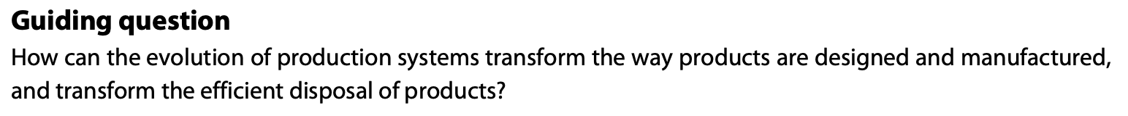
Design for Manufacture Strategies
Design in context

Slide 2
Contents
Design for manufacture (DfM) 3 strategies | Able to outline design for process, design for assembly and design for disassembly strategies.
Design for process | Able to outline the advantages of design for process and explain how a product could be designed using this strategy.
Design for assembly | Able to outline the advantages of design for assembly and explain how a product could be designed using the design for assembly strategy.
Design for disassembly | Able to outline the advantages of design for disassembly and explain how a product could be designed using this strategy.
Environmental impact | Able to discuss how designers use DfM strategies to reduce the environmental impact of the manufacture, use and disposal of products.

Slide 3
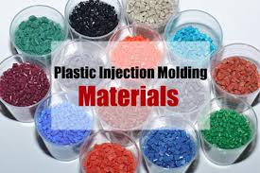
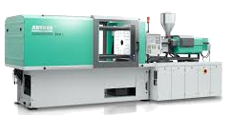
C 4.1.1 Design for manufacture (DfM) comprises of three strategies.
DfM means designing with production in mind. When products are easier to manufacture and assemble, the production process becomes faster, more reliable, and less expensive. Reduced complexity leads to lower labour costs, fewer errors, improved quality control, and shorter production times. As a result, manufacturers benefit from higher profitability, while customers may gain better value through lower prices and improved product reliability. Additionally, efficient production often reduces material waste and energy consumption, contributing positively to environmental sustainability.
If a company has injection moulders available then the designer designs the product with that manufacturing machine in mind – i.e. considers the material needed (thermoplastic) and its related properties and workability.
Before DfM the motto was ‘I design it, you build it!!’. Design engineers worked alone or only in company of other design engineers in “The Engineering Department”.The modern DfM approach replaces this separation with integrated development teams. Designers, engineers, manufacturers, and other stakeholders collaborate from the early stages of product development.
DfM practices incorporate environmental responsibility. Designers consider how products can be easily disassembled for recycling, repaired to extend their life cycle, and manufactured using sustainable processes. By integrating all these factors early in development, DfM reduces the likelihood of costly revisions and enhances overall product performance.
Process that improves manufacturability, reduces costs, enhances product quality, and supports sustainability.
Injection moulder

Slide 4
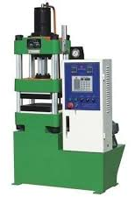
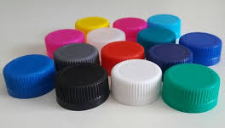
C 4.1.2 Design for process considers how products are made using a specific manufacturing technique.
DfM can be broken down into three parts:
1. Design for process,
2. Design for assembly, and
3. Design for disassembly.
Design for process: this relates to the design of a product to made using a specific manufacturing technique; for example, injection moulding.
Design for process allows the process to be mass produced, by developing the products design to specifically meet the available characteristics and the availability of certain processes. You would be surprised at how many products have been designed without the thought of ‘how’ it would actually be made being taken into consideration. If a product has a specific manufacturing process in mind at the time of conception, then it can be specifically tailored to take advantage of the advantages of this process, and negate its disadvantages.
For example, if a designer worked for a company that had compression moulding equipment, they would specifically have this process in mind when designing new products.

Slide 5
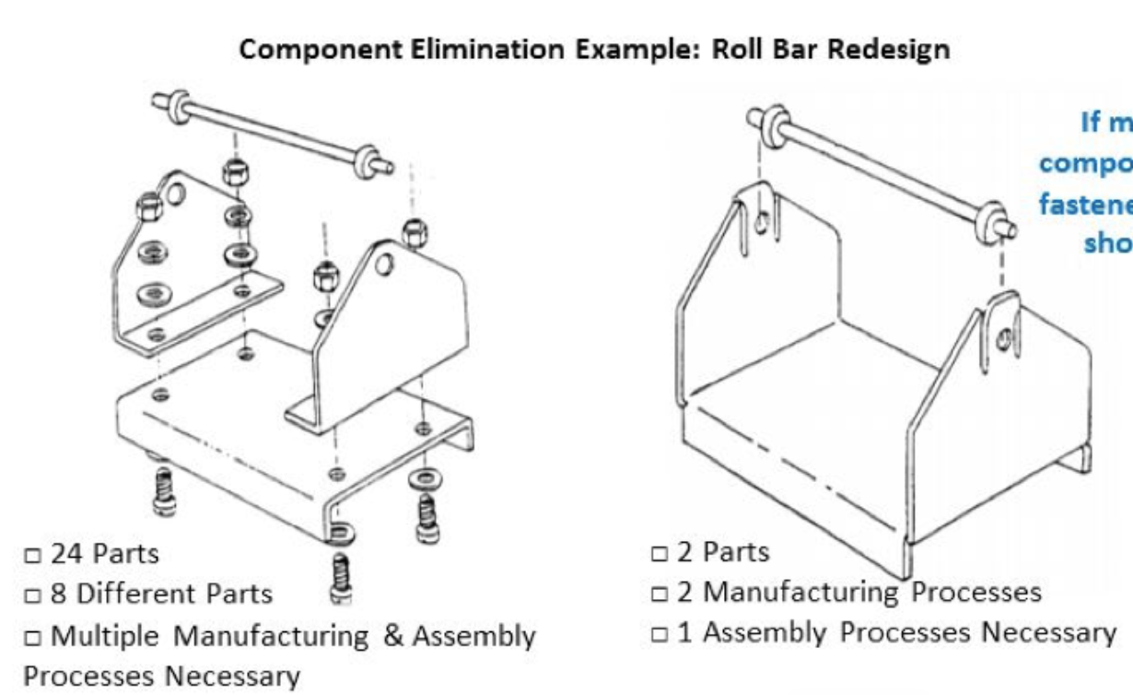
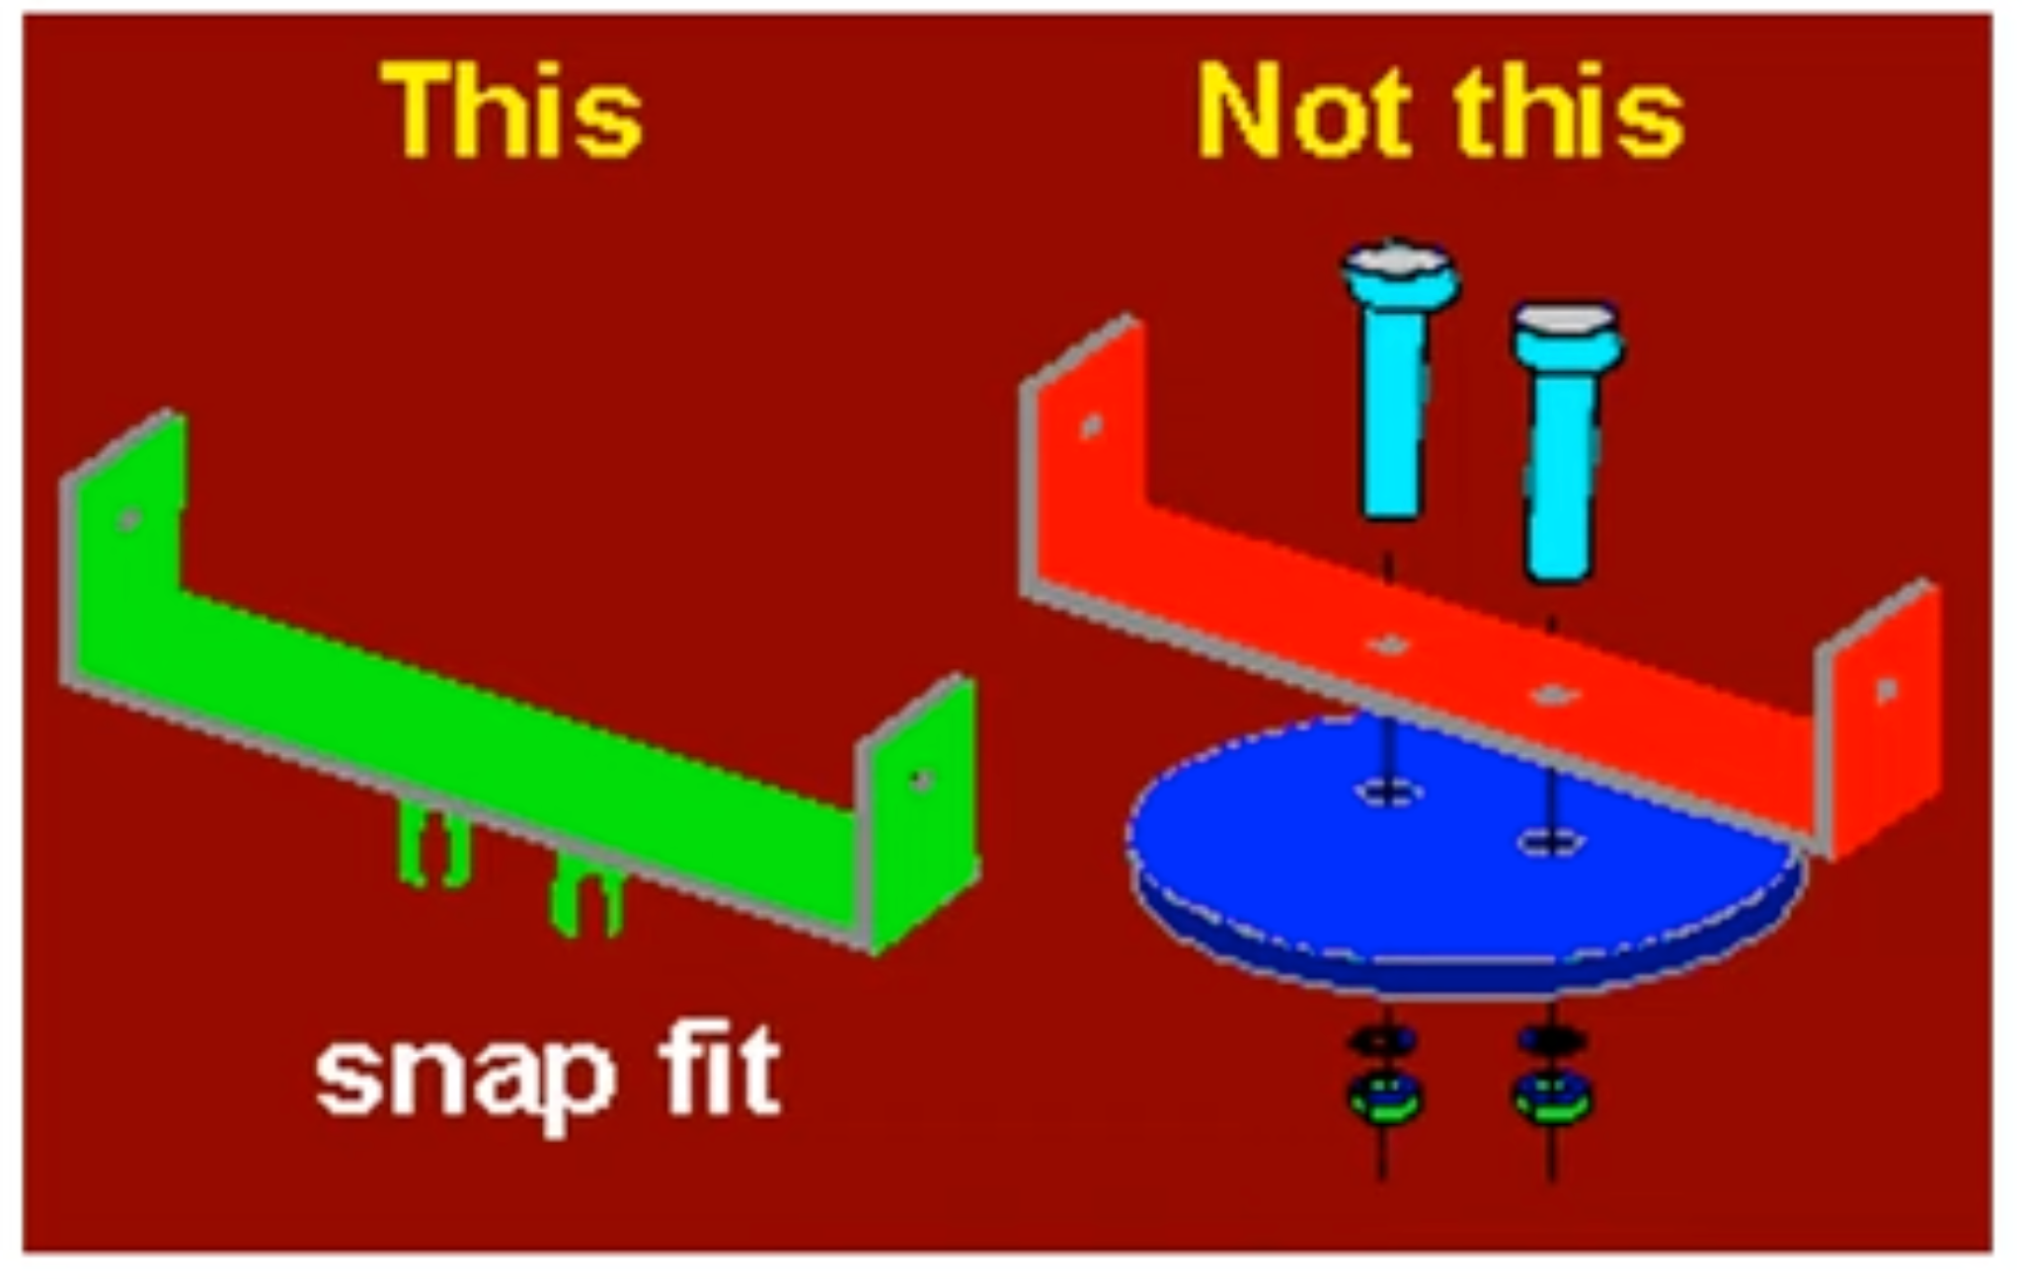
C 4.1.3 Design for assembly considers how components of a product are combined.
Design for Assembly: is designing and taking into consideration how a product is put together, and how different parts interact with each other. For example, component to component, components to sub-assemblies, and sub-assemblies into complete products. The ultimate aim of design for assembly (DfMA) is to reduce the cost of a component, parts or product without reducing its performance. By eliminating unnecessary components or parts not only reduces material costs, but also reduce the production, processing, and assembly time - therefore further reducing costs to the manufacturer.
Reduce number of components
Snap-fit instead of screws
Parts fitting one way, to reduce time and errors in assembly
Standardise fasteners
Faster assembly time
Reduced labor cost
Low assembly errors
Increased production efficiency
Method of design of a product for ease of assembly to reduce cost, parts, time without reducing its performance.

Slide 6
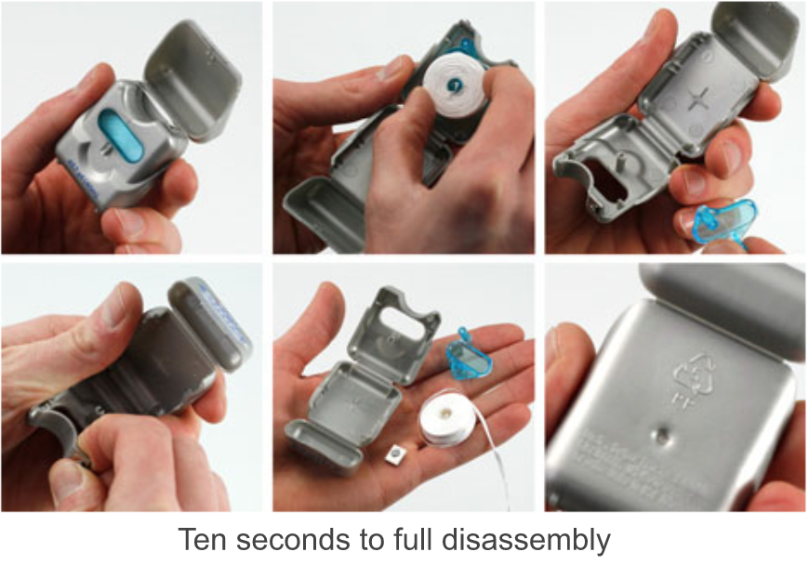

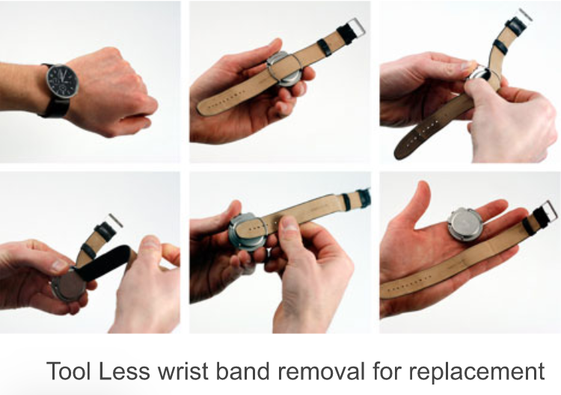
C 4.1.4 Design for disassembly considers how components of a product can be separated.
Design for disassembly: designing a product so when it becomes obsolete, damaged or out of date, it or its components can be easily and economically taken apart. These parts, or components can then be reused or repaired, and the materials repurposed or recycled.
When design for disassembly (DfD) is taken into consideration at the early stages of the design cycle, the design team would consider some of these questions:
Will the product need to be repaired?
Does it make economic sense to repair?
Which parts will need to be replaced?
Who will repair it?
How can the experience be simple and intuitive?
Can the product be reclaimed, refurbished or resold?
If it is discarded, how can we facilitate disassembly into recyclable parts?
What components are likely to wear out first?
Design for Disassembly
Design for Disassembly:
Modular product design - the future?
Non permanent fasteners
Separate materials easily
Label for recycling
Supports recycling
Easy repair & maintenance
Reduced environmental impact
Improves sustainability

Slide 7
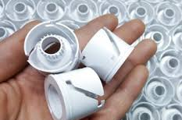

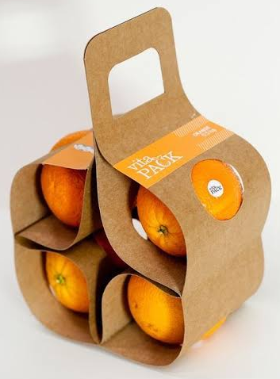
C 4.1.5 The selection of DfM strategies has a direct effect on the environmental impact of the manufacture, use and disposal of a product.
The selection of Design for Manufacturing (DfM) strategies has a direct impact on the environmental footprint of a product throughout its life cycle from manufacture, use and disposal
During Manufacturing
DfM strategies such as reducing the number of components, standardising parts, and selecting processes that minimise material waste can significantly lower energy consumption and raw material usage.
Example: Designing parts for efficient injection moulding or additive manufacturing can reduce scrap and optimise material yield. Choosing recyclable or low-impact materials also reduces embodied energy and carbon emissions at this stage
Reducing the number of components lowers material use and assembly energy.
Designing for minimal material waste which will reduces waste generation.
Selecting time and energy-efficient manufacturing processes decreases carbon emissions.
Standardising components reduces tooling requirements and production waste.
Choosing recyclable or low-embodied-energy materials lowers overall environmental impact.
Designing for automation improves precision, reducing rework and wasted materials.
Efficient packaging design during production reduces material consumption before distribution.

Slide 8

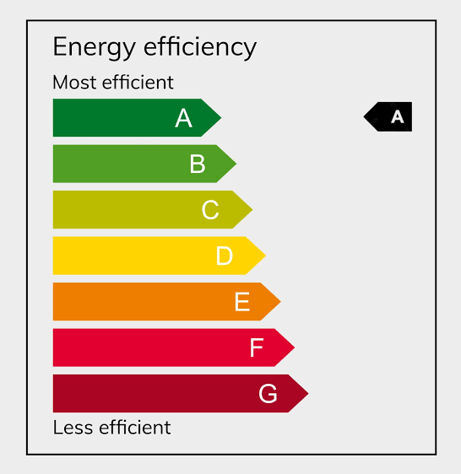
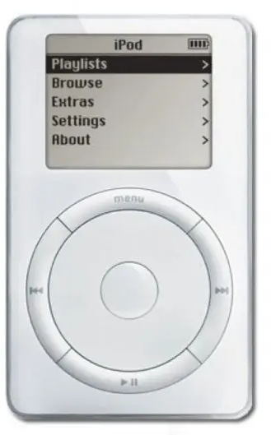
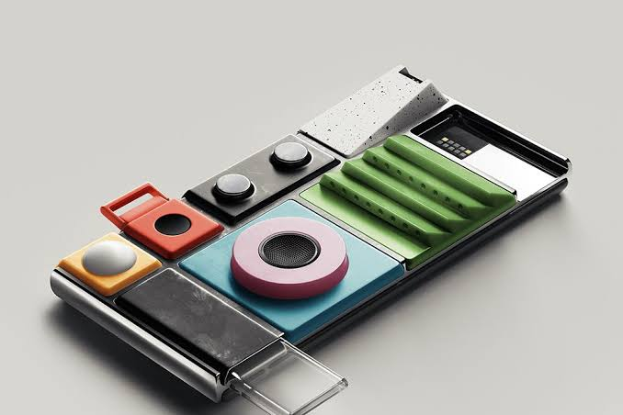

C 4.1.5 The selection of DfM strategies has a direct effect on the environmental impact of the manufacture, use and disposal of a product.
During Use
During the use phase, DfM influences environmental performance by enabling energy-efficient operation and durability. Designing for precision assembly improves product reliability, reducing failures and extending product lifespan. A longer-lasting product means fewer replacements, which reduces overall resource extraction and manufacturing emissions.
Designing for energy efficiency reduces electricity or fuel consumption during operation.
Selecting durable materials increases product lifespan, reducing replacement frequency.
Minimising moving parts reduces wear and maintenance requirements.
Incorporating modular components allows easy part replacement instead of full product disposal.
Designing intuitive user interfaces encourages efficient and correct product use.
Designing for automation improves precision, reducing rework and wasted materials.
Selecting non-toxic materials reduces harmful emissions during prolonged use.

Slide 9
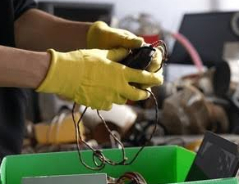

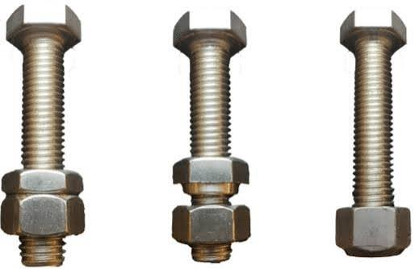
C 4.1.5 The selection of DfM strategies has a direct effect on the environmental impact of the manufacture, use and disposal of a product.
During disposal
DfM strategies such as design for disassembly, modular construction, and material labelling facilitate repair, reuse, remanufacturing, and recycling. Products that are easy to separate into single-material components are more likely to be effectively recycled rather than sent to landfill.
Designing for easy disassembly enables efficient separation of components for recycling.
Reducing the number of material types simplifies sorting and improves recyclability.
Avoiding permanent adhesives allows parts to be separated without damage.
Using recyclable or biodegradable materials reduces landfill impact.
Clearly labelling materials supports correct recycling processes.
Designing modular components allows reuse or remanufacture instead of full disposal.
Standardising fasteners (e.g., using screws instead of rivets) improves repair and material recovery.
Designing durable components enables secondary use markets.

Slide 10
