Slide 1
IA Explained
First Assessment M2027

Slide 2
Standard and Higher Levels
Criterion A: Empathize
Criterion B: Defining the project
Criterion C: Ideation and modelling
Criterion D: Designing a solution
Criterion E: Presenting a solution

Slide 3

Criterion A: Empathize
9 Pages | 900 Words | 9 Marks
A1 - Analyse a primary persona
A2 - Present a storyboard
A3 - Analyse a range of existing products
Page:
1
Page:
2
Page:
3
Page:
4
Page:
5
Page:
6
Page:
7
Page:
8
Page:
9
A1
A2
A3

Slide 4
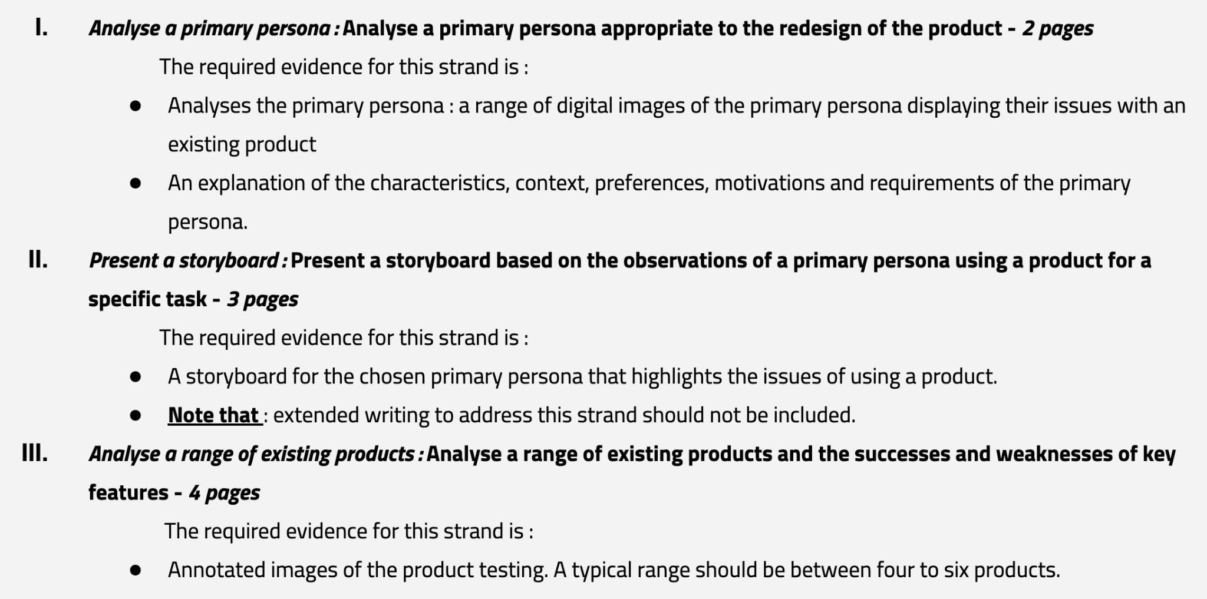
Criterion A: Empathize

Slide 5
Criterion B: Defining the project
4 Pages | 1200 Words | 6 Marks
B1 - Produce a problem statement
B2 - Produce product design specifications
Page:
1
Page:
2
Page:
3
Page:
4
B1
B2

Slide 6
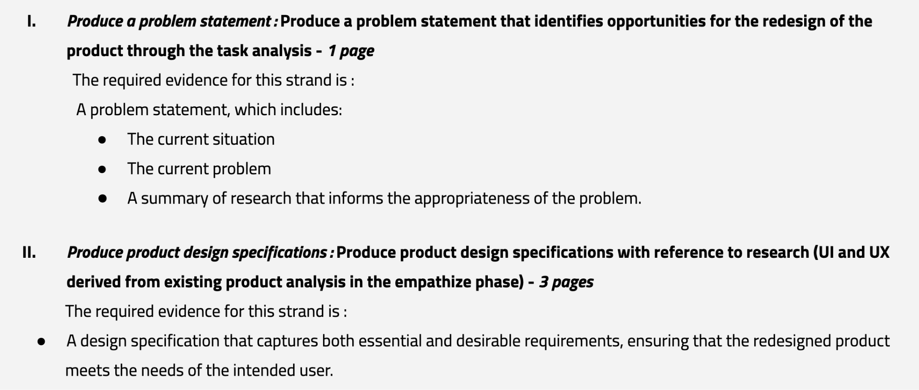
Criterion B: Defining the project

Slide 7
Criterion C: Ideation and modelling
8 Pages | 900 Words | 6 Marks
C1 - Present feasible redesign ideas
C2 - Identify the redesign ideas
Page:
1
Page:
2
Page:
3
Page:
4
Page:
5
Page:
6
Page:
7
Page:
8
C1
C2

Slide 8
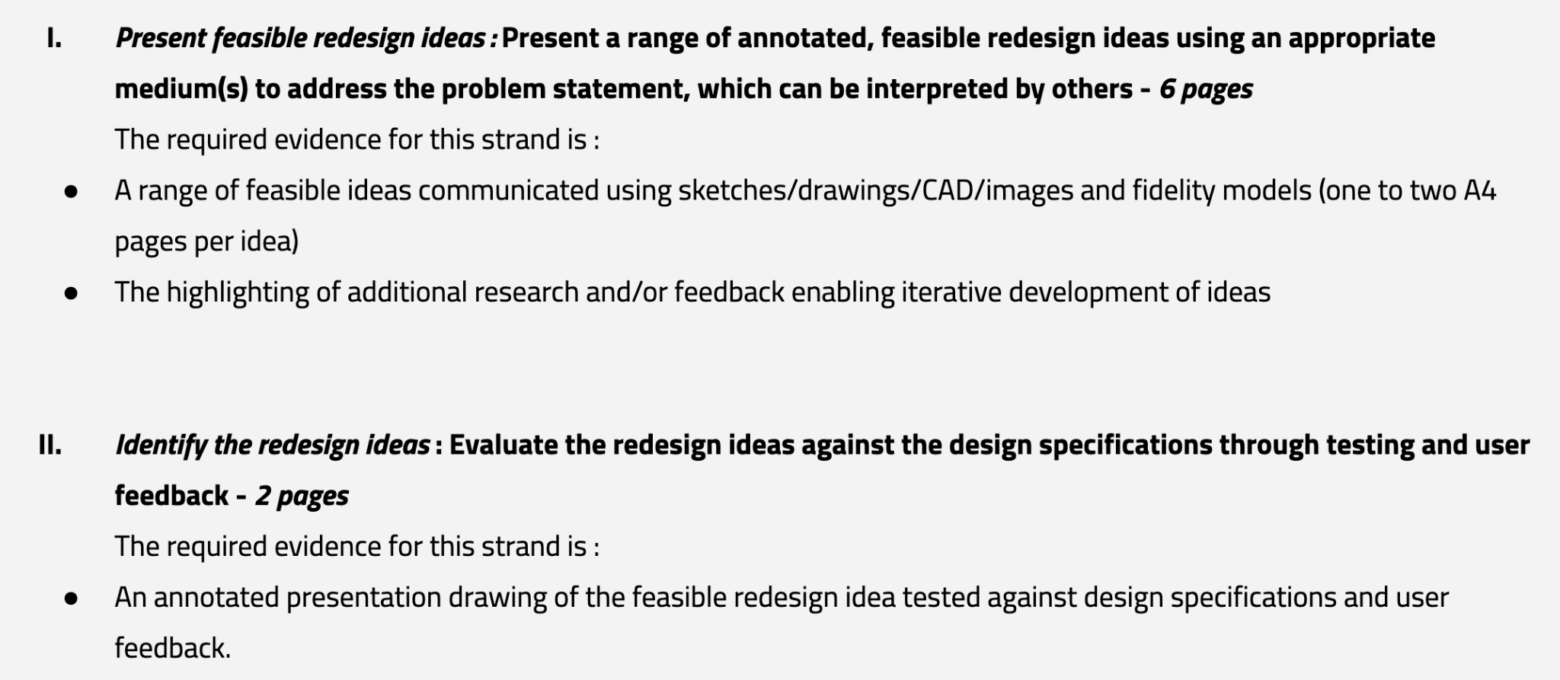
Criterion C: Ideation and modelling

Slide 9
Criterion D: Designing a solution
10 Pages | 300 Words | 6 Marks
D1 - Develop fidelity models
D2 - Design drawings of the intended solution
Page:
1
Page:
2
Page:
3
Page:
4
Page:
5
Page:
6
Page:
7
Page:
8
Page:
9
Page:
10
D1
D2

Slide 10
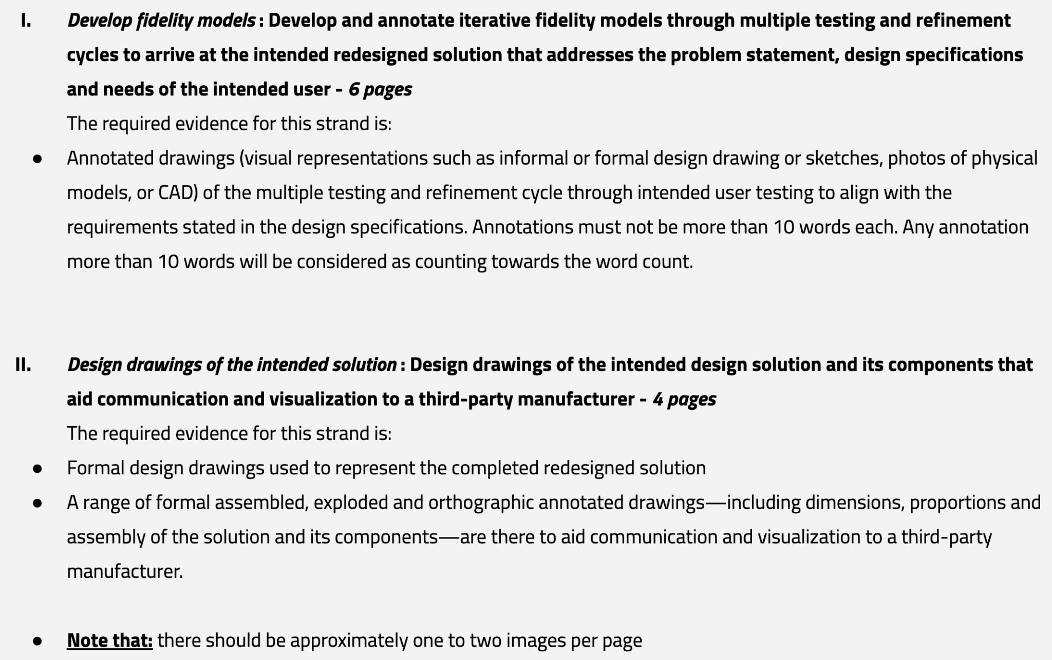
Criterion D: Designing a solution

Slide 11
Criterion E: Presenting a solution
4 Pages | 200 Words | 6 Marks
E1 - Present the intended redesign solution
E2 - Present how the intended redesign solution improves on the
existing product
Page:
1
Page:
2
Page:
3
Page:
4
E1
E2

Slide 12
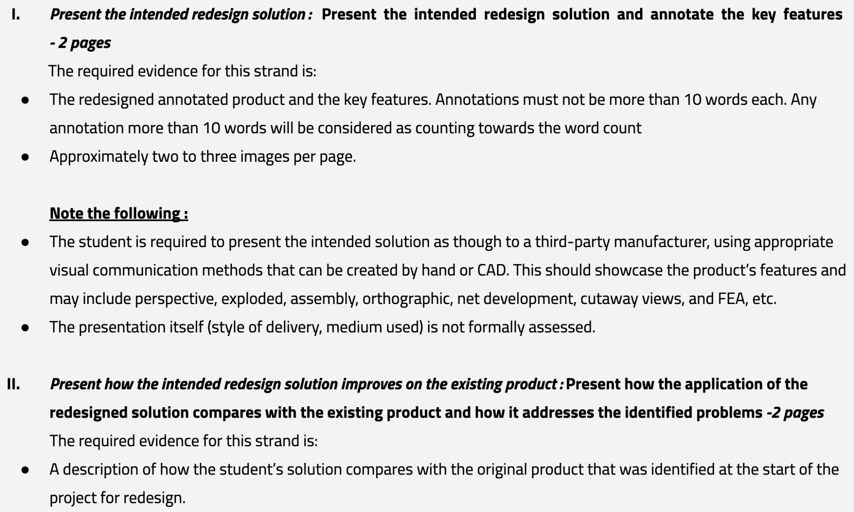
Criterion E: Presenting a solution

