Slide 1
Workshop tools

Slide 2
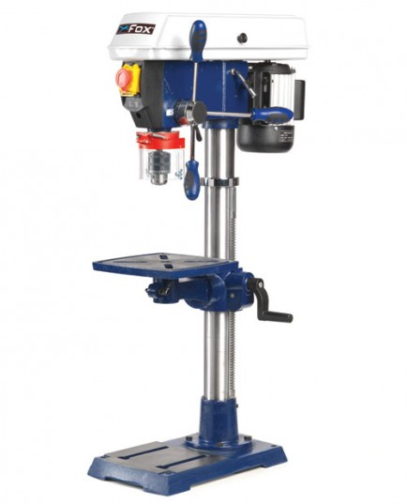
Tool name
Pillar Drill
https://www.youtube.com/watch?v=fGbnim4GcAE

Slide 3
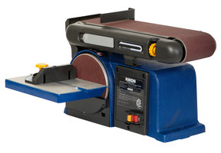
Tool name
Sanding Machine
https://www.youtube.com/watch?v=x1FehVIkq_k

Slide 4
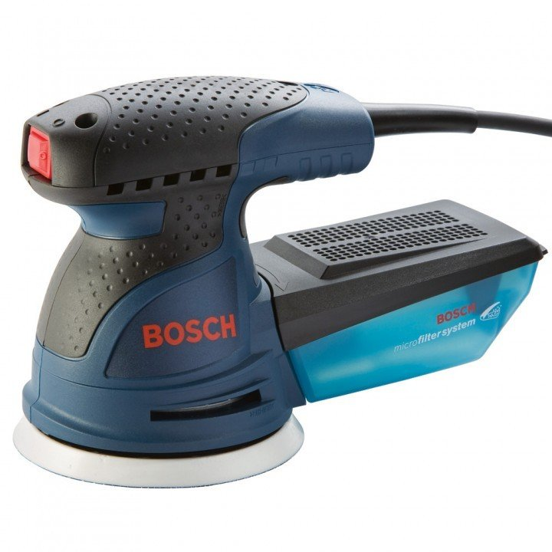
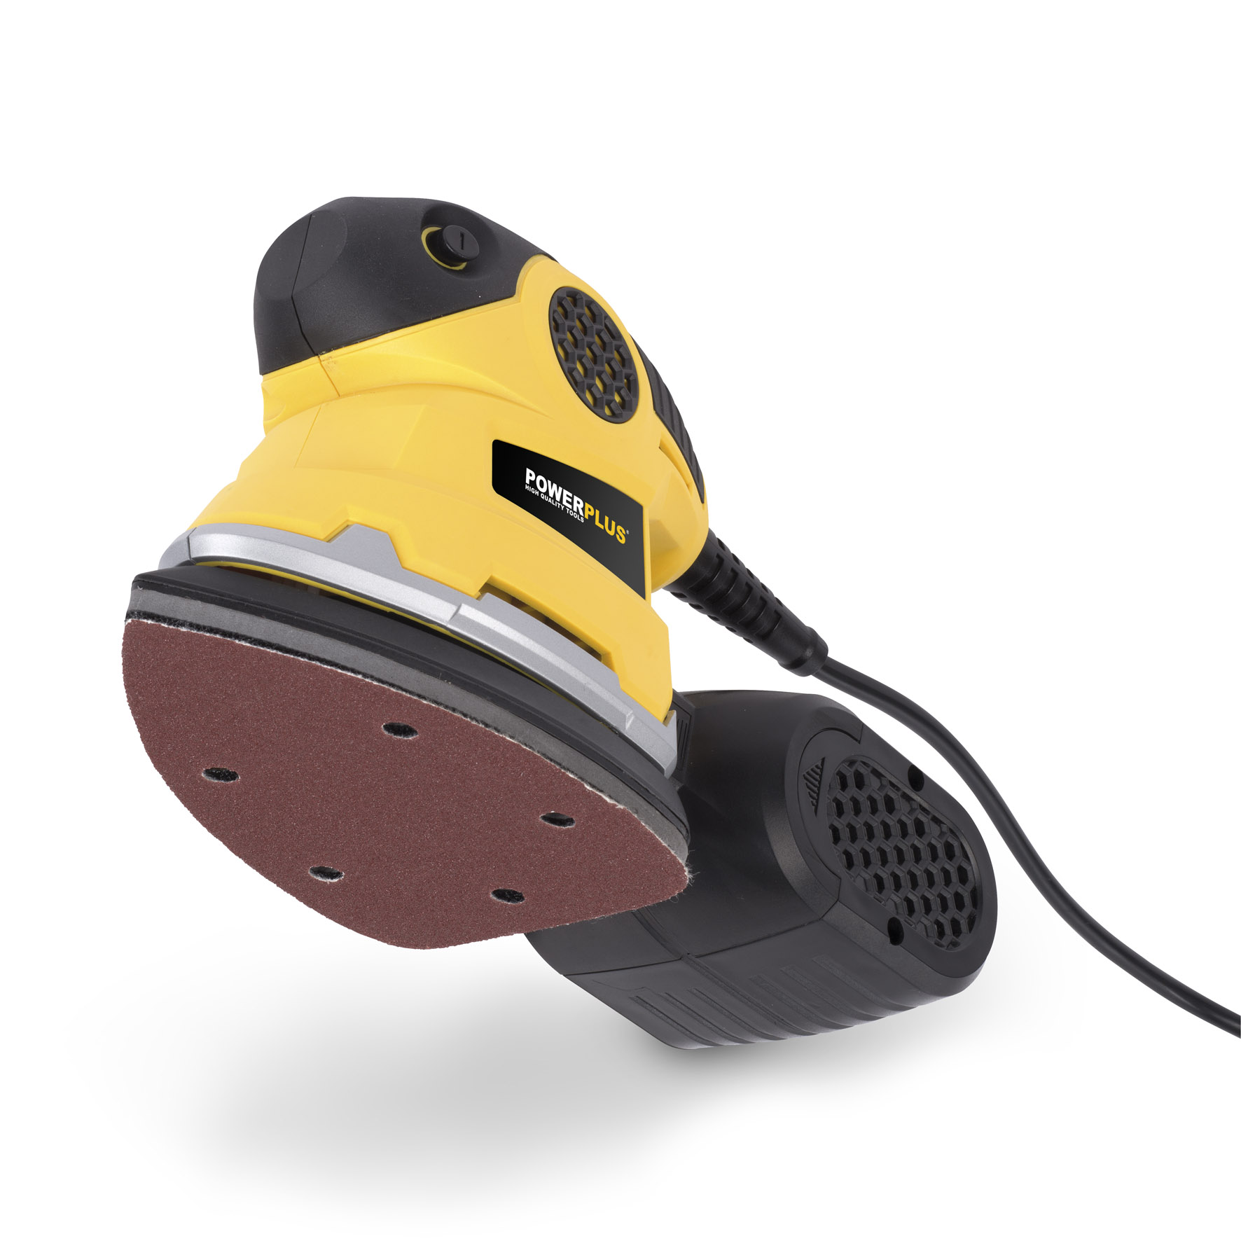
Tool name
Hand Sanding Machine
https://www.youtube.com/watch?v=O4v9u2f67qY

Slide 5
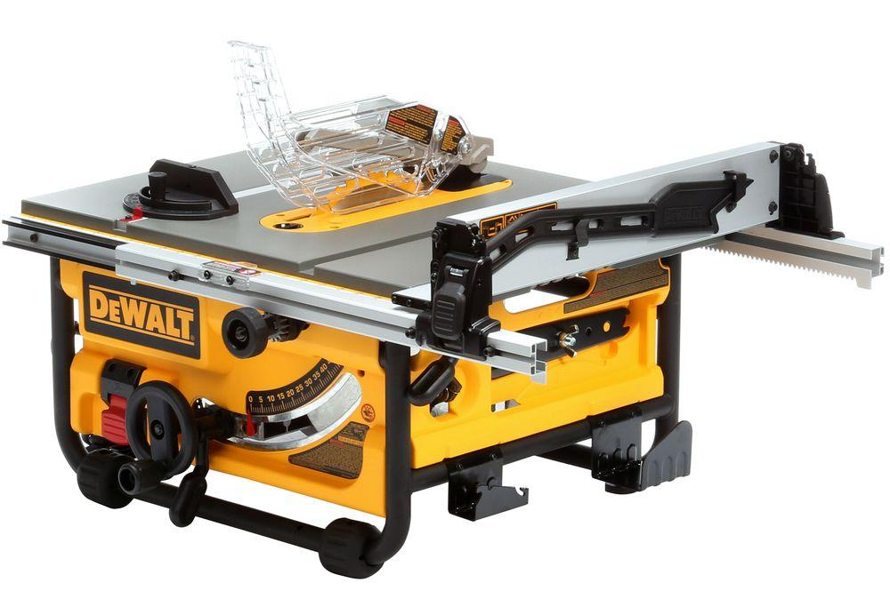
Tool name
Table Saw Cutter
https://www.youtube.com/watch?v=F8kUMwluwMk

Slide 6
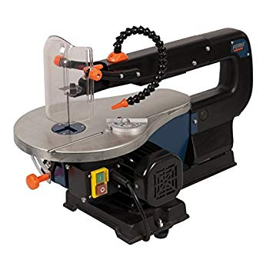
Tool name
Scroll Saw
https://www.youtube.com/watch?v=VpooR4AcBQI

Slide 7
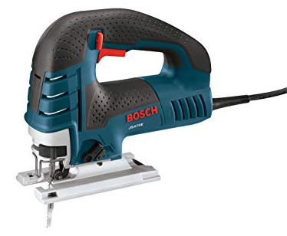
Tool name
Jig Saw
https://www.youtube.com/watch?v=b3RB3Vq8yQI

Slide 8
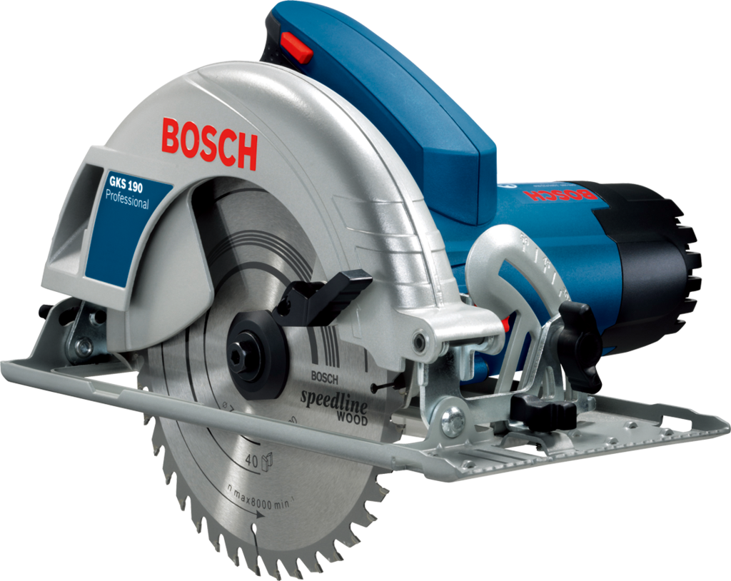
Tool name
Circular Saw
https://www.youtube.com/watch?v=4jpOYxRyTFY

Slide 9
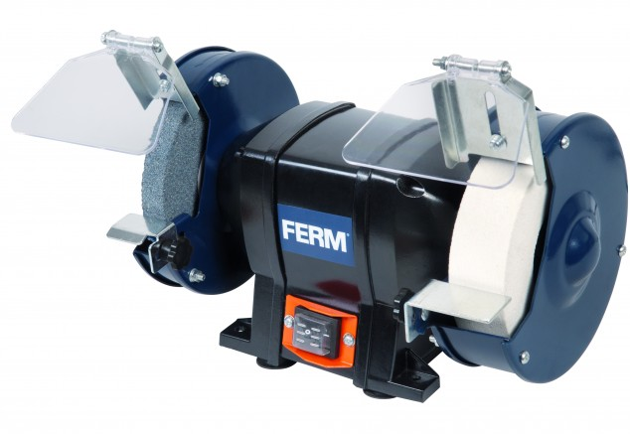
Tool name
Bench grinder
https://www.youtube.com/watch?v=wpzgH8zGhTE

Slide 10
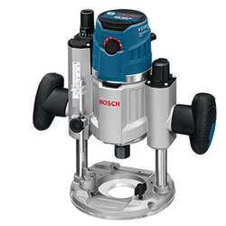
Tool name
Wood Router
https://www.youtube.com/watch?v=eI1gK9qicQU

Slide 11
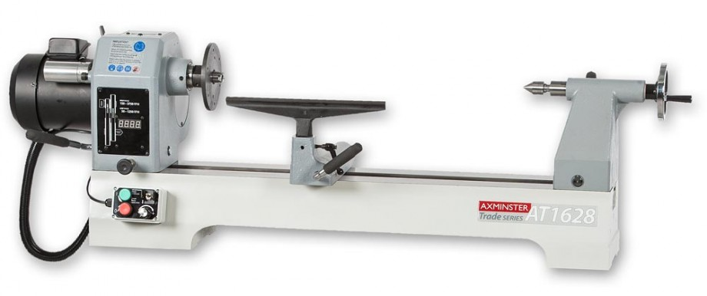
Tool name
Wood turning machine
https://www.youtube.com/watch?v=N92XNewzrpc

Slide 12
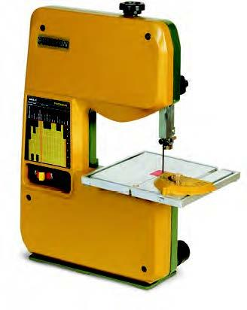
Tool name
Band Saw
https://www.youtube.com/watch?v=Svom3LqJtqY

Slide 13
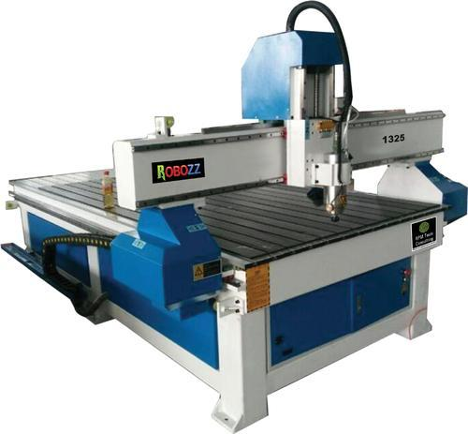
Tool name
CNC machine

Slide 14
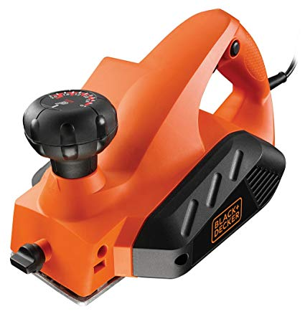
Tool name
Wood Planer
https://www.youtube.com/watch?v=ZY7OE31xTJ8

Slide 15
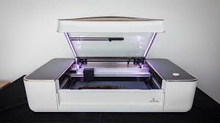
Tool name
Laser machine

Slide 16
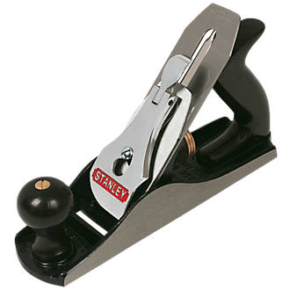
Tool name
Wood Plane
https://www.youtube.com/watch?v=3LBbxC9KQBY

Slide 17
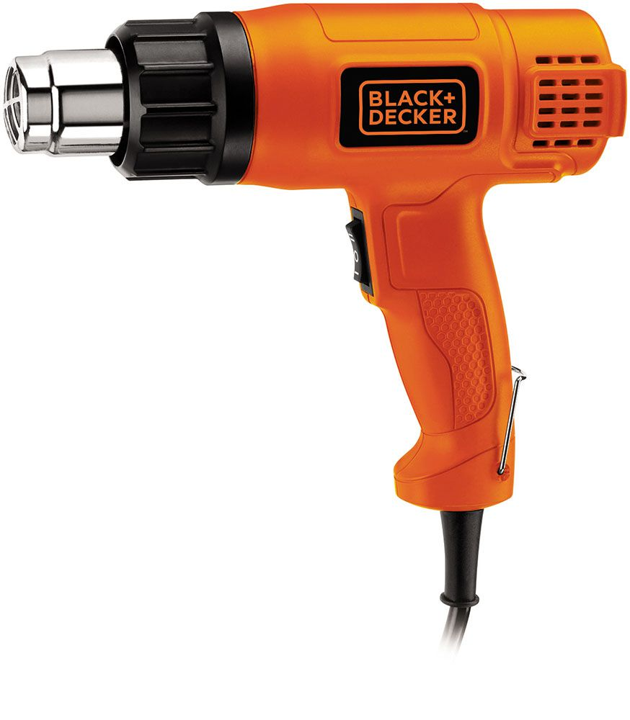
Tool name
Hot air gun

Slide 18
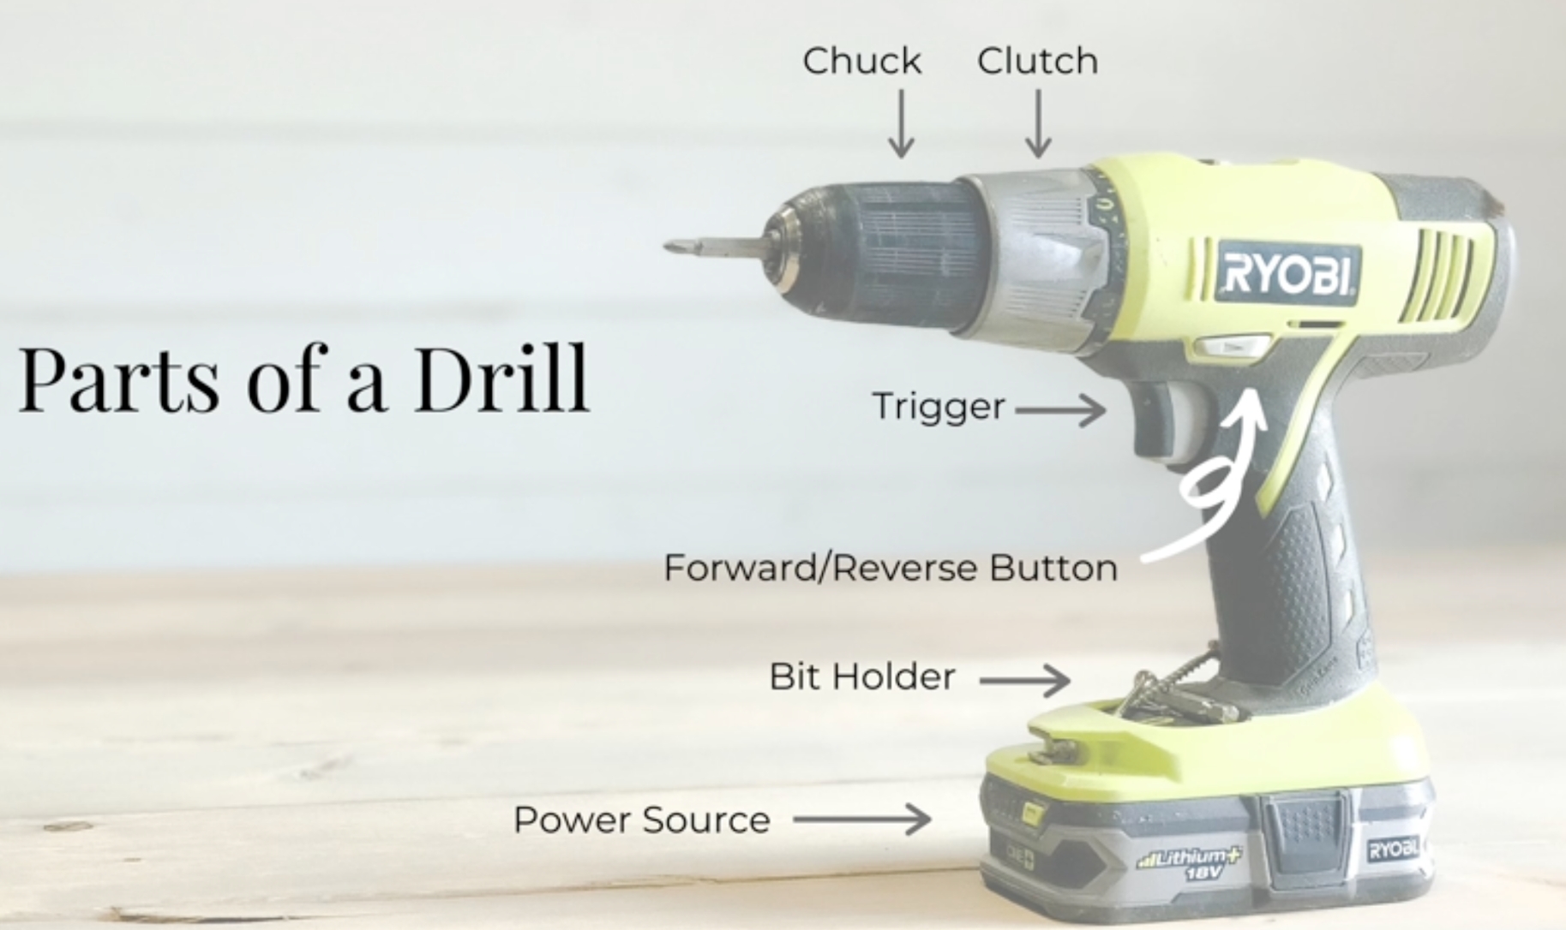
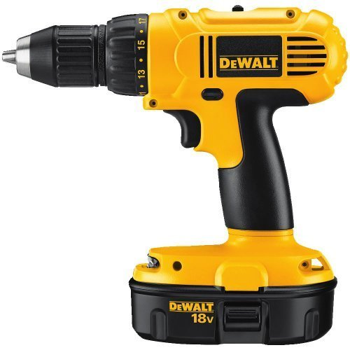

Tool name
Hand Drill
Function

Slide 19
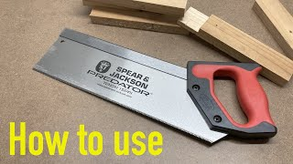
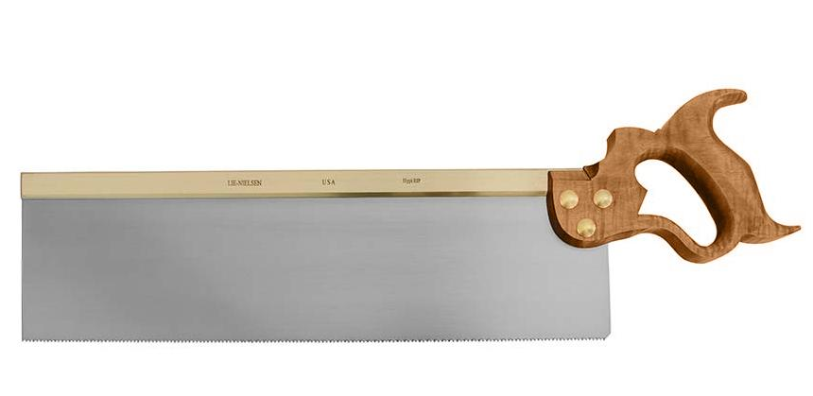
Tool name
Tenon Saw

Slide 20
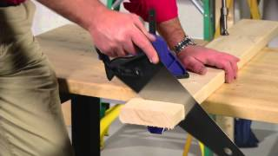
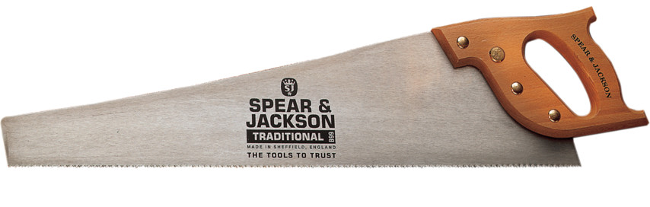
Tool name
Hand Saw

Slide 21

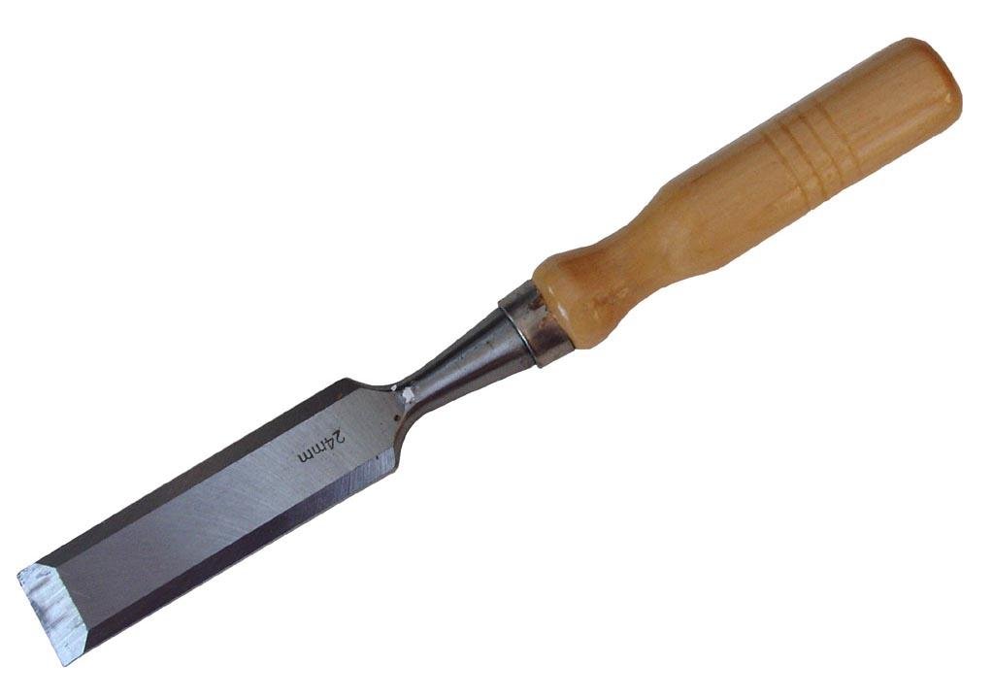
Tool name
Chisel

Slide 22
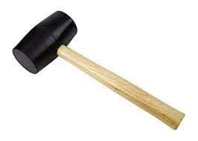
Tool name
Mallet

Slide 23
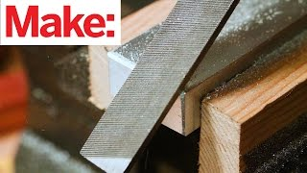
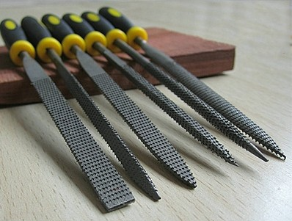
Tool name
File

Slide 24
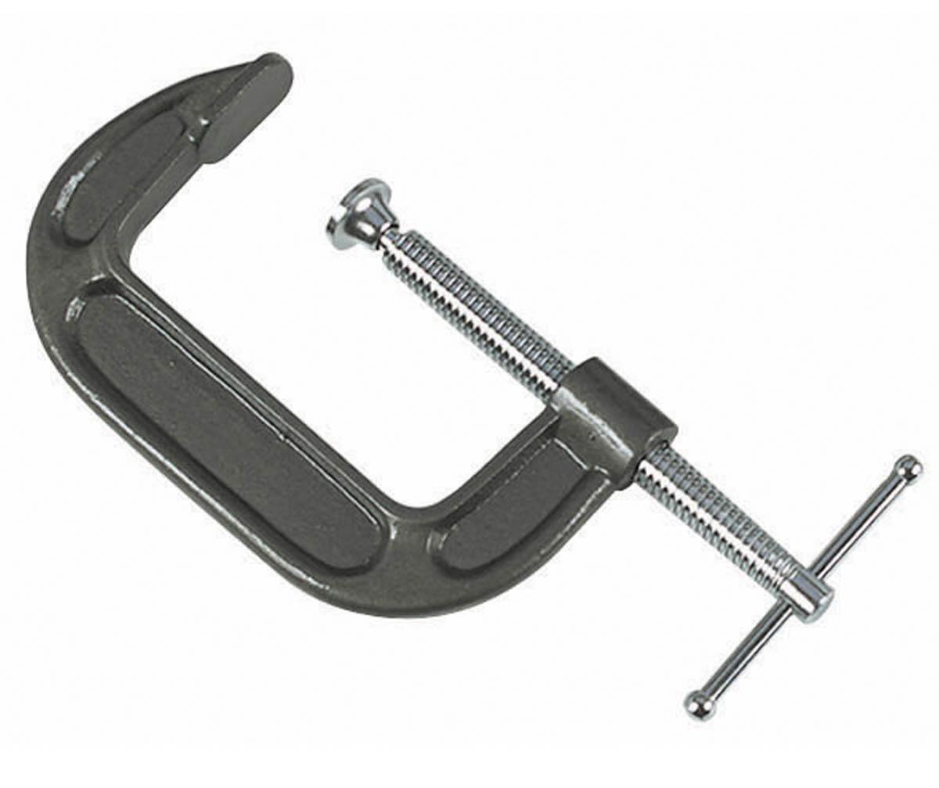
Tool name
G Clamp

Slide 25
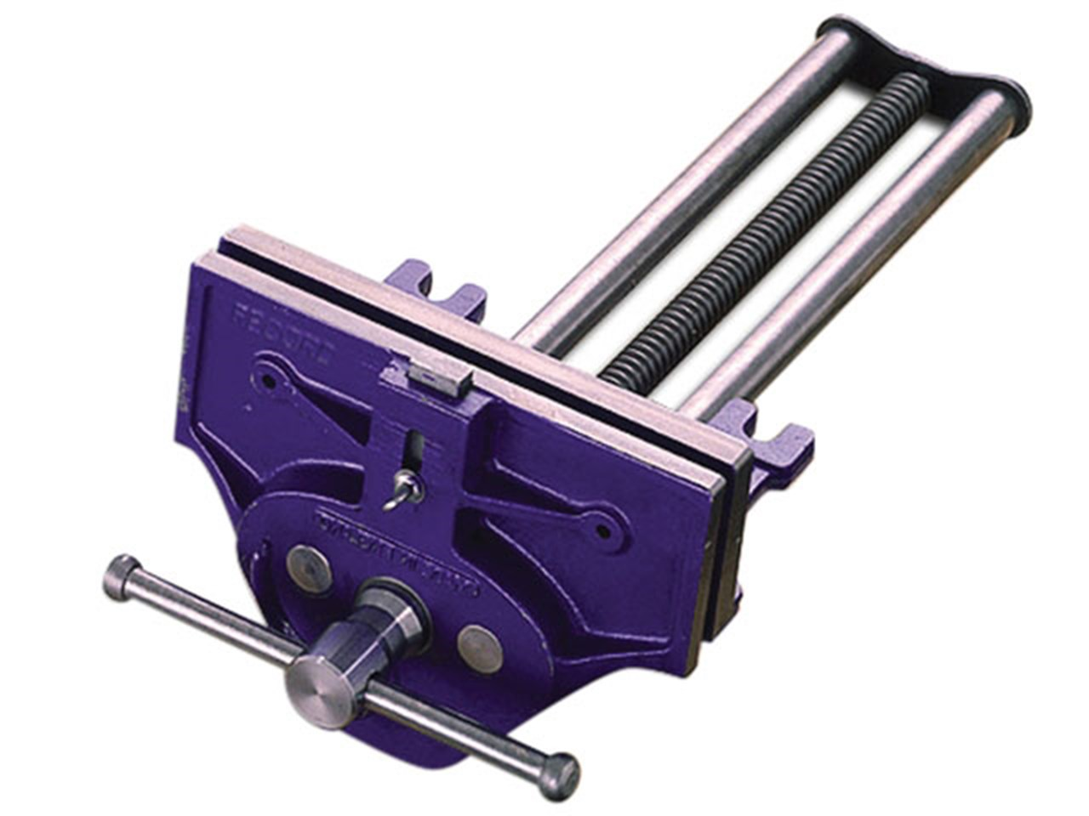
Tool name
Woodworking Vice

Slide 26
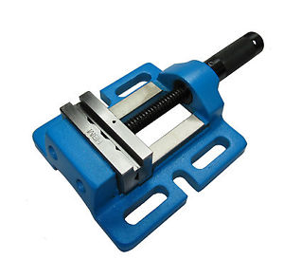
Tool name
Engineering Vice

Slide 27
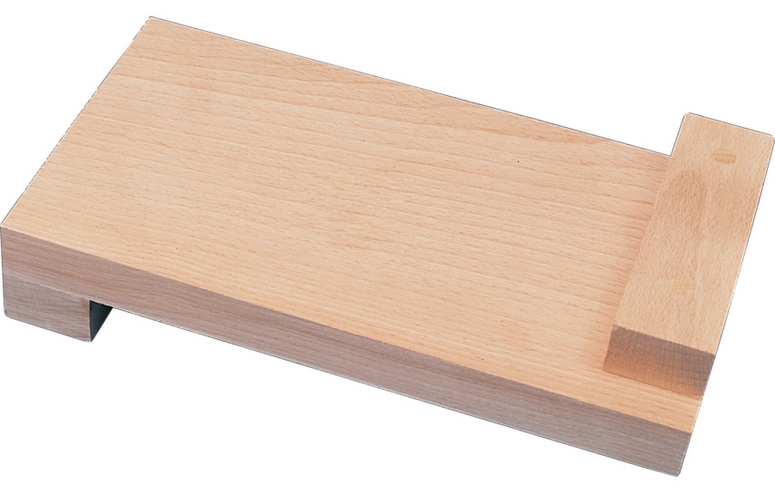
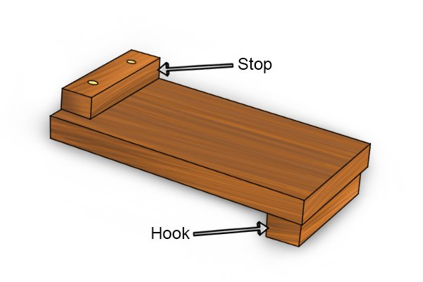
Tool name
Bench Hooks

Slide 28
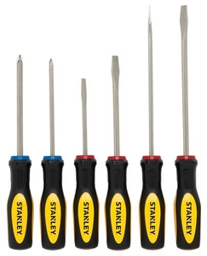
Tool name
Screw driver set

Slide 29
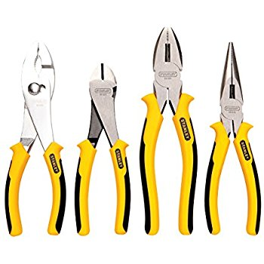
Tool name
Plier

Slide 30
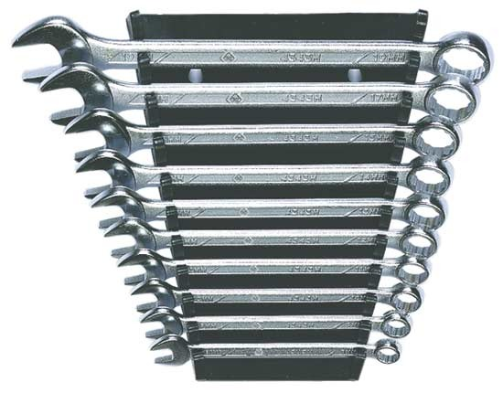
Tool name
Spanner set

Slide 31
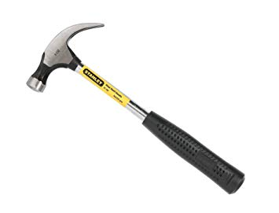
Tool name
Hammer

Slide 32
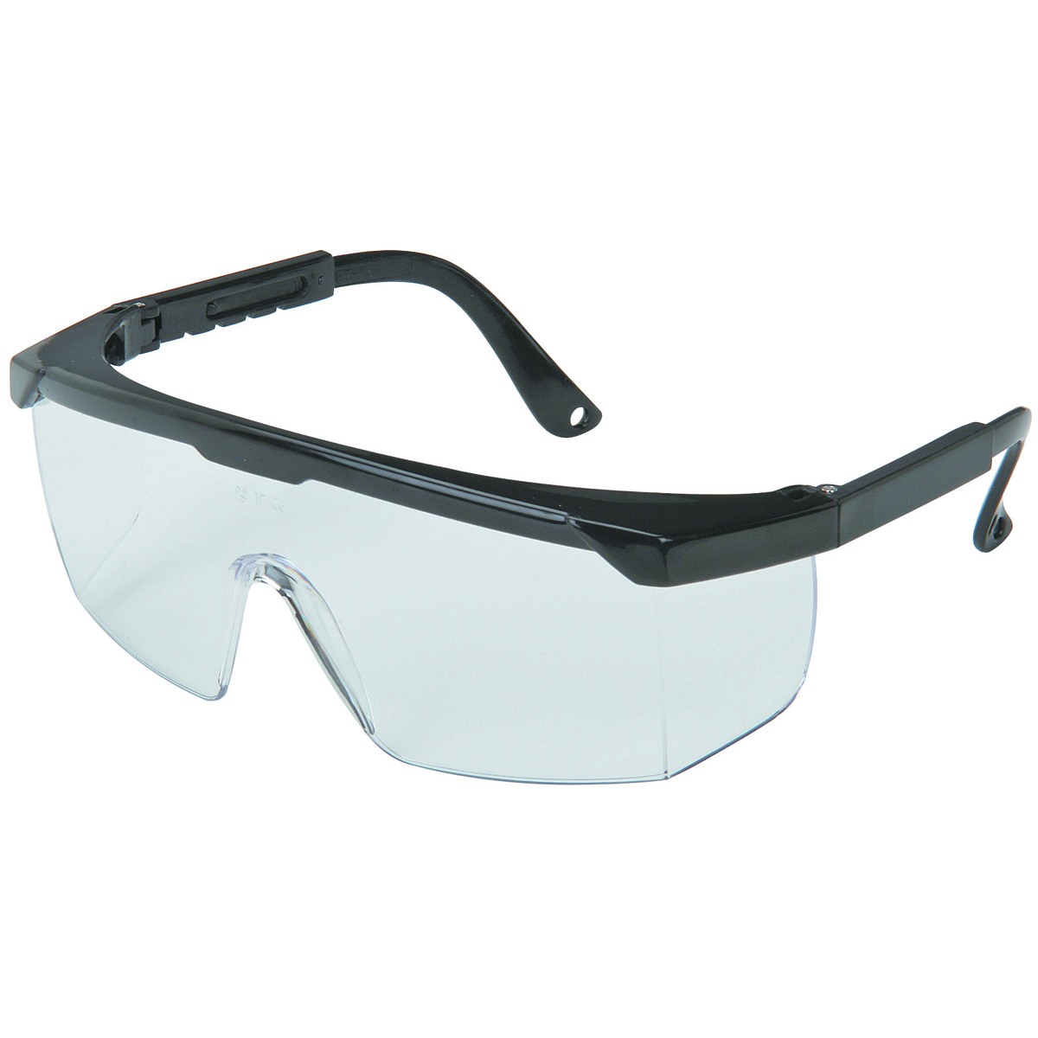
Tool name
Safety Glasses

Slide 33

Tool name
Apron

Slide 34
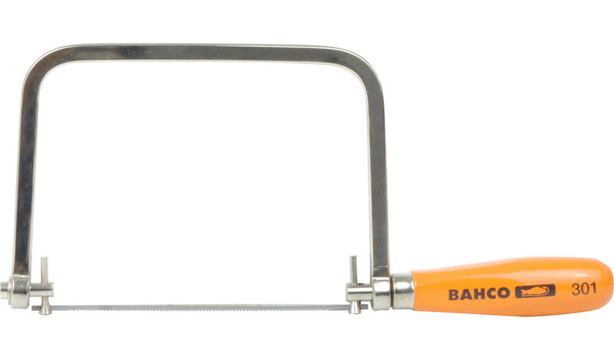
Tool name
Coping Saw

Slide 35
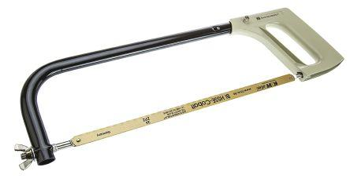
Tool name
Hacksaw

Slide 36
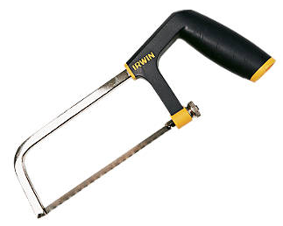
Tool name
Junior hacksaw

Slide 37
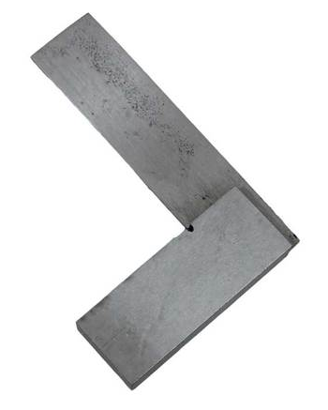
Tool name
90 Degree Square

Slide 38
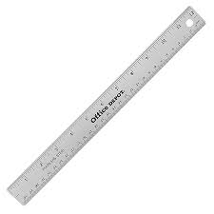
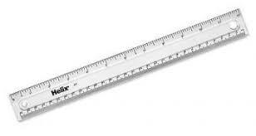
Tool name
Rulers

Slide 39
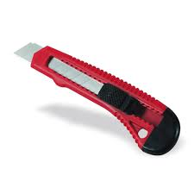
Tool name
Cutting knife

Slide 40
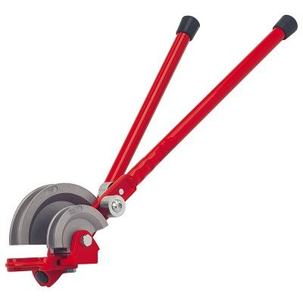
Tool name
Pipe bender

Slide 41

Tool name
Sand paper

Slide 42
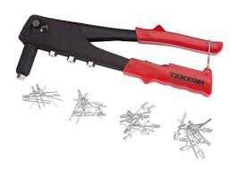
Tool name
Pop rivet gun

Slide 43
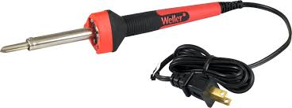
Tool name
Soldering Iron

Slide 44
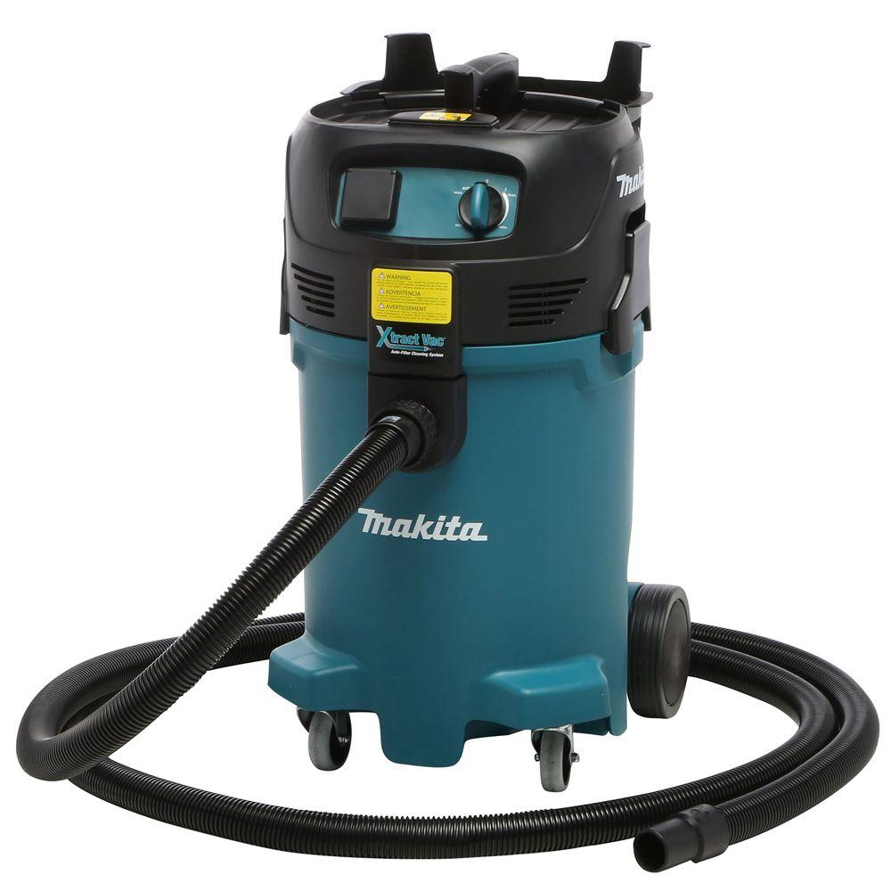
Tool name
Wet and dry vacuum cleaner

Slide 45

Tool name
Emergency Stop

